Slide 1
Project: IEEE P802.15 Working Group for Wireless Personal Area Networks (WPANs)
Submission Title: [Sensing Pulse Definition Considerations]
Date Submitted: [17 January 2023]
Source: [Igor Dotlic, Carl Murray, Michael McLaughlin, Billy Verso, and Jarek Niewczas]
Company [Qorvo]
Address [Adelaide Chambers, Peter Street, Dublin 8, Ireland]
E-Mail:[igor(dot)dotlic(at)qorvo(dot)com]
Re: [Study Group 4ab: UWB Next Generation.]
Abstract: [Reexamining the current sensing pulse definition.]
Purpose: [Having a clear definition of the sensing pulse shape in IEEE 802.15.4ab.]
Notice: This document has been prepared to assist the IEEE P802.15. It is offered as a basis for discussion and is not binding on the contributing individual(s) or organization(s). The material in this document is subject to change in form and content after further study. The contributor(s) reserve(s) the right to add, amend or withdraw material contained herein.
Release: The contributor acknowledges and accepts that this contribution becomes the property of IEEE and may be made publicly available by P802.15.
Notes:
Jul 12, 2010
Page 1

Slide 2
Sensing Pulse Definition Considerations

Slide 3
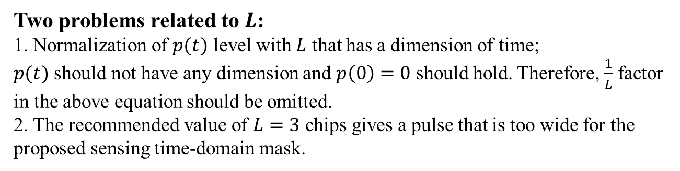
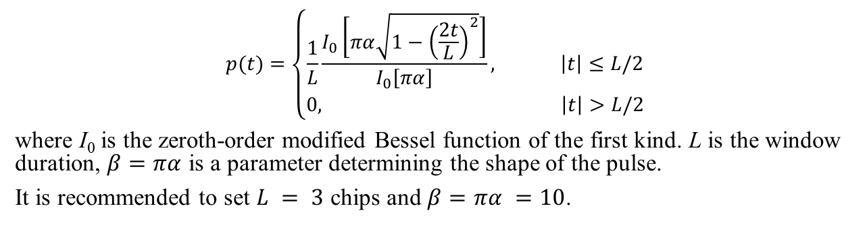
Sensing Pulse as Defined in DCN: 15-23-0001-00-04ab
$$p(t)=\left\{\begin{aligned}\frac{1}{L}\frac{I_{0}\left[πα\sqrt{1−{\left(\frac{2t}{L}\right)}^{2}}\right]}{I_{0}\left[πα\right]}, \left|t\right|≤L/2 \\ 0, \left|t\right|>L/2\end{aligned}\right.$$
where I₀ is the zeroth-order modified Bessel function of the first kind. L is the window duration, $β=πα$ is a parameter determining the shape of the pulse.
It is recommended to set $L = 3$ chips and $β=πα =10$.
Two problems related to $L$:
1. Normalization of $p(t)$ level with $L$ that has a dimension of time;
$p(t)$ should not have any dimension and $p\left(0\right)=0$ should hold. Therefore, $\frac{1}{L}$ factor in the above equation should be omitted.
2. The recommended value of $L=3$ chips gives a pulse that is too wide for the proposed sensing time-domain mask.

Slide 4
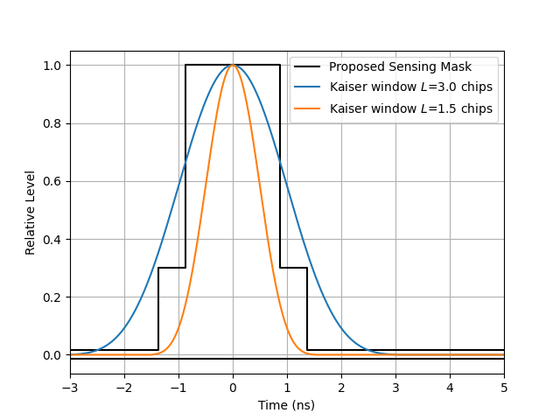
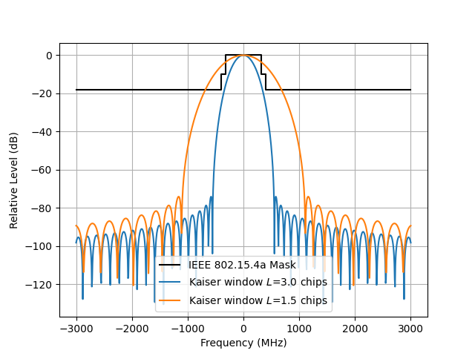
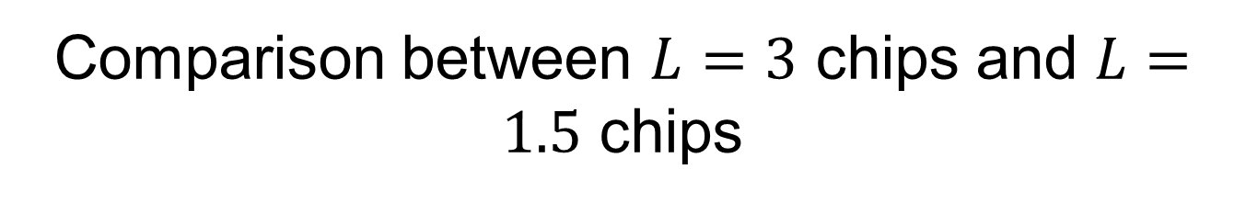
Comparison between $L=3$ chips and $L=1.5$ chips
Time domain
Frequency domain

Slide 5
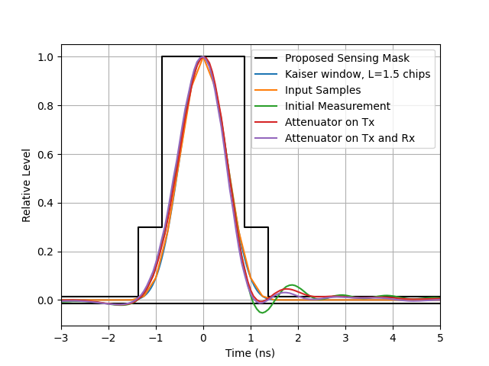
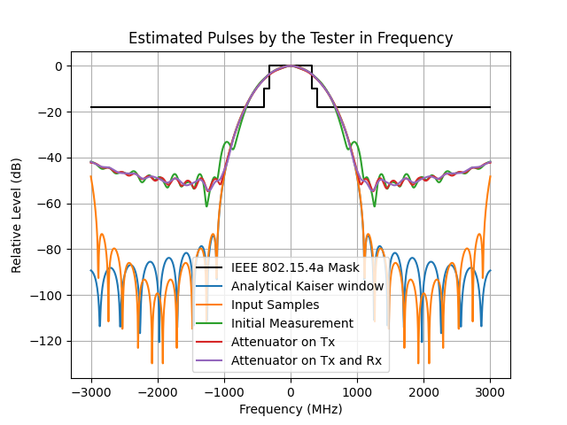
Note w.r.t. DCN 53: “Kaiser Pulse Shape Estimation using Test Equipment on 4z BPRF3 Packet”
In this work, L=1.5 chips has been used, which can be seen by comparing L=1.5 chips generated Kaiser window with different results in time and frequency.
Time domain
Frequency domain

