Slide 1
Project: IEEE P802.15 Working Group for Wireless Personal Area Networks (WPANs)
Submission Title: Two candidate PHYs for NB CCA
Date Submitted: April, 2023
Source: Huan-Bang Li, Takeshi Matsumura (NICT, Japan).
Address: 3-4 Hikarino-oka, Yokosuka-shi, Kanagawa, 239-0847 Japan
E-Mail: {lee, matsumura}@nict.go.jp
Abstract: Further explanation and discussion on NB-assisted UWB channel access.
Purpose: To improve coexistence among UWB systems.
Notice: This document has been prepared to assist the IEEE P802.15. It is offered as a basis for discussion and is not binding on the authoring individual(s) or organization(s). The material in this document is subject to change in form and content after further study. The authors(s) reserve(s) the right to add, amend or withdraw material contained herein.

Slide 2
Quick Review on NB CCA
NB CCA is based on a pair of coupled NB PHY and UWB PHY, that are operated concurrently using the same timer: either synchronized clock or MAC timer.
NB radio is used to indicate UWB channel occupancy status. CCA is performed at NB channel. UWB channel access is based on the coupled NB radio’s CCA results.
NB CCA can be conducted uniformly regardless the types of UWB signals.

Slide 3
Use NB Channels Defined in NBA-TFD
In 15-23-0100-01-04ab NBA-TFD, 50 NB channels at UNII-3 (5725-5850 MHz) and 200 NB channels at UNII-5 (5925-6425 MHz) are defined. Each has a bandwidth of 2.5 MHz.
NB-CCA operation is contained within one of the above NB channels.

Slide 4
NB PHY Candidate #1
Use OFDM PHY of Clause 20 in IEEE 802.15.4-2020.
  Use OFDM option 1 in Table 20-10 as baseline, where BW is less than 1.2 MHz (contained within the 2.5 MHz BW of NBA-TFD), 8 active pilot tones and 96 active data tones are available.
A simple realization is to only use pilot tones (pt)
  Use 1, 2, …, k pilot tones to present UWB channel
  Use k+1, k+2, …, n pilot tones to present UWB duration

Slide 5
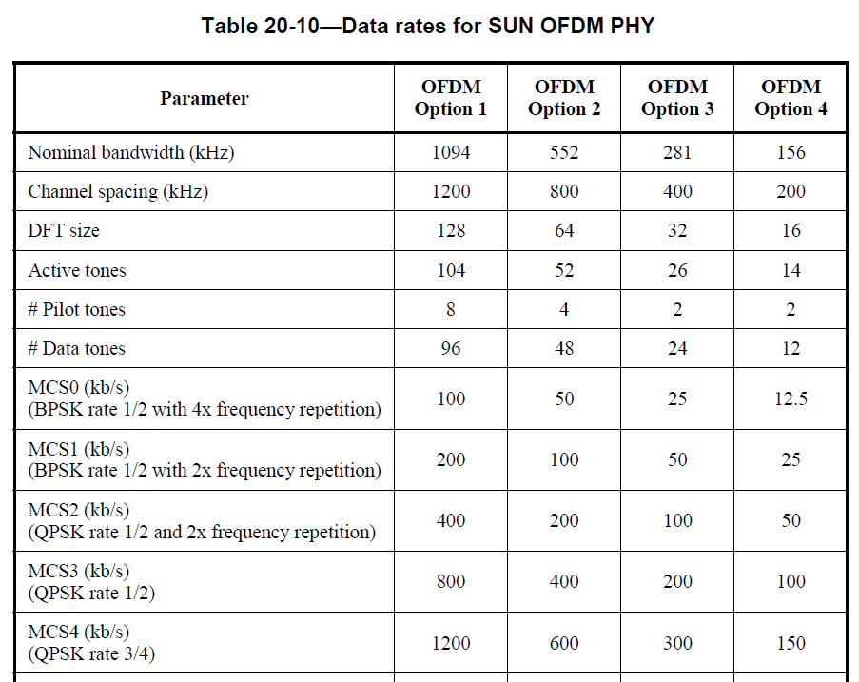
NB PHY Candidate #1

Slide 6
NB PHY Candidate #1
Use OFDM PHY of Clause 20 in IEEE 802.15.4-2020.
  Use OFDM option 1 in Table 20-10 as baseline, where BW is less than 1.2 MHz (contained within the 2.5 MHz BW of NBA-TFD), 8 active pilot tones and 96 active data tones are available.
A simple realization is to only use pilot tones (pt)
  Use 1, 2, …, k pilot tones to present UWB channel
  Use k+1, k+2, …, n pilot tones to present UWB duration

Slide 7
Example of Using Multiple Pilot Tones
pt_1 … … pt_k pt_k+1 … pt_n
Pilot tones form patterns to declare UWB channels.
Pilot tones form patterns to declare UWB time duration to be occupied.

Slide 8
NB Candidate PHY #2
Use single carrier PHY defined in 802.15.4-2020 such as O-QPSK with BW to be less than 250kHz.
Obtain M=2500/BW sub-channels within an NBA-TFD channel.
Pair two sub-channels. One declare start of UWB transmission, whereas another declare end of UWB transmission.

Slide 9
Example of Using Single Carrier PHY
Using a pair of sub-channels to represent a UWB channel
UWB ch_i UWB ch_j UWB ch_k
2500kHz
sub-ch_i sub-ch_i+1 sub-ch_j sub-ch_j+1 sub-ch_k sub-ch_k+1
NB sub-ch declares end of UWB
NB sub-cb declares start of UWB
Duration between these two transmissions is equal to channel occupation time of UWB

Slide 10
More works ahead

