Slide 1
Project: IEEE P802.15 Working Group for Wireless Personal Area Networks (WPANs)
Submission Title: Secured frames for MMS ranging
Date Submitted: May, 2023
Source: Rojan Chitrakar, Lei Huang, Kuan Wu, Stephen McCann, David Xun Yang (Huawei Technologies)
Email: rojan.chitrakar@huawei.com
Abstract: Considerations for security for MMS ranging.
Purpose: Considerations for security for MMS ranging.
Notice: This document has been prepared to assist the IEEE P802.15. It is offered as a basis for discussion and is not binding on the contributing individual(s) or organization(s). The material in this document is subject to change in form and content after further study. The contributor(s) reserve(s) the right to add, amend or withdraw material contained herein.
Release: The contributor acknowledges and accepts that this contribution becomes the property of IEEE and may be made publicly available by P802.15.

Slide 2
PAR Objective | Proposed Solution (how addressed)
Safeguards so that the high throughput data use cases will not cause significant disruption to low duty-cycle ranging use cases
Interference mitigation techniques to support higher density and higher traffic use cases
Other coexistence improvement
Backward compatibility with enhanced ranging capable devices (ERDEVs)
Improved link budget and/or reduced air-time
Additional channels and operating frequencies
Improvements to accuracy / precision / reliability and interoperability for high-integrity ranging
Reduced complexity and power consumption
Hybrid operation with narrowband signaling to assist UWB | Mechanism to provide security for frames used for MMS ranging (NBA or UWB)
Enhanced native discovery and connection setup mechanisms | Mechanism to provide security for frames used for MMS ranging (NBA or UWB)
Sensing capabilities to support presence detection and environment mapping
Low-power low-latency streaming
Higher data-rate streaming allowing at least 50 Mbit/s of throughput
Support for peer-to-peer, peer-to-multi-peer, and station-to-infrastructure protocols
Infrastructure synchronization mechanisms

Slide 3
Background: Compressed PSDU
[1] introduces NBA-MMS-UWB Compressed PSDU:
Keeping NB packets shorter than 1ms; NB O-QPSK 250k has limited PSDU capacity (~25 bytes/ms)
Compressed PSDU specific to NBA-MMS-UWB control frames:
  1-octet message ID (0x00=Poll, 0x01=Response, 0x02=Report, …)
  2-octet session identifier/address
  ID specific data (variable length)
  2-octet CRC16
Secure compressed PSDU (Example: Report with Secured timestamp):
  1-octet message ID (0xtbd)
  2-octet session identifier/address
  4-octet timestamp(s) (Secured)
  8-octet cryptographic protection (MAC)
  Redundancy between ENC-MIC-64 and CRC16 can be exploited to reduce PSDU size
[1] 15-22/0604r0, NBA-MMS-UWB Compressed PSDU, Alexander Krebs

Slide 4
Background: Compressed Header IE [2]
Using header IE-only packets for broadcast traffic in NBA-MMS UWB
Enabling ”compressed PSDU design principles” for header IE design
  Stripping IE length field for message compression
  Maintaining the frame control (FC) field in 15.4 for managing the compressed header IE
Octets: 1/2 | 2 | 1 | Variable | 2
FC | Address | Header IE message ID (128~255) | Data Content | CRC
[2] 15-22/608r1, Header IE Extension, Alexander Krebs

Slide 5
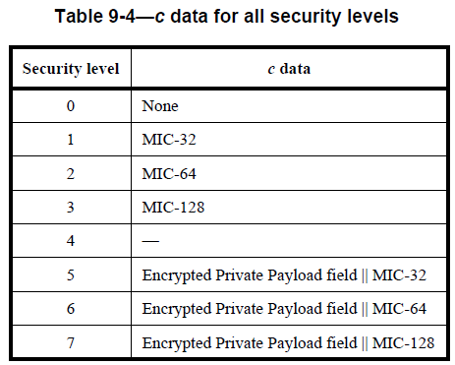
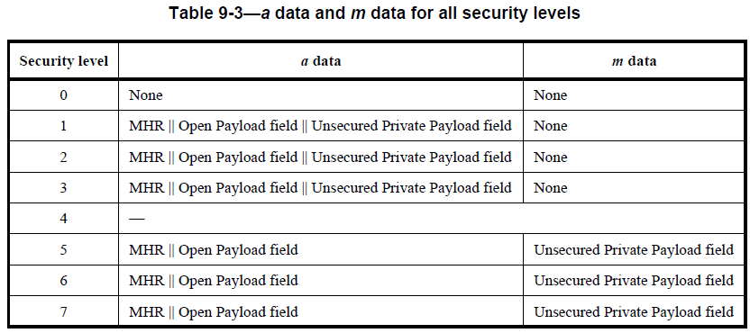
Background: Authenticated encryption with associated data (AEAD) Security Operation in 802.15.4-2020
AEAD encryption and authentication transformation (CCM* using AES-128) :
3 levels for Authentication and 3 levels for encryption are provided.
The inputs are as follows:
Key
Nonce
a data (AddAuthData: data to be authenticated)
m data (PlaintextData: data to be encrypted)
The output is c data (Ciphertext + MIC)
The Private Payload field of the original unsecured frame shall be replaced by the right-concatenation of that field and the c field if data confidentiality is not provided and shall be replaced by the c field otherwise

Slide 6
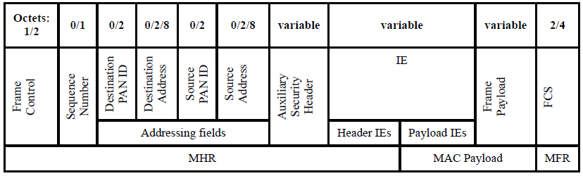
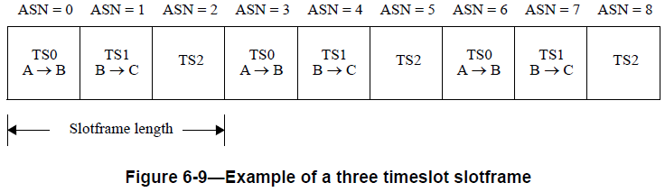
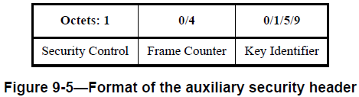
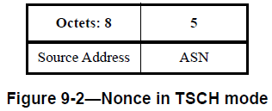
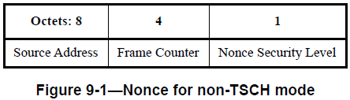
Background: Authenticated encryption with associated data (AEAD) Security Operation in 802.15.4-2020
AEAD transformation and inverse transformation:
The Nonce is constructed from the content of the MHR:
In TSCH mode, Absolute Slot Number (ASN) is used in Nonce instead of frame counter. Frame Counter is not present in the MHR.

Slide 7
Motivation:
MMS ranging representative flow:
May carry sensitive information related to the ranging session (e.g., Time offset, block structure parameters, RSF code index etc.) .
May carry sensitive information related to the ranging measurement (e.g. RTT, AOA etc.)
At minimum 802.15.4ab should be able to Authenticate frames. If supported, encryption of sensitive information in the frames should also be supported.

Slide 8


Discussion
As explained earlier, 802.15.4-2020 already provides comprehensive AEAD security operation. We would like to reuse the existing AEAD operation for 802.15.4ab as much as possible for both NB and non-NB frames.
Annex B mandates that within the scope of any encryption key, the nonce value shall be unique. Two formats of nonce are provided in 802.15.4-2020 :
A key question is how to construct the variable field of the Nonce (Frame Counter or ASN), especially for compressed frames that do not carry a frame counter?

Slide 9
Proposal 1
Different frame format and nonce construction methods are used for secured frames in the Initialization and Setup phase and frames in Measurement Cycles.
A secured frame carries the frame counter to construct the Nonce.
The indices of the Block, Round, Slot in which a secured frame is transmitted or received, are used as a frame counter to construct the Nonce.

Slide 10
Proposal 1
A 4 octets Packet Number (PN) is carried in a secured frame that is transmitted during the Initialization and Setup phase (e.g., SOR, ADV-RESP). The Packet Number (PN) is used as frame counter for Nonce construction.
One bit (e.g., the MSB of the ID field) indicates whether security is enabled or not.
The MIC obtained from the AEAD security operation replaces the CRC.
  Size of the MIC field depends on the negotiated security level.
Example:
Secured SOR
Bits: 0-6 | 7 | Octets: 2 | 0 or 4 | variable | 4/8
ID | Security Enabled = 1 | Address | PN | Secured Payload | MIC
Nonce
Octets: 8 | 4 | 1
Source Address | Frame Counter (PN) | Nonce Security Level

Slide 11
Proposal 1
Frame Counter is not carried in a secured frame that is transmitted in a measurement cycle (e.g., RPRT).
The indices of the Block, Round, Slot in which a secured frame is transmitted or received is used as a frame counter to construct the nonce.
Example (if an encrypted RPRT is transmitted in slot m, round 1 of block 1):
Nonce
Encrypted RPRT
Octets: 8 | Bits: 0-7 | 8-23 | 24-39
Source Address | Frame Counter (40 bits)
 | Slot Index = m | Round Index = 1 | Block Index = 1
Bits: 0-6 | 7 | Octets: 2 | variable | 4/8
ID | Security Enabled = 1 | Address | Encrypted Payload | MIC

Slide 12
Proposal 2
Unified frame format and nonce construction method are used in the Initialization and Setup phase as well as in the Measurement Cycles.
Assumption: Block structure (at least block and round) exists during the Initialization and Setup phase.
Secured frames carry a short Packet Number (PN); the PN and round, block indices are used as frame counter to construct nonce

Slide 13
Proposal 2
Examples (if an encrypted RPRT is transmitted in round 1 of block 10):
Nonce
Octets: 8 | Bits: 0-7 | 8-23 | 24-39
Source Address | Frame Counter (40 bits)
 | PN | Round Index = 1 | Block Index = 10
Encrypted SOR
Encrypted RPRT
Bits: 0-6 | 7 | Octets: 2 | 0 or 1 | variable | 4/8
ID | Security Enabled = 1 | Address | PN | Encrypted Payload | MIC
Bits: 0-6 | 7 | Octets: 2 | 0 or 1 | variable | 4/8
ID | Security Enabled = 1 | Address | PN | Encrypted Payload | MIC

Slide 14
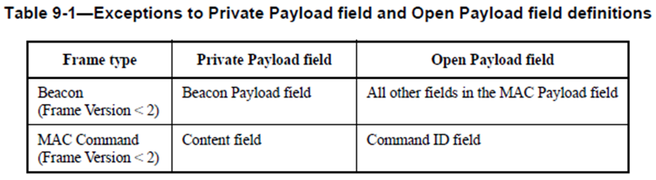
Field selection for secured operation
802.15.4-2020 allows encryption of a selected field of the MAC payload field for the following:
For all other frames, if encryption is enabled, the entire MAC payload field needs to be encrypted.
For compressed frames, 802.15-4-2020 compliant selective encryption of the MAC payload field could be achieved by placing the private payload field at the end of the MAC payload field:
Encrypted RPRT
Bits: 0-6 | 7 | Octets: 2 | variable | variable | 4/8
ID | Security Enabled = 1 | Address | Unencrypted Payload | Encrypted Payload | MIC
MAC Header
Open Payload
Private Payload

Slide 15
Summary
We discussed enabling security for the compressed frames.
We proposed two methods to construct the nonce for the security operation:
  Different frame formats and nonce construction methods are used for secured frames in the Initialization and Setup phase and in Measurement Cycles.
  Unified frame format and nonce construction method are used for secured frames in the Initialization and Setup phase as well as in Measurement Cycles.

Slide 16
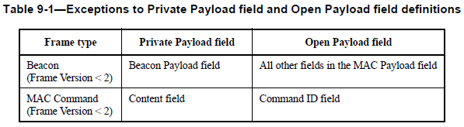
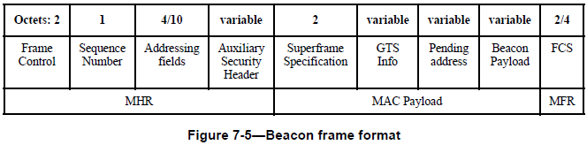
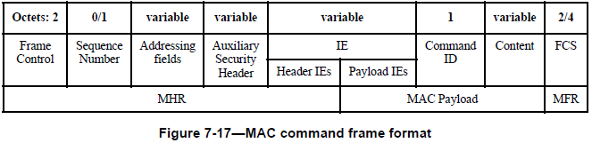
Annex - I
Exceptions to Private Payload field and Open Payload field definitions:

