Slide 1
Project: IEEE P802.15 Working Group for Wireless Specialty Networks (WSN)
Submission Title: Considerations on CIR scaling and quantization
Source: Bin Qian, Chenchen Liu, Rojan Chitrakar, Xiaohui Peng, Lei Huang, David Xun Yang (Huawei Technologies)
Address : [Huawei Bantian Base, Longgang District, Shenzhen, 518129 China]
E-Mail: [qianbin14@huawei.com]
Re: Task Group 4ab: UWB Next Generation for 802.15.4
Abstract: [UWB, sensing, CIR]
Purpose:
Notice: This document has been prepared to assist the IEEE P802.15. It is offered as a basis for discussion and is not binding on the contributing individual(s) or organization(s). The material in this document is subject to change in form and content after further study. The contributor(s) reserve(s) the right to add, amend or withdraw material contained herein.
Release: The contributor acknowledges and accepts that this contribution becomes the property of IEEE and may be made publicly available by P802.15.
Notes:
Jul 12, 2010
Page 1

Slide 2
PAR Objective | Proposed Solution (how addressed)
Safeguards so that the high throughput data use cases will not cause significant disruption to low duty-cycle ranging use cases
Interference mitigation techniques to support higher density and higher traffic use cases
Other coexistence improvement
Backward compatibility with enhanced ranging capable devices (ERDEVs)
Improved link budget and/or reduced air-time
Additional channels and operating frequencies
Improvements to accuracy / precision / reliability and interoperability for high-integrity ranging
Reduced complexity and power consumption
Hybrid operation with narrowband signaling to assist UWB
Enhanced native discovery and connection setup mechanisms
Sensing capabilities to support presence detection and environment mapping | Adaptive CIR scaling and quantization to reach a better performance in terms of SQNR
Low-power low-latency streaming
Higher data-rate streaming allowing at least 50 Mbit/s of throughput
Support for peer-to-peer, peer-to-multi-peer, and station-to-infrastructure protocols
Infrastructure synchronization mechanisms

Slide 3
Reference
[1] IEEE 802.15-23-0079-01-04ab-latest-consensus-on-uwb-sensing-for-802.15.4ab
[2] IEEE 802.15-23-0120-00-04ab-cir-report-size
[3] IEEE 802.15-23-0121-00-04ab-cir-scaling-and-quantization

Slide 4
Recap
In [1], the group agreed that encoding signed I/Q values each with 16 bits is mandatory, and other bit-width values could be optional
In [2], it is shown that the CIR report size could be as large as thousands bytes, which leads to a transmission duration of several milliseconds.
To reduce the overhead of CIR report, [3] proposed a power-of-two scaling and quantization method of the I/Q values in the CIR report
  The proposed method followed the idea of CSI scaling and quantization in 11bf
One concern is that the CSI is in the frequency domain while the CIR is in the time domain. Whether the scaling and quantization method in 11bf could be directly applied to UWB needs more investigation

Slide 5
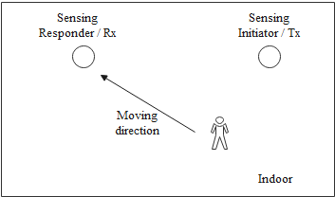
Real Data Testing
Indoor environment
  The distance between the sensing initiator and the sensing responder is about 5m. A person is walking towards the sensing responder
Both the CIR data and CSI data are collected
  The sampling rate of CIR data is 1GHz. 14 sensing packets are tested with bitmap length 64. The time offset from the reference tap is 3 taps.
  The CSI data is 20MHz with 52 effective subcarriers. 18 OFDM symbols are tested.

Slide 6
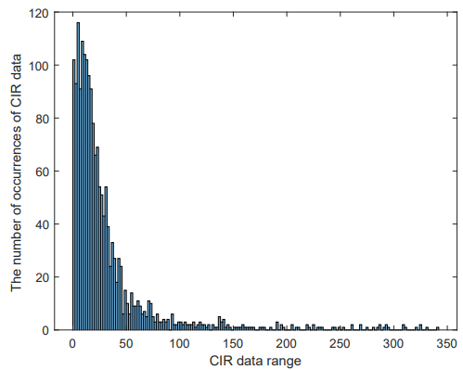
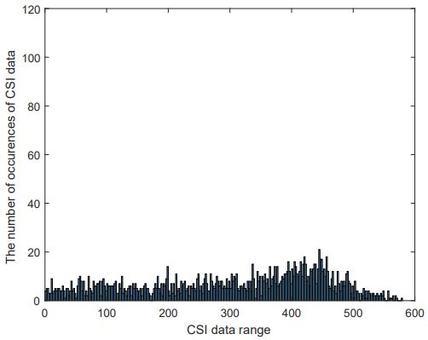
Real Data Histogram
The Histogram of absolute I/Q values of CIR and CSI are analyzed
The energy of the CIR data is dominated by limited paths. The energy of most paths is weak
The energy of the CSI data is distributed more evenly
The different distribution of CIR and CSI may lead to scaling and quantization performance loss

Slide 7
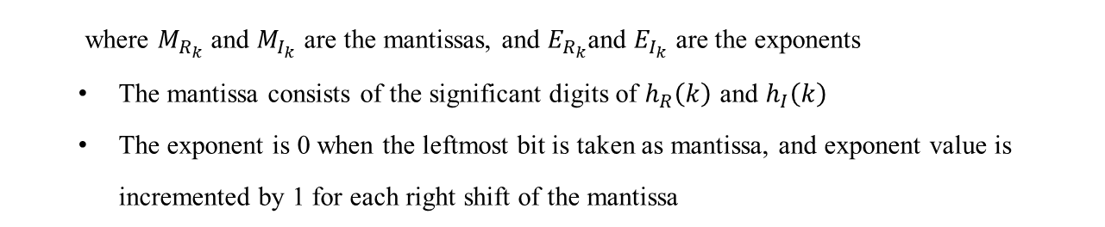


Adaptive Power-of-Two Scaling and Quantization
The proposed method takes into account the property that the energy of the CIR data is dominated by limited paths
The proposed method
  Let $h\left(k\right)=h_{R}\left(k\right)+j∙h_{I}\left(k\right), k=1,2,…K$ denote the CIR values, where $h_{R}\left(k\right)$ and $h_{I}\left(k\right)$ are the real component and imaginary component of the CIR values, respectively.
  Each $h_{R}\left(k\right)$ and $h_{I}\left(k\right)$ could be quantized as
$$\left\{\begin{aligned}h_{R}\left(k\right)=M_{R_{k}}∙2^{E_{R_{k}}} \\ h_{I}\left(k\right)=M_{I_{k}}∙2^{E_{I_{k}}}\end{aligned}\right.$$
  where $M_{R_{k}}$ and $M_{I_{k}}$ are the mantissas, and $E_{R_{k}}$and $E_{I_{k}}$ are the exponents
  The mantissa consists of the significant digits of $h_{R}\left(k\right)$ and $h_{I}\left(k\right)$
  The exponent is 0 when the leftmost bit is taken as mantissa, and exponent value is incremented by 1 for each right shift of the mantissa

Slide 8

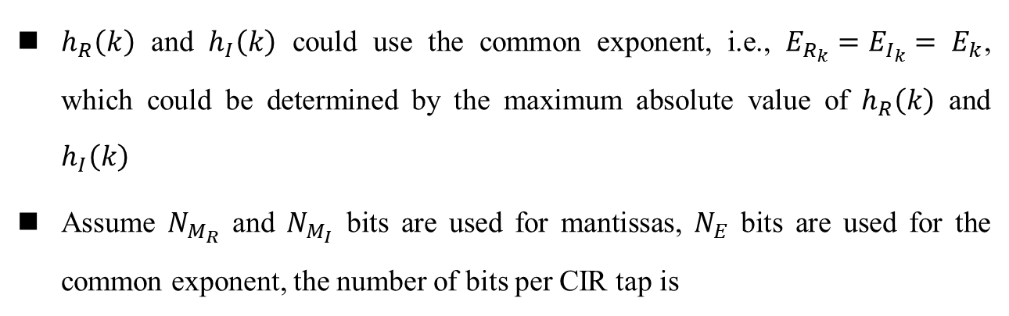
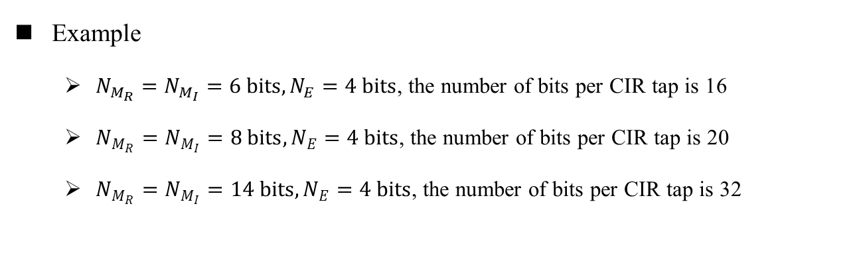
Adaptive Power-of-Two Scaling and Quantization (cont.)
$h_{R}\left(k\right)$ and $h_{I}\left(k\right)$ could use the common exponent, i.e., $E_{R_{k}}=E_{I_{k}}= E_{k}$, which could be determined by the maximum absolute value of $h_{R}\left(k\right)$ and $h_{I}\left(k\right)$
Assume $N_{M_{R}}$ and $N_{M_{I}}$ bits are used for mantissas, $N_{E}$ bits are used for the common exponent, the number of bits per CIR tap is
$N_{M_{R}}$+ $N_{M_{I}}$+ $N_{E}$
Example
  $N_{M_{R}}=N_{M_{I}}=6 bits,N_{E}=4 bits$, the number of bits per CIR tap is 16
  $N_{M_{R}}=N_{M_{I}}=8 bits,N_{E}=4 bits$, the number of bits per CIR tap is 20
  $N_{M_{R}}=N_{M_{I}}=14 bits,N_{E}=4 bits$, the number of bits per CIR tap is 32

Slide 9
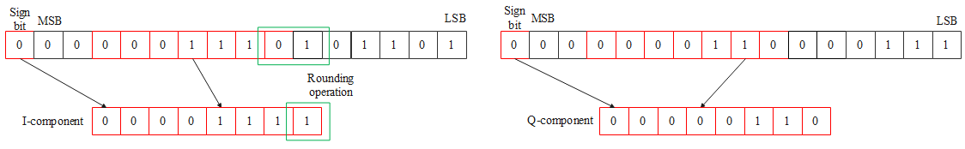
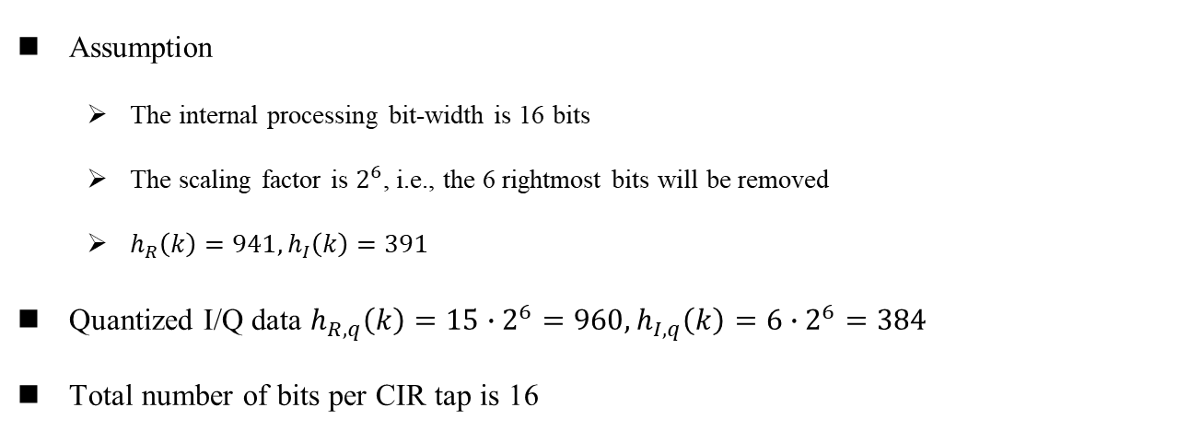
Illustrative Example: Power-of-two Scaling in [3]
I-component
Q-component
Assumption
  The internal processing bit-width is 16 bits
  The scaling factor is $2^{6}$, i.e., the 6 rightmost bits will be removed
  $h_{R}\left(k\right)=941,h_{I}\left(k\right)=391$
Quantized I/Q data $h_{R,q}\left(k\right)=15∙2^{6}=960,h_{I,q}\left(k\right)=6∙2^{6}=384$
Total number of bits per CIR tap is 16

Slide 10
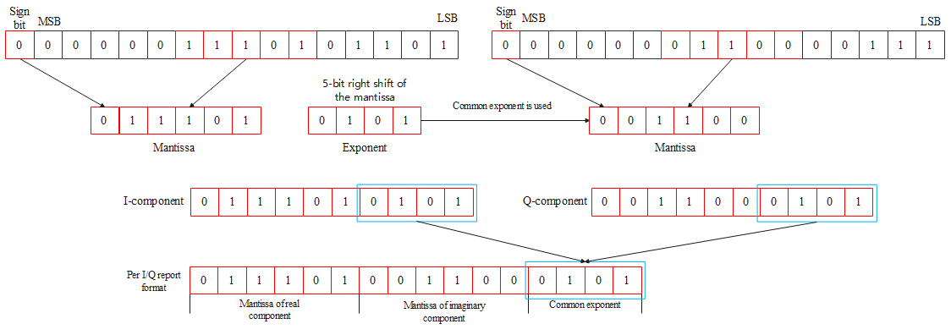
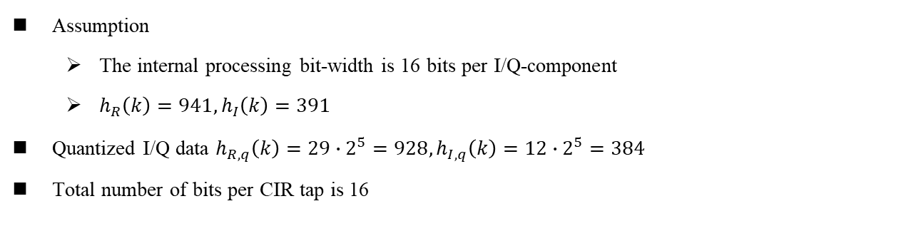
Illustrative Example: Adaptive Power-of-two Scaling
I-component
Q-component
Assumption
  The internal processing bit-width is 16 bits per I/Q-component
  $h_{R}\left(k\right)=941,h_{I}\left(k\right)=391$
Quantized I/Q data $h_{R,q}\left(k\right)=29∙2^{5}=928,h_{I,q}\left(k\right)=12∙2^{5}=384$
Total number of bits per CIR tap is 16

Slide 11
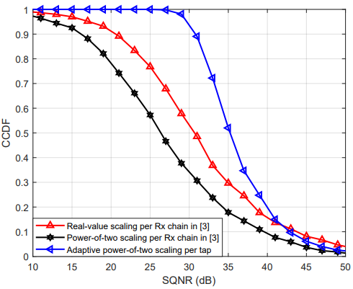
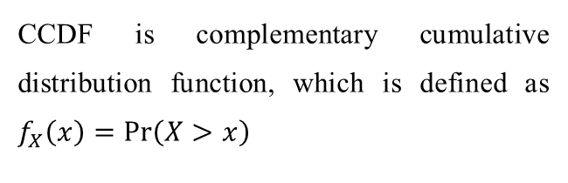
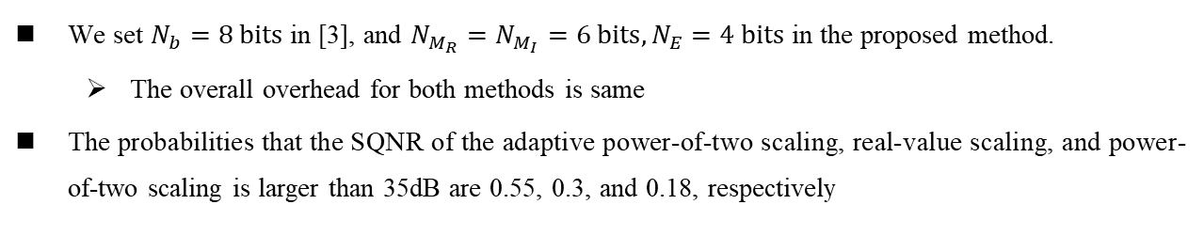
CIR Tap 16-bit Simulations
CCDF is complementary cumulative distribution function, which is defined as $f_{X}\left(x\right)=Pr\left(X>x\right)$
We set $N_{b}=8 bits$ in [3], and $N_{M_{R}}=N_{M_{I}}=6 bits,N_{E}=4 bits$ in the proposed method.
  The overall overhead for both methods is same
The probabilities that the SQNR of the adaptive power-of-two scaling, real-value scaling, and power-of-two scaling is larger than 35dB are 0.55, 0.3, and 0.18, respectively

Slide 12
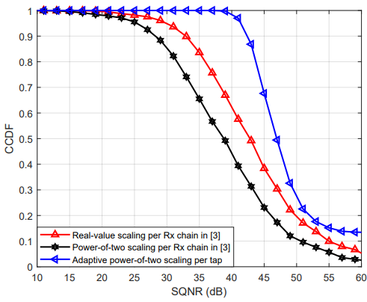
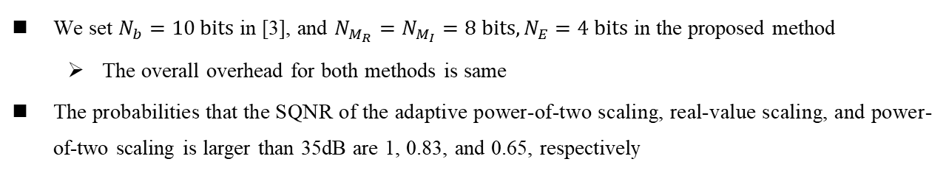
CIR Tap 20-bit Simulations
CCDF is complementary cumulative distribution function, which is defined as $f_{X}\left(x\right)=Pr\left(X>x\right)$
We set $N_{b}=10 bits$ in [3], and $N_{M_{R}}=N_{M_{I}}=8 bits,N_{E}=4 bits$ in the proposed method
  The overall overhead for both methods is same
The probabilities that the SQNR of the adaptive power-of-two scaling, real-value scaling, and power-of-two scaling is larger than 35dB are 1, 0.83, and 0.65, respectively

Slide 13
Summary
Compared with the method in [3], our proposed method has better performance in terms of SQNR.
  All the multiplications and divisions could be converted to left or right bit shifts
  Both methods have the same complexity and overhead
The proposed CIR reporting method is recommended to be included in the sensing TFD

Slide 14
Appendix

Slide 15
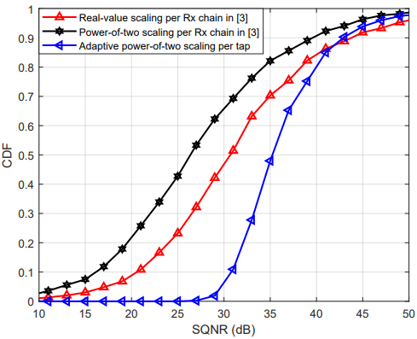
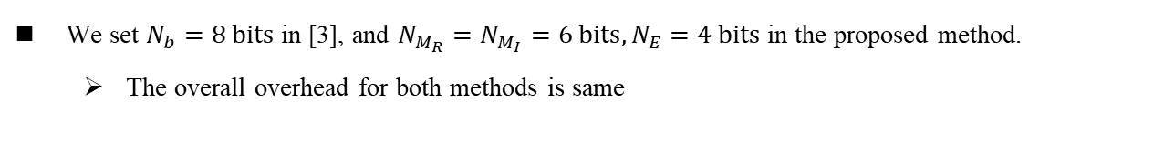
CIR Tap 16-bit Simulations
We set $N_{b}=8 bits$ in [3], and $N_{M_{R}}=N_{M_{I}}=6 bits,N_{E}=4 bits$ in the proposed method.
  The overall overhead for both methods is same

Slide 16
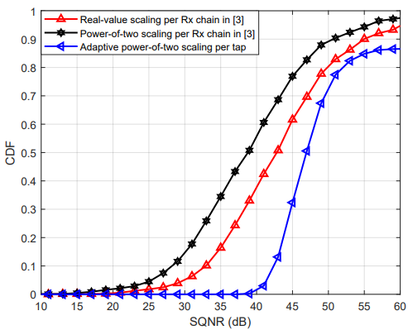

CIR Tap 20-bit Simulations
We set $N_{b}=10 bits$ in [3], and $N_{M_{R}}=N_{M_{I}}=8 bits,N_{E}=4 bits$ in the proposed method
  The overall overhead for both methods is same

Slide 17
Thank You

