Slide 1
Project: IEEE P802.15 Working Group for Wireless Specialty Networks (WSN)
Submission Title: Intra-packet frequency stitching considerations
Source: Bin Qian, Chenchen Liu, Xiaohui Peng, Lei Huang, David Xun Yang (Huawei Technologies)
Address : [Huawei Bantian Base, Longgang District, Shenzhen, 518129 China]
E-Mail: [qianbin14@huawei.com]
Re: Task Group 4ab: UWB Next Generation for 802.15.4
Abstract: [UWB, sensing, frequency stitching]
Purpose:
Notice: This document has been prepared to assist the IEEE P802.15. It is offered as a basis for discussion and is not binding on the contributing individual(s) or organization(s). The material in this document is subject to change in form and content after further study. The contributor(s) reserve(s) the right to add, amend or withdraw material contained herein.
Release: The contributor acknowledges and accepts that this contribution becomes the property of IEEE and may be made publicly available by P802.15.
Notes:
Jul 12, 2010
Page 1

Slide 2
PAR Objective | Proposed Solution (how addressed)
Safeguards so that the high throughput data use cases will not cause significant disruption to low duty-cycle ranging use cases
Interference mitigation techniques to support higher density and higher traffic use cases
Other coexistence improvement
Backward compatibility with enhanced ranging capable devices (ERDEVs)
Improved link budget and/or reduced air-time
Additional channels and operating frequencies
Improvements to accuracy / precision / reliability and interoperability for high-integrity ranging
Reduced complexity and power consumption
Hybrid operation with narrowband signaling to assist UWB
Enhanced native discovery and connection setup mechanisms
Sensing capabilities to support presence detection and environment mapping | Intra-packet frequency stitching
Low-power low-latency streaming
Higher data-rate streaming allowing at least 50 Mbit/s of throughput
Support for peer-to-peer, peer-to-multi-peer, and station-to-infrastructure protocols
Infrastructure synchronization mechanisms

Slide 3
Reference
[1] IEEE 802.15/22-061r0, “Sensing Continued”
[2] IEEE 802.15/22-422r0, “UWB Sensing - Scheduling”
[3] IEEE 802.15/23-178r0, “Frequency Stitching Considerations”
[4] IEEE 802.15/23-079r1, “Latest Consensus on UWB Sensing for 802.15.4ab”

Slide 4
Recap: Intra-packet Frequency Stitching
The frequency stitching is discussed in [1-3] to improve the effective bandwidth of sensing by aggregating multiple frequency segments together.
The time to obtain each measurement should be less than the coherent time of the channel. The coherent time is scenario dependent and ranges from several nanoseconds to several milliseconds.
In [3], the intra-packet frequency stitching is introduced where different portions (e.g., SENS segments) of the packet are transmitted over different UWB channels.
The intra-packet frequency stitching could have shorter total time span per measurement update.

Slide 5
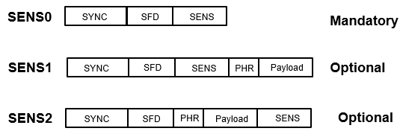
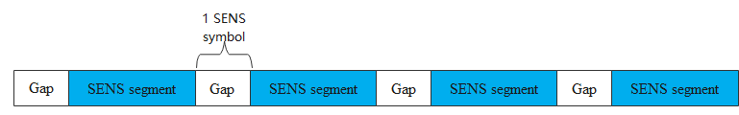
Recap: Sensing Packet Structure
Sensing packet format [4]
Sensing field could have 1 (mandatory), 2, 3, 4 (optional) segments
When multiple segments are used, gaps are included between segments. The duration of each gap interval is one SENS symbol.

Slide 6
Problem
Due to the hardware limitation, the frequency switch time spans from tens of microseconds to one hundred microseconds.
The duration of the gap is about one microsecond, which is not long enough to support the frequency switch.
Thus, to enable the intra-packet frequency stitching, the frequency switch time needs to be taken into account.

Slide 7
Possible Solution
According to the gap duration, the gap could be classified as the normal gap and the extended gap
  When the intra-packet frequency stitching is disabled, the duration of each gap interval is one SENS symbol
  When the intra-packet frequency stitching is enabled, the duration of each gap is extended such that the frequency switch is performed
Normal gap duration
Extended gap duration
The duration of the sensing segment will not be changed

Slide 8
Summary
To achieve intra-packet frequency stitching, the frequency switch time needs to be taken into account
The extended gap duration could be used when the intra-packet frequency is enabled

Slide 9
Thank You

