Slide 1
Project: IEEE P802.15 Working Group for Wireless Specialty Networks
Submission Title: Channel Modeling Activities of TG6ma for Human and Vehicle Body Area Networks
Date Submitted: May 16th, 2023
Source: Takumi Kobayashi, Daisuke Anzai, Minsoo Kim, Marco Hernandez, Ryuji Kohno
Company: (1) Nagoya Institute of Technology, (2) YRP International Alliance Institute, (3) CWC Oulu Univ. Finland, (4) Yokohama National University
Address: YRP1 Blg., 3-4 HikarinoOka, Yokosuka-City, Kanagawa, 239-0847 Japan
Voice:[+81-90-5408-0611] E-Mail:[kobayashi@nitech.ac.jp, Anzai@nitech.ac.jp, minsoo@minsookim.com, marco.hernandez@ieee.org, kohno@ynu.ac.jp, Kohno@yrp-iai.jp]
Re: In response to call for technical contributions
Abstract: This provides draft of channel and environmental model and its classification for vehicle body area network(VBAN) of amendment of IEEE802.15.6-2012 for wireless body area network(BAN) with enhanced dependability.
Purpose: Material for discussion in P802.15.6ma TG corresponding to comments in EC Meeting
Notice: This document has been prepared to assist the IEEE P802.15. It is offered as a basis for discussion and is not binding on the contributing individual(s) or organization(s). The material in this document is subject to change in form and content after further study. The contributor(s) reserve(s) the right to add, amend or withdraw material contained herein.
Release: The contributor acknowledges and accepts that this contribution becomes the property of IEEE and may be made publicly available by P802.15.

Slide 2
Channel Modeling Activities of TG6ma for Human and Vehicle Body Area Networks
Takumi Kobayashi, Daisuke Anzai,
Marco Hernandez , Minsoo Kim ,
Ryuji Kohno
⁽¹⁾ Nagoya Institute of Technology, Japan
⁽²⁾YRP-International Ariane Institute, Japan
⁽³⁾ CWC, University of Oulu, Finland
⁽⁴⁾ Yokohama National University, Japan

Slide 3
Background
IEEE802.15 TG6ma
Task group for revision of 802.15.6-2012
IEEE std. IEEE802.15.6 -2012
10 years…
IEEE802.15.6 for dependable body area networks (BAN) has been published in 2012.
In order to achieve more enhanced dependability, Task group 6ma (TG6ma) is in active.
Narrow band (NB) PHY,
Ultra wide band (UWB) PHY,
Human body communication (HBC) PHY
By focusing on UWB PHY for more wider applications required higher dependability.

Slide 4
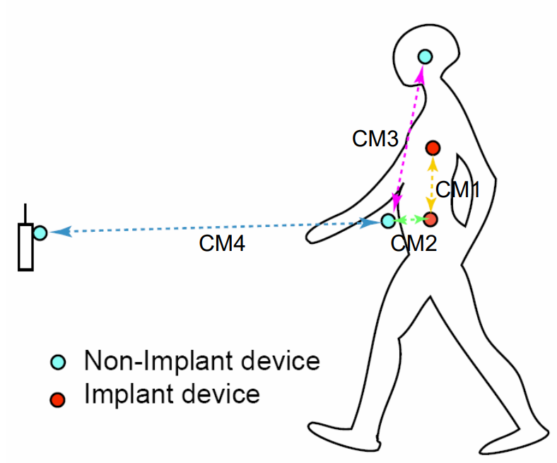
Channel models
IEEE802.15.6 – 2012 defined “Channel models document”[1] to define the channel models that can be used to performance analysis of expected use cases.
Original IEEE802,15,6 mainly focused Medical applications as the applications requires dependability.
Channel models of IEEE802.15.6 also defines the channel models in / on / around the human body.
[1] IEEE P802.15-08-0780-12-0006-TG6

Slide 5
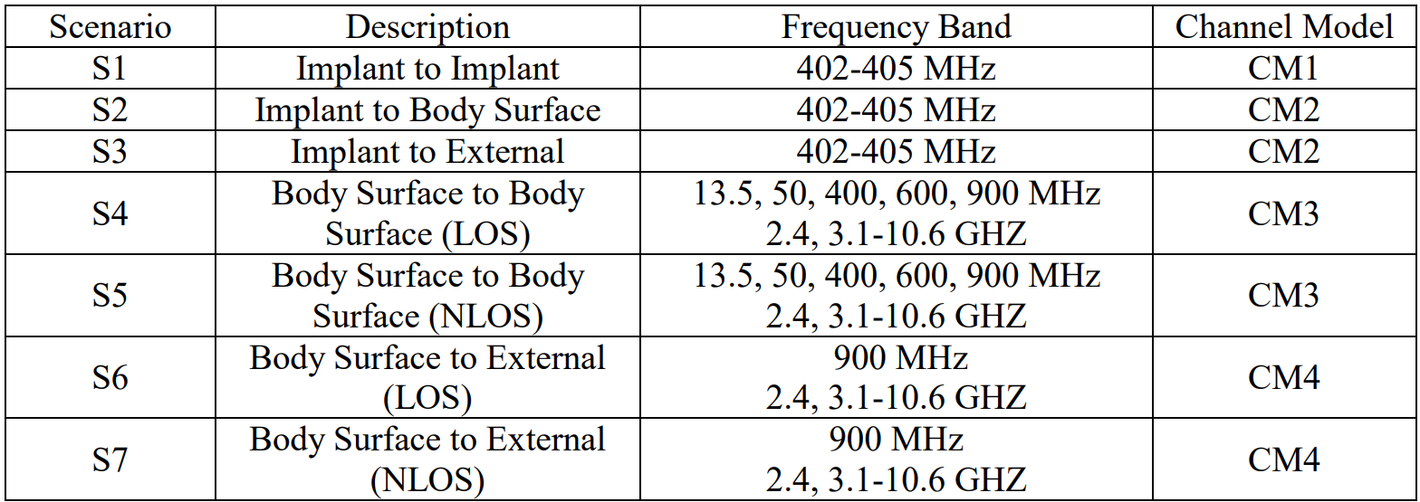
Channel models and scenarios in IEEE802.15.6-2012
No definition of UWB channel models for implant devices
IEEE 802.15.6-2012 channel models considered
IEEE P802.15-08-0780-12-0006-TG6
Fading ( Small scale/ large scale)
Path loss
Shadowing
Power delay profile
In-body (implant)
On-body (body surface)
CM1, 2, 3, 4
Scenario 1, to Scenario 7. (S1 – S7)

Slide 6


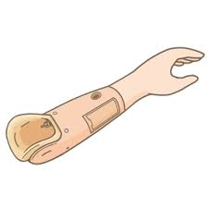
Extend more wider applications
TG6ma, revision of IEEE802.15.6 is considering extend to more wider application by using UWB-PHY
Brain-Computer/Machine Interfaces
Vehicle Body Area Network
coordinator
Engine Compartment
Cabin Room
Transceiver on body surface
Capsule endoscopy
Gastrointestinal tract
capsule endoscopy

Slide 7
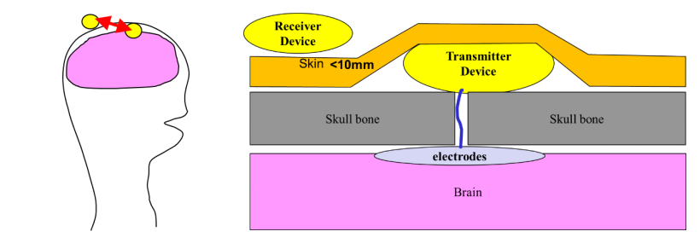
New application of enhanced dependable BANs
On-body (head) transmitter device
Recently, brain computer interface (BCI) and brain machine interface (BMI) technologies are dramatically advanced. However, most of these researches use wired connection due to difficulties to keep dependability on wireless communication.
On-body device
External
Device
In-head device
Enhanced dependable BAN is highly expected to be used for the BMI and BCI sensing and controlling systems.

Slide 8
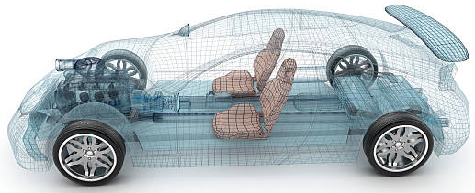
New application of enhanced dependable BANs
Engine/Motor room environment model
Engine/motor diagnostic sensor and controller
Air pressure sensor, wheel health sensor and controller
Transmission monitoring sensor and controller
Cabin environment sensor (temperature, brightness, humidity etc.)
Sheet sensor, health care sensors for driver
Sheet sensor, health care sensors for passenger
Cabin room environment model
Note:
Various type of car/vehicles
Bus, Bulldozer, Heavy construction equipment needed each different sensors.
4
2
5
1
3
6
https://media.istockphoto.com/photos/transparent-car-design-wire-model3d-illustration-my-own-car-design-picture-id594040008?k=6&m=594040008&s=612x612&w=0&h=XE8LiBjpM51aB4pH2CFt6-MT6IvALRPnlxPcac0RXhg=

Slide 9
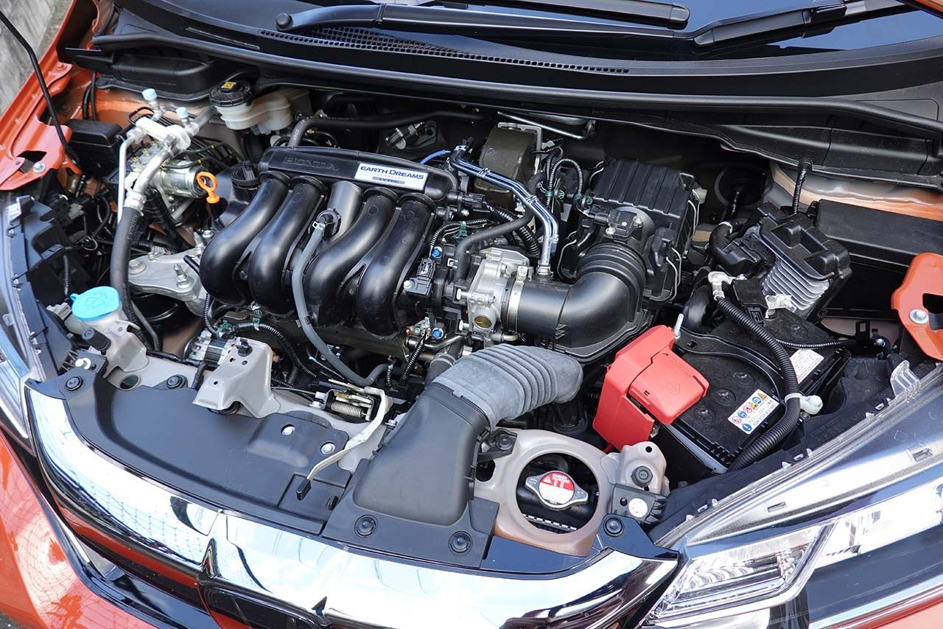
Engine/Motor Room Environment
Many metallic components
Components existing in densely
Ignition noise, motor noise
Larger path-loss than free propagation
A lot of reflection of RF signal
Electro-magnetic interference, EMI issues
Especially EV
https://www.as-web.jp/car/575374/attachment/03a_sub_dsc01273
Ignition coil
Spark plug
Electric generator
Electric motor
High current battery and cable

Slide 10
VBAN Use cases
Failure and/or deterioration detection of vehicle components.
  - Nodes are in engine compartment / coordinator is in engine compartment
Sensing for safety driving support / Collision avoidance
  - Nodes are on outside surface of vehicle / coordinator is in engine compartment
Entertainment for passengers
  - Nodes are in cabin / coordinator is in cabin.
Key-less entry system
- Node is around user outside of vehicle / coordinator is in engine compartment
Communication between user on pedestrian and vehicle
  - Node is around user outside of vehicle / coordinator is on outside surface of vehicle (vehicle moves at walking speed (<5km/h))
Vehicle controlling / Wireless herness
  - Coordinator and nodes are in between cabin and chassis of vehicle.
Driver’s health problem detection
  - Coordinator in engine compartment / nodes are on human (driver) body.
Driver’s and passenger’s healthcare application
  - Nodes and coordinator are on human body.

Slide 11
Classification of Channel and Environment Models for Human and Vehicle Body Area Networks (HBAN&VBAN)
Channel model
※Covered by
IEEE 802.15.6-2012
HBAN model
In-body (Implant)
※
On-body
※
Channel model
With environment
Around body
Outdoor
※Around means;
Desk, WiFi AP in the room etc.
Indoor
※
Home
Implanted BCI model
Office
※
On skull BCI model
Medical (e.g. Hospital)
※
capsule endoscopy
※not covered in 2012
VBAN model
In-vehicle
Engine compartment
Note:
HBAN-model:
-Environment with co-existing systems is not considered.
VBAN model:
Key-less entry system
Localization in-body, on-body
Most dominant model should be defined and separatory defined as Mandatory and Optional.
Cabin
Through Engine compartment and cabin
On-vehicle
Roof
Around vehicle
Side Right/Left/Front/back
Bottom
Static vehicle
Moving vehicle

Slide 12
Channel and Environmental Models
Environment model
※will be defined in this amendment
Channel model
Environment model
Channel model
Path loss
Reflection
Multipath
Fading
LOS / NLOS model
White Gaussian noise
Interference from co-existing wireless systems
e.g. Bluetooth, IEEE 802.11, IEEE 802.15.4 etc.
Interference from the other BANs.
Interference from the other electric systems, devices and components (Electro-magnetic interference; EMI from electric motors, spark plugs in vehicles, etc.
Electro-magnetic compatibility; EMC. Possibility to affect to the other systems and human body.
VBAN ⬄ HBAN interference
VBAN and HBAN ⬄ Vehicle control and human body impacts.
Colored noise (Impulse noise, spike noise, ignition noise etc.)
Time-varying channel and interference modeling (Statistic, non-static, pseudo static model)
※IEEE802.15.6-2012
Other wireless systems
EMI EMC
Colored noise
Time-varying modeling
※mandatory
※optional
※mandatory
※mandatory
※Comments in May 2021.
※optional
or
?
※mandatory
or
?
※optional
※mandatory
※mandatory
※optional

Slide 13
Environmental model
EMI from vehicle system
Colored noise
EV Switching noise
Ignition noise
etc…
Standard antenna
Standard antenna
Channel model
Propagation Model （based on S-V Model）
RF
ANT
+
ANT
RF
Distance dependent function
Interference from the other Wireless systems
Interference from the other BAN
Interference from the other UWB (not BAN)
Distance dependent function
We propose to define environmental models including antenna effect. Parameter measurements will be performed by using standard antennas which will be defined separately.

Slide 14
Channel models and scenarios in IEEE802.15.6ma
Scenario | Description | Frequency Band | Channel Model
S1 | Implant to Implant | 402-405 MHz, | CM1
S2 | Implant to Body Surface | 402-405 MHz, | CM2
S2.1 | Implant (upper body) to Body Surface | 3.1-10.6 GHz UWB | CM2.1
S2.2 | Implant (head) to Body Surface | 3.1-10.6 GHz UWB | CM2.2
S3 | Implant to External | 402-405 MHz, 3.1-10.6 GHz UWB | CM2
S4 | Body Surface to Body Surface (LOS) | 400, 600, 900 MHz 2.4, 3.1-10.6 GHz | CM3
S4.1 | Body Surface to Body Surface (LOS) | 3.1-10.6 GHz CM4.1 | CM4.1
S5 | Body Surface to Body Surface (NLOS) | 400, 600, 900 MHz 2.4, 3.1-10.6 GHz | CM3
S6 | Body Surface to External (LOS) | 900 MHz 2.4, 3.1-10.6 GHz | CM4
S6.1 | Body Surface (head) to External (LOS) | 3.1-10.6 GHz | CM6.1
S6.2 | BAN Coordinator to BAN coordinator | 3.1-10.6 GHz | CM6.2
S7 | Body Surface to External (NLOS) | 900 MHz 2.4, 3.1-10.6 GHz | CM7
Path loss (Mandatory)
Optional;
  Fading ( Small scale/ large scale)
  Shadowing
  Power delay profile
Specific use cases
Implant to Body Surface for BCI
Implant to External for BCI
Body surface to body surface for BCI
Body Surface to External for BCI
Implant to body surface for capsule endoscopy

Slide 15
Channel models and scenarios for capsule endoscopy S.2.1
Specific use cases
Implant(head) to on-body for BCI
Implant to External for BCI
Body surface to body surface for BCI
Body Surface to External for BCI
Implant to body surface for capsule endoscopy
Transceiver on body surface
Gastrointestinal tract
capsule endoscopy
Implant to Body Surface for Capsule Endoscopy

Slide 16
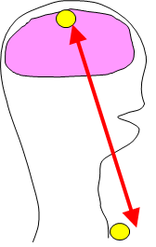
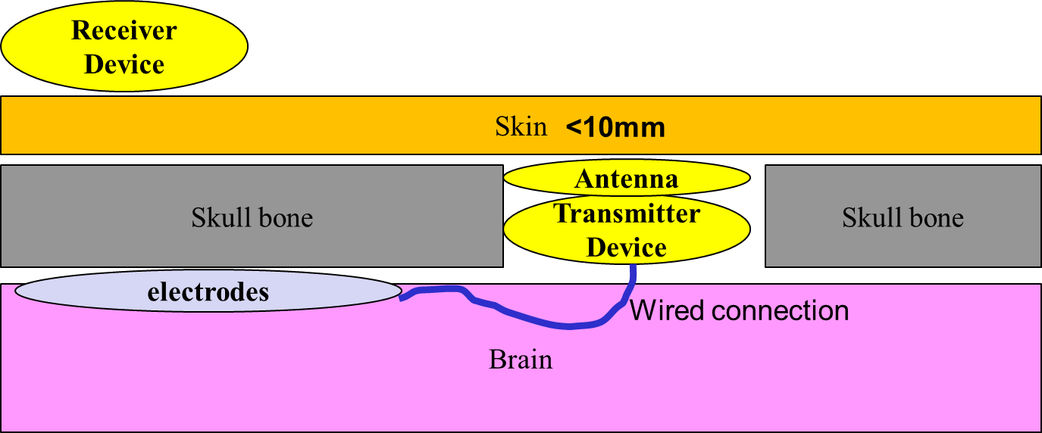
Channel models for BMI and BCI
S2.2 implant(head) to on-body
Specific use cases
Implant(head) to on-body for BCI
Implant to External for BCI
Body surface to body surface for BCI
Body Surface to External for BCI
Implant to body surface for capsule endoscopy

Slide 17
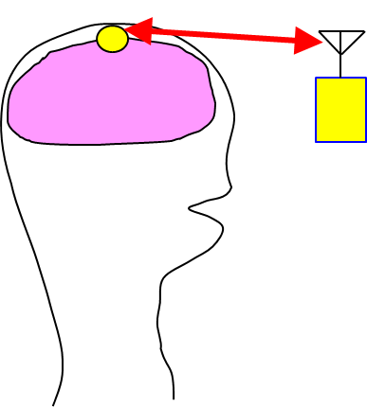
Channel models for BMI and BCI
S2.3 implant(head) to external
Specific use cases
Implant(head) to on-body for BCI
Implant to External for BCI
Body surface to body surface for BCI
Body Surface to External for BCI
Implant to body surface for capsule endoscopy

Slide 18
Channel models for BMI and BCI
S4.1 ― on-body(head) to on-body
Specific use cases
Implant(head) to on-body for BCI
Implant to External for BCI
Body surface to body surface for BCI
Body Surface to External for BCI
Implant to body surface for capsule endoscopy
On-body (head) transmitter device
Receiver
Device

Slide 19
Channel models for BMI and BCI
S6.1 ― on-body(head) to external
On-body (head) transmitter device
Specific use cases
Implant(head) to on-body for BCI
Implant to External for BCI
Body surface to body surface for BCI
Body Surface to External for BCI
Implant to body surface for capsule endoscopy
Receiver
Device

Slide 20
HBAN coordinator to HBAN coordinator
S6.2&CM6.2
Body surface to ANOTHER body surface
Cannot be considered as similar
Need to consider SAR issues
Body surface to body surface
Body surface to body surface

Slide 21
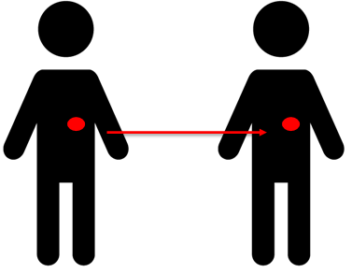
Channel models for BMI and BCI
S6.2 ― HBAN to HBAN

Slide 22
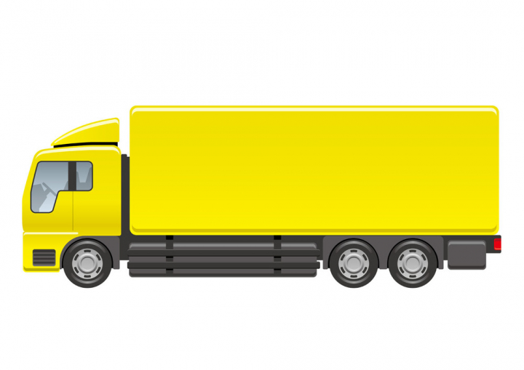
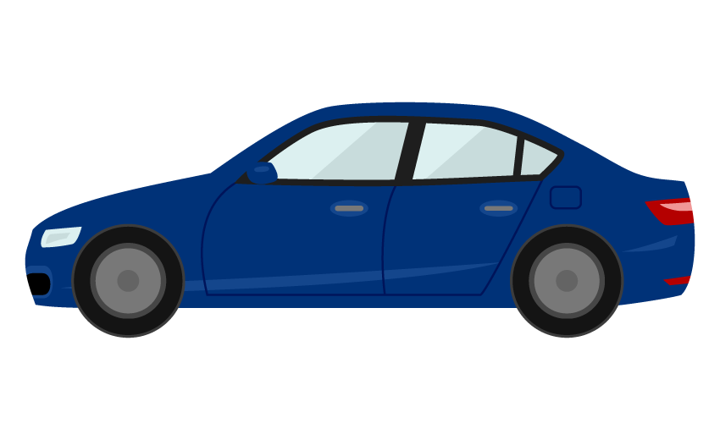
Environment models that can be applicable against different type of vehicles
Cabin
Engine
Cabin
Engine
Different
Size;
Structure;...etc.
https://nohat.cc/f/heavy-truck-illustration-isolated-on-a-white-background/comvecteezy328938-201908251309.html
Categories:
Categorize several type of vehicle like “for passengers”, “bus”, “small cargo”, “middle cargo”, “Large cargo” and “special purpose vehicles” such as a construction machines and build models for various categories.
Policy:
IEEE 802.15.6ma defines several common environment models against most dominant use cases as mandatory models.

Slide 23
Symmetric scenario
In channel model (without EMC/EMI and Interference issues), two direction of propagation should be considered as equal:
Channel reciprocity.
Coordinator
Node
Coordinator
Node
Channel models of “Coordinator to node” and “Node to coordinator” without noise source should be the same.
Asymmetric scenario
Noise and/or interference source
In case of environmental model including EMC/EMI . colored noise and interference issues, two direction between source and sink is not same meaning.
Coordinator
Node
Environmental model of two different direction should be defined separately.
Coordinator
Node
Environmental models of “Coordinator to node” and “Node to coordinator” should be different.

Slide 24
Engine/Motor Room Environment
Many metallic components
Components existing in densely
Ignition noise, motor noise
Larger path-loss than free propagation
A lot of reflection of RF signal
Electro-magnetic interference, EMI issues
Especially EV
https://www.as-web.jp/car/575374/attachment/03a_sub_dsc01273
Ignition coil
Spark plug
Electric generator
Electric motor
High current battery and cable

Slide 25
Models between VBAN and HBAN
Channel and Environmental models between VBAN coordinator and VBAN coordinators.
VBAN
node
VBAN
coordinator
VBAN
coordinator
Channel and Environmental models for VBAN.
Channel and Environmental models between VBAN coordinator and HBAN coordinators.
VBAN
node
HBAN
coordinator
HBAN
coordinator
HBAN
coordinator
HBAN
coordinator
Channel and Environmental models for HBAN.
HBAN
node
HBAN
node
HBAN
node
HBAN
node
HBAN
node

Slide 26
Channel and Environmental models of VBAN
Scenario 8.1 & CM8.1 “In-vehicle to In-vehicle (functional compartment)”
S8: In-vehicle to In-vehicle (sedan)
coordinator
S8.2: In-vehicle to In-vehicle (functional compartment)
Engine Compartment
Cabin Room

Slide 27

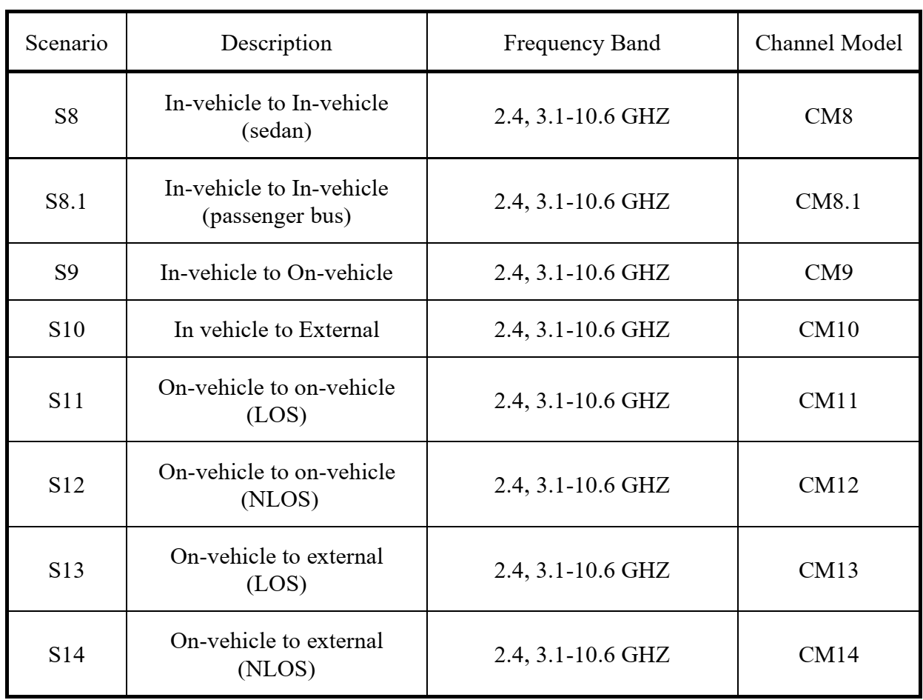
Channel models and scenarios in IEEE802.15.6ma
S11: On-vehicle to on-vehicle (LOS)
S13: On-vehicle to external (LOS)
S12: On-vehicle to on-vehicle (NLOS)
S9: In-vehicle to On-vehicle
S10: In vehicle to External
S8: In-vehicle to In-vehicle (sedan)
S14: On-vehicle to external (NLOS)

Slide 28
Channel and Environmental models of VBAN
S11: On-vehicle to on-vehicle (LOS)
S13: On-vehicle to external (LOS)
S12: On-vehicle to on-vehicle (NLOS)
S9: In-vehicle to On-vehicle
S10: In vehicle to External
S8: In-vehicle to In-vehicle (sedan)
S14: On-vehicle to external (NLOS)

Slide 29
Scenario 8
Geometrical configuration
Nodes and coordinator are in cabin room
Common channel model to IEEE 802.15.4a
Coordinator or node
S8: In-vehicle to In-vehicle (sedan)
Use case
Entertainment for passengers
  Nodes are in cabin room / coordinator is in cabin room.
  Symmetric environmental model
  EMI from engine and electric system are negligible. => channel model
 | Use case | Sedan/RV / SUV with engine | Sedan/RV / SUV without engine | Bus | Cargo / pickup | Special purpose
8 | Entertainment for passengers | Case 8 |  | Case 8.1 | Same as 8.1 | ---

Slide 30
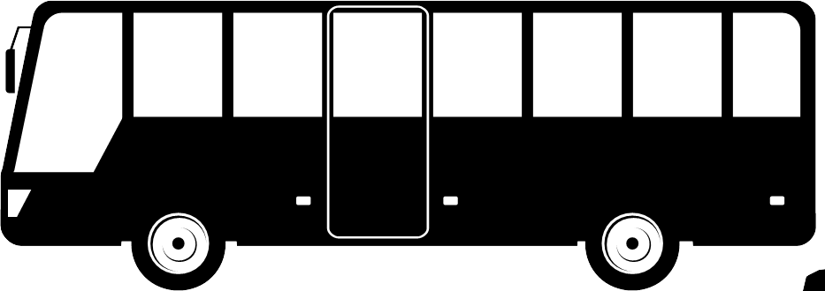
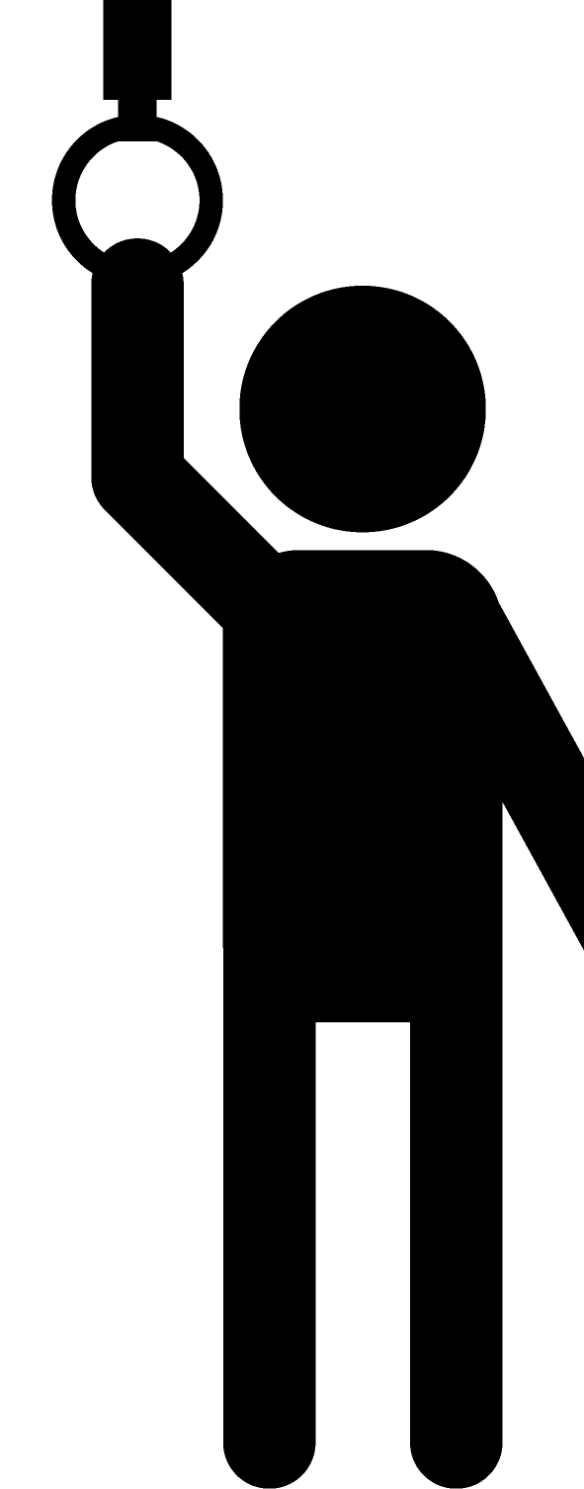

Channel models for BUS
Geometrical configuration
Nodes and coordinator, VBAN and HBAN are in cabin room
VBAN Coordinator
HBAN Coordinator
Noise source
coordinator
Use case
Entertainment for passengers
  Nodes are in cabin room / coordinator is in cabin room.
scenario |  | Sedan/RV / SUV with engine | Sedan/RV / SUV without engine | Bus | Cargo / pickup | Special purpose
8.1vv | VBAN coordinator and VBAN coordinator | Case 3.1a |  | Case 3.1a | Same as 3.1a | ---
8.1vh | VBAN coordinator and HBAN coordinator | Case 3.1b |  |  |  | ---

Slide 31
Scenario 8.1 for BUS
Geometrical configuration
Nodes and coordinator are in cabin room
S8.1: In-vehicle to In-vehicle (bus)

Slide 32
Scenario 10
Geometrical configuration
In-body / External
Common channel model to IEEE 802.15.4a
VBAN Coordinator
HBAN Coordinator
Noise source
Use case
Key-less entry system
  Node is around user outside of vehicle / coordinator is in Engine compartment
  Asymmetric environment. Two direction model should be defined separatory.
scenario | Use case | Sedan/RV / SUV with engine | Sedan/RV / SUV without engine | Bus | Cargo / pickup | Special purpose
10 | Key-less entry system | Case 4.1 V-H | Case 4.2 V-H | Case 4.3 V-H |  | ---
 |  | Case 4.1 H-V | Case 4.2 H-V | Case 4.3 H-V |  | ---

Slide 33
Channel and Environmental models of VBAN
Scenario 8.1 & CM8.1 “In-vehicle to In-vehicle (functional compartment)”
S8: In-vehicle to In-vehicle (sedan)
coordinator
S8.2: In-vehicle to In-vehicle (functional compartment)
Engine Compartment
Cabin Room

Slide 34
 |  |  |  | STATUS | PL | PDP | Matlab | Modeling & Documentation | Reference
Scenario | Description | Frequency Band | Channel Model
S1 | Implant to Implant | 402 - 405 MHz | CM1 | OK | COPY of ORIGINAL | COPY of ORIGINAL | COPY of ORIGINAL | done | Original CMD of IEEE 802.15.6-2012
S2 | Implant to Body Surface | 402-405 MHz | CM2 | OK | COPY of ORIGINAL | COPY of ORIGINAL | COPY of ORIGINAL | done | Original CMD of IEEE 802.15.6-2012
S2.1 | Implant (upper body) to Body Surface ※Capsule endoscopy | 3.1-10.6 GHz | CM2.1 | OK(PL) | Done | TBD (0%) | Done(PL option2) | Done(PL) | Kamran's Contribution, [DCN15-22-0401-01-006a], Daisuke's contribution [DCN15-23-0145-00-006a],
S2.2 | Implant (head) to Body Surface ※BCI | 3.1-10.6 GHz | CM2.2 | OK(PL) | Done | Done | Done(PL) | Done(PL) | Daisuke's contribution [DCN15-23-0145-00-006a],
S2.3 | Implant (head) to external ※BCI | 3.1-10.6 GHz | CM2.3 | OK(PL) | Done | Done | Done(PL) | Done(PL) | Daisuke's contribution [DCN15-23-0145-00-006a],
S3 | Implant to External | 402-405MHz | CM3.1 | OK | COPY of ORIGINAL | COPY of ORIGINAL | COPY of ORIGINAL | done | Original CMD of IEEE 802.15.6-2012
S3.1 | Implant (upper body) to External ※Capsule endoscopy | 3.1-10.6GHz | CM3.1 | OK(PL) | Done (Will be enhanced?),(antenna gain) |  |  | 90% | Daisuke's contribution New doc. May.
S4 | Body Surface to Body Surface (LOS) | 400, 600, 900 MHz | CM4 | OK | COPY of ORIGINAL | COPY of ORIGINAL | COPY of ORIGINAL | done | Original CMD of IEEE 802.15.6-2012
 |  | 2.4, |  | OK | COPY of ORIGINAL | COPY of ORIGINAL | COPY of ORIGINAL | done | Original CMD of IEEE 802.15.6-2012
 |  | 3.1-10.6 GHz |  | OK | COPY of ORIGINAL | COPY of ORIGINAL | COPY of ORIGINAL | done | Original CMD of IEEE 802.15.6-2012
S5 | Body Surface to Body Surface (NLOS) | 2.4 GHz | CM5 | OK | COPY of ORIGINAL | COPY of ORIGINAL | COPY of ORIGINAL | done | Original CMD of IEEE 802.15.6-2013
 |  | 3.1-10.6 GHz |  | OK | COPY of ORIGINAL | COPY of ORIGINAL | COPY of ORIGINAL | done | Original CMD of IEEE 802.15.6-2014
S6 | Body Surface to External (LOS) | 3.1-10.6 GHz | CM6 | OK | COPY of ORIGINAL | COPY of ORIGINAL | COPY of ORIGINAL | done | Original CMD of IEEE 802.15.6-2015
S6.1 | Body Surface (head) to External (LOS) | 3.1-10.6 GHz | CM6.1 | OK(PL) | Done | Done | Done(PL) | Done(PL) | Daisuke's contribution [DCN15-23-0145-00-006a],
S6.2 | BAN coordinator to BAN coordinator | 3.1-10.6 GHz | CM6.2 | OK(PL) | Done | T.B.D (0%) | Done(PL) | 80% | Daisuke's contribution New doc. May.
S7 | Body Surface to External (NLOS) | 3.1-10.6 GHz | CM7 | OK | COPY of ORIGINAL | COPY of ORIGINAL | COPY of ORIGINAL | Editing (COPY of ORIGINAL) | Original CMD of IEEE 802.15.6-2012

Slide 35
 |  |  |  | STATUS | PL | PDP | Matlab | Modeling & Documentation | Reference
Scenario | Description | Frequency Band | Channel Model
S8 | In-vehicle to In-vehicle (sedan) | 2.4 GHz | CM8 | CFP |  |  |  |  | Car industry documents
 |  | 3.1-10.6 GHz |  | OK(PL) | Done | TBD (20%) simulation running | TBD (1%) ready to start | 100% (for PL) | Daisuke's contribution P802.15-23-0146-00-006a
S8.1 | In-vehicle to In-vehicle (passenger bus) | 2.4 GHz | CM8.1 | CFP |  |  |  |  | Car industry documents
 |  | 3.1-10.6 GHz |  | OK(PL) | Done | TBD (50%) simulation running | TBD (1%) ready to start | 100% (for PL) | Daisuke's contribution P802.15-23-0146-00-006a
S8.2 | In-vehicle to In-vehicle (functional compartment) | 2.4 GHz | CM8.2 | CFP |  |  |  |  | Car industry documents
 |  | 3.1-10.6 GHz |  | OK(PL) | Done | TBD (70%) simulations done | TBD (1%) ready to start | 100% (for PL) | Daisuke's contribution P802.15-23-0146-00-006a
S9 | In-vehicle to On-vehicle | 2.4 GHz | CM9 | CFP |  |  |  |  | Car industry documents
 |  | 3.1-10.6 GHz |  | OK(PL) | Done | 10% | T.B.D (1%) | 100% (for PL) | Daisuke's contribution P802.15-23-0146-00-006a + New doc. at May.
S10 | In vehicle to External | 2.4 GHz | CM10 | CFP |  |  |  |  | Car industry documents
 |  | 3.1-10.6 GHz |  | OK(PL) | Done | 10% | T.B.D (1%) | 100% (for PL) | Daisuke's contribution P802.15-23-0146-00-006a + New doc. at May.
S11 | On-vehicle to on-vehicle (LOS) | 2.4 GHz | CM11 | CFP |  |  |  |  | Car industry documents
 |  | 3.1-10.6 GHz |  | OK(PL) | Done | 10% | T.B.D (1%) | 100% (for PL) | Daisuke's contribution P802.15-23-0146-00-006a + New doc. at May.
S12 | On-vehicle to on-vehicle (NLOS) | 2.4 GHz | CM12 | CFP |  |  |  |  | Car industry documents
 |  | 3.1-10.6 GHz |  | OK(PL) | Done | 10% | T.B.D (1%) | 100% (for PL) | Daisuke's contribution P802.15-23-0146-00-006a + New doc. at May.
S13 | On-vehicle to external (LOS) | 2.4 GHz | CM13 | CFP |  |  |  |  | Car industry documents
 |  | 3.1-10.6 GHz |  | OK(PL) | Done | 10% | T.B.D (1%) | 100% (for PL) | Daisuke's contribution P802.15-23-0146-00-006a + New doc. at May.
S14 | On-vehicle to external (NLOS) | 2.4 GHz | CM14 | CFP |  |  |  |  | Car industry documents
 |  | 3.1-10.6 GHz |  | OK(PL) | Done | 10% | T.B.D (1%) | 100% (for PL) | Daisuke's contribution P802.15-23-0146-00-006a + New doc. at May.

Slide 36
Summary
IEEE 802.15 TG6ma is now active to revision for IEEE802.15.6-2012
Channel models document has been defined with new channel models and scenarios for new applications.
In this TG activity, we define new scenarios for HBAN and 8 scenarios for VBAN.
Scenario S2.1 is for the application of capsule endoscopy
Scenarios S2.2 S4.1 and S6.1 are for the BCI/BMI application
Scenarios S6.2 is for communication between coordinator to coordinator.
Some of VBAN channel and environment models are defined by the original contributions.

Slide 37
References
“802.15.6-2012 - IEEE Standard for Local and metropolitan area networks –Part 15.6: Wireless Body Area Networks,” IEEE, NY, Feb., 2012. DOI:10.1109/IEEESTD.2012.6161600
Kamya Yekeh Yazdandoost and Kamran Sayrafian-Pour, “Channel
Model for Body Area Network,” IEEE P802.15-08-0780-
11-0006, Sept., 2010.
Yan T, Suzuki K, Kameda S, Maeda M, Mihara T, Hirata M , “Electrocorticographic effects of acute ketamine on non-human primate brains,” J Neural Eng. 2022, 19(2): 026434
Kaiju T, Inoue M, Hirata M, Suzuki T, “High-density mapping of primate digit representations with a 1152-channel µECoG array,” J Neural Eng. 17 March 2021 Volume 18, Number 3
Takumi Kobayashi, Daisuke Anzai, Minsoo Kim, Marco Hernandez, Ryuji Kohno, “Summary of Channel and Environmental Modeling Activities for BANs on TG15.6a,” IEEE P802.15-22-0091-05-006a, Jan., 2023.
Takumi Kobayashi, Minsoo Kim, Marco Hernandez, Ryuji Kohno, “Channel Model for Wearable and Implant BAN in use case of BMI and BCI,” IEEE P802.15-22-0069-04-006a, Sept., 2022.
Takumi Kobayashi, Minsoo Kim, Marco Hernandez, Ryuji Kohno, “TG6ma Channel Model Document for Enhanced Dependability,” IEEE P802.15-22-0519-00-006a, Sept., 2022.
Takumi Kobayashi, Minsoo Kim, Marco Hernandez, Ryuji Kohno, “Chanel and Environmental Models Classification for Vehicle Body Area Network (VBAN) on TG15.6a,” IEEE P802.15-21-0560-01-006a, Nov. 2021.

Slide 38
Thank you for your attention

Slide 39
↓ Supplementary ↓

Slide 40
Channel and Environmental models of VBAN
Scenario 8.1 & CM8.1 “In-vehicle to In-vehicle (functional compartment)”
S8: In-vehicle to In-vehicle (sedan)
S8.2: In-vehicle to In-vehicle (functional compartment)
coordinator
Cargo space
Cabin Room

Slide 41
Scenario 13
Geometrical configuration
Outside surface of vehicle / coordinator is on vehicle
Common channel model to IEEE 802.15.4a
VBAN Coordinator
HBAN Coordinator
Moving at walking speed (<5km/h)
Noise source
Use case
Communication between user on pedestrian and vehicle
  Node is around user outside of vehicle / coordinator is on outside surface of vehicle (vehicle moves in walking speed (<5km/h))
  Asymmetric environmental model
S | Use case | Sedan/RV / SUV with engine | Sedan/RV / SUV without engine | Bus | Cargo / pickup | Special purpose
13 | Communication between user on pedestrian and vehicle | Case 5.1 V-H |  | Case 5.3 V-H |  | ---
 |  | Case 5.1 H-V |  | Case 5.3 H-V |  | ---

Slide 42

Dynamic Channel Models Situations
Channel between a user on pedestrian and a vehicle.
Users in a vehicle are slightly moving due to vibration and acceleration.
Walking and/or standing users on a bus and train.
Between a tractor and trailer tail.
VBAN Coordinator
HBAN Coordinator
Moving at walking speed (<5km/h)
Noise source
LOS
LOS
NLOS

Slide 43
Classification of Channel and Environment Models for Human and Vehicle Body Area Networks (HBAN&VBAN)
Channel model
※Covered by
IEEE 802.15.6-2012
HBAN model
In-body (Implant)
※
On-body
※
Channel model
With environment
Around body
Outdoor
※Around means;
Desk, WiFi AP in the room etc.
Indoor
※
Home
Implanted BCI model
Office
※
On skull BCI model
Medical (e.g. Hospital)
※
capsule endoscopy
※not covered in 2012
VBAN model
In-vehicle
Engine compartment
Note:
HBAN-model:
-Environment with co-existing systems is not considered.
VBAN model:
Key-less entry system
Localization in-body, on-body
Most dominant model should be defined and separatory defined as Mandatory and Optional.
Cabin
Through Engine compartment and cabin
On-vehicle
Roof
Around vehicle
Side Right/Left/Front/back
Bottom
Static vehicle
Moving vehicle

Slide 44
Channel models and scenarios in IEEE802.15.6-2012
IEEE P802.15-08-0780-12-0006-TG6
IEEE 802.15.6-2012 channel models considered
Fading ( Small scale/ large scale)
Path loss
Shadowing
Power delay profile
In-body (implant)
On-body (body surface)
CM1, 2, 3, 4
Scenario 1, to Scenario 7. (S1 – S7)

Slide 45
Channel models and scenarios in IEEE802.15.6ma
Scenario | Description | Frequency Band | Channel Model
S2 | Implant to Body Surface | 402-405 MHz, | CM2
S2.1 | Implant (upper body) to Body Surface | 3.1-10.6 GHz UWB | CM2.1
S2.2 | Implant (head) to Body Surface | 3.1-10.6 GHz UWB | CM2.2
S3 | Implant to External | 402-405 MHz, 3.1-10.6 GHz UWB | CM2
S4 | Body Surface to Body Surface (LOS) | 400, 600, 900 MHz 2.4, 3.1-10.6 GHz | CM3
S4.1 | Body Surface to Body Surface (LOS) | 3.1-10.6 GHz CM4.1 | CM4.1
S5 | Body Surface to Body Surface (NLOS) | 400, 600, 900 MHz 2.4, 3.1-10.6 GHz | CM3
S6 | Body Surface to External (LOS) | 900 MHz 2.4, 3.1-10.6 GHz | CM4
S6.1 | Body Surface (head) to External (LOS) | 3.1-10.6 GHz | CM6.1
S7 | Body Surface to External (NLOS) | 900 MHz 2.4, 3.1-10.6 GHz | CM4
Path loss (Mandatory)
Optional;
  Fading ( Small scale/ large scale)
  Shadowing
  Power delay profile
Specific use cases
Implant to Body Surface for BCI
Implant to External for BCI
Body surface to body surface for BCI
Body Surface to External for BCI
Implant to body surface for capsule endoscopy

Slide 46
Channel models and scenarios in use case of BMI and BCI
Specific use cases
Implant to Body Surface for BCI
Implant to External for BCI
Body surface to body surface for BCI
Body Surface to External for BCI
Implant to body surface for capsule endoscopy
We will define what is BCI and BMI.
Wired connection
Body Surface to Body Surface for BCI
electrode
Future
Future
Arm
Implant to Body Surface for BCI
Body Surface to External on-body surface for BCI
Implant to External for BCI

Slide 47
Suggestion from Prof. Hirata
Implant to implant model for next Gen.
Wired connection
electrode
Future
Arm

Slide 48
1.5 Gen.
Receiver can be placed any where on body like on arm, wrist, neck etc.
Receiver
Device
Transmitter Device
Skin
<10mm
Skull bone
Skull bone
electrodes
Brain

Slide 49
Channel models for BMI and BCI
S2.2 (A) implant(head) to on-body
Specific use cases
Implant(head) to on-body for BCI
Implant to External for BCI
Body surface to body surface for BCI
Body Surface to External for BCI
Implant to body surface for capsule endoscopy

Slide 50
Channel models for BMI and BCI
S2.2 (B,C) implant(head) to on-body
Specific use cases
Implant(head) to on-body for BCI
Implant to External for BCI
Body surface to body surface for BCI
Body Surface to External for BCI
Implant to body surface for capsule endoscopy
Receiver
Receiver
Skin tissues
Skin tissues
<10mm
<10mm
Tx antenna
Skull bone
Skull bone
Skull bone
electrodes
Tx antenna
electrodes
transmitter
Brain
Brain

Slide 51
Channel models for BMI and BCI
S4.1 ― on-body(head) to on-body
Specific use cases
Implant(head) to on-body for BCI
Implant to External for BCI
Body surface to body surface for BCI
Body Surface to External for BCI
Implant to body surface for capsule endoscopy
On-body (head) transmitter device
Receiver
Device

Slide 52
Channel models for BMI and BCI
S6.1 ― on-body(head) to external
On-body (head) transmitter device
Specific use cases
Implant(head) to on-body for BCI
Implant to External for BCI
Body surface to body surface for BCI
Body Surface to External for BCI
Implant to body surface for capsule endoscopy
Receiver
Device

Slide 53
Future generation
Receiver
Skin
<10mm
Skull bone
Future
Transmitter
electrodes
Brain

Slide 54
Channel models and scenarios for capsule endoscopy S.2.1
Specific use cases
Implant(head) to on-body for BCI
Implant to External for BCI
Body surface to body surface for BCI
Body Surface to External for BCI
Implant to body surface for capsule endoscopy
Transceiver on body surface
Gastrointestinal tract
capsule endoscopy
Implant to Body Surface for Capsule Endoscopy

Slide 55
Titanium courted implanted device
Non-metallic material
Ant.
Ant.
Ant.
RF
RF
RF
Metal e.g. Titanium
Metal e.g. Titanium
Metal e.g. Titanium
Whole body of an implanted device is covered by metallic material.
Partially non-metallic window is on the surface of the implant devices.
Antenna is outside of metallic chassis

Slide 56
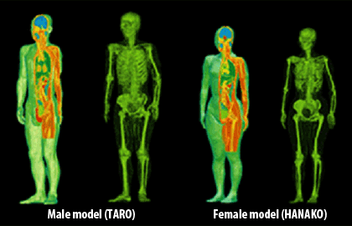
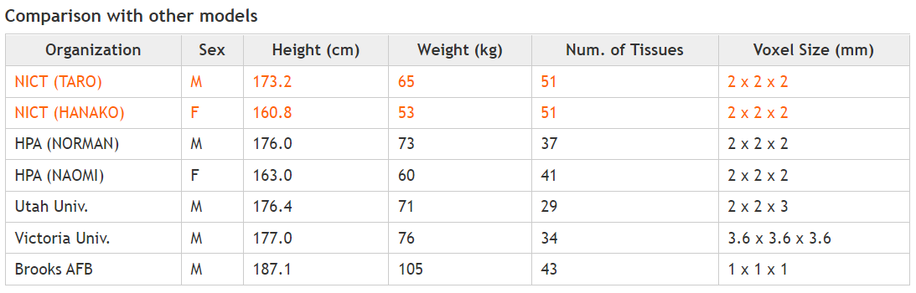
Whole-body voxel human models for numerical simulation
Whole-body voxel human models for numerical simulation is ready to use to develop and analyze channel and environmental model around human brain numerically.
Development of whole-body voxel human models
https://emc.nict.go.jp/bio/model/model01_1_e.html

Slide 57
Environment Model in Vehicle
Engine/Motor room environment model
Engine/motor diagnostic sensor and controller
Air pressure sensor, wheel health sensor and controller
Transmission monitoring sensor and controller
Cabin environment sensor (temperature, brightness, humidity etc.)
Sheet sensor, health care sensors for driver
Sheet sensor, health care sensors for passenger
Cabin room environment model
Note:
Various type of car/vehicles
Bus, Bulldozer, Heavy construction equipment needed each different sensors.
4
2
5
1
3
6
https://media.istockphoto.com/photos/transparent-car-design-wire-model3d-illustration-my-own-car-design-picture-id594040008?k=6&m=594040008&s=612x612&w=0&h=XE8LiBjpM51aB4pH2CFt6-MT6IvALRPnlxPcac0RXhg=

Slide 58
From 15.6-2012
with new contribution
From 15.4a
NEW contribution
From 15.8
Channel model
Large scale fading
Small scale fading
Path loss
UWB Channel model
15.4 Indoor residential
Shadowing
New contributions
Simulation methodology
HBAN
Channel model
VBAN
Channel model
HBAN
Channel model
VBAN
Channel model
In-body
In-vehicle
On-body
On-vehicle
Surrounding body
Surrounding vehicle
In-body
In-vehicle
On-body
On-vehicle
Surrounding body
Surrounding vehicle
15.4 outdoor

Slide 59



Use cases
 | Use case | Sedan/RV / SUV with combustion internal engine | Sedan/RV / SUV EV | Bus | Cargo / pickup | Special purpose
1 | Failure and/or deterioration detection of vehicle components | Case 1.1 | Case 1.2 | Case 1.3 |  | Case 1.5
2 | Sensing for safety driving support / Collision avoidance | Case 2.1 C-N | Case 2.2 C-N | Case 2.3 C-N |  | Case 2.5 C-N
 |  | Case 2.1 N-C | Case 2.2 N-C | Case 2.3 N-C |  | Case 2.5 N-C
3 | Entertainment for passengers | Case 3.1 |  | Case 3.3 | Same as 3.1 | ---
4 | Key-less entry system | Case 4.1 C-N | Case 4.2 C-N | Case 4.3 C-N |  | ---
 |  | Case 4.1 N-C | Case 4.2 N-C | Case 4.3 N-C |  | ---
5 | Communication between user on pedestrian and vehicle | Case 5.1 C-N |  | Case 5.3 C-N |  | ---
 |  | Case 5.1 N-C |  | Case 5.3 N-C |  | ---
6 | Vehicle controlling / Wireless herness | Case 6.1 C-N |  | Case 6.3 C-N |  | Case 6.5 C-N
 |  | Case 6.1 N-C |  | Case 6.3 N-C |  | Case 6.5 N-C
7 | Driver’s health problem detection | Case 7.1 C-N |  | Case 7.3 C-N |  | Case 7.5 C-N
 |  | Case 7.1 N-C |  | Case 7.3 N-C |  | Case 7.5 N-C
8 | Driver’s and passenger’s healthcare application | IEEE 802.15.6 – 2012 Channel models can be applied

