Slide 1
Project: IEEE P802.15 Working Group for Wireless Specialty Networks
Submission Title: Concept of channel coding for 15.6ma
Date Submitted: 12 July 2023
Source: Kento Takabayashi¹, Ryuji Kohno^{2,3}
Company: (1) Toyo University (2)Yokohama National University (3) YRP International Alliance Institute
Address: (1) 2100 Kujirai, Kawagoe, Saitama, Japan 351-8585, (2)79-5 Tokiwadai, Hodogaya-ku, Yokohama, 240-8501 Japan,
(3) YRP1 Blg., 3-4 Hikarinooka, Yokosuka-City, Kanagawa, 239-0847 Japan
Voice:[(1) +81-866-94-2104 , (2) +81-90-5408-0611] E-Mail:[takabayashi.kento.xp@gmail.com, kohno@ynu.ac.jp, kohno@yrp-iai.jp]
Re: In response to call for technical contributions
Abstract: The concept of error correcting codes for IEEE 802.15.6ma is provided. IEEE 802.15.6ma will deal with various QoS level data. Hence, it is required to consider an error control scheme corresponding to these QoS. We introduce the concept of applying a single error correcting code to low priority data and an outer and an inner error correcting codes to high priority data. In addition, we also consider coexistence with IEEE 802.15.4ab.
Purpose: Material for discussion in P802.15.6a TG corresponding to comments in EC Meeting
Notice: This document has been prepared to assist the IEEE P802.15. It is offered as a basis for discussion and is not binding on the contributing individual(s) or organization(s). The material in this document is subject to change in form and content after further study. The contributor(s) reserve(s) the right to add, amend or withdraw material contained herein.
Release: The contributor acknowledges and accepts that this contribution becomes the property of IEEE and may be made publicly available by P802.15.

Slide 2
Concept of channel coding for IEEE 802.15.6ma
July 2023,
Hybrid Session ,
Estrel Hotel, Berlin, Germany
Kento Takabayashi ⁽¹⁾, Ryuji Kohno^{(2, 3)}
⁽¹⁾ Toyo University
⁽²⁾ Yokohama National University,
⁽³⁾ YRP-International Alliance Institute

Slide 3
Importance of QoS control
In WBAN systems, a wearable vital sign sensor node can include various types of sensors with different data rates, the allowable communication error ratio and delay
IEEE 802.15.6 based WBAN may deal with 8 levels of user priority data
Those data have a wide range of quality of service (QoS)
Therefore, optimal error control for input data is an important feature in sensor data transmission procedures
User priority | Traffic designation | Frame type
0 | Background (BK) | Data
1 | Best effort (BE) | Data
2 | Excellent effort (EE) | Data
3 | Video (VI) | Data
4 | Voice (VO) | Data
5 | Medical data or network control | Data or management
6 | High-priority medical data or network control | Data or management
7 | Emergency or medical implant event report | Data

Slide 4
Error control in current IEEE 802.15.6
IEEE 802.15.6 shall use a (63, 51) BCH code as an error correcting code in narrowband, UWB and HBC PHY
Only user priority 6 data in UWB-PHY may use a hybrid ARQ with a (126, 63) shortened BCH code
However, the error control scheme of the current IEEE 802.15.6 cannot deal with the QoS because of lack of flexibility
In IEEE 802.15.6ma, we indicate a concept of channel coding technique to deal with various types of QoS data as shown in a next figure

Slide 5
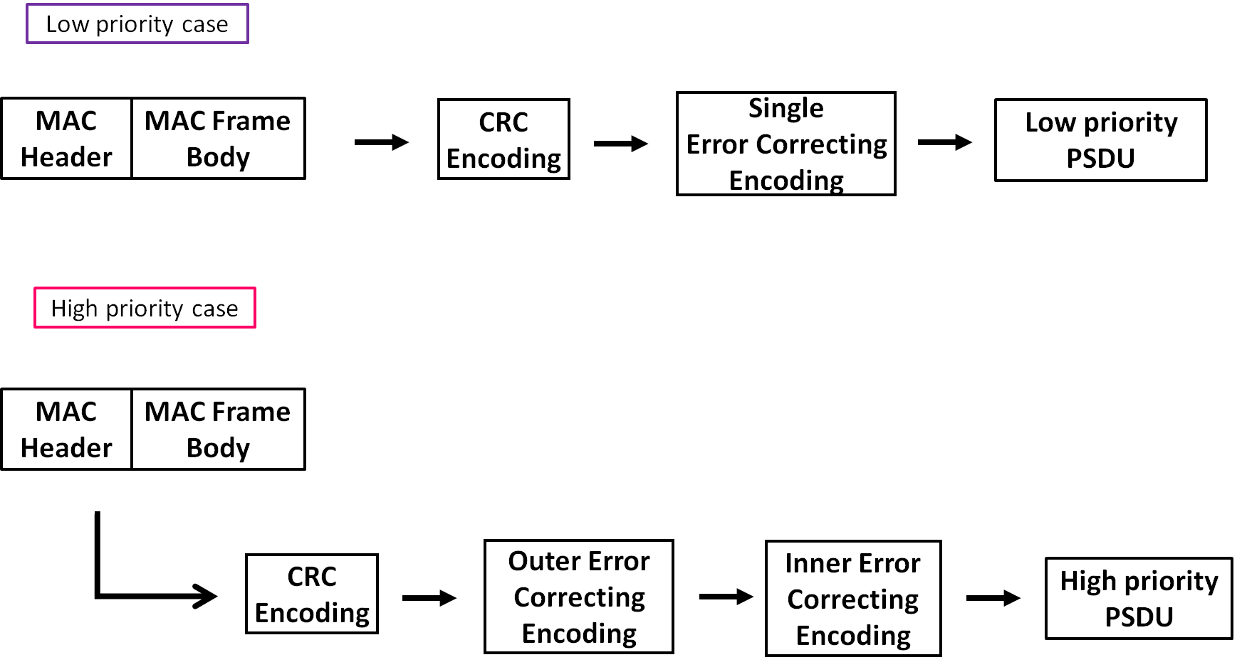
Concept of channel coding for PSDU
In a low priority QoS case, only a single error correcting code will be applied for PSDU
In a high priority QoS case, an outer and an inner error correcting codes will be serially applied for PSDU
MPDU is encoded by CRC-16-CCITT to detect bit errors

Slide 6
Concept Table #1
User priority | Inner code | Outer code | HARQ
0 | 15.4ab LDPC code (R=1/2) |  | -
1 | 15.4ab LDPC code (R=1/2) |  | -
2 | 15.4ab LDPC code (R=1/2) |  | -
3 | 15.4ab LDPC code (R=1/2) |  | -
4 | 15.4ab LDPC code (R=1/2) | (54, 46) shortened RS code | -
5 | 15.4ab LDPC code (R=1/2) | (54, 38) shortened RS code | -
6 | 15.4ab LDPC code (R=1/2) | (54, 28) shortened RS code | -
7 | 15.4ab LDPC code (R=1/2) | (54, 14) shortened RS code | -
As an outer code, shortened Reed-Solomon (RS) codes with N=54 (original code length N=63) will be selected to correct burst errors due to interference from other WBANs and the coding rates are changed according to each QoS and channel condition
As an inner code, 15.4ab LDPC codes (K=324, 648, 972, R=1/2) will be selected for the coexistence of 15.6ma and 15.4ab
This updated concept table is considered as the first priority
Notes:
N=54 shortened Reed-Solomon codes has 324 bits code length (m=6, 54*6=324)
Hence, this code length matches the information bit length of 15.4ab LDPC codes in multiples
For low QoS case, original 15.6 BCH codes will be applied as a one idea
Coexistence class 0~7

Slide 7
Current Evaluation
Bit error ratio of (54,46), (54,38), (54,28), (54,14) shortened RS codes and no encoding were evaluated under an
AWGN channel and BPSK modulation
Performances were improved as the coding rate decreased
LDPC simulator is currently checked and will be combined with the RS simulator

Slide 8
Concept Table #2
User priority | Inner code | Outer code | HARQ
0 | - | 15.4ab LDPC code (R=1/2) | -
1 | - | 15.4ab LDPC code (R=1/2) | -
2 | - | 15.4ab LDPC code (R=1/2) | -
3 | - | 15.4ab LDPC code (R=1/2) | -
4 | 15.4a/z based convolutional code, R=4/5 | 15.4ab LDPC code (R=1/2) | ◯
5 | 15.4a/z based convolutional code, R=2/3 | 15.4ab LDPC code (R=1/2) | ◯
6 | 15.4a/z convolutional code, R=1/2 | 15.4ab LDPC code (R=1/2) | ◯
7 | 15.4a/z based convolutional code, R=1/4 | 15.4ab LDPC code (R=1/2) | ◯
As an outer code, 15.4ab LDPC (K=324, 648, 972, R=1/2) codes will be selected for the coexistence of 15.6ma and 15.4ab
As an inner code, 15.4a/z based convolutional codes (which are almost the same of our proposed decomposable codes) will be selected, and the coding rates are changed according to each QoS and channel condition, which can be applied to hybrid ARQ
This table is considered as the second choice
Notes:
Coexistence class 8
Hybrid ARQ is utilized
Table #1 and #2 are shared by One drive

Slide 9
Summary of Updated Tables
Table #1
  Inner code: 15.4ab LDPC codes (R=1/2, K=324, 648, 972)
  Outer code: Shortened RS code (N=54, K=46, 38, 28, 14, original code length N=63)
  A hybrid ARQ shall not be utilized
  The table shall be applied to coexistence class 0~7
Table #2
  Inner code: 15.4a/z based convolutional codes (or our proposed decomposable codes, which is the almost same as the error correcting code), R= 4/5, 2/3, 1/2, 1/4
  Outer code: 15.4ab LDPC codes (R=1/2, K=324, 648, 972)
  A hybrid ARQ shall is utilized
  The table shall be applied to coexistence class 8

Slide 10
Thank you for your attention ! ! !

