Slide 1
Project: IEEE P802.15 Working Group for Wireless Specialty Networks (WSN)
Submission Title: TG 15.4ab May 2023 Interim Session Meeting Slides
Date Submitted: 14 May 2023
Source: Philip Orlik (Mitsubishi Electric)
Contact:
Voice: [deprecated], E-Mail: Porlik @ merl.com
Re: Japan Sub-1GHz Interest Group
Abstract: Mixed-mode interim session meeting slides
Purpose: Emulate organization, encourage participation and make further progress
Notice: This document has been prepared to assist the IEEE P802.15. It is offered as a basis for discussion and is not binding on the contributing individual(s) or organization(s). The material in this document is subject to change in form and content after further study. The contributor(s) reserve(s) the right to add, amend or withdraw material contained herein.
Release: The contributor acknowledges and accepts that this contribution becomes the property of IEEE and may be made publicly available by P802.15.
Notes:
Jul 12, 2010
Page 1

Slide 2
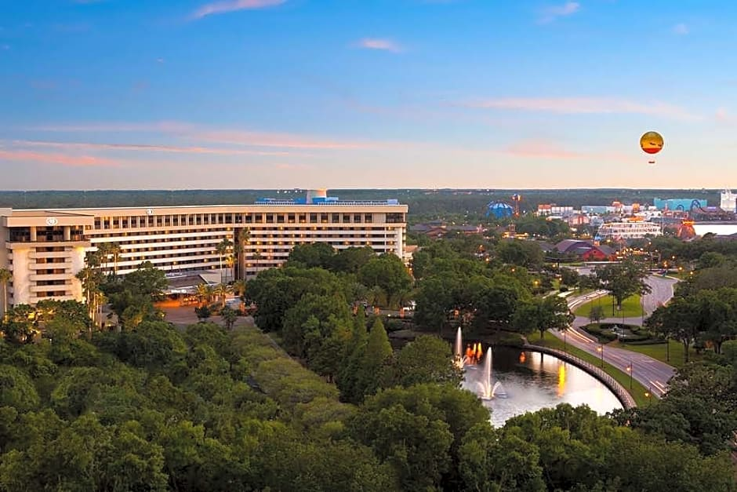
Japan Sub-1GHz Interest Group
Mixed Mode Wireless Interim, May 2023
Live from Orlando FLA USA

Slide 3
Interest Group Rules
Discussion: Everyone present is welcome
Straw polls: Everyone present may vote
Patent policy for non-PAR activities applies
All the usual rules of conduct
Please identify yourself on first contact with name and affiliation

Slide 4
IEEE-SA Patent, Copyright, and Participation Policies
See: https://grouper.ieee.org/groups/802/sapolicies.shtml
IEEE-SA Patent Slides for Standards Development Meetings (.pdf)
https://development.standards.ieee.org/myproject/Public/mytools/mob/slideset.pdf
IEEE-SA Standards Board Patent Committee (PatCom) home page
https://standards.ieee.org/content/ieee-standards/en/about/sasb/patcom/index.html
IEEE-SA Participation Policy meeting slide set - individual method (.pdf)
https://standards.ieee.org/content/dam/ieee-standards/standards/web/documents/other/Participant-Behavior-Individual-Method.pdf
Working Group Copyright Materials
https://standards.ieee.org/ipr/copyright-materials.html
https://standards.ieee.org/content/dam/ieee-standards/standards/web/documents/other/ieee-sa-copyright-policy-2019.pdf
This is your reminder: the rules explained during the WG opening apply to this meeting!

Slide 5
IEEE 802 Ground Rules
Respect … give it, get it
NO product pitches
NO corporate pitches
NO prices
NO restrictive notices – (no confidentially notices in email)
Presentations must be openly available

Slide 6
Registration for 802 LMSC Plenaries and 802 Wireless Interims
This 802.15 meeting is part of the IEEE 802 Plenary session
You must pay the registration fee in order to attend virtually or in person
If you have not already done so please register:
  Session Information & Registration Website: https://cvent.me/kqE5PN
  If you do not intend to register for this session you must leave this meeting and, if you have logged attendance on IMAT, email the appropriate WG chair or vice chairs to have your attendance cancelled

Slide 7
Deadbeat Consequences
(Deadbeat: in default of paying registration fee for a prior mtg.)
No participation credit will be granted for said session.
Any participation credit acquired before said session toward membership in any IEEE 802 LMSC group is revoked.
Membership in any IEEE 802 LMSC group is terminated.
No participation credit will be granted for attendance at any subsequent IEEE 802 LMSC session until the individual has complied with the registration requirements for all previously attended IEEE 802 LMSC sessions by the start of said subsequent session.

Slide 8
Mixed Mode Logistics
Head table will project
Remember remote attendees will hear you only if you use the microphone!
Remote attendees queue via chat window
Local attendees do not need to join WebEx except presenters
Presenters, both local and remote, will present via WebEx
Local attendees when joining WebEx connect without audio!
In-room Webex with audio enabled will disrupt the meeting!
For those Remote Attendees connecting to Webex, Configure Webex Audio to use “Music Mode”.
Makes sure “mute on entry” is set in WebEx
Please do not turn on video!

Slide 9
Agenda
Document:
https://mentor.ieee.org/802.15/dcn/23/15-23-0233-01-js1g-ig-js1g-may-agenda.xlsx

Slide 10
Session Objectives
Technical contributions
Refine input to TG4me
Consider next steps

Slide 11

Technical Presentations

Slide 12

Next Steps

Slide 13
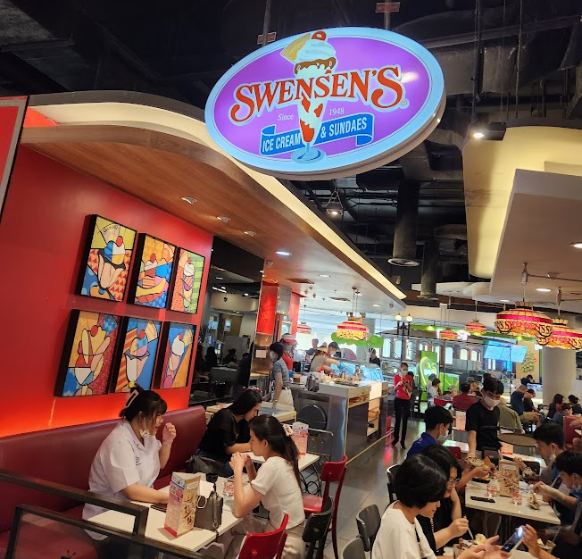
Other Business

