Slide 1
        doc.:15-23-0403-00-04ab
Project: IEEE P802.15 Working Group for Wireless Personal Area Networks (WPANs)
Submission Title: Optional Spreading Factor L=16 for Ranging Integrity Fragments (RIF)
Date Submitted: 13 July 2023
Source: Claudio Anliker (ETH Zurich), David Barras, Boris Danev (3db Access)
Address: ETH Zürich, Universitätstrasse 6, 8092 Zürich, Switzerland
E-Mail: claudio.anliker@inf.ethz.ch, david.barras@3db-access.com, boris.danev@3db-access.com
Purpose: Recap of the benefits of an additional spreading factor for 4ab RIFs
Notice: This document has been prepared to assist the IEEE P802.15. It is offered as a basis for discussion and is not binding on the contributing individual(s) or organization(s). The material in this document is subject to change in form and content after further study. The contributor(s) reserve(s) the right to add, amend or withdraw material contained herein.
Release: The contributor acknowledges and accepts that this contribution becomes the property of IEEE and may be made publicly available by P802.15.

Slide 2
Optional Spreading Factor L=16 for
Ranging Integrity Fragments (RIF)
        doc.:15-23-0403-00-04ab
Notes:
affiliation

Slide 3
        doc.:15-23-0403-00-04ab
PAR Objective | Proposed Solution (how addressed)
Safeguards so that the high throughput data use cases will not cause significant disruption to low duty-cycle ranging use cases
Interference mitigation techniques to support higher density and higher traffic use cases
Other coexistence improvement
Backward compatibility with enhanced ranging capable devices (ERDEVs)
Improved link budget and/or reduced air-time
Additional channels and operating frequencies
Improvements to accuracy / precision / reliability and interoperability for high-integrity ranging | Improvement of UWB ranging security
Reduced complexity and power consumption | Simplication of RIF verification
Hybrid operation with narrowband signaling to assist UWB | Applicable to NBA-MMS-UWB
Enhanced native discovery and connection setup mechanisms
Sensing capabilities to support presence detection and environment mapping
Low-power low-latency streaming
Higher data-rate streaming allowing at least 50 Mbit/s of throughput
Support for peer-to-peer, peer-to-multi-peer, and station-to-infrastructure protocols
Infrastructure synchronization mechanisms

Slide 4
Why L=16?
        doc.:15-23-0403-00-04ab
Objective: A Ranging Integrity Fragment (RIF) that
enables robust, bit-wise verification under dense multipath [15-22-0413]
requires only minimal changes to the proposed 4ab RIF waveform [15-23-0327].
Motivation:
Security: a reference approach supported by academic research
Implementation: reuse 4z hardware features
Proposal: An optional spreading factor of L=16 for RIFs.

Slide 5
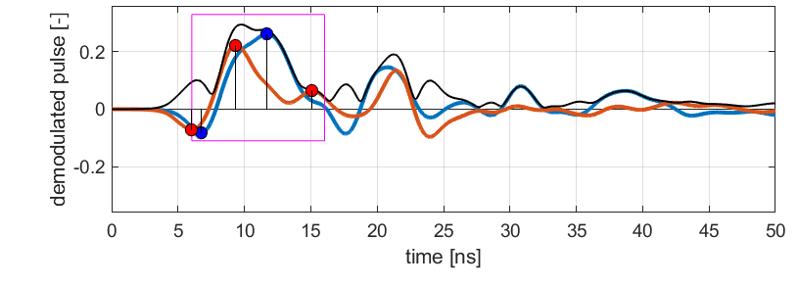
Security-related parameters
        doc.:15-23-0403-00-04ab
The security of bit-wise RIF verification depends on three parameters (assuming ideal device clocks [15-23-0274, 3]):
Number of pseudo-random bits
Number of bits that have to be correct
Aperture time (length of the bit energy integration window)
first path (ToA)
aperture time for late paths
(here T_{int,RF}=10ns, starting from 1st path)
paths found during UWB RSF fragment [3]

Slide 6

Aperture time – security implications
        doc.:15-23-0403-00-04ab
The length of the aperture time is a theoretical upper bound for distance reduction attacks [2].
An attacker could try to advance the window, e.g., by sending the RSF a few ns earlier.
Example: $6ns →2m$
Achieving larger reductions requires guessing a pre-defined number of bits correctly.

Slide 7
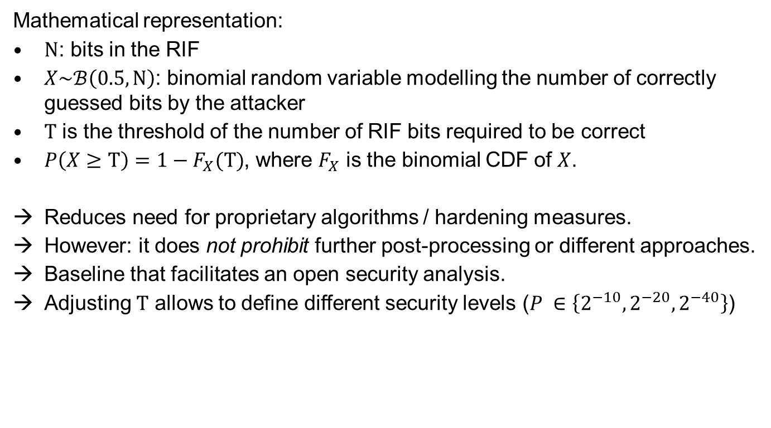
Bit-wise Verification
        doc.:15-23-0403-00-04ab
Mathematical representation:
$N$: bits in the RIF
$X\sim ℬ\left(0.5, N\right)$: binomial random variable modelling the number of correctly guessed bits by the attacker
$T$ is the threshold of the number of RIF bits required to be correct
$P\left(X≥T\right)=1−F_{X}(T)$, where $F_{X}$ is the binomial CDF of $X$.
Reduces need for proprietary algorithms / hardening measures.
However: it does not prohibit further post-processing or different approaches.
Baseline that facilitates an open security analysis.
Adjusting $T$ allows to define different security levels ($P ∈\left\{{2^{−10},2^{−20}, 2}^{−40}\right\}$)

Slide 8
Summary
        doc.:15-23-0403-00-04ab
Low-complexity bit-wise verification scheme
Enables open security analysis
Security and implementation can be largely decoupled
Analyzed and backed up by academic research (slide 11)
To conclude:
Only addition required to the standard: L=16
It is optional

Slide 9
Way forward
        doc.:15-23-0403-00-04ab
  → Add L=16 to the TFD
  Original:
  “Each RIF contains one STS segment with a spreading factor L=4. Each STS segment is of the same length. The length of the STS segment is allowed from the set {32, 64, 128, 256} in the unit of 512 chips.”
Updated:
“Each RIF contains one STS segment with a spreading factor L={4, 16 (optional)}. Each STS segment is of the same length. The length of the STS segment is allowed from the set {32, 64, 128, 256} in the unit of 512 chips.”

Slide 10
IEEE References
        doc.:15-23-0403-00-04ab
Way forward on RIF waveform: https://mentor.ieee.org/802.15/dcn/23/15-23-0327-00-04ab-way-forward-on-rif-waveform.pptx
More on clock-related attacks against UWB ranging: https://mentor.ieee.org/802.15/dcn/23/15-23-0274-00-04ab-more-on-clock-related-attacks-against-uwb-ranging.pptx
Performance analysis of ranging integrity fragment (RIF) with distance commitment: https://mentor.ieee.org/802.15/dcn/22/15-22-0413-00-04ab-performance-analysis-of-ranging-integrity-fragment-rif-with-distance-commitment.pptx
Optional RIF waveform (for TFD draft): https://mentor.ieee.org/802.15/dcn/23/15-23-0166-00-04ab-optional-rif-waveform-for-tfd-draft.docx
Recap and New Considerations on NBA MMS Ranging Integrity Fragments: https://mentor.ieee.org/802.15/dcn/22/15-22-0651-00-04ab-recap-and-new-considerations-on-nba-mms-ranging-integrity-fragments.pptx)
Considerations of the STS in 802.15.4z HRP: https://mentor.ieee.org/802.15/dcn/22/15-22-0544-00-04ab-considerations-of-the-sts-in-802-15-4z-hrp.pptx

Slide 11
Academic References
[1] UWB with Pulse Reordering: Securing Ranging against Relay and Physical-Layer Attacks: https://eprint.iacr.org/2017/1240.pdf
[2] Distance Bounding with IEEE 802.15.4a: Attacks and Countermeasures: https://ieeexplore.ieee.org/stamp/stamp.jsp?tp=&arnumber=5714149
[3] Time for Change: How Clocks Break UWB Secure Ranging: https://arxiv.org/abs/2305.09433
[4] Distance-Bounding Protocols: https://link.springer.com/chapter/10.1007/3-540-48285-7_30
[5] So Near and Yet So Far: Distance-Bounding Attacks in Wireless Networks: https://www.cl.cam.ac.uk/~mgk25/esas2006-distance.pdf

