Slide 1
Project: IEEE P802.15 Working Group for Wireless Personal Area Networks (WPANs)
Submission Title: Discussion on the Issues of Draft D4 comments
Date Submitted: July 2023
Source: Huy Nguyen[Kookmin University], Sang-Kyu Lim[ETRI],Yeong Min Jang [Kookmin University].
Contact: +82-2-910-5068 E-Mail: yjang@kookmin.ac.kr
Re:
Abstract: Discussion on the Issues of Draft D4 comments
Purpose: Discussion on the Issues of Draft D4 comments
Notice: This document has been prepared to assist the IEEE P802.15. It is offered as a basis for discussion and is not binding on the contributing individual(s) or organization(s). The material in this document is subject to change in form and content after further study. The contributor(s) reserve(s) the right to add, amend or withdraw material contained herein.
Release: The contributor acknowledges and accepts that this contribution becomes the property of IEEE and may be made publicly available by P802.15.

Slide 2
Discussion on the Issues of Draft D4 comments

Slide 3
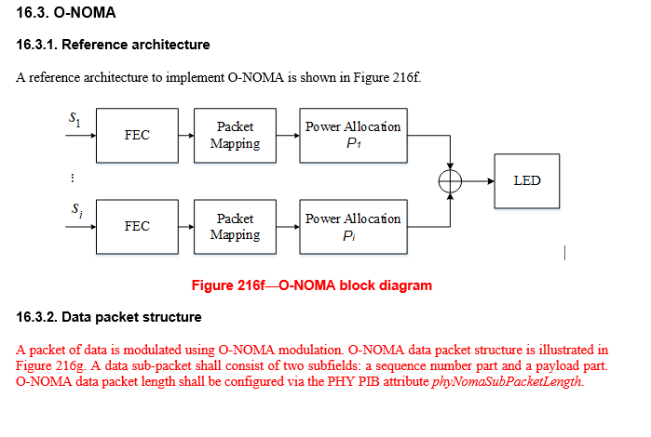
Issue #1: Clause 16

Slide 4
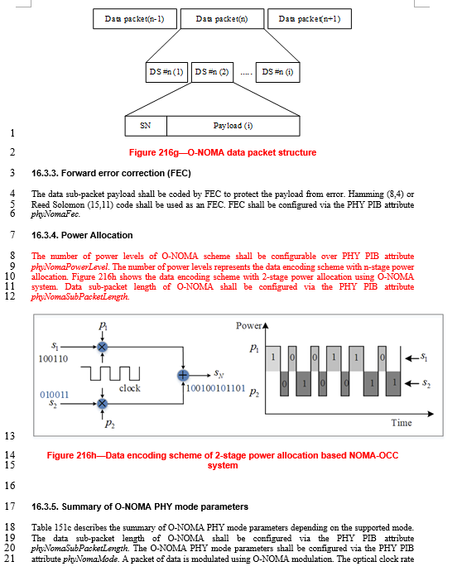
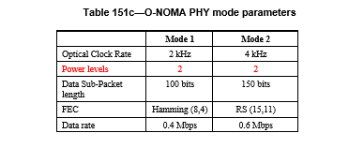
Issue #2: Clause 16

Slide 5
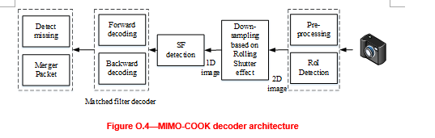
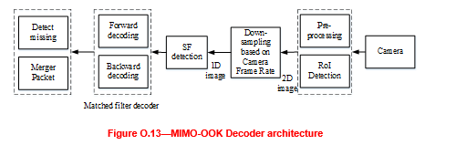
Issue #3: Annex O

Slide 6
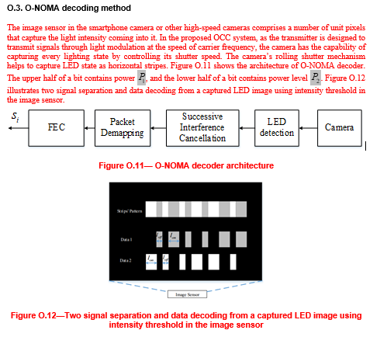
Issue #3: Annex O

Slide 7
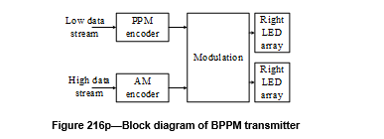
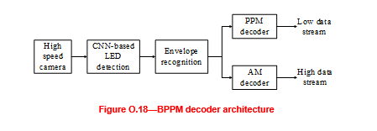
Issue #3: Annex O

