Slide 1
Project: IEEE P802.15 Working Group for Wireless Personal Area Networks (WPANs)
Submission Title: Resolution for CIDs (32, 33, 42, 44, and 49) of the 2nd Recirculation
Date Submitted: July 2023
Source: Huy Nguyen[Kookmin University], Sang-Kyu Lim[ETRI],Yeong Min Jang [Kookmin University].
Contact: +82-2-910-5068 E-Mail: yjang@kookmin.ac.kr
Re:
Abstract: Resolution for CIDs (32, 33, 42, 44, and 49) of the 2nd Recirculation
Purpose: Resolution for CIDs (32, 33, 42, 44, and 49) of the 2nd Recirculation
Notice: This document has been prepared to assist the IEEE P802.15. It is offered as a basis for discussion and is not binding on the contributing individual(s) or organization(s). The material in this document is subject to change in form and content after further study. The contributor(s) reserve(s) the right to add, amend or withdraw material contained herein.
Release: The contributor acknowledges and accepts that this contribution becomes the property of IEEE and may be made publicly available by P802.15.

Slide 2
Resolution for CIDs (32, 33, 42, 44, and 49) of the 2nd Recirculation

Slide 3
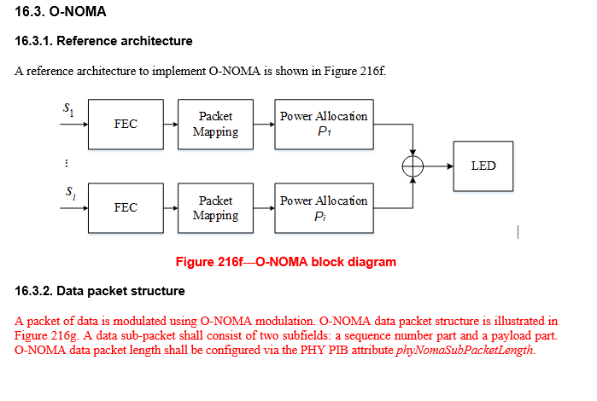
Issue 1: CID 32

Slide 4
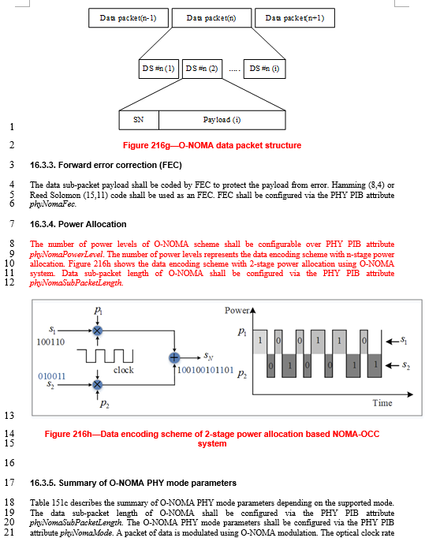
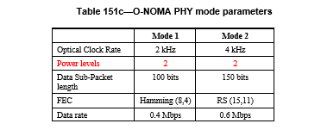
Issue 2: CID 32 and 33

Slide 5
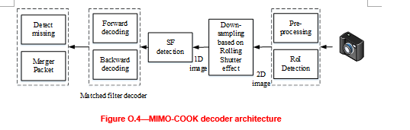
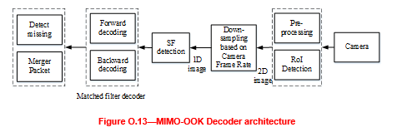
Issue 3: CID 42 and 44

Slide 6
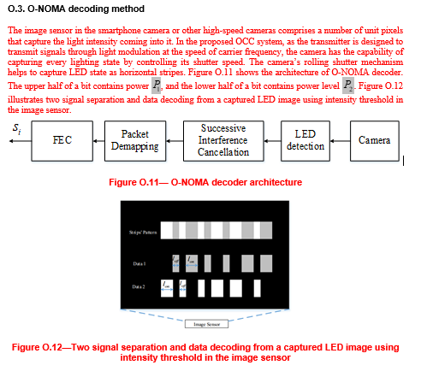
Issue 4: CID 32

Slide 7
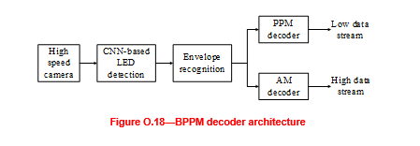
Issue 5: CID 49

