Slide 1
Project: IEEE P802.15 Working Group for Wireless Personal Area Networks (WPANs)
Submission Title: UWB Positioning in 15.6ma for Multiple BAN Adjacent Scenarios
Date Submitted: 07 Nov. 2023
Source: Jeong Gon Kim, Sung Hyun Oh
Company: Tech University of Korea, Republic of Korea
Address: 237 Sangidaehak-ro, Siheung-si, Gyeonggi-do, Republic of Korea
Voice: +82-31-8041-0486, FAX: +82-31-8041-4899, E-Mail: jgkim@tukorea.ac.kr
Re: In response to call for technical contributions
Abstract: This provides a preliminary investigation of UWB positioning in hospital room with ranging error under multiple BAN interference environments.
Purpose: Material for discussion in P802.15.6a TG corresponding to comments in EC Meeting
Notice: This document has been prepared to assist the IEEE P802.15. It is offered as a basis for discussion and is not binding on the contributing individual(s) or organization(s). The material in this document is subject to change in form and content after further study. The contributor(s) reserve(s) the right to add, amend or withdraw material contained herein.
Release: The contributor acknowledges and accepts that this contribution becomes the property of IEEE and may be made publicly available by P802.15.

Slide 2
Introduction
Ranging and Positioning is a key issue in various kinds of UWB applications, including IEEE 802.15.6ma, 4ab, and 4z
UWB techniques have the potential to achieve high positioning accuracy in supporting applications of VBAN and HBAN
It is important to discuss feasibility of UWB positioning with ranging error under the agreed multiple cases of specific BAN channel models

Slide 3
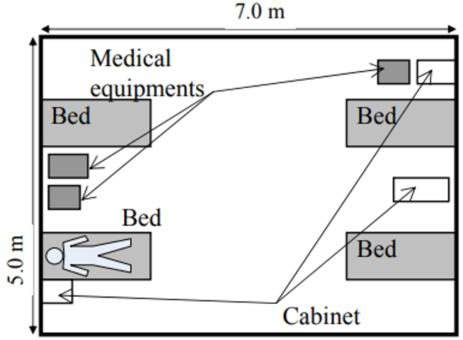
Indoor Model for UWB positioning
: Anchor
Number of Anchor : 2 ~ 4
Room size : 5m * 7m
Number of interference : 0 ~ 2
Layout of the measurement room (a hospital room)
[1] 802.15-23-0353, Preliminary Performance Evaluation of Ranging in Coexistence Environment

Slide 4
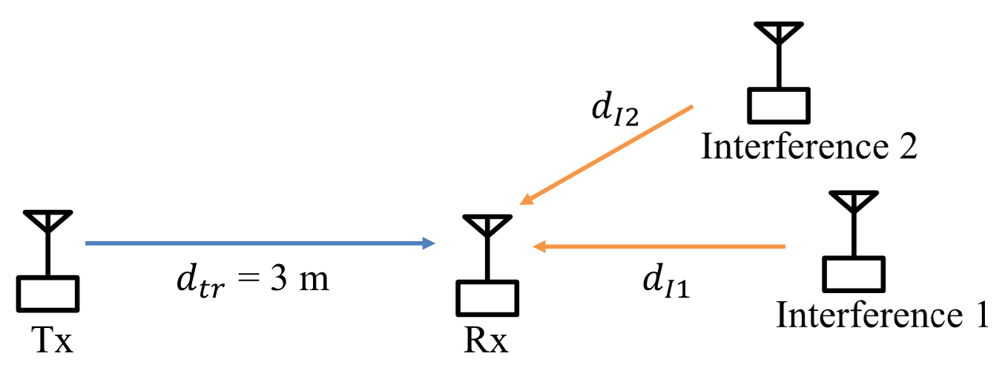
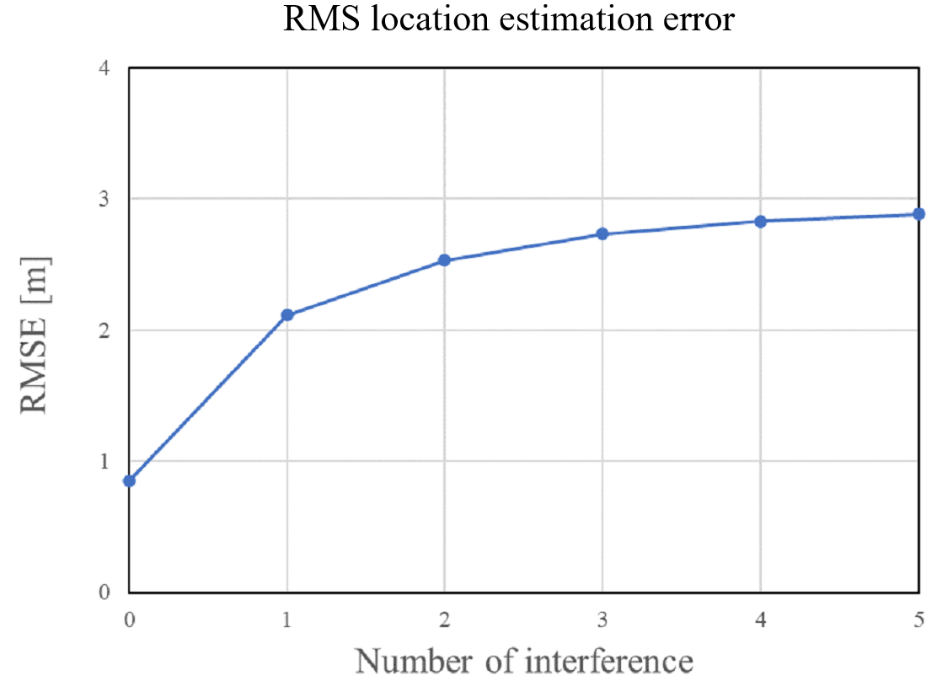
Interference Model for UWB positioning
RMSE [m]
Interference = 0
> approx. 0.9m
Interference = 1
> approx. 2.1m
Interference = 2
> approx. 2.5m
[1] 802.15-23-0353, Preliminary Performance Evaluation of Ranging in Coexistence Environment

Slide 5
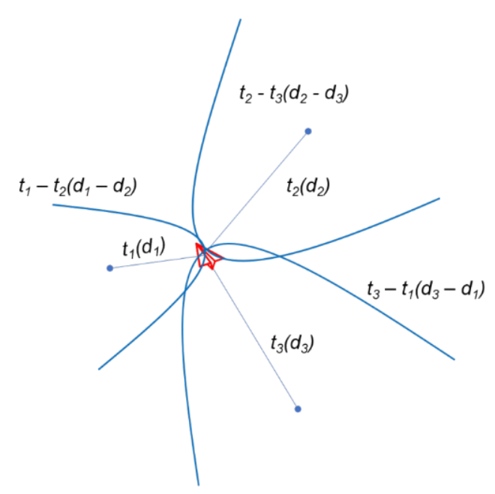

TDOA for UWB positioning
Positioning method by TDOA
$d_{1}−d_{2}= \sqrt{(x_{1}−x_{m})^{2}+(y_{1}−y_{m})^{2} }$
$−$ $\sqrt{(x_{2}−x_{m})^{2}+(y_{2}−y_{m})^{2}}$
$d_{2}−d_{3}=\sqrt{(x_{2}−x_{m})^{2}+(y_{2}−y_{m})^{2} }$
$− \sqrt{(x_{3}−x_{m})^{2}+(y_{3}−y_{m})^{2}}$
$d_{3}−d_{4}=\sqrt{(x_{3}−x_{m})^{2}+(y_{3}−y_{m})^{2} }$
$− \sqrt{(x_{4}−x_{m})^{2}+(y_{4}−y_{m})^{2}}$
Concept of TDOA positioning

Slide 6
Accuracy Evaluation
Interference = 0
Interference = 1
Interference = 2

Slide 7
Results of Evaluation
 | Average RMSE [m]
 | Anchor = 2 | Anchor = 3 | Anchor = 4
Interference = 0 | 3.15 | 0.48 | 0.39
Interference = 1 | 3.16 | 1.25 | 0.51
Interference = 2 | 3.51 | 1.37 | 0.99
Achieve positioning accuracy within 1m when the number of anchors is 4.
If more than 4 anchors are used, stable positioning is possible even if two BAN interference applies to the target mobile.

Slide 8
Conclusion
To examine the UWB positioning, effect of the interference are analyzed in the ranging error from multiple BAN adjacent scenarios.
TDOA is used to obtain the position and anchors must be at least 4 to guarantee the accuracy less than 1m in case of two interfering BAN scenarios.
UWB positioning can be extended to special VBAN scenario, e.g. Digital Car Keys, etc..
To improve final accuracy, methods such as Particle Filters or AI-based positioning can
be applied when the ranging is not fully provided.

