Slide 1
Project: IEEE P802.15 Working Group for Wireless Specialty Networks (WSN)
Submission Title: CIR Report IE format
Date Submitted: 5 November, 2023
Source: Rojan Chitrakar, Lei Huang, Bin Qian, David Xun Yang (Huawei Technologies)
Email: rojan.chitrakar@huawei.com
Abstract: Considerations for CIR Report IE format
Purpose: Considerations for CIR Report IE format
Notice: This document has been prepared to assist the IEEE P802.15. It is offered as a basis for discussion and is not binding on the contributing individual(s) or organization(s). The material in this document is subject to change in form and content after further study. The contributor(s) reserve(s) the right to add, amend or withdraw material contained herein.
Release: The contributor acknowledges and accepts that this contribution becomes the property of IEEE and may be made publicly available by P802.15.
Notes:
Jul 12, 2010
Page 1

Slide 2
PAR Objective | Proposed Solution (how addressed)
Safeguards so that the high throughput data use cases will not cause significant disruption to low duty-cycle ranging use cases
Interference mitigation techniques to support higher density and higher traffic use cases
Other coexistence improvement
Backward compatibility with enhanced ranging capable devices (ERDEVs)
Improved link budget and/or reduced air-time
Additional channels and operating frequencies
Improvements to accuracy / precision / reliability and interoperability for high-integrity ranging
Reduced complexity and power consumption
Hybrid operation with narrowband signaling to assist UWB
Enhanced native discovery and connection setup mechanisms
Sensing capabilities to support presence detection and environment mapping | Flexible format for CIR Report IE to support various sensing scenarios with reduced signaling overhead
Low-power low-latency streaming
Higher data-rate streaming allowing at least 50 Mbit/s of throughput
Support for peer-to-peer, peer-to-multi-peer, and station-to-infrastructure protocols
Infrastructure synchronization mechanisms

Slide 3
CIR Report IE (D0 + 23/496r1)

Slide 4
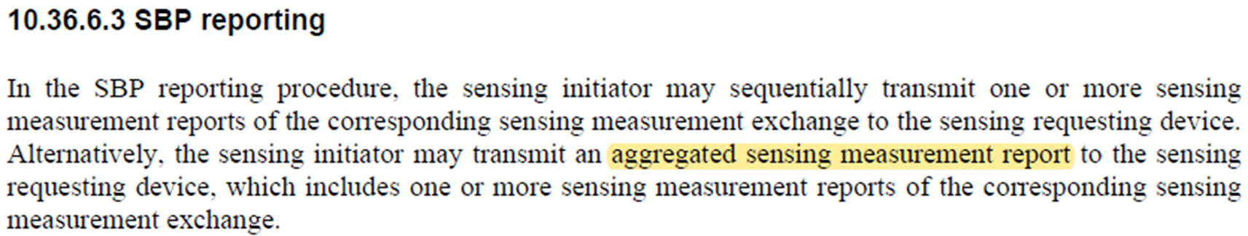
SBP Reporting
The (aggregated) sensing measurement report may carry reports from a single sensing responder or multiple sensing responders.

Slide 5
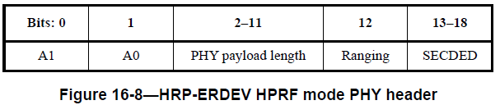
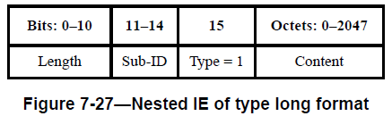
PHY payload lengths and IE lengths
HRP-UWB PPDU:
When A1 and A0 are used to signal an additional gap between the payload and the STS:
Max PSDU length = 1023 octets
Nested IE:
Max IE length = 2047 octets
Each Receive Report field can be up to 1027-octets per receive antenna and segment pair (assuming 32 octet CIR bitmap, 16-bits per I and Q) => Very likely that a CIR Report cannot fit into a single PPDU.

Slide 6
Proposed CIR Report IE
Bits: 0-1 | 2-3 | 4-13 | 14-15 | 16 | 17-23 | Octets:4/8/16/32
Number of Rx Antennas | Bitmap Length | Bitmap Offset | Number of Segments | Compression | Reserved | CIR Bitmap
CIR Report IE content
Octets: 2 or 4 or 10 | 0/7/11/19/36 | Variable
Report Identity Control | Report Parameters Control | Receive Report(s)
Bits: 0-1 | 2 | 3-7 | Octets:1 | 0/2/8
Responder Address Mode | First Report Fragment | Remaining Report Fragments | Measurement ID | Responder Address
Bits: 0-5 | 6-9 | 10-11 | 12-13 | 14-15 | Octets: 1 | Variable
Timing Offset | Normalization Factor | Rx Antenna ID | Segment ID | Reserved | RSSI | CIR Taps
New fields are highlighted in bold letters.

Slide 7
Report Identity Control field (1/3)
CIR Report IE content
Octets: 2 or 4 or 10 | 0/7/11/19/36 | Variable
Report Identity Control | Report Parameters Control | Receive Report(s)
Bits: 0-1 | 2 | 3-7 | Octets:1 | 0/2/8
Responder Address Mode | First Report Fragment | Remaining Report Fragments | Measurement ID | Responder Address
Report Identification:
Measurement ID (MID): A unique ID that identifies a particular sensing measurement instance. The MID can be used by the sensing initiator to identify reports corresponding to a particular sensing measurement instance.

Slide 8
Report Identity Control field (2/3)
CIR Report IE content
Octets: 2 or 4 or 10 | 0/7/11/19/36 | Variable
Report Identity Control | Report Parameters Control | Receive Report(s)
Bits: 0-1 | 2 | 3-7 | Octets:1 | 0/2/8
Responder Address Mode | First Report Fragment | Remaining Report Fragments | Measurement ID | Responder Address
Report fragmentation:
When the CIR report is too large to fit in a single CIR Report IE, the report is split into multiple fragments.
First Report Fragment: Set to 1 for the 1st report fragment or for an unfragmented report and set 0 otherwise.
Remaining Report Fragments: Indicates the number of remaining report fragments. Set to 0 for the last report fragment or an unfragmented report. Set to a value between 1 and 31 for a report fragment that is not the last fragment.

Slide 9
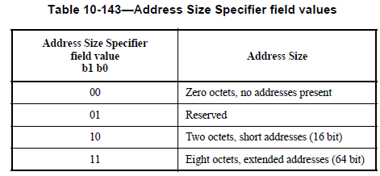
Report Identity Control field (3/3)
CIR Report IE content
Octets: 2 or 4 or 10 | 0/7/11/19/36 | Variable
Report Identity Control | Report Parameters Control | Receive Report(s)
Bits: 0-1 | 2 | 3-7 | Octets:1 | 0/2/8
Responder Address Mode | First Report Fragment | Remaining Report Fragments | Measurement ID | Responder Address
Responder Address:
Responder Address Mode: Indicates the presence and size of the Responder Address field.
Responder Address: Identifies the sensing responder that generated the CIR report.
This addresses comment #40 on D0:
Responder Address Mode
Name | Sub-Clause | Page.Line | Comment | Proposed Change
Li-Hsiang Sun | 10.36.6.3 | 76.19 | what is the message/IE used to send report? | add an address field in CIR report IE for initiator identity different responders to the SBP requesting device

Slide 10
Report Parameters Control field
Bits: 0-1 | 2-3 | 4-13 | 14-15 | 16 | 17-23 | Octets:4/8/16/32
Number of Rx Antennas | Bitmap Length | Bitmap Offset | Number of Segments | Compression | Reserved | CIR Bitmap
CIR Report IE content
Octets: 2 or 4 or 10 | 0/7/11/19/36 | Variable
Report Identity Control | Report Parameters Control | Receive Report(s)
Report Parameters Control:
Carries report parameters that are common to all reports with the same Measurement ID.
When a CIR report is fragmented, the Report Parameters Control field is only present in the first fragment (i.e., when the First Report Fragment bit is set to 1) and absent in the rest of the fragments.

Slide 11
Receive Report(s) field
CIR Report IE content
Octets: 2 or 4 or 10 | 0/7/11/19/36 | Variable
Report Identity Control | Report Parameters Control | Receive Report(s)
The below two fields are relevant only when the report is fragmented and identify the receive report of a specific Rx antenna, segment pair. The fields are reserved for a report that is not fragmented.
Rx Antenna ID: ID of the receive antenna corresponding to the CIR taps
Segment ID: ID of the Sensing PPDU SENS segment corresponding to the CIR taps
Bits: 0-5 | 6-9 | 10-11 | 12-13 | 14-15 | Octets: 1 | Variable
Timing Offset | Normalization Factor | Rx Antenna ID | Segment ID | Reserved | RSSI | CIR Taps

Slide 12
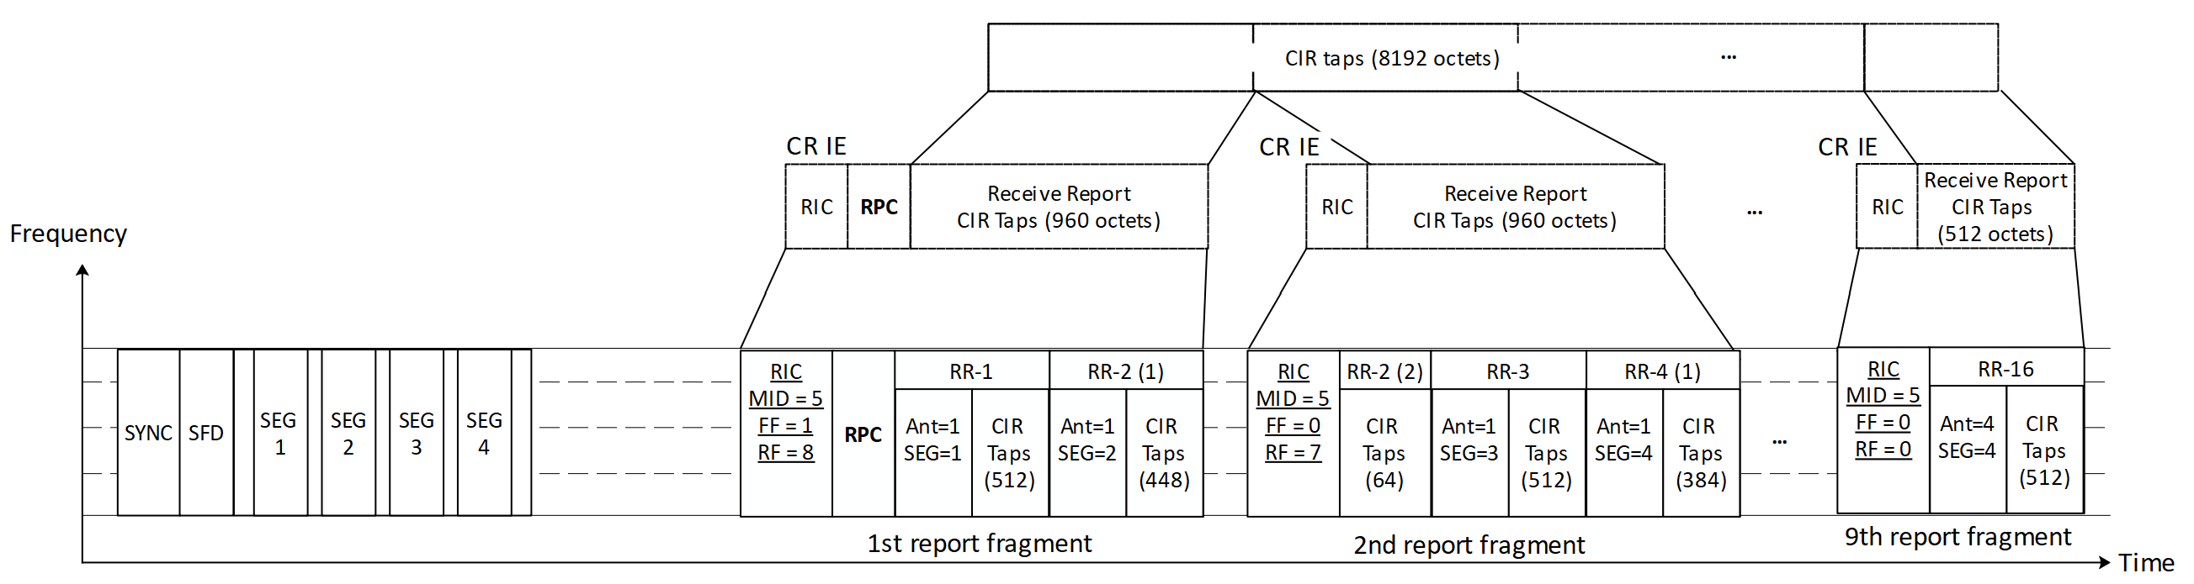
An example
Transmitter: SENS PPDUs with four segments
Receiver: Four receive antennas
16 Receive Reports (512 octets each) carried in 9 report frames (fragments)

Slide 13
Summary
We proposed a flexible format for the CIR Report IE to support various sensing scenarios with reduced signaling overhead. The following changes were proposed:
Include a Report Identity Control field to identify a report frame and its fragments (when fragmented) as well as the source sensing responder.
The common report parameters (Report Parameters Control field) is only present in the first fragment and is omitted in subsequent fragments.
Include Rx Antenna ID and Segment ID fields in each Receive Report field of a fragmented report to identify the receive report of a specific Rx antenna, segment pair.

Slide 14
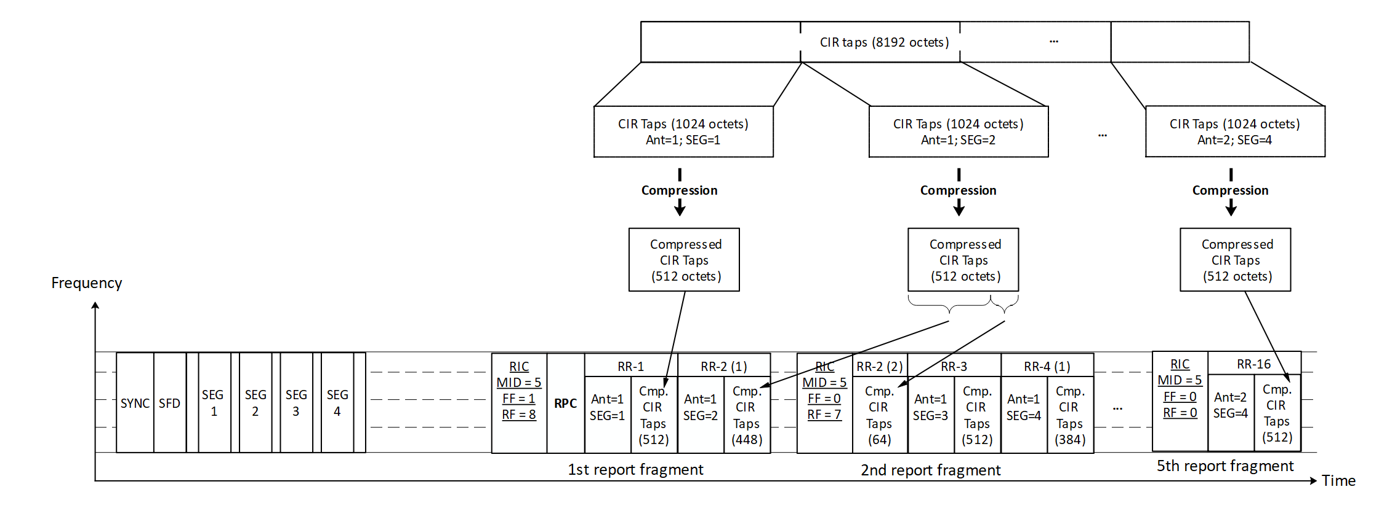
Annex I – example with compression
Transmitter: SENS PPDUs with four segments
Receiver: Two receive antennas
8 Receive Reports (1024 octets each) carried in 5 report frames (fragments)

