Slide 1
Project: IEEE P802.15 Working Group for Wireless Personal Area Networks (WPANs)
Submission Title: Current status of IEEE 802.15.7a Task Group
Date Submitted: November 2023
Source: Yeong Min Jang, Sangsung Choi, Huy Nguyen[Kookmin University].
Contact: +82-2-910-5068 E-Mail: yjang@kookmin.ac.kr
Re:
Abstract: Current status of IEEE 802.15.7a Task Group
Purpose: Current status of IEEE 802.15.7a Task Group
Notice: This document has been prepared to assist the IEEE P802.15. It is offered as a basis for discussion and is not binding on the contributing individual(s) or organization(s). The material in this document is subject to change in form and content after further study. The contributor(s) reserve(s) the right to add, amend or withdraw material contained herein.
Release: The contributor acknowledges and accepts that this contribution becomes the property of IEEE and may be made publicly available by P802.15.

Slide 2
Current status of IEEE 802.15.7a Task Group

Slide 3
Scope of task group
IEEE 802.15.7a Task Group amendment specifies a high-rate Optical Camera Communications (OCC) Physical Layer (PHY) using light wavelengths from 10.000 nm to 190 nm in optically transparent media.
It is capable of delivering data rates and is designed for point-to-point and point-to-multipoint communication.
Maintaining connectivity during high mobility.
Flicker mitigation.
Radio Frequency (RF) co-existence, and a communication range.
Multiple-Input-Multiple-Output (MIMO) is utilized to deal with high-levels of optical interference while maintaining high-rate data transmission.

Slide 4
Purpose of task group
IEEE 802.15.7a standard provides:
Access to unlicensed spectrum.
Inherent communication security due to inability to penetrate through optically opaque walls.
Data delivery without using RF spectrum.
Apply MIMO and Artificial intelligence (AI)-based PHY and MAC layers.
Communication augmenting and complementing existing services (such as illumination, indication, localization, etc.)

Slide 5
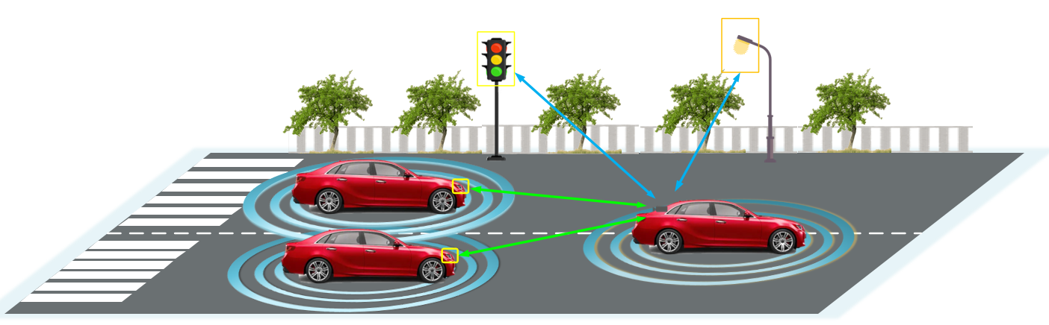
Technologies applied to IEEE 802.15.7a TG:
OFDM technology
MIMO and NOMA technologies
Deep Learning based OCC
Hybrid technology

Slide 6
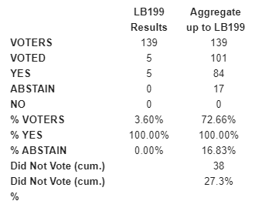
Results of 4th Letter Ballot Recirculation for the P802.15.7a
(Letter Ballot #199 concluded on Oct. 6, 2023)
The ballot meets quorum and passes with a 100% rate.
And 0 comments were submitted against the draft D6 document
➔ We expected to start SB (Sponsor Ballot) on November Meeting

Slide 7
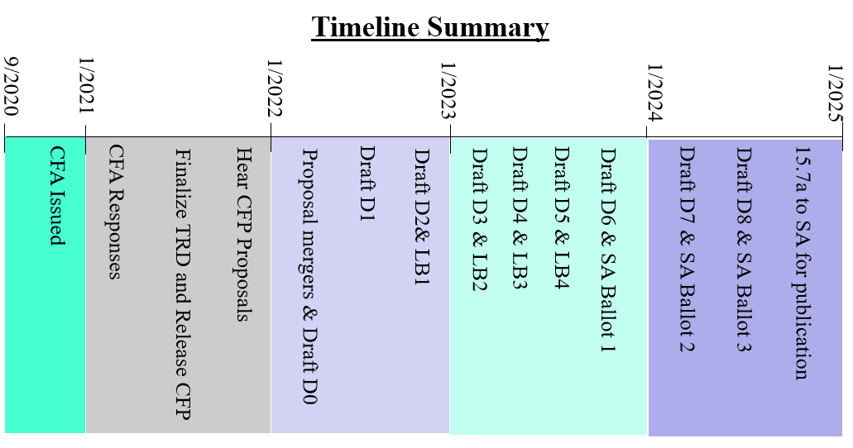
Current status of IEEE 802.15.7a Higher Rate, Longer Range OCC TG:
Currently, the Draft standard (D6) is in stage the 4th Letter Ballot Recirculation and is expected to start SB (Sponsor Ballot) on November 2023
It is hoped that the standard will be finalized by the middle of 2024
Suggested 15.7a Schedule and Milestones (May 2023)

