Slide 1
Project: IEEE P802.15 Working Group for Wireless Personal Area Networks (WPANs)
Submission Title: [Use cases for Next Generation SUN]
Date Submitted: 15 Nov. 2023
Source: Hiroshi Harada (Kyoto University)
Address Yoshidahonmachi. Sakyo, Kyoto, 606-8501, Japan
Voice: +81-75-753-5317 , E-Mail: hiroshi.harada@i.kyoto-u.ac.jp
Re: [Wireless Next Generation, Long Range extension enhancements to 802.15.4-2020]
Abstract: Propose use cases based on the PER evaluation of SUN-OFDM with mobility support.
Purpose: Provide basic information for extending SUN-PHYs
Notice: This document has been prepared to assist the IEEE P802.15. It is offered as a basis for discussion and is not binding on the contributing individual(s) or organization(s). The material in this document is subject to change in form and content after further study. The contributor(s) reserve(s) the right to add, amend or withdraw material contained herein.
Release: The contributor acknowledges and accepts that this contribution becomes the property of IEEE and may be made publicly available by P802.15.

Slide 2
Use cases for Next Generation SUN
Nov. 15, 2023
Hiroshi Harada, Ph.D.

Slide 3
Expected use cases of IEEE 802.15.4 SUN (15-23-0390)
H. Harada, K. Mizutani, J. Fujiwara, K. Mochizuki, K. Obata, and R. Okumura, “IEEE 802.15.4g based Wi-SUN Communication Systems,” IEICE Transactions on Communications (Open Access), E100-B, No. 07, pp. 1032–1043, Jul. 2017.

Slide 4
Expected use cases of IEEE 802.15.4 SUN (15-23-0390)
H. Harada, K. Mizutani, J. Fujiwara, K. Mochizuki, K. Obata, and R. Okumura, “IEEE 802.15.4g based Wi-SUN Communication Systems,” IEICE Transactions on Communications (Open Access), E100-B, No. 07, pp. 1032–1043, Jul. 2017.

Slide 5
Main Parameters of IEEE 802.15.4 SUN-OFDM
Parameters |  | Option 1 | Option 2 | Option 3 | Option 4
Nominal bandwidth (kHz) |  | 1094 | 552 | 281 | 156
Channel spacing (kHz) |  | 1200 | 800 | 400 | 200
DFT size |  | 128 | 64 | 32 | 16
Number of data-subcarriers |  | 96 | 48 | 24 | 12
Number of pilot-subcarriers |  | 8 | 4 | 2 | 2
Cyclic prefix length |  | 1/4 (24 µs)
Primary modulation scheme |  | BPSK (MCS 0-1), QPSK (MCS 2-4) 16QAM (MCS 5-6)
Coding scheme and rate |  | Convolutional code (Constraint length:7), Coding rate:1/2 (MCS 0-3,5), 3/4 (MCS 4,6)
Spreading factor |  | 4(MCS 0), 2(MCS 1-2), 1(MCS 3-6)
Data rate for PSDU (kbps) | MCS 0 | 100 | 50 | 25 | 12.5
 | MCS 1 | 200 | 100 | 50 | 25
 | MCS 2 | 400 | 200 | 100 | 50
 | MCS 3 | 800 | 400 | 200 | 100
 | MCS 4 | 1200 | 600 | 300 | 150
 | MCS 5 | 1600 | 800 | 400 | 200
 | MCS 6 | 2400 | 1200 | 600 | 300
(Option, MCS)=(4,0)
Need more distance
(Option, MCS)=(1,6)
Need more data rate
K. Nakura, H. Masaki, H. Harada, “Performance Evaluation of IEEE 802.15.4 SUN OFDM in VHF-bandfor Super-large Coverage Communication Systems ”, IEEE WF-IoT, Oct. 2023
(Option, MCS)=(3,x) Extension of current smart metering system

Slide 6
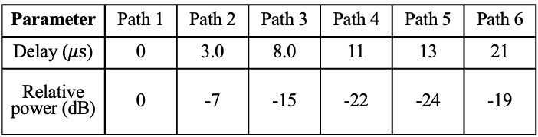
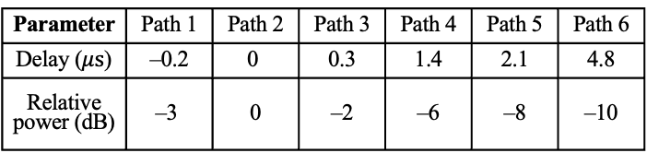
Analysis of PER performance
Simulation parameters
Multipath Channel model
Parameters | Values
Option, MCS | (1,6), (3, 3), (3, 4), (3, 5), (3, 6), (4,0)
Oversampling | 16 samples
PSDU length | 250 octets
Center frequency | 175MHz
Decoding scheme | Viterbi (Soft decision)
Channel estimation Mobility support | LTF + pilot+[1],[2]
Interleaver | ON
Channel model | GSM Typical Urban/ IEEE 802.22 profile A
Moving speed | 0, 40, 80 km/h
Antenna | Tx: 1, Rx: 2 (MRC diversity)
Required PER | 10⁻¹
(a) GSM typical urban model
Parameter | Path 1 | Path 2 | Path 3 | Path 4 | Path 5 | Path 6
Delay ($μs$) | –0.2 | 0 | 0.3 | 1.4 | 2.1 | 4.8
Relative power (dB) | –3 | 0 | –2 | –6 | –8 | –10
(b) IEEE 802.22 profile A model
Parameter | Path 1 | Path 2 | Path 3 | Path 4 | Path 5 | Path 6
Delay ($μs$) | 0 | 3.0 | 8.0 | 11 | 13 | 21
Relative power (dB) | 0 | ­­-7 | -15 | -22 | -24 | -19
[1] S. Kadoi, H. Ochiai, R. Okumura, K. Mizutani, H. Harada, “IEEE 802.15. 4g/4x-based Orthogonal Frequency Division Multiplexing Transmission Scheme for Wide Area and Mobile IoT Communication Systems”, IEEE Internet of Things Journal, Dec. 2021
[2] K. Nakura, H. Masaki, H. Harada, “Performance Evaluation of IEEE 802.15.4 SUN OFDM in VHF-band for Super-large Coverage Communication Systems ”, IEEE WF-IoT, Oct. 2023

Slide 7
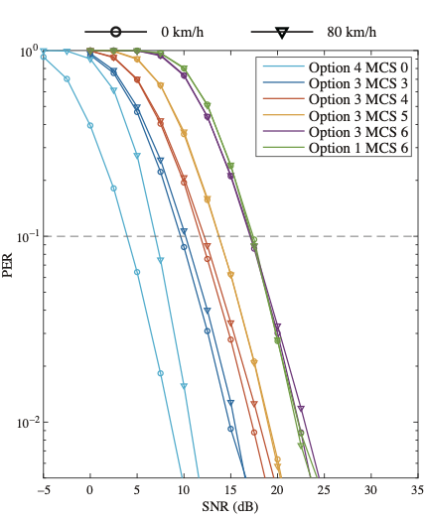
PER performance
(a) GSM typical urban model
(b) IEEE 802.22 profile A model
K. Nakura, H. Masaki, H. Harada, “Performance Evaluation of IEEE 802.15.4 SUN OFDM in VHF-band for Super-large Coverage Communication Systems ”, IEEE WF-IoT, Oct. 2023

Slide 8
Required SNR to achieve required PER
Parameters |  |  | Required SNR to achieve required PER=10⁻¹ [dB]
 |  |  | Vehicular speed (km/h)
Chanel model | Option, MCS | Data rate (kbps) | 0 | 40 | 80
GSM typical urban | (4, 0) | 12.5 | 3.9 | 6.4 | 6.9
 | (3, 3) | 200 | 9.6 | 9.8 | 10.2
 | (3, 4) | 300 | 11.8 | 11.8 | 12.1
 | (3, 5) | 400 | 13.7 | 13.6 | 13.7
 | (3, 6) | 600 | 17.1 | 16.9 | 17.1
 | (1, 6) | 2400 | 17.4 | 17.0 | 17.2
IEEE 802.22 profile A | (4, 0) | 12.5 | 3.6 | 5.3 | 5.6
 | (3, 3) | 200 | 10.0 | 9.8 | 10.2
 | (3, 4) | 300 | 12.4 | 12.1 | 12.4
 | (3, 5) | 400 | 14.0 | 13.6 | 14.0
 | (3, 6) | 600 | 18.0 | 17.6 | 17.8
 | (1, 6) | 2400 | 24.8 | 23.2 | 23.6
K. Nakura, H. Masaki, H. Harada, “Performance Evaluation of IEEE 802.15.4 SUN OFDM in VHF-band for Super-large Coverage Communication Systems ”, IEEE WF-IoT, Oct. 2023

Slide 9
Transmission distance estimation
By using the required PER, transmission range is calculated
The calculation is based on super-wide area communication in VHF band
Areas 1, 2, 3, and 4 are rural, suburban, small- and medium-sized cities, and metropolitan environments [1]
The calculation is based on [2]
Parameters |  | Values
Carrier Frequency |  | 175 MHz
BS | Height | 60 m
 | TX power | 37 dBm
 | TX antenna gain | 3 dB
UE | Height | 1.1 m
 | RX antenna gain | 0 dB
 | Noise figure | 4 dB
 | Temperature | 300 K
Propagation model |  | Okumura-Hata Model
Fading margin |  | 5 dB
[1] M. Hata, “Empirical Fomula for Propagation Loss in Land Mobile Radio Services,” IEEE Trans. on Vehicular Technology, vol. VT-29, no. 3, pp.317-325, Aug. 1980
[2] K. Nakura, H. Masaki, H. Harada, “Performance Evaluation of IEEE 802.15.4 SUN OFDM in VHF-band for Super-large Coverage Communication Systems ”, IEEE WF-IoT, Oct. 2023

Slide 10
Transmission distance of SUN OFDM
Vehicular speed= 0km/h
K. Nakura, H. Masaki, H. Harada, “Performance Evaluation of IEEE 802.15.4 SUN OFDM in VHF-bandfor Super-large Coverage Communication Systems ”, IEEE WF-IoT, Oct. 2023
Parameters |  |  | Transmission distance [km]
 |  |  | Area
Chanel model | Option, MCS | Data rate (kbps) | 1 | 2 | 3 | 4
GSM typical urban | (4, 0) | 12.5 | 106.3 | 32.3 | 20.3 | 20.5
 | (3, 3) | 200 | 58.1 | 17.7 | 11.1 | 11.2
 | (3, 4) | 300 | 49.9 | 15.2 | 9.6 | 9.6
 | (3, 5) | 400 | 43.8 | 13.3 | 8.4 | 8.4
 | (3, 6) | 600 | 34.6 | 10.5 | 6.6 | 6.7
 | (1, 6) | 2400 | 24.3 | 7.4 | 4.7 | 4.7
IEEE 802.22 profile A | (4, 0) | 12.5 | 108.5 | 33.0 | 20.8 | 20.9
 | (3, 3) | 200 | 56.5 | 17.2 | 10.8 | 10.9
 | (3, 4) | 300 | 47.9 | 14.5 | 9.2 | 9.2
 | (3, 5) | 400 | 42.9 | 13.0 | 8.2 | 8.3
 | (3, 6) | 600 | 32.5 | 9.9 | 6.2 | 6.3
 | (1, 6) | 2400 | 14.6 | 4.4 | 2.8 | 2.8
Vehicular speed= 80 km/h
Parameters |  |  | Transmission distance [km]
 |  |  | Area
Chanel model | Option, MCS | Data rate (kbps) | 1 | 2 | 3 | 4
GSM typical urban | (4, 0) | 12.5 | 86.3 | 26.2 | 16.5 | 16.6
 | (3, 3) | 200 | 55.8 | 16.9 | 10.7 | 10.8
 | (3, 4) | 300 | 48.9 | 14.9 | 9.4 | 9.4
 | (3, 5) | 400 | 43.8 | 13.3 | 8.4 | 8.4
 | (3, 6) | 600 | 34.3 | 10.4 | 6.6 | 6.6
 | (1, 6) | 2400 | 24.7 | 7.5 | 4.7 | 4.8
IEEE 802.22 profile A | (4, 0) | 12.5 | 94.5 | 28.7 | 18. | 18.2
 | (3, 3) | 200 | 55.8 | 16.9 | 10.7 | 10.7
 | (3, 4) | 300 | 47.9 | 14.5 | 9.2 | 9.2
 | (3, 5) | 400 | 42.9 | 13.0 | 8.2 | 8.3
 | (3, 6) | 600 | 32.9 | 10.0 | 6.3 | 6.3
 | (1, 6) | 2400 | 15.8 | 4.8 | 3.0 | 3.1

Slide 11
Update use cases
Red: update part
Category | (a) Indoor communication | (b) Wide area open space communication | (c) Wide area urban area communication |  | (d) Wide area mobile communication
Applications | Sensor, meter and/or monitor network for Industry, Medical environment, and so on | Sensor, meter and/or monitor network for Energy management, Agriculture, disaster prevention, animal husbandry, and so on | Information distribution, digital signage to building and store Sensing, surveillance, and monitoring for building and store (smart city) Sensing and monitoring from smartphone via Wi-SUN router |  | Collection of sensing data from vehicles such as car and bus Control and management of vehicles
Frequency , Typical data rate | Sub-GHz bands (mainly 800-900 MHz bands), VHF (150-250 MHz) several kbps- several Mbps | Sub-GHz bands (mainly 800-900 MHz bands), VHF (150-250 MHz) several kbps- several Mbps
TX power | AP：several tens mW- several W Terminal: several tens mW | AP：several tens mW- several W Terminal: several tens mW | AP：20 mW, 250 mW Terminal, router: 20 mW |  | AP：20 mW, 250 mW Terminal: 20 mW
Antenna configuration | AP TX: Compliant with regulation in each region AP RX: Multiple antennas. Diversity reception may be used. Terminal: Compliant with regulation in each region | AP TX: Compliant with regulation in each region AP RX: Multiple antennas. Diversity reception may be used. Terminal: Compliant with regulation in each region
Antenna height | < 2m | > 4 m
Coverage area | < several 10m | 1 km-5 km | 100 m-2 km | 100 m-2 km
Radio propagation | Line-of-sight | Line-of-sight | Non line-of-sight | Non line-of sight
Path-loss model | Need to propose | Okumura-Hata model | Walfisch-Ikegami model | Walfisch-Ikegami model
Fading model | Multipath fading (maximum delay time :several 10 ns) | Multipath fading (maximum delay time :several µs) | Multipath fading (maximum delay time :several 10 µs)
Terminal radio devices | Fixed installation | Fixed installation | Fixed installation Vehicle speed: 4-40 km/h | Installation in vehicle Vehicle speed: 40-80 km/h
Multi-hop support | May be needed to extend its coverage area and/or to keep high reliability. | May be needed to extend its coverage area and/or to keep high reliability.

