Slide 1
Project: IEEE P802.15 Working Group for Wireless Specialty Networks (WSN)
Submission Title: Frequency stitching in ranging
Source: Bin Qian, Chenchen Liu, Lei Huang, Rojan Chitrakar, David Xun Yang (Huawei Technologies), Frank Leong, Riku Pirhonen, Wolfgang Küchler, Bernhard Großwindhager (NXP Semiconductors)
Address : [Huawei Bantian Base, Longgang District, Shenzhen, 518129 China]
E-Mail: [qianbin14@huawei.com]
Re: Task Group 4ab: UWB Next Generation for 802.15.4
Abstract: [UWB, frequency stitching, ranging]
Purpose:
Notice: This document has been prepared to assist the IEEE P802.15. It is offered as a basis for discussion and is not binding on the contributing individual(s) or organization(s). The material in this document is subject to change in form and content after further study. The contributor(s) reserve(s) the right to add, amend or withdraw material contained herein.
Release: The contributor acknowledges and accepts that this contribution becomes the property of IEEE and may be made publicly available by P802.15.
Notes:
Jul 12, 2010
Page 1

Slide 2
PAR Objective | Proposed Solution (how addressed)
Safeguards so that the high throughput data use cases will not cause significant disruption to low duty-cycle ranging use cases
Interference mitigation techniques to support higher density and higher traffic use cases
Other coexistence improvement
Backward compatibility with enhanced ranging capable devices (ERDEVs)
Improved link budget and/or reduced air-time
Additional channels and operating frequencies
Improvements to accuracy / precision / reliability and interoperability for high-integrity ranging | Applying frequency stitching in ranging applications
Reduced complexity and power consumption
Hybrid operation with narrowband signaling to assist UWB
Enhanced native discovery and connection setup mechanisms
Sensing capabilities to support presence detection and environment mapping
Low-power low-latency streaming
Higher data-rate streaming allowing at least 50 Mbit/s of throughput
Support for peer-to-peer, peer-to-multi-peer, and station-to-infrastructure protocols
Infrastructure synchronization mechanisms

Slide 3
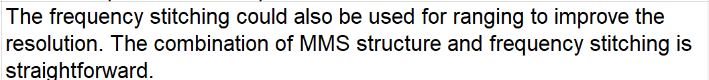
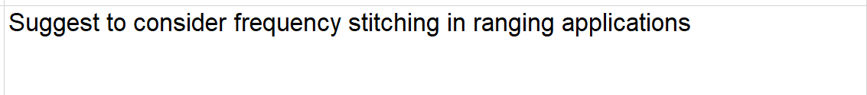
Comment
Comment (CID #407)
Proposed change

Slide 4
Background
In Pre-ballot Draft C, the frequency stitching has been adopted as an optional feature in sensing, which could aggregate multiple sensing fragments to achieve the larger effective bandwidth to improve the sensing performance
As a powerful tool, the frequency stitching could also be used in ranging to improve the resolution
The larger effective bandwidth results in shorter UWB pulses, due to the inverse relationship between time and bandwidth. This means the time resolution is higher, enabling more accurate determination of ToF.
  This is particularly useful when the earliest detected pulse overlaps with the following pulses
Sensing performance may depend on the accuracy with which sensing devices can locate each other. Therefore, frequency stitching in ranging is expected to improve the sensing performance.

Slide 5
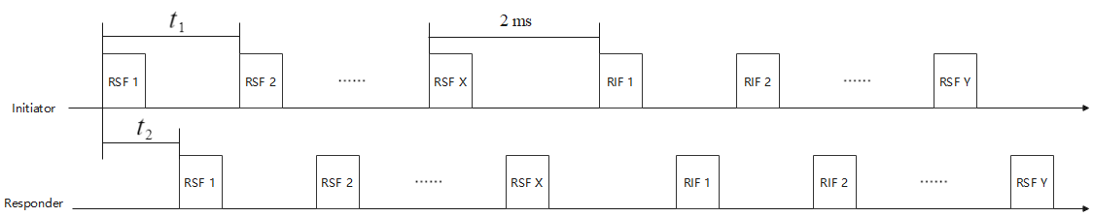
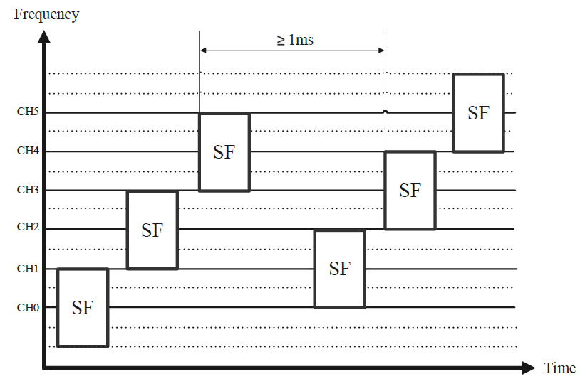

Recap
MMS ranging
  $t_{1}=1200 RSTUs$, i.e., 1ms, $t_{2}=600 RSTUs$
Frequency stitching in sensing
  Different sensing fragments (e.g., sensing packet, sensing segment in the sensing field) are transmitted on different UWB channels
  Each channel is used only by one sensing fragment

Slide 6
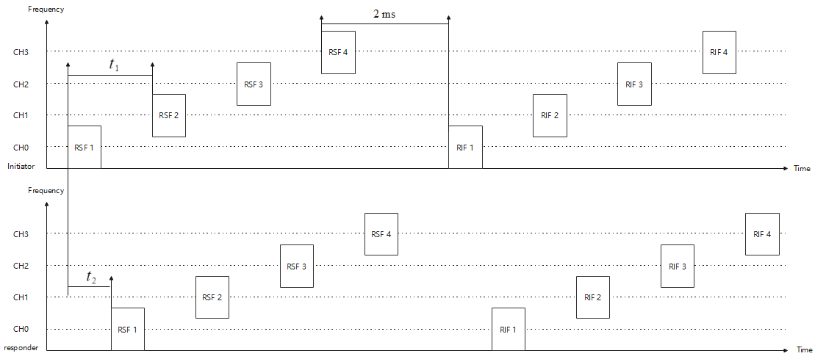
Combination of Frequency Stitching and MMS
Each channel is only used by one RSF and one RIF
Both the initiator and the responder will follow the same channel order sequence

Slide 7
Considerations
To introduce frequency stitching into the MMS ranging, several aspects needs to be considered
  MMS timing parameters
  Ranging measurement report
  Configurations of frequency stitching parameters
  Device capability

Slide 8
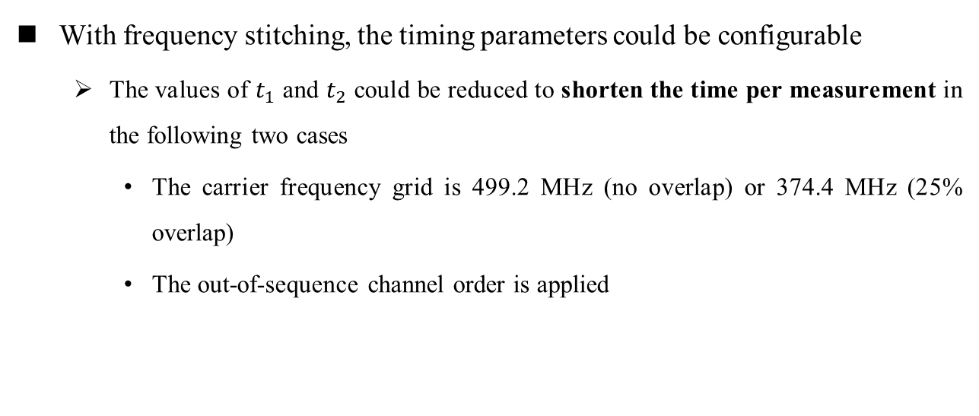
MMS Timing Parameters Considerations
With frequency stitching, the timing parameters could be configurable
  The values of $t_{1}$ and $t_{2}$ could be reduced to shorten the time per measurement in the following two cases
    The carrier frequency grid is 499.2 MHz (no overlap) or 374.4 MHz (25% overlap)
    The out-of-sequence channel order is applied

Slide 9
Ranging Measurement Report Considerations
Both the initiator and the responders shall generate the timestamps based on the aggregated channel
There is no change to the existing report format

Slide 10
Frequency Stitching Parameters Configurations
Method 1 (via AC IE): MMS ranging configuration field of the AC IE
Method 2 (via Compact frame): The Ranging PHY Config field
Bits: 0-2 | 3-5 | 6-11 | 12-18 | 19-21 | 22-23 | 24-27 | 28 | 29-31 | Octets: 0/1
Number of RSF | Number of RIF | Preamble Code Index | MMRS Gap Size | MSR For MMRS | STS Segment Length | UWB Channel | MMS Frequency Stitching Enable | Reserved | MMS Frequency Stitching Parameters
Bits: 0-5 | 6-12 | 13-15 | 16-17 | 18-21 | 22 | 23 | Octets: 0/1
Sequence Code Index | MMRS Complementary Set Zeroes | N_MSR | STS Segment Length | UWB Channel | MMS Frequency Stitching Enable | Reserved | MMS Frequency Stitching Parameters
The MMS Frequency Stitching Enable field where one indicates that frequency stitching is enabled and the presence of the MMS Frequency Stitching Parameters field, and where zero indicates that frequency stitching is disabled and the MMS Frequency Stitching Parameters field is not present

Slide 11
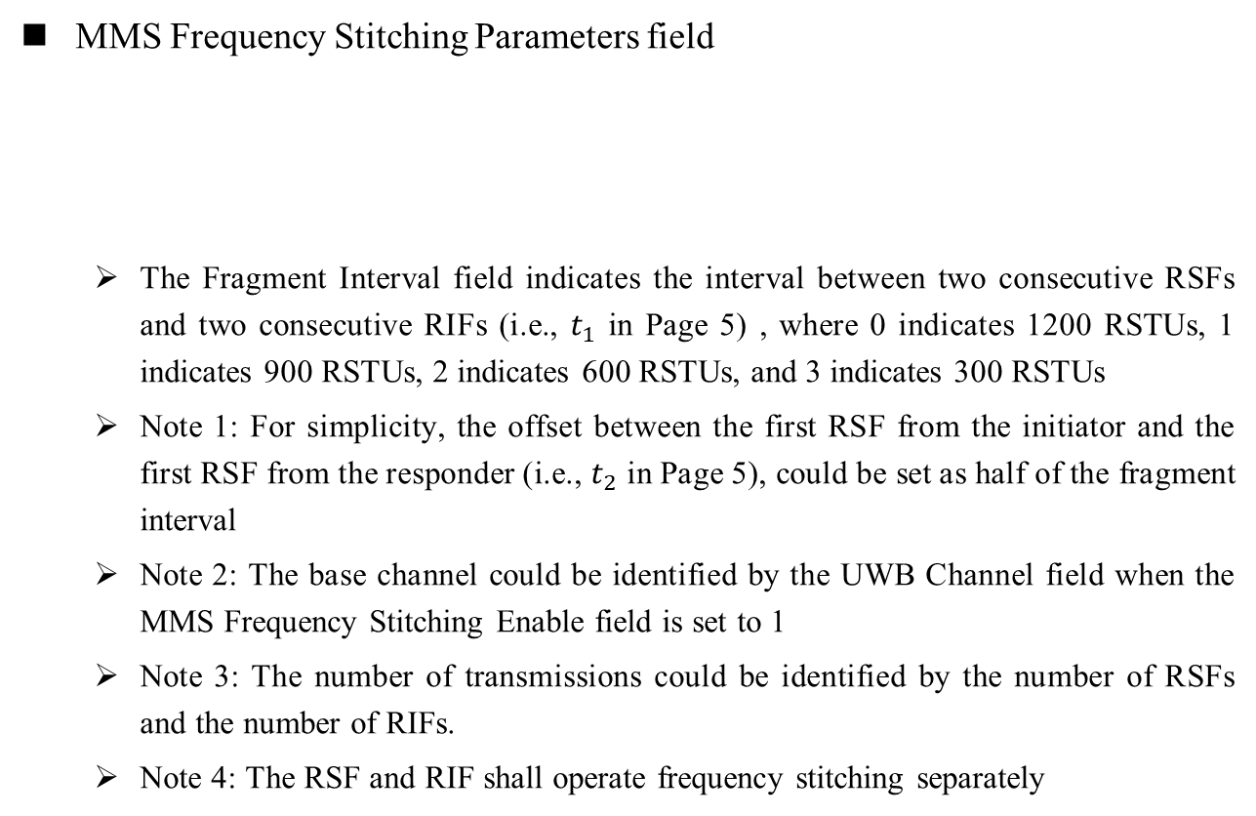
MMS Frequency Stitching Parameters
MMS Frequency Stitching Parameters field
  The Fragment Interval field indicates the interval between two consecutive RSFs and two consecutive RIFs (i.e., $t_{1}$ in Page 5) , where 0 indicates 1200 RSTUs, 1 indicates 900 RSTUs, 2 indicates 600 RSTUs, and 3 indicates 300 RSTUs
  Note 1: For simplicity, the offset between the first RSF from the initiator and the first RSF from the responder (i.e., $t_{2}$ in Page 5), could be set as half of the fragment interval
  Note 2: The base channel could be identified by the UWB Channel field when the MMS Frequency Stitching Enable field is set to 1
  Note 3: The number of transmissions could be identified by the number of RSFs and the number of RIFs.
  Note 4: The RSF and RIF shall operate frequency stitching separately
Bits: 0 | 1-2 | 3 | 4-5 | 6-7
Frequency Stitching Direction | Carrier Frequency Grid | Channel Order | Fragment Interval | Reserved

Slide 12
Device Capability Considerations
Frequency stitching for ranging should be an optional feature
The controlee (i.e., responder) shall indicate its capability to support MMS frequency stitching via the UWB HRP Capability Information field in the HRP UWB Association Request command
Bits: 0 | 1 | 2-3 | 4 | 5 | 6 | 7 | 8 | 9-15
LDPC | High Throughput | Supported AIFS | SBP | Dynamic PHR | Frequency Stitching for Sensing | Aggregated Channel Report | Frequency Stitching for Ranging | Reserved

Slide 13
Summary
It is suggested to introduce frequency stitching in ranging applications to improve the resolution
With frequency stitching, the MMS timing parameters could be configurable
Frequency stitching in ranging could be configured by either the MMS Ranging Configuration field in AC IE or the Ranging PHY Config field in a Compact frame
The capability to support frequency stitching for ranging is reported by the responder in the association phase

Slide 14
Thank You

