Slide 1
Project: IEEE P802.15 Working Group for Wireless Personal Area Networks (WPANs)
Submission Title: Deep Learning based OCC to support high mobility Vehicle
Date Submitted: January 14, 2024
Source: Herfandi Herfandi, Nguyen Ngoc Huy, Yeong Min Jang [Kookmin University]
Address: Kookmin University, 77 Jeongneung-Ro, Seongbuk-Gu, Seoul, 02707, Republic of Korea
Voice: +82-2-910-5068 E-Mail: yjang@kookmin.ac.kr
Re:
Abstract: Present the use case AI for IEEE 802.15 IG NG-OCC
Purpose: Presentation for contribution on IEEE 802.15 IG NG-OCC
Notice: This document has been prepared to assist the IEEE 802.15 IG NG-OCC. It is offered as a basis for discussion and is not binding on the contributing individual(s) or organization(s). The material in this document is subject to change in form and content after further study. The contributor(s) reserve(s) the right to add, amend or withdraw material contained herein.
Release: The contributor acknowledges and accepts that this contribution becomes the property of IEEE and may be made publicly available by IEEE 802.15 IG NG-OCC.

Slide 2
Deep Learning based OCC to support high mobility Vehicle
January 14, 2024

Slide 3
Contents
Background
Proposed Method
Literature Review
System Architecture
Processing algorithm
Result
Conclusion

Slide 4
Background
Despite the numerous benefits of the OCC system, there are certain problems that necessitate attention in its development, particularly in regions characterized by high mobility as well as elevated levels of noise and interference. The initial issue emerges in scenarios characterized by high mobility, wherein the occurrence of optical flow on the image sensor can lead to a reduction in the accuracy of LED identification. This, in turn, has a simultaneous impact on the performance of communication [1,2,3].

Slide 5
Proposed Method
In the study [4], a deep learning-based OCC system combined with an adaptive segmentation algorithm has been proposed to rectify optical distortions caused by optical flow on the image sensor. This method aims to improve the accuracy of LED recognition in high-mobility conditions as well as the selection of ROI.

Slide 6
Literature Review
Study [5] investigated the phenomenon of blurring in optical vehicle communication systems, including motion blur and blurring induced by rainy, foggy, or snowy weather conditions, in an effort to improve OCC performance in a high-mobility environment. The presence of other light sources has the potential to induce a rise in the bit error rate (BER) of the system as a result of the interference they generate at the receiver. The author proposed a neural network (NN)-based method for performing RoI selection and detecting the target transmitter on the receiver of a VLC or OCC system to mitigate the impact of parasitic light incidents.
Nguyen et al. [6] proposed a MIMO C-OOK scheme based on rolling-shutter effect for the mobility environment using a deep learning network. This method achieved a communication distance of up to 22 m with a considerably low bit error rate when considering the movement speeds at 2 m/s. However, the proposed method only works on the rolling-shutter camera which limits its implementation.
Although significant progress has been made, experimental demonstrations of the efficacy of an OCC system in high-mobility environments are limited.

Slide 7
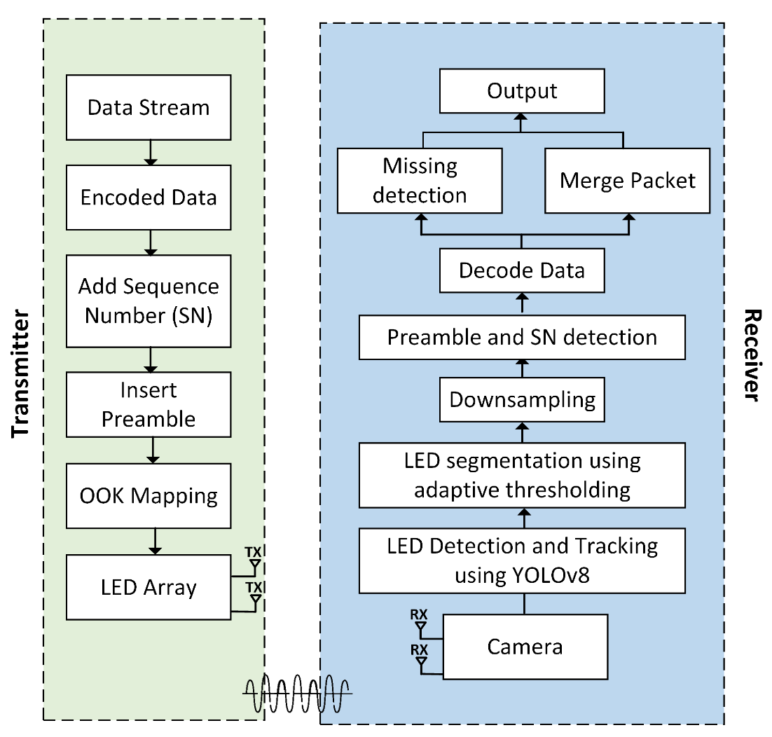
System Architecture
Description of the deep learning-based two-dimensional on-off keying multiple-input multiple-output (2D OOK-MIMO) OCC.
Figure 1. Reference architecture of OCC for a system-based 2D OOK-MIMO and deep learning technique using an LED array.

Slide 8
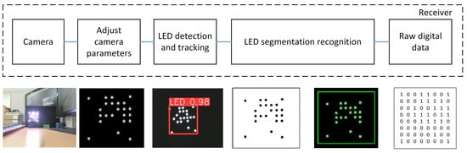
Processing algorithm
After acquiring raw digital data, the system must quickly identify and assess the preamble pattern to determine the authenticity and reliability of the data. If the packet data is accurate, the system uses the SN identification process to differentiate packets. The next stages include comprehensive data decoding and collection, as illustrated in Figure 2.
Figure 2. Receiving-side processing algorithm.

Slide 9
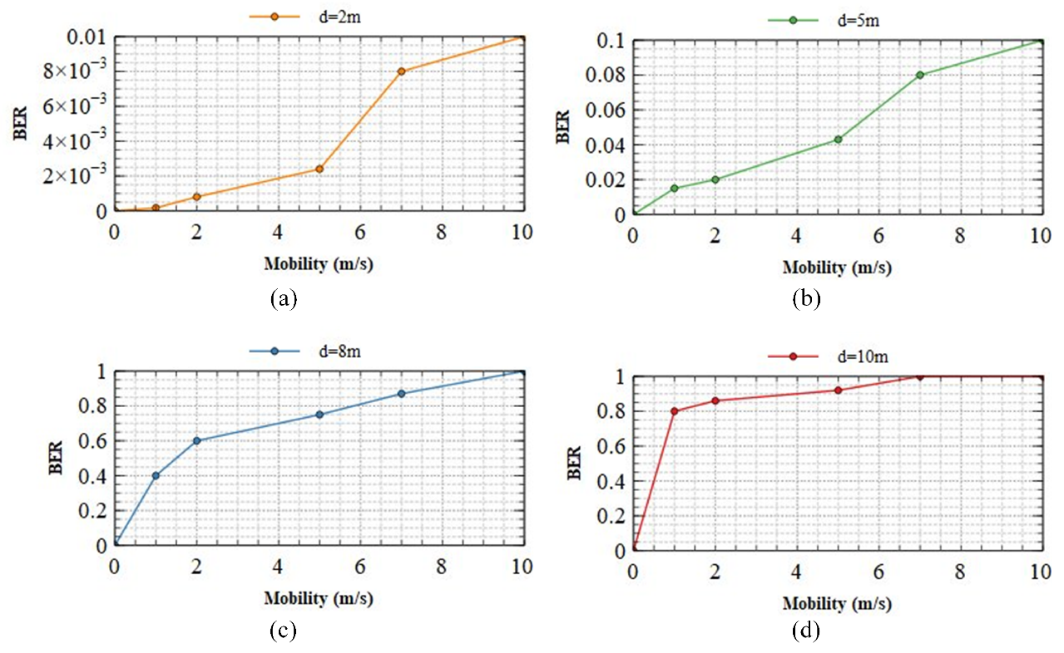

Results
Figure 3a demonstrates that the transmitted motion has a minimal effect on the BER. Even at 10 m/s, the BER does not exceed${10}^{−2}$. In this scenario, the system demonstrates outstanding mobility support, and its performance remains consistent despite a variety of mobile circumstances. Therefore, faultless transmission is possible within a 2 m range, regardless of system motion. Figure 3b shows that between 5 m and 8 m, the system’s mobility begins to affect transmission. The BER of ${10}^{−1}$indicates that the system’s performance is unaffected by its mobility, even at 10 m/s, as demonstrated by the system’s performance. Regarding Figure 3c,d, it can be seen that the mobility of the system has a substantial impact on the BER.
Figure 3. The BER performance of our scheme at different communication distances with changes in the speed of the camera (a) 2 m; (b) 5 m; (c) 8 m; (d) 10 m.

Slide 10
Conclusion
Therefore, This system is capable of real-time operation on embedded devices with limited configurations. Furthermore, they are proposed a method for LED segmentation recognition based on conventional image processing which reduces processing complexity compared to deep neural network algorithms while maintaining a high level of precision. Additionally, implemented a system to evaluate the performance of the OCC system at different transmission ranges in mobile environments. The results demonstrate that our OCC system exhibits high efficacy at a range of 10 m in a low-mobility environment and achieves high mobility (speed = 10 m/s) at a range of 2 m. However, obstacles remain when the system operates with high mobility over long distances. Our design can be utilized in future OCC systems that require a high degree of mobility.

Slide 11
Reference
Yamazato, T.; Kinoshita, M.; Arai, S.; Souke, E.; Yendo, T.; Fujii, T.; Kamakura, K.; Okada, H. Vehicle motion and pixel illumination modeling for image sensor based visible light communication. IEEE J. Sel. Areas Commun. 2015, 33, 1793–1805.
Ashraf, K.; Islam, S.M.T.; Hosseini, A.S.; Ashok, A. Motion characterization for vehicular visible light communications. In Proceedings of the 2019 11th International Conference on Communication Systems & Networks (COMSNETS), Bengaluru, India, 7–11 January 2019.
Kinoshita, M.; Yamazato, T.; Okada, H.; Fujii, T.; Arai, S.; Yendo, T.; Kamakura, K. Motion modeling of mobile transmitter for image sensor based I2V-VLC, V2I-VLC, and V2V-VLC. In Proceedings of the 2014 IEEE Globecom Workshops (GC Wkshps), Austin, TX, USA, 8–12 December 2014.
Sitanggang, O.S.; Nguyen, V.L.; Nguyen, H.; Pamungkas, R.F.; Faridh, M.M.; Jang, Y.M. Design and Implementation of a 2D MIMO OCC System Based on Deep Learning. Sensors 2023, 23, 7637. https://doi.org/10.3390/s23177637.
Pham, T.L.; Nguyen, H.; Nguyen, T.; Jang, Y.M. A novel neural network-based method for decoding and detecting of the DS8-PSK scheme in an OCC system. Appl. Sci. 2019, 9, 2242.
Nguyen, V.L.; Tran, D.H.; Nguyen, H.; Jang, Y.M. An experimental demonstration of MIMO C-OOK scheme based on deep learning for optical camera communication system. Appl. Sci. 2022, 12, 6935.

