Slide 1
Project: IEEE P802.15 Working Group for Wireless Personal Area Networks (WPANs)
Submission Title: OCC MAC and Network Layer for Bidirectional communications
Date Submitted: January 14, 2024
Source: Muhammad Miftah Faridh, Nguyen Ngoc Huy, Yeong Min Jang [Kookmin University]
Address: Kookmin University, 77 Jeongneung-Ro, Seongbuk-Gu, Seoul, 02707, Republic of Korea
Voice: +82-2-910-5068 E-Mail: yjang@kookmin.ac.kr
Re:
Abstract: Present the use case of OCC for MAC/Network layer and Bidirectional Communication
Purpose: Presentation for contribution on IEEE 802.15 IG NG-OCC
Notice: This document has been prepared to assist the IEEE 802.15 IG NG-OCC. It is offered as a basis for discussion and is not binding on the contributing individual(s) or organization(s). The material in this document is subject to change in form and content after further study. The contributor(s) reserve(s) the right to add, amend or withdraw material contained herein.
Release: The contributor acknowledges and accepts that this contribution becomes the property of IEEE and may be made publicly available by IEEE 802.15 IG NG-OCC.

Slide 2
OCC MAC and Network Layer for Bidirectional communications
January 14, 2024

Slide 3
Contents
Background
Methodology
Experiment
Conclusion

Slide 4
Background
Motivation: RF spectrum congestion and security concerns necessitate exploration of alternative communication strategies. OCC, utilizing existing ambient light and camera infrastructure, presents a promising solution for short-range IoT communication.
OpenVLC as a prototyping platform: OpenVLC's software library and hardware modules provide a readily available framework for developing and testing OCC prototypes.

Slide 5
Methodology:
Application Definition: Determine the specific IoT application, establishing data rate, range, and security requirements. Adapt these requirements to the capabilities of OCC technology.
Hardware Selection: Choose camera modules and any additional hardware as needed. Consider factors like frame rate, sensitivity to ambient light, and integration with existing infrastructure.
Software Development: Adapt OpenVLC's software library for OCC. This involves:
  Modulation techniques: Develop and implement suitable light modulation techniques visible to the camera sensor. Explore options like on-off keying, flicker modulation, or symbol encoding.
  Decoding algorithms: Design algorithms to extract data from the captured video stream, accounting for potential background noise and lighting variations.
  Communication protocols: Implement protocols for reliable data transmission and error correction tailored to the OCC channel characteristics.

Slide 6
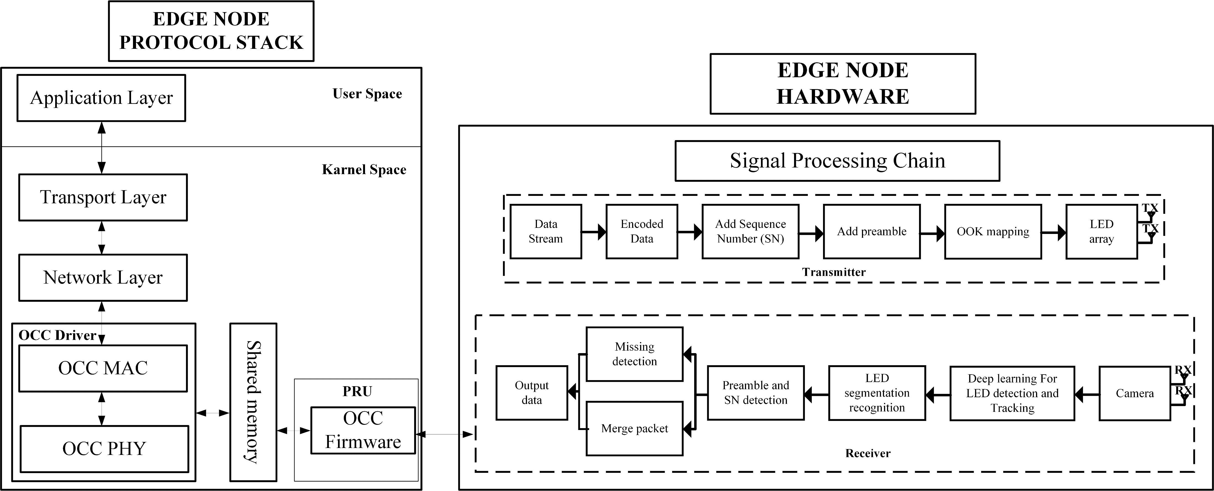
Experiment
(OCC MAC and Network Layer for Bidirectional communications)
Conduct a controlled experiment to validate the OCC prototype's performance.

Slide 7
Conclusion
Summarize the findings of the research, highlighting the potential of OpenVLC-based OCC for secure, low-power communication in IoT scenarios. Address remaining challenges and future research directions for improving OCC technology and expanding its applicability within the IoT landscape.
This revamped version emphasizes the adaptation of OpenVLC for OCC applications, providing a framework for researchers and developers interested in exploring this emerging communication technology for the Internet of Things. Remember, further research and experimentation are vital to refine OCC techniques and unlock its full potential for enhancing secure and energy-efficient data transmission within diverse IoT environments.

Slide 8
References :
B. G. Guzman, M. S. Mir, D. F. Fonseca, A. Galisteo, Q. Wang, and D. Giustiniano, “Prototyping visible light communication for the internet of things using OpenVLC,” IEEE Commun. Mag., vol. 61, no. 5, pp. 122–128, 2023.

