Slide 1
Project: IEEE P802.15 Working Group for Wireless Personal Area Networks (WPANs)
Submission Title: Performance Evaluation of Channel Coding Based on TG6ma Channel Model for Some Classes of Coexistence
Date Submitted: Mar. 13rd, 2024
Source: Kento Takabayashi¹, Takumi Kobayashi², Daisuke Anzai², Macro Hernandez^{3,4}, Ryuji Kohno^{3,4}
Company: Nagoya Institute of Technology (NIT), Japan
Address: Gokiso-cho, Showa-ku, Nagoya, 466-8555, Japan
Voice: +81-52-735-5389, FAX: +81-52-735-5389, E-Mail: anzai@nitech.ac.jp
Re: In response to call for technical contributions
Abstract: Performance evaluations of error correcting codes for IEEE 802.15.6ma under some channel models is provided. In addition, we also consider coexistence with IEEE 802.15.4ab.
Purpose: Material for discussion in P802.15.6a TG corresponding to comments in EC Meeting
Notice: This document has been prepared to assist the IEEE P802.15. It is offered as a basis for discussion and is not binding on the contributing individual(s) or organization(s). The material in this document is subject to change in form and content after further study. The contributor(s) reserve(s) the right to add, amend or withdraw material contained herein.
Release: The contributor acknowledges and accepts that this contribution becomes the property of IEEE and may be made publicly available by P802.15.

Slide 2
Performance Evaluation of Channel Coding Based on TG6ma Channel Model for Some Classes of Coexistence
Daisuke Anzai, Sho Asano, Kento Takabayashi,
Takumi Kobayashi, Marco Hernandez, Ryuji Kohno
Nagoya Institute of Technology (NIT)
Toyo University, YNU, YRP-IAI, CWC Oulu Univeristy

Slide 3
Importance of QoS control
In WBAN systems, a wearable vital sign sensor node can include various types of sensors with different data rates, the allowable communication error ratio and delay
IEEE 802.15.6 based WBAN may deal with 8 levels of user priority data
Those data have a wide range of quality of service (QoS)
Therefore, optimal error control for input data is an important feature in sensor data transmission procedures
User priority | Traffic designation | Frame type
0 | Background (BK) | Data
1 | Best effort (BE) | Data
2 | Excellent effort (EE) | Data
3 | Video (VI) | Data
4 | Voice (VO) | Data
5 | Medical data or network control | Data or management
6 | High-priority medical data or network control | Data or management
7 | Emergency or medical implant event report | Data

Slide 4
Error control in current IEEE 802.15.6
IEEE 802.15.6 shall use a (63, 51) BCH code as an error correcting code in narrowband, UWB and HBC PHY
Only user priority 6 data in UWB-PHY may use a hybrid ARQ with a (126, 63) shortened BCH code
However, the error control scheme of the current IEEE 802.15.6 cannot deal with the QoS because of lack of flexibility
In IEEE 802.15.6ma, we indicate a concept of channel coding technique to deal with various types of QoS data as shown in a next figure

Slide 5
Forward error correcting codes in TG6ma
User priority | Inner code | Outer code | HARQ
0 | 15.4ab LDPC or BCC (R=1/2) |  | -
1 | 15.4ab LDPC or BCC (R=1/2) |  | -
2 | 15.4ab LDPC or BCC (R=1/2) |  | -
3 | 15.4ab LDPC or BCC (R=1/2) |  | -
4 | 15.4ab LDPC or BCC (R=1/2) | (54, 46) shortened RS code | -
5 | 15.4ab LDPC or BCC (R=1/2) | (54, 38) shortened RS code | -
6 | 15.4ab LDPC or BCC (R=1/2) | (54, 28) shortened RS code | -
7 | 15.4ab LDPC or BCC (R=1/2) | (54, 14) shortened RS code | -
As an outer code, shortened Reed-Solomon (RS) codes with N=54 (original code length N=63) will be selected to correct burst errors due to interference from other WBANs and the coding rates are changed according to each QoS and channel condition
As an inner code, 15.4ab LDPC (K=324, 648, 972, R=1/2) or BCC will be selected for the coexistence of 15.6ma and 15.4ab
This updated concept table is considered as the first priority

Slide 6
Evaluations (LDPC and RS)
Inner code: N=1296-bit (R=1/2) LDPC code
Outer code: (54,46), (54,38), (54,28), (54,14) shortened RS codes and no encoding
Performances can be controlled by changing the code rate of the RS code
Low coding rate cases can correct a lot of errors and erasures
AWGN channel and BPSK modulation
Burst erasure occurs at 32.5% of the code length of the LDPC code (70 consecutive 6-bit erasures)

Slide 7
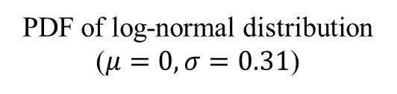
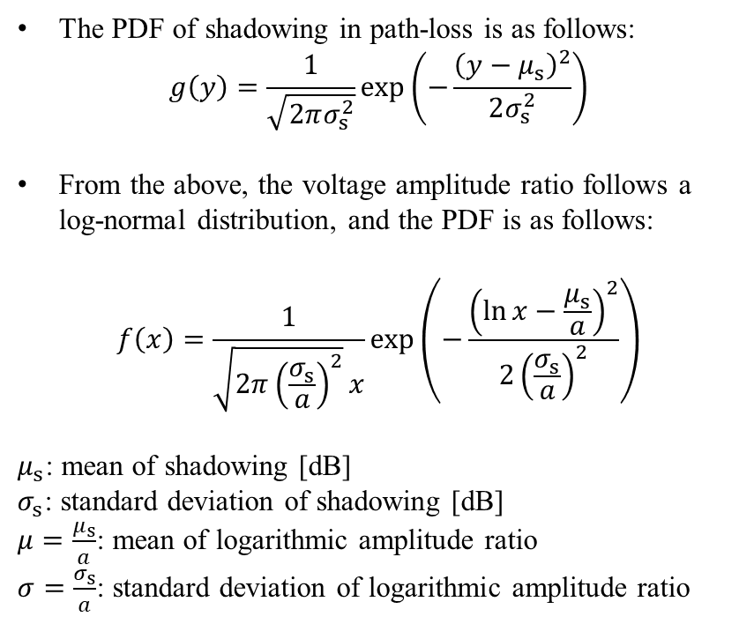
FEC performance evaluation under TG6ma channel model
The PDF of shadowing in path-loss is as follows:
$$g\left(y\right)=\frac{1}{\sqrt{2πσ_{s}^{2}}}\exp\left(−\frac{{\left(y−μ_{s}\right)}^{2}}{2σ_{s}^{2}}\right)$$
From the above, the voltage amplitude ratio follows a log-normal distribution, and the PDF is as follows:
$$f\left(x\right)=\frac{1}{\sqrt{2π{\left(\frac{σ_{s}}{a}\right)}^{2}}x}\exp\left(−\frac{{\left(\ln{x}−\frac{μ_{s}}{a}\right)}^{2}}{2{\left(\frac{σ_{s}}{a}\right)}^{2}}\right)$$
$μ_{s}$: mean of shadowing [dB]
$σ_{s}$: standard deviation of shadowing [dB]
$μ=\frac{μ_{s}}{a}$: mean of logarithmic amplitude ratio
$σ=\frac{σ_{s}}{a}$: standard deviation of logarithmic amplitude ratio
PDF of log-normal distribution ($μ=0, σ=0.31$)

Slide 8
Evaluation results in shadow fading
BPSK modulation
AWGN and Shadowing
・LDPC
・Outer: RS, Inner: LDPC
RS parameter
Code length: 324 bits
LDPC parameter
Code length: 1296 bits
Fading parameter
Variance: 1.61 [dB]

Slide 9
Evaluation results in shadow fading
BPSK modulation
AWGN and Shadowing
・LDPC
・Outer: RS, Inner: LDPC
RS parameter
Code length: 324 bits
LDPC parameter
Code length: 1296 bits
Fading parameter
Variance: 2.69 [dB]

Slide 10
References
D. Anzai, I. Balasingham, G. Fischer, J. Wang, “Reliable and High-Speed Implant Ultra-Wideband Communications with Transmit–Receive Diversity,” EAI/Springer Innovations in Communication and Computing, pp. 27-32, March 2020.
Y. Shimizu, D. Anzai, R. C-Santiago, P. A. Floor, I. Balasingham, and J. Wang, “Performance evaluation of an ultra-wideband transmit diversity in a living animal experiment” IEEE Trans. Microw. Theory Tech., vol. 65, no. 7, pp. 2596-2606, July 2017.
D. Anzai, K. Katsu, R. Chavez-Santiago, Q. Wang, D. Plettemeier, J. Wang, and I. Balasingham, “Experimental evaluation of implant UWB-IR transmission with living animal for body area networks,” IEEE Trans. Microw. Theory Tech., vol. 62, no. 1, pp. 183-192, Jan. 2014.
J. Shi, D. Anzai, and J. Wang, “Channel modeling and performance analysis of diversity reception for implant UWB wireless link,” IEICE Trans. Commun., no. E95-B, vol. 10, pp. 3197-3205, Oct. 2012.

Slide 11
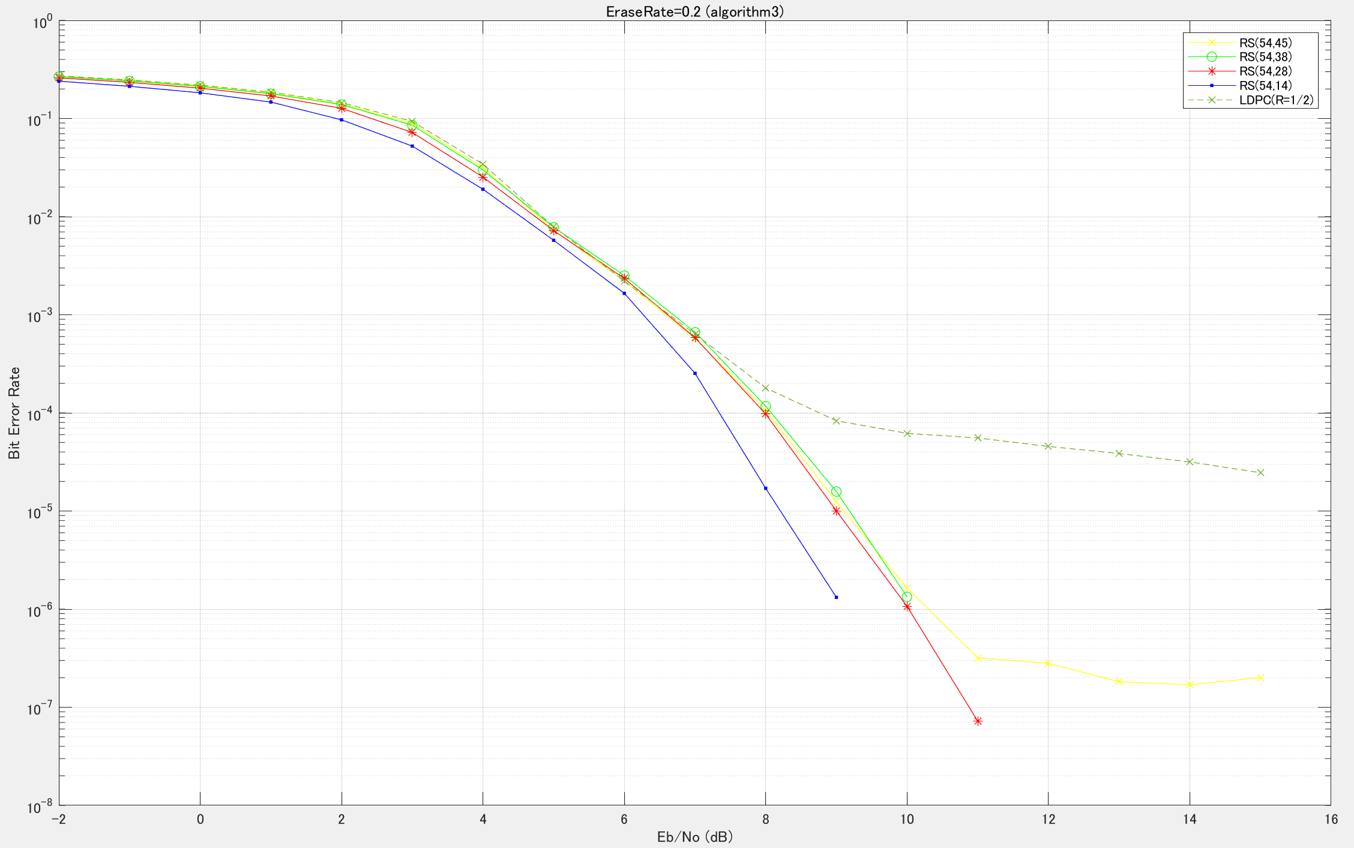
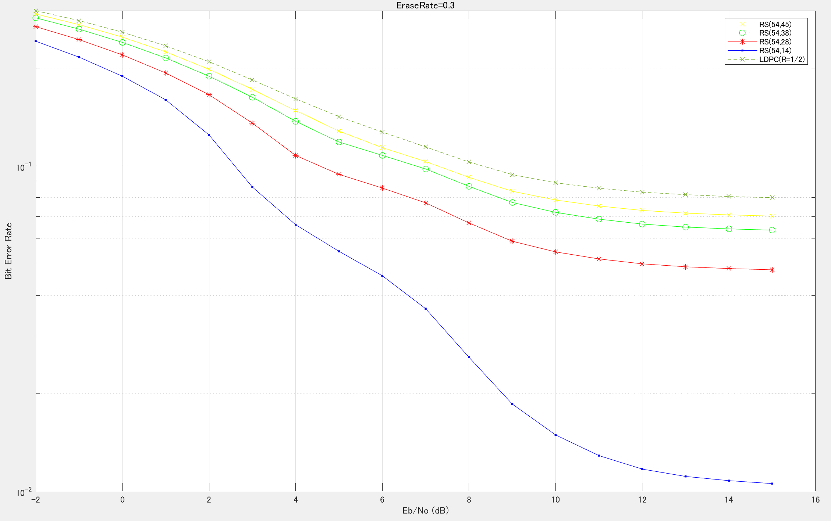
Evaluation results in burst erasure case
(a)
(b)
Performance evaluation on bit error ratio
in the case of AWGN channel and burst bit sequence erasure
(a) The ratio of burst erasure is 20% of packet length, (b) That is 30%

