Slide 1
Project: IEEE P802.15 Working Group for Wireless Specialty Networks (WSNs)
Submission Title: IEEE 802.15 IG NG-OCC Closing Report (January 2024)
Date Submitted: January 18, 2024
Source: Yeong Min Jang [Kookmin University]
Address: Kookmin University, 77 Jeongneung-Ro, Seongbuk-Gu, Seoul, 02707, Republic of Korea
Voice: +82-2-910-5068 E-Mail: yjang@kookmin.ac.kr
Re:
Abstract: IG NG-OCC Closing Report for January 2024
Purpose: [Report progress to WG]
Notice: This document has been prepared to assist the IEEE P802.15. It is offered as a basis for discussion and is not binding on the contributing individual(s) or organization(s). The material in this document is subject to change in form and content after further study. The contributor(s) reserve(s) the right to add, amend or withdraw material contained herein.
Release: The contributor acknowledges and accepts that this contribution becomes the property of IEEE and may be made publicly available by P802.15.

Slide 2
IEEE 802.15 IG NG-OCC
Closing report
January 18, 2024

Slide 3
Session Objectives
Present seven contributions related to the future of next generation OCC

Slide 4
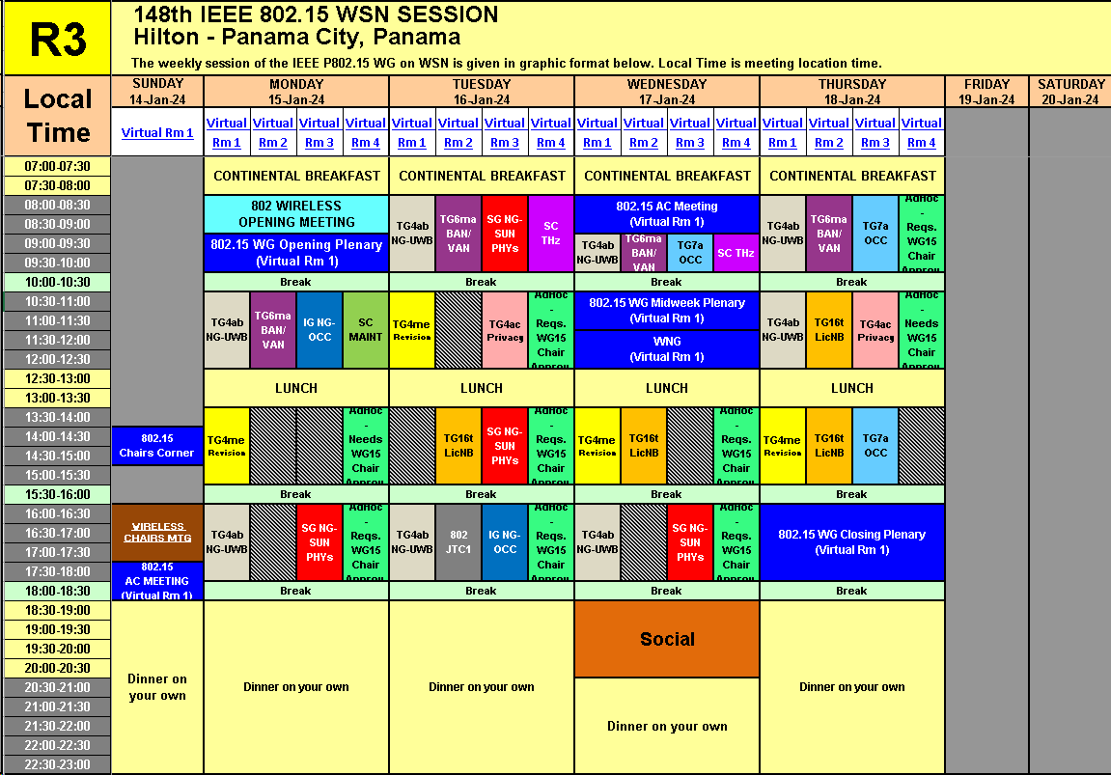
Session Schedule
The Group scheduled 2 time slots in this meeting
- Monday AM2 and Tuesday PM2

Slide 5
Accomplishment for the meeting
1st Slot: Monday AM2
  Meeting Objectives and Agenda Approval (0028-01)
  Presentation from Kookmin University titled "Future Applications of NG OCC" (0043-00)
  Presentation from Kookmin University titled "OCC Channel Model to Support High Mobility under Adverse Condition" (0045-00)
  Presentation from Kookmin University titled "Artificial Intelligence for Next Generation OCC" (0037-00)

Slide 6
Accomplishment for the meeting
2nd Slot: Tuesday PM2
  Meeting Objectives and Agenda Approval (0028-01)
  presentation from Kookmin University titled "Deep Learning based OCC to Support High Mobility Vehicle" (0042-00)
  presentation from Kookmin University titled "Indoor Positioning using OCC and LiDAR" (0036-01)
  presentation from Kookmin University titled "OCC MAC and Network Layer for Bidirectional Communications" (0044-00)
  presentation from Kookmin University titled "Functional Requirement of Drone Networks based on Next Generation OCC" (0041-00)
  The key ideas of all seven contributions are accepted and adopted for IEEE 802.15 WNG presentations and the PAR for IG NG-OCC
  Plan for March meeting
  Plan for IG NG-OCC

Slide 7
Plan for March Meeting
2 Time Slots (PM2)
Need to contributions for NG-OCC
Invite some companies for presentations

Slide 8
  Plan for IG NG-OCC
Invite contributors from research institutes and companies

