Slide 1
Project: IEEE P802.15 Working Group for Wireless Specialty Networks (WSNs)
Submission Title: OCC in Virtual Power Plant Use case for NG-OCC
Date Submitted: March 11, 2024
Source: Herfandi Herfandi, Md . Shahriar Nazim, Md. Ibne Joha, Nguyen Ngoc Huy, Yeong Min Jang [Kookmin University]
ByungDeok Chung [ENS Co. Ltd.]
Address: Room #603 Mirae Building, Kookmin University, 77 Jeongneung-Ro, Seongbuk-Gu, Seoul, 136702, Republic of Korea
Voice: +82-2-910-5068 E-Mail: yjang@kookmin.ac.kr
Re:
Abstract: Present the OCC in Virtual Power Plant Use case for NG-OCC
Purpose: Presentation for contribution on IG NG-OCC
Notice: This document has been prepared to assist the IG NG-OCC. It is offered as a basis for discussion and is not binding on the contributing individual(s) or organization(s). The material in this document is subject to change in form and content after further study. The contributor(s) reserve(s) the right to add, amend or withdraw material contained herein.
Release: The contributor acknowledges and accepts that this contribution becomes the property of IEEE and may be made publicly available by IG NG-OCC.

Slide 2
OCC in Virtual Power Plant Use case for NG-OCC
March 11, 2024

Slide 3
Contents
Background
NG-OCC in VPP
Use Case in Virtual Power Plant
Conclusion

Slide 4
Background
OCC uses cameras as receivers for signals. In industrial IoT, OCC can facilitate communication between devices, employing LEDs or digital signage as transmitters for reliable processes.
IoT evolves from RFID to diverse sensors in local areas. In industrial IoT, advanced communication technology is vital for optimizing processes and efficiency.
The implementation of IoT is discussed across various industries, including Industrial IoT. The adaptation of IoT systems to industry-specific characteristics, such as using specialized sensors in agriculture and vibration sensing systems in construction.

Slide 5
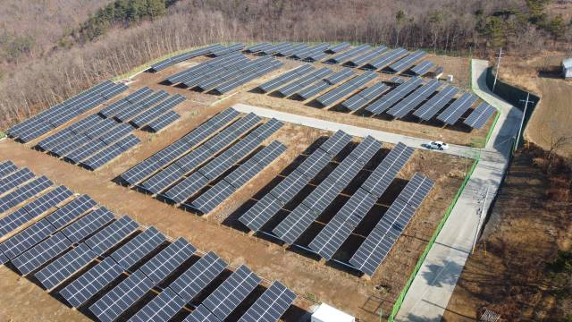
NG-OCC in VPP
In the age of sustainable development, the adoption of renewable energy sources has become paramount.
The versatility of Next-Generation Optical Camera Communication (NG-OCC) makes it applicable across various sectors, particularly in the energy domain.
NG-OCC, utilizing light as its communication medium, offers distinct advantages over RF-based communication. Unlike radio frequencies, NG-OCC minimizes the risk of interfering with other sensors, making it a more efficient and reliable choice in the energy sector.

Slide 6
Use Case in Virtual Power Plant
Within the Virtual Power Plant (VPP), NG-OCC plays a crucial role in seamlessly transmitting data acquired from the PV plant to the database via the API.
Boasting a high data-rate capability, NG-OCC ensures swift data transmission from the plant to the database. Moreover, its suitability for outdoor environments enhances its potential applications.
NG-OCC contributes to the stability of devices within the power plant, mitigating interference and optimizing the performance of installed equipment.
intelligent IoT platform for multiple PV plant monitoring with OCC.

Slide 7
Conclusion
IoT systems are being adapted across various industries.
Optical Camera Communication (OCC) is a promising technology utilized in industrial IoT.
Next-Generation Optical Camera Communication (NG-OCC) offers significant advantage.
NG-OCC plays a crucial role in Virtual Power Plants (VPPs), ensuring seamless transmission of data from photovoltaic plants to databases.
Within VPPs, NG-OCC contributes to the stability of devices, mitigating interference and optimizing equipment performance.

Slide 8
Reference
Utama, I.B.K.Y.; Pamungkas, R.F.; Faridh, M.M.; Jang, Y.M. Intelligent IoT Platform for Multiple PV Plant Monitoring. Sensors 2023, 23, 6674. https://doi.org/10.3390/s23156674
Herfandi, H.; Sitanggang, O.S.; Nasution, M.R.A.; Nguyen, H.; Jang, Y.M. Real-Time Patient Indoor Health Monitoring and Location Tracking with Optical Camera Communications on the Internet of Medical Things. Appl. Sci. 2024, 14, 1153. https://doi.org/10.3390/app14031153
Bin Mofidul, R.; Alam, M.M.; Rahman, M.H.; Jang, Y.M. Real-Time Energy Data Acquisition, Anomaly Detection, and Monitoring System: Implementation of a Secured, Robust, and Integrated Global IIoT Infrastructure with Edge and Cloud AI. Sensors 2022, 22, 8980. https://doi.org/10.3390/s22228980

