Slide 1
Study Group SUN PHY
Next Generation SUN PHY’s
Hybrid Meeting
March, 2024

Slide 2
Agenda
Existing LPWAN network interference model.
Narrow band FSK
Wi-SUN frequency hopping networks
CSS Networks

Slide 3
Asynchronous transmissions using 50-300kbps frequency hopping network with CCA (Wi-SUN like)
Asynchronous transmissions based on 10kbps FSK. These systems typically including frequency hopping, but there is no CCA.
CSS

Slide 4
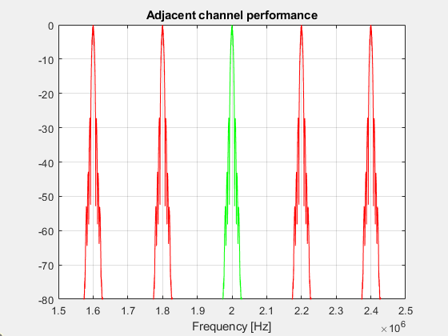
Narrow band FSK (10kbps), 200 KHz channel spacing

Slide 5
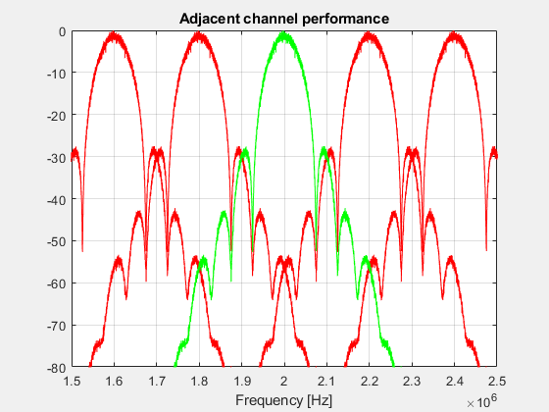
Medium data rate FSK (100kbps), 200kHz channel spacing

Slide 6
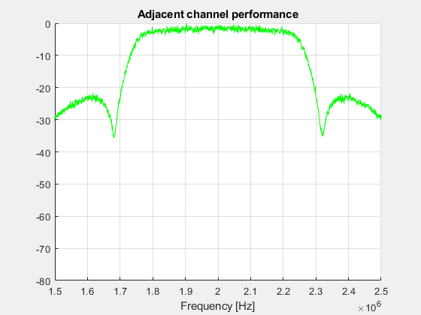
Emulation of CSS signal (500kHz occupied BW)

Slide 7
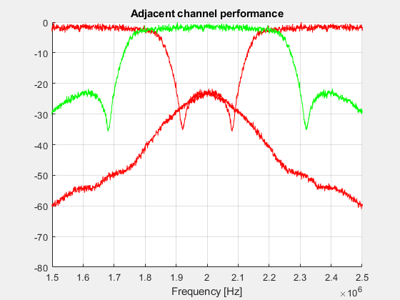
Emulation of CSS signal (500kHz occupied BW) (400 kHz channel spacing)

