Slide 1
Project: IEEE P802.15 Working Group for Wireless Specialty Networks
Submission Title: Update of path loss model parameters for CM6.2, (S6.2) in TG6ma
Date Submitted: March 14th, 2024
Source: Yutaro Aoki¹, Takumi Kobayashi^{1,2}, Daisuke Anzai¹,
Company: [¹Nagoya Institute of Technology, ²YRP International Alliance Institute]
Address [1; Gokiso-cho, Showa-ku, Nagoya 466-8555 Japan, 2: YRP1 Blg., 3-4 HikarinoOka, Yokosuka-City, Kanagawa, 239-0847 Japan]
E-Mail:[kobayashi@nitech.ac.jp, anzai@nitech.ac.jp]
Re: In response to call for technical contributions
Abstract: This provides updates of path loss model simulations and parameters for the drafting of channel model document of human body area network(HBAN) and vehicle body area network(VBAN) for enhanced dependability.
Purpose: Material for discussion in P802.15 TG6ma
Notice: This document has been prepared to assist the IEEE P802.15. It is offered as a basis for discussion and is not binding on the contributing individual(s) or organization(s). The material in this document is subject to change in form and content after further study. The contributor(s) reserve(s) the right to add, amend or withdraw material contained herein.
Release: The contributor acknowledges and accepts that this contribution becomes the property of IEEE and may be made publicly available by P802.15.

Slide 2
Update of path loss model parameters for CM6.2, (S6.2) in TG6ma
Yutaro Aoki¹, Takumi Kobayashi^{1,2}, Daisuke Anzai¹
¹ Nagoya Institute of Technology
² YRP International Alliance Institute

Slide 3
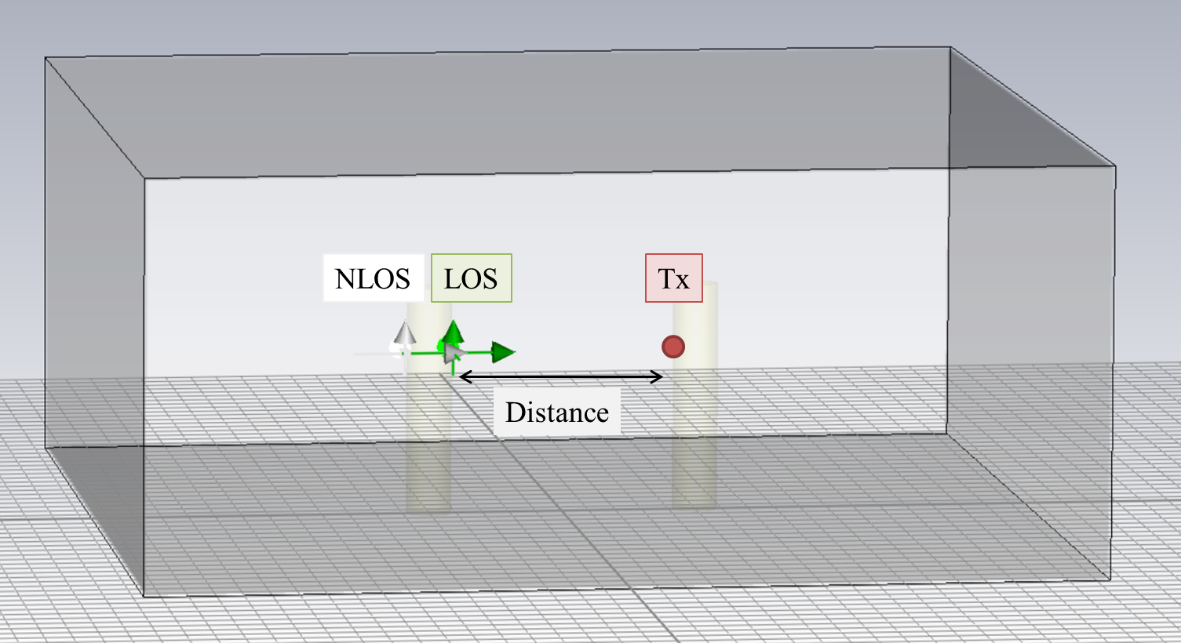

Previous simulation results
 | n | PL₀ (dB) (d₀=1000 (mm))
LOS | 0.47 | 59.09
NLOS | -0.03 | 65.83
$$PL=PL_{0}+10n\log_{10}\left(\frac{d}{d_{0}}\right) [dB]$$

Slide 4
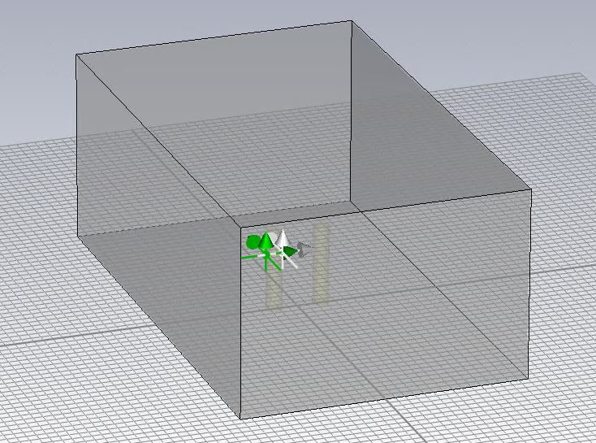
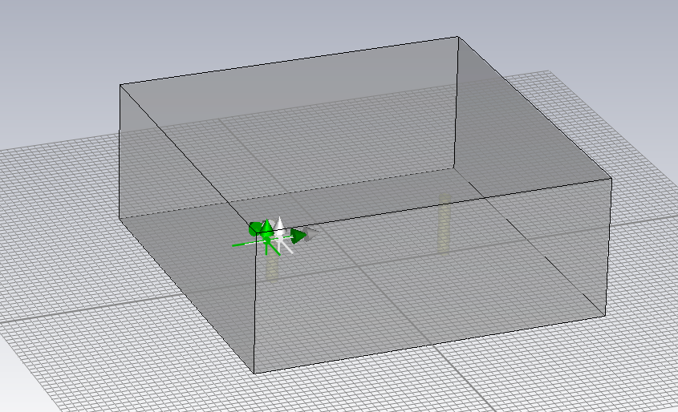
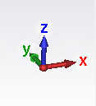
New simulation environment
NLOS
LOS
NLOS
LOS
Tx
Tx
Distance
Distance
Distance=1000 [mm]
Distance=5000 [mm]
= Changes =
Simulation space size settings have been changed.
New simulation has been performed with adaptive size of simulation spaces against change of distance between two human bodies.
●distance between human bodies●
9 points for every 500mm.
Distance: 1000-5000 [mm]
Simulation space size;
x: [old] Distance+5000[mm]
⇒ [new] 6000-10000 [mm]
y: 10000 [mm]
z: 4000 [mm]

Slide 5

 | n | PL₀ (dB) (d₀=1000 (mm))
LOS | 1.26 | 60.70
NLOS | 0.03 | 68.36
$$PL=PL_{0}+10n\log_{10}\left(\frac{d}{d_{0}}\right) [dB]$$
PL=12.578 log(d)+22.966
PL=0.2535 log(d)+67.598
Negative value problem of in “n” has been solved.

Slide 6
Thank you for your attention.

