Slide 1
Project: IEEE P802.15 Working Group for Wireless Personal Area Networks (WPANs)
Submission Title: IEEE 802.15 IG NG-OCC Closing Report (March 2024)
Date Submitted: March 14, 2023
Source: Yeong Min Jang [Kookmin University].
Address
Voice: +82-2-910-5068 E-Mail: yjang@kookmin.ac.kr
Re:
Abstract: IG NG-OCC Closing Report for March 2024
Purpose: [Closing Report to WG]
Notice: This document has been prepared to assist the IEEE P802.15. It is offered as a basis for discussion and is not binding on the contributing individual(s) or organization(s). The material in this document is subject to change in form and content after further study. The contributor(s) reserve(s) the right to add, amend or withdraw material contained herein.
Release: The contributor acknowledges and accepts that this contribution becomes the property of IEEE and may be made publicly available by P802.15.

Slide 2
IEEE 802.15 IG NG-OCC
Closing report
March 14, 2024

Slide 3
Session Objectives
Present three contributions related to the future of next generation OCC

Slide 4
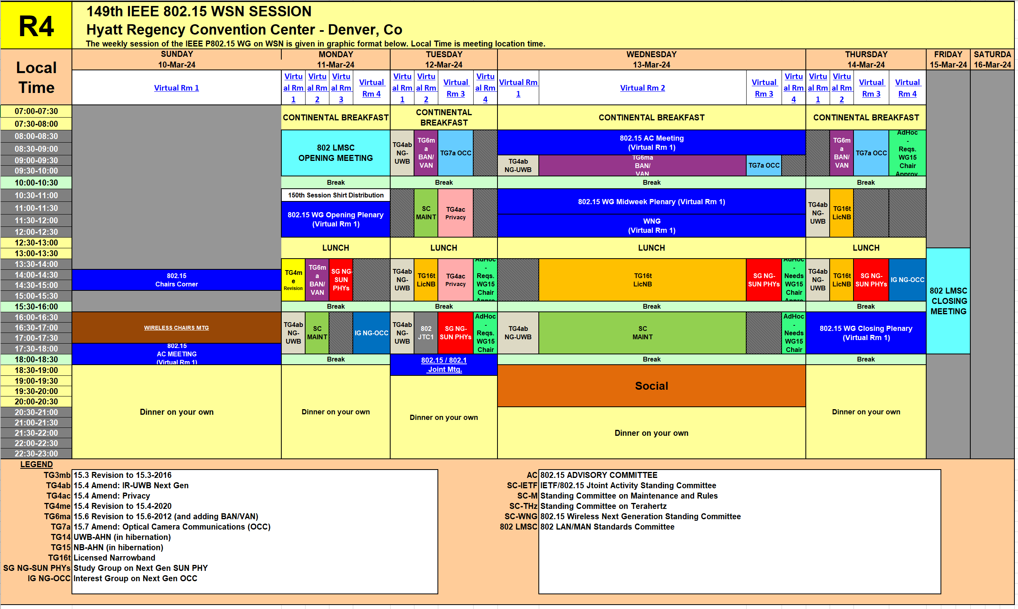
Session Schedule
The Group scheduled 1 time slot in this meeting
- Monday PM2 and Thursday PM1(Cancelled)

Slide 5
Accomplishment for the meeting
2 Slots (on PM2 Mon. and PM1 Thur.)
1st Slot:
  Meeting Objectives and Agenda Approval (132-01)
  Hear contributions
  OCC in Virtual Power Plant Use case for NG-OCC (152-00) [Kookmin University and ENS]
  GAN-based Deep Learning for NG-OCC (153-00) [Kookmin University]
  OCC Enabled Software Defined Vehicular Networks for NG-OCC (154-00) [Kookmin University]
  The key ideas of all three contributions are accepted and adopted for the PAR for IG NG-OCC
  Plan for May meeting
  Plan for IG NG-OCC
  Adjourn
2nd Slot:
  Adjourn

Slide 6
Plan for May Meeting
2 slots (AM2 on Tues. and Thur.)
Need to contributions for NG-OCC
Invite some companies for presentations

Slide 7
  Plan for IG NG-OCC
Invite contributors from research institutes and companies

