Slide 1
Project: IEEE P802.15 Working Group for Wireless Specialty Networks (WSN)
Submission Title: UWB channel numbering
Source: Panpan Li, Lei Huang, Bin Qian, Rojan Chitrakar, David Xun Yang (Huawei Technologies)
Address : [Huawei Bantian Base, Longgang District, Shenzhen, 518129 China]
E-Mail: [lipanpan25@huawei.com]
Re: Task Group 4ab: UWB Next Generation for 802.15.4
Abstract: [UWB, channel numbering]
Purpose:
Notice: This document has been prepared to assist the IEEE P802.15. It is offered as a basis for discussion and is not binding on the contributing individual(s) or organization(s). The material in this document is subject to change in form and content after further study. The contributor(s) reserve(s) the right to add, amend or withdraw material contained herein.
Release: The contributor acknowledges and accepts that this contribution becomes the property of IEEE and may be made publicly available by P802.15.
Notes:
Jul 12, 2010
Page 1

Slide 2
CIDs
Name | Idx | Pg | L. | Comment | Proposed Change
Billy Verso | 222 | 116 | 7 | To allow more flexibility in choosing UWB channel, suggest to combine define the reserved field following this to make extended channel number, (optional support for this only). | In figure 132 take change reserved bits into UWB Channel Extension, and change text here to say that if the UWB Channel Extension field is non-zero it is taken as high order bits and combined with the UWB Channel field value to make an extended UWB channel number as per 16.4.1.2.
Billy Verso | 237 | 147 | 6 | The channel assignment clause for the HRP UWB PHY, was not updated however we have an new definition in 16.4.1.2 covering an (optional) extended set of channels. Being able to select these individually is needed for instance to do frequency stitched sensing with individual frame TX on the different frequencies, (as an alternative to the automatic stepped case). Would also allow for future regulatory changes without further UWB text update. | Add in coverage for extended range. And, revisit all places UWB channel number is signaled, especially in new 4ab messages. To ensure the UWB channel number field size is sufficient to signal the extern range.

Slide 3
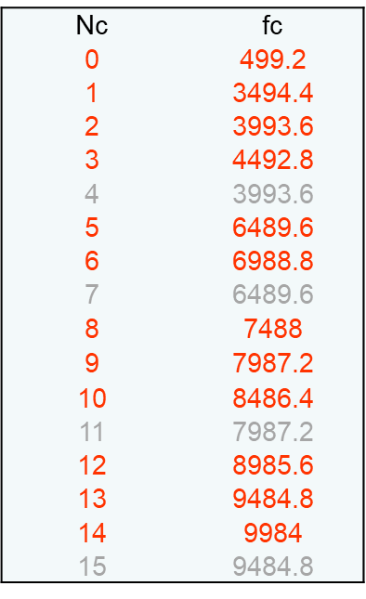
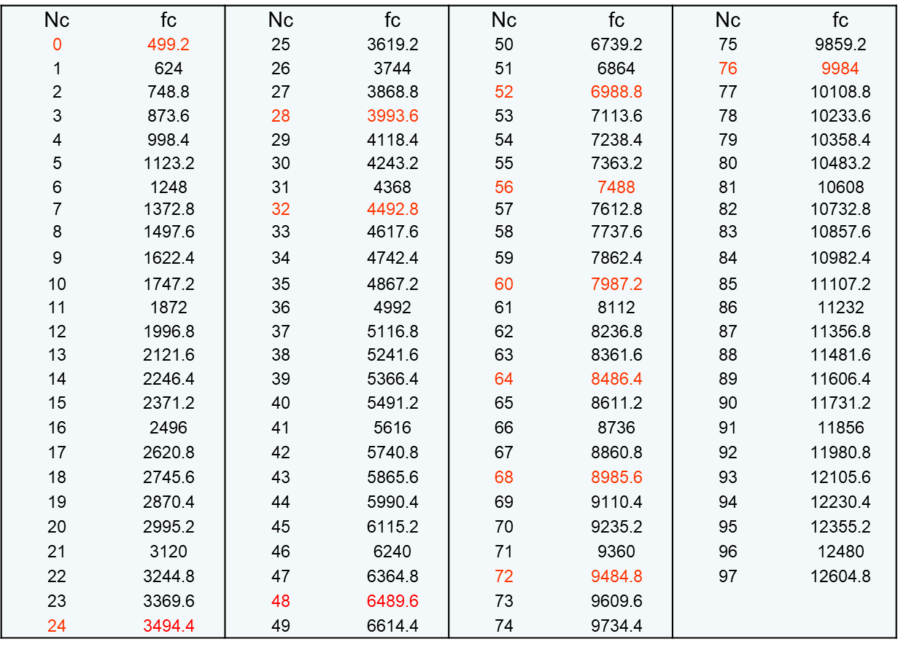
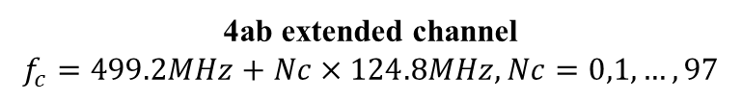
Background
contradiction
Same center frequencies have different numbers!
HRP UWB PHY bands in 802.15.4-2020
4ab extended channel
$$f_{c}=499.2MHz+Nc×124.8MHz, Nc=0,1,…,97$$

Slide 4
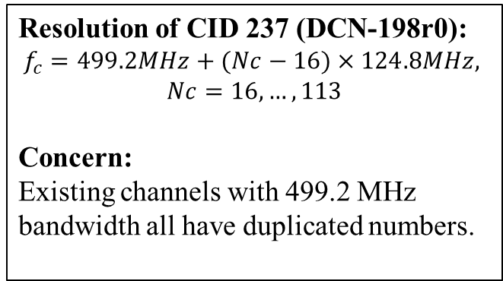
Background
Nc | fc | Nc | fc | Nc | fc | Nc | fc
0/ 16 | 499.2 | 41 | 3619.2 | 66 | 6739.2 | 91 | 9859.2
17 | 624 | 42 | 3744 | 67 | 6864 | 14/ 92 | 9984
18 | 748.8 | 43 | 3868.8 | 6/ 68 | 6988.8 | 93 | 10108.8
19 | 873.6 | 2/ 44 | 3993.6 | 69 | 7113.6 | 94 | 10233.6
20 | 998.4 | 45 | 4118.4 | 70 | 7238.4 | 95 | 10358.4
21 | 1123.2 | 46 | 4243.2 | 71 | 7363.2 | 96 | 10483.2
22 | 1248 | 47 | 4368 | 8/ 72 | 7488 | 97 | 10608
23 | 1372.8 | 3/ 48 | 4492.8 | 73 | 7612.8 | 98 | 10732.8
24 | 1497.6 | 49 | 4617.6 | 74 | 7737.6 | 99 | 10857.6
25 | 1622.4 | 50 | 4742.4 | 75 | 7862.4 | 100 | 10982.4
26 | 1747.2 | 51 | 4867.2 | 9/ 76 | 7987.2 | 101 | 11107.2
27 | 1872 | 52 | 4992 | 77 | 8112 | 102 | 11232
28 | 1996.8 | 53 | 5116.8 | 78 | 8236.8 | 103 | 11356.8
29 | 2121.6 | 54 | 5241.6 | 79 | 8361.6 | 104 | 11481.6
30 | 2246.4 | 55 | 5366.4 | 10/ 80 | 8486.4 | 105 | 11606.4
31 | 2371.2 | 56 | 5491.2 | 81 | 8611.2 | 106 | 11731.2
32 | 2496 | 57 | 5616 | 82 | 8736 | 107 | 11856
33 | 2620.8 | 58 | 5740.8 | 83 | 8860.8 | 108 | 11980.8
34 | 2745.6 | 59 | 5865.6 | 12/ 84 | 8985.6 | 109 | 12105.6
35 | 2870.4 | 60 | 5990.4 | 85 | 9110.4 | 110 | 12230.4
36 | 2995.2 | 61 | 6115.2 | 86 | 9235.2 | 111 | 12355.2
37 | 3120 | 62 | 6240 | 87 | 9360 | 112 | 12480
38 | 3244.8 | 63 | 6364.8 | 13/ 88 | 9484.8 | 113 | 12604.8
39 | 3369.6 | 5/ 64 | 6489.6 | 89 | 9609.6
1/ 40 | 3494.4 | 65 | 6614.4 | 90 | 9734.4
Resolution of CID 237 (DCN-198r0):
$$f_{c}=499.2MHz+(Nc−16)×124.8MHz,$$
$$Nc=16,…,113$$
Concern:
Existing channels with 499.2 MHz bandwidth all have duplicated numbers.

Slide 5
Why One-to-one Channel Numbering is Preferable?
To our best knowledge, there is no non-one-to-one channel numbering in any IEEE 802 standards.

Slide 6
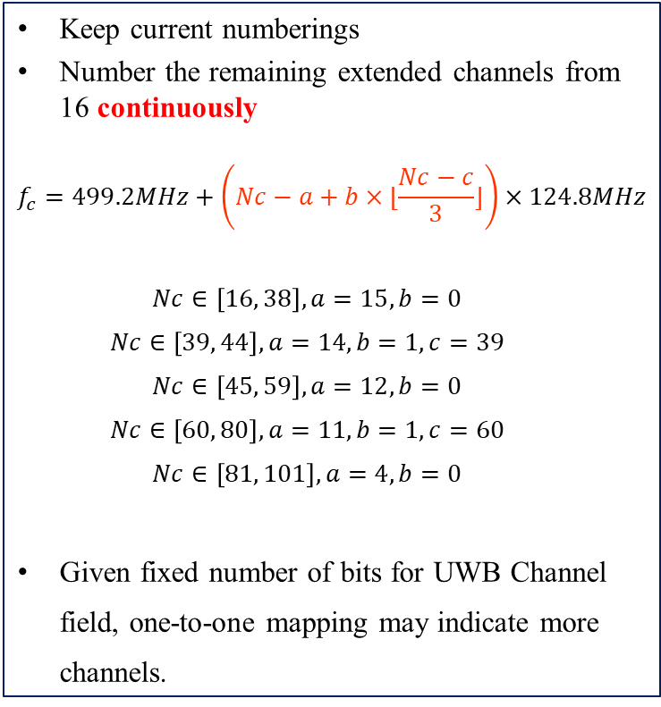
Option 1
Keep current numberings
Number the remaining extended channels from 16 continuously
  $$f_{c}=499.2MHz+\left(Nc−a+b×⌊\frac{Nc−c}{3}⌋\right)×124.8MHz$$
  $$Nc∈\left[16, 38\right],a=15, b=0$$
  $$Nc∈\left[39, 44\right],a=14, b=1,c=39$$
  $$Nc∈\left[45, 59\right],a=12, b=0$$
  $$Nc∈\left[60, 80\right],a=11, b=1,c=60$$
  $$Nc∈\left[81, 101\right],a=4, b=0$$
Given fixed number of bits for UWB Channel field, one-to-one mapping may indicate more channels.
fc | Nc | fc | Nc | fc | Nc | fc | Nc
499.2 | 0 | 3619.2 | 39 | 6739.2 | 61 | 9859.2 | 80
624 | 16 | 3744 | 40 | 6864 | 62 | 9984 | 14
748.8 | 17 | 3868.8 | 41 | 6988.8 | 6 | 10108.8 | 81
873.6 | 18 | 3993.6 | 2 | 7113.6 | 63 | 10233.6 | 82
998.4 | 19 | 4118.4 | 42 | 7238.4 | 64 | 10358.4 | 83
1123.2 | 20 | 4243.2 | 43 | 7363.2 | 65 | 10483.2 | 84
1248 | 21 | 4368 | 44 | 7488 | 8 | 10608 | 85
1372.8 | 22 | 4492.8 | 3 | 7612.8 | 66 | 10732.8 | 86
1497.6 | 23 | 4617.6 | 45 | 7737.6 | 67 | 10857.6 | 87
1622.4 | 24 | 4742.4 | 46 | 7862.4 | 68 | 10982.4 | 88
1747.2 | 25 | 4867.2 | 47 | 7987.2 | 9 | 11107.2 | 89
1872 | 26 | 4992 | 48 | 8112 | 69 | 11232 | 90
1996.8 | 27 | 5116.8 | 49 | 8236.8 | 70 | 11356.8 | 91
2121.6 | 28 | 5241.6 | 50 | 8361.6 | 71 | 11481.6 | 92
2246.4 | 29 | 5366.4 | 51 | 8486.4 | 10 | 11606.4 | 93
2371.2 | 30 | 5491.2 | 52 | 8611.2 | 72 | 11731.2 | 94
2496 | 31 | 5616 | 53 | 8736 | 73 | 11856 | 95
2620.8 | 32 | 5740.8 | 54 | 8860.8 | 74 | 11980.8 | 96
2745.6 | 33 | 5865.6 | 55 | 8985.6 | 12 | 12105.6 | 97
2870.4 | 34 | 5990.4 | 56 | 9110.4 | 75 | 12230.4 | 98
2995.2 | 35 | 6115.2 | 57 | 9235.2 | 76 | 12355.2 | 99
3120 | 36 | 6240 | 58 | 9360 | 77 | 12480 | 100
3244.8 | 37 | 6364.8 | 59 | 9484.8 | 13 | 12604.8 | 101
3369.6 | 38 | 6489.6 | 5 | 9609.6 | 78
3494.4 | 1 | 6614.4 | 60 | 9734.4 | 79
Notes:
保留现有number不变，新增的从16开始编

Slide 7
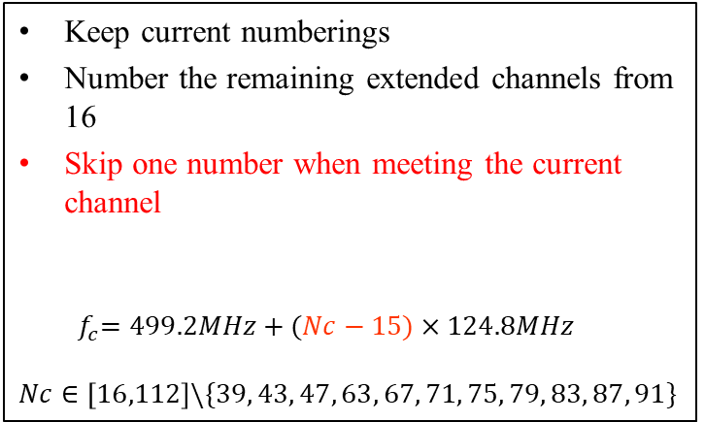
Option 2
fc | Nc | fc | Nc | fc | Nc | fc | Nc
499.2 | 0 | 3619.2 | 40 | 6739.2 | 65 | 9859.2 | 90
624 | 16 | 3744 | 41 | 6864 | 66 | 9984 | 14
748.8 | 17 | 3868.8 | 42 | 6988.8 | 6 | 10108.8 | 92
873.6 | 18 | 3993.6 | 2 | 7113.6 | 68 | 10233.6 | 93
998.4 | 19 | 4118.4 | 44 | 7238.4 | 69 | 10358.4 | 94
1123.2 | 20 | 4243.2 | 45 | 7363.2 | 70 | 10483.2 | 95
1248 | 21 | 4368 | 46 | 7488 | 8 | 10608 | 96
1372.8 | 22 | 4492.8 | 3 | 7612.8 | 72 | 10732.8 | 97
1497.6 | 23 | 4617.6 | 48 | 7737.6 | 73 | 10857.6 | 98
1622.4 | 24 | 4742.4 | 49 | 7862.4 | 74 | 10982.4 | 99
1747.2 | 25 | 4867.2 | 50 | 7987.2 | 9 | 11107.2 | 100
1872 | 26 | 4992 | 51 | 8112 | 76 | 11232 | 101
1996.8 | 27 | 5116.8 | 52 | 8236.8 | 77 | 11356.8 | 102
2121.6 | 28 | 5241.6 | 53 | 8361.6 | 78 | 11481.6 | 103
2246.4 | 29 | 5366.4 | 54 | 8486.4 | 10 | 11606.4 | 104
2371.2 | 30 | 5491.2 | 55 | 8611.2 | 80 | 11731.2 | 105
2496 | 31 | 5616 | 56 | 8736 | 81 | 11856 | 106
2620.8 | 32 | 5740.8 | 57 | 8860.8 | 82 | 11980.8 | 107
2745.6 | 33 | 5865.6 | 58 | 8985.6 | 12 | 12105.6 | 108
2870.4 | 34 | 5990.4 | 59 | 9110.4 | 84 | 12230.4 | 109
2995.2 | 35 | 6115.2 | 60 | 9235.2 | 85 | 12355.2 | 110
3120 | 36 | 6240 | 61 | 9360 | 86 | 12480 | 111
3244.8 | 37 | 6364.8 | 62 | 9484.8 | 13 | 12604.8 | 112
3369.6 | 38 | 6489.6 | 5 | 9609.6 | 88
3494.4 | 1 | 6614.4 | 64 | 9734.4 | 89
Keep current numberings
Number the remaining extended channels from 16
Skip one number when meeting the current channel
  $${ f}_{c}=499.2MHz+(Nc−15)×124.8MHz$$
  $$Nc∈\left[16,112\right]\backslash \{39, 43, 47, 63, 67, 71, 75, 79, 83, 87, 91\}$$
Notes:
保留现有编号，新增的从16开始编，遇到现有信道跳1个number

Slide 8
Straw Poll
Which kind of channel numbering do you prefer?
  A: Duplicated channel numbering
  B: One-to-one channel numbering
  C: Abstain

Slide 9
Thank You

