Slide 1
Project: IEEE P802.15 Working Group for Wireless Specialty Networks (WSN)
Submission Title: Discussion issues on the initial SA Ballot comment resolution for CIDs I-1 to I-50 (doc. 15-24-0072-11-007a) and IEEE P802.15.7a D7 redline draft
Date Submitted: April 22, 2024
Source: Sang-Kyu Lim [ETRI]
Address: 218 Gajeong-ro, Yuseong-gu, Daejeon, 34129, Korea
Voice:[+82-42-860-1573], FAX: [+82-42-860-5218], E-Mail:[sklim@etri.re.kr]
Re:
Abstract: This document is to resolve the initial SA ballot comments and to update IEEE P802.15.7a draft
Purpose: Contribution to IEEE P802.15.7a
Notice: This document has been prepared to assist the IEEE P802.15. It is offered as a basis for discussion and is not binding on the contributing individual(s) or organization(s). The material in this document is subject to change in form and content after further study. The contributor(s) reserve(s) the right to add, amend or withdraw material contained herein.
Release: The contributor acknowledges and accepts that this contribution becomes the property of IEEE and may be made publicly available by P802.15.

Slide 2
Discussion issues on the initial SA Ballot
comment resolution for CIDs I-1 to I-50
(doc. 15-24-0072-11-007a)
and IEEE P802.15.7a D7 redline draft
Sang-Kyu Lim [ETRI]

Slide 3

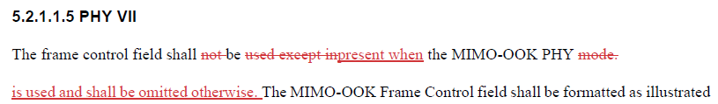
CID# I-1
D6 Draft
Current D7 Draft
5.2.1.1.5 PHY VII
The frame control field shall not be used except in the MIMO-OOK PHY mode.
The frame control field shall be present when the MIMO-OOK PHY is used and shall be omitted otherwise.
Suggestion for D7 Draft
It’s better if the changes are expressed like this so that readers can track the changes easily.

Slide 4
CID# I-2
“Change L19 to L22 as indicated below: ”
See the comment, I-12. It should be “a”.
Current D7 Draft
The sentences in the disposition details do not match exactly the sentences in D7 redline. So, we need to check again the disposition details and D7 draft.

Slide 5
CID# I-3
typo here in the proposed change
Current D7 Draft
Suggestion for
Comment resolution
Disposition Status : ACCEPTED → REVISED
Disposition Detail : “Blank” → Replace the sentences in L4 to L6 by “This amendment adds new transmission modes with higher rate and longer range to IEEE Std 802.15.7-4 2018.”
It’s better if the comment resolution are changed like this to satisfy the comment resolution guidelines.

Slide 6
CID# I-6
“Change L4 to L10 in p18 as indicated below: ”
“delete”
Current D7 redline
It’s better if the disposition detail in this comment is changed like this to satisfy the comment resolution guidelines.

Slide 7
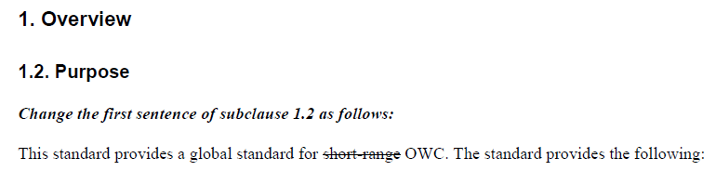
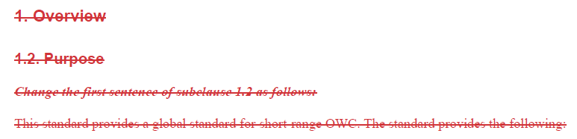
CID# I-8 and I-9
D6 Draft
Current D7 Draft
The comments related to 1.2 are only I-8 and I-9. Two comments have been rejected as shown above. However, the sub-clause 1.2 has been deleted in the current D7 draft as shown above. What happened to this ?

Slide 8

CID# I-10
“Change L2 to L5 in p13 as indicated below: ”
“the”
Current D7 Draft
It’s better if the disposition detail in this comment is changed like this to satisfy the comment resolution guidelines.

Slide 9
CID# I-11
“Change L2 to L5 in p13 as indicated below: ”
“the”
Current D7 Draft
It’s better if the disposition detail in this comment is changed like this to satisfy the comment resolution guidelines.

Slide 10
CID# I-17
“Change the description for
“phyMimoCookSubPacketLength”
on p25 as indicated below: ”
It’s better if the disposition detail in this comment is changed like this to satisfy the comment resolution guidelines.

Slide 11
CID# I-18
“Change the description for
“phyNomaSubPacketLength”
on p25 as indicated below: ”
It’s better if the disposition detail in this comment is changed like this to satisfy the comment resolution guidelines.

Slide 12
CID# I-19
“Change the description for
“phyMimoOokSubPacketLength”
on p26 as indicated below: ”
It’s better if the disposition detail in this comment is changed like this to satisfy the comment resolution guidelines.

Slide 13
CID# I-22
“And also, replace all of
‘phyNomaSubPacketLength’ by
‘phyNomaPacketLength’.”
The disposition detail on this comment says only “Remove sentence ‘The data packet length of O-NOMA shall be configured via the PHY PIB attribute phyNomaSubPacketLength.’ in sub-clause 16.3.5.”. By the way, it has been found that some changes have been done without any disposition details or proposed changes in the current D7 redline. That is a big problem.
For examples, “phyNomaSubPacketLength phyNomaPacketLength” on page 28, page 34, and page 35 does not have any corresponding deposition details or proposed change. Thus, if the changes are needed, then “Replace all of ‘phyNomaSubPacketLength’ by ‘phyNomaPacketLength’.” should be added in this disposition detail.

Slide 14
CID# I-24
Change L10 to L11 in p35
as indicated below:
“The data packet structure
of hybrid modulation scheme
is described in Figure 216m.”
“REVISED”
Current D7 Draft
The disposition status and the disposition detail in this comment should be changed like this to satisfy the comment resolution guidelines.

Slide 15
CID# I-25
“Change all of the text in 16.5.3.3 as indicated below: ”
It should be “an AM”.
It should be “The PPM”.
“ ? ”
“punctuation missing”
There is no “disposition detail” on how they are updated. And also, see the next slide.
The sentences in the disposition details do not match exactly the sentences in D7 redline. So, we need to check again the disposition details and D7 draft.

Slide 16
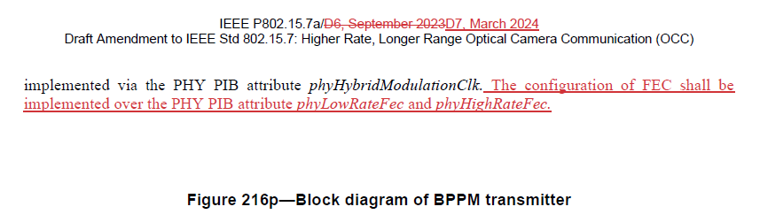
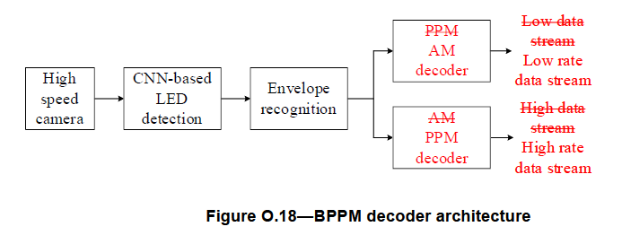
CID# I-25 (continued)
Page 41 in the current D7 draft
“Blank”
“Disposition detail” on these changes is not found. So, we need to check again the disposition details and D7 draft.

Slide 17
CID# I-26
“Change all of the text in O.1.3 as indicated below: ”
“the Sequence Number. SN ” in D7 draft,
so what is correct ?
The sentences in the disposition details do not match exactly the sentences in D7 redline. So, we need to check again the disposition details and D7 draft.

Slide 18
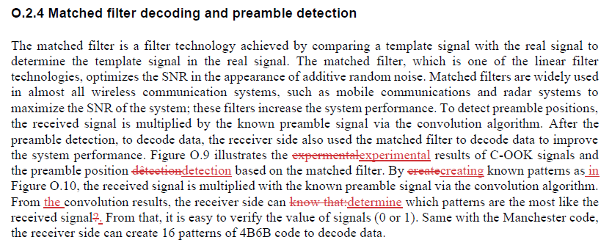
CID# I-29
Change L9 to L14 in p42
as indicated below:
“Figure O.9 illustrates the experimental results of C-OOK signals and the preamble position detection based on the matched filter. By creating known patterns as in Figure O.10, the received signal is multiplied with the known preamble signal via the convolution algorithm. From the convolution results, the receiver side can determine which patterns are the most likely in the received signal. From that, it is easy to verify the value of signals (0 or 1). Same with the Manchester code, the receiver side can create 16 patterns of 4B6B code to decode data.”
“REVISED”
Current D7 Draft
“ ? ”
“ I-27 ”
“ I-28 ”
“ ? ”
“ I-29 ”
The sentences in the proposed change do not match exactly the sentences in D7 redline. So, we need to check again the disposition status and D7 draft.

Slide 19
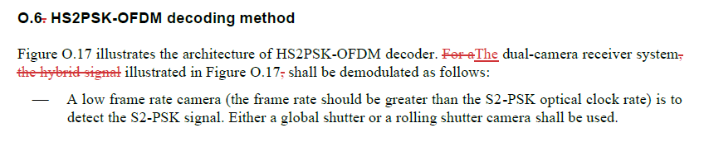
CID# I-31
Change L13 to L14 in p44
as indicated below:
“Figure O.17 illustrates the architecture of HS2PSK-OFDM decoder. The dual-camera receiver system illustrated in Figure O.17 shall be demodulated as follows:”
“REVISED”
Current D7 Draft
“ ? ”
“ ? ”
The sentences in the proposed change do not match exactly the sentences in D7 redline. So, we need to check again the disposition status and D7 draft.

Slide 20
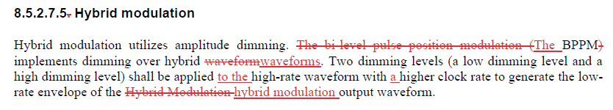
CID# I-32
Change L23 to L26 in p20
as indicated below:
“Hybrid modulation utilizes amplitude dimming. The BPPM implements dimming over hybrid waveforms. Two dimming levels (a low dimming level and a high dimming level) shall be applied to the high-rate waveform with a higher clock rate to generate the low-rate envelope of the hybrid modulation output waveform.”
“REVISED”
Current D7 Draft
“ Which comment is related to this change ? ”
The sentences in the proposed change do not match exactly the sentences in D7 redline. So, we need to check again the disposition status and D7 draft.

Slide 21
CID# I-36
Change all of the sub-clause numbering style from “x.y.” to “x.y”
The current disposition detail does not say all of the changes related to this comment. So, the disposition detail should be changed to like this for convenience. For examples, 16.1, 16.1.1, 16.1.2. 16.1.3 and so on have been changed in D7 draft as well.

Slide 22
CID# I-37
This is not a wrong comment.
“REJECTED”
The disposition status on this comment should be changed to “REJECTED” because it is not a wrong comment.

Slide 23
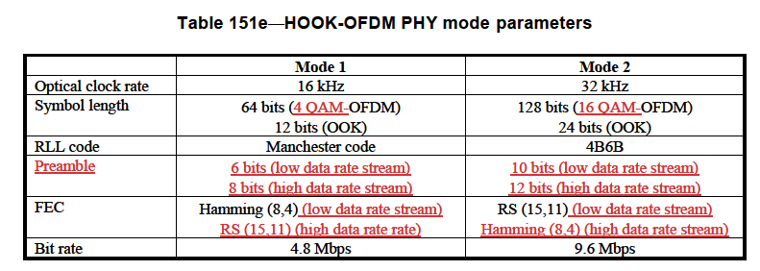
CID# I-38
“It’s not clear.”
Table 79a in the current D7 draft
Table 151e in the current D7 draft
Re-specify the disposition detail in order to clarify the changes in Table 79a and Table 151e which means “what” has been changed to “what” and “what” has been added to these tables.

Slide 24
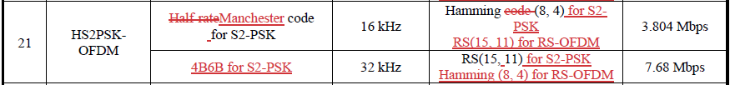
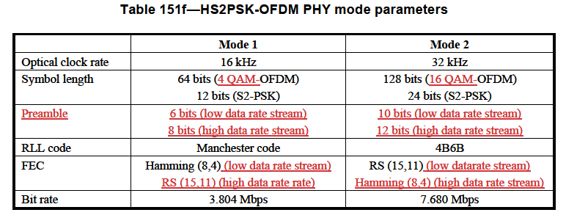
CID# I-39
“It’s not clear.”
Table 79a in the current D7 draft
Table 151f in the current D7 draft
Re-specify the disposition detail in order to clarify the changes in Table 79a and Table 151f which means “what” has been changed to “what” and “what” has been added to these tables.

Slide 25
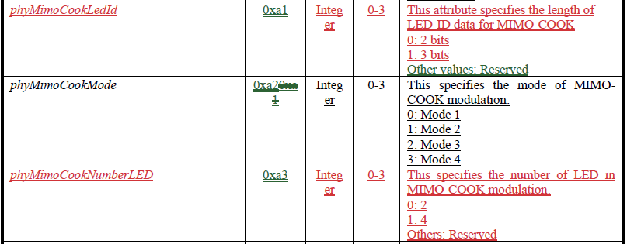
CID# I-44
Re-specify the disposition detail in order to clarify the changes in Table 115
“Change all of the text in 16.2.7 as indicated below: ”
“the”
∨
“number”
Table 115 in the current D7 draft
What makes this change ?
The disposition details do not match exactly the sentences in D7 redline. So, we need to check again the disposition details and D7 draft.

Slide 26
CID# I-45
Change the power levels for Mode 2
in Table 151c from “2” to “3”.
It’s better if the disposition detail in this comment is changed like this in order to clarify the changes in Table 151c, which means “what” has been changed to “what”.

Slide 27

CID# I-48
“Change all of the text in 16.4.3 as indicated below: ”
p37 in the current D7 draft
“the”
∨
“FEC”
∨
“Change the description for
“phyMimoOokFec” in Table 115
as indicated below: ”
It’s better if the disposition detail in this comment is changed like this to satisfy the comment resolution guidelines.

Slide 28
CID# I-50
Add the new attribute for Hybrid modulation to Table 115 as indicated below:
“Attribute : phyHybridModulationRLLCode”
“Identifier : 0xb8”
“Type : Integer”
“Range : ”
“Description : This specifies the RLL coding for hybrid modulation.
0: Manchester
1: 4B6B coding
Other values: Reserved”
Change all of the text
in 16.5.3.1 as indicated below:
“ at ” in D7 redline ?
“ of ” in D7 redline ?
“ preambles ” in D7 redline ?
The disposition details do not match exactly the sentences in D7 redline. So, we need to check again the disposition details and D7 draft.

