Slide 1
        Doc.: IEEE 15-24-0220-00-04ab
Project: IEEE P802.15 Working Group for Wireless Personal Area Networks (WPANs)
Submission Title: time efficient MMS for one-to-many DS-TWR ranging
Date Submitted: [April 29, 2024]
Source: [Zhongxing Yu, (Calterah)]
Email: zhongxing.yu@calterah.com
Re: [Input to the Working Group]
Abstract: [Recommendation how to apply MMS in car ranging scenario with time efficient ranging ]
Purpose: []
Notice: This document has been prepared to assist the IEEE P802.15. It is offered as a basis for discussion and is not binding on the contributing individual(s) or organization(s). The material in this document is subject to change in form and content after further study. The contributor(s) reserve(s) the right to add, amend or withdraw material contained herein.
Release: The contributor acknowledges and accepts that this contribution becomes the property of IEEE and may be made publicly available by P802.15.

Slide 2
time efficient MMS for one-to-many DS-TWR ranging
        Doc.: IEEE 15-24-0220-00-04ab
In Chapter 10.38.9.3 Time Efficient one-to-many ranging, it says about time efficient MMS for SS-TWR ranging. But in most scenario ,DS-TWR is more popular than SS-TWR. This doc want to discuss how to apply time efficient MMS for one-to-many DS-TWR ranging.

Slide 3
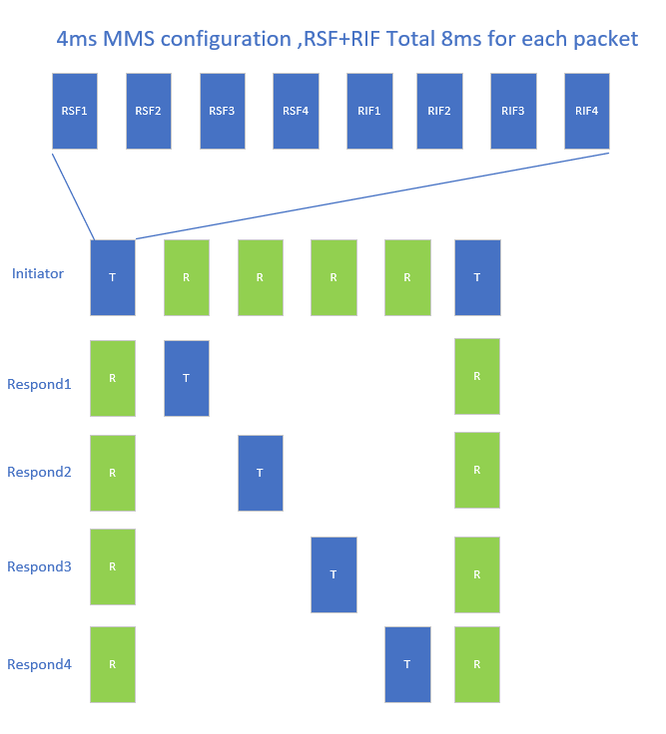
time efficient MMS for one-to-many DS-TWR ranging
        Doc.: IEEE 15-24-0220-00-04ab
In the right chart, there are 1 initiator and 4 responders, and MMS is configured 4 RSFs and 4 RIFs. If we do not apply time efficient actions, the all the ranging time will come up to 6*8 = 48ms.
4ms RSF + 4ms RIF = 8ms
1 initiator with 4 responders ranging need 6 packet , so total time is 6*8=48ms

Slide 4
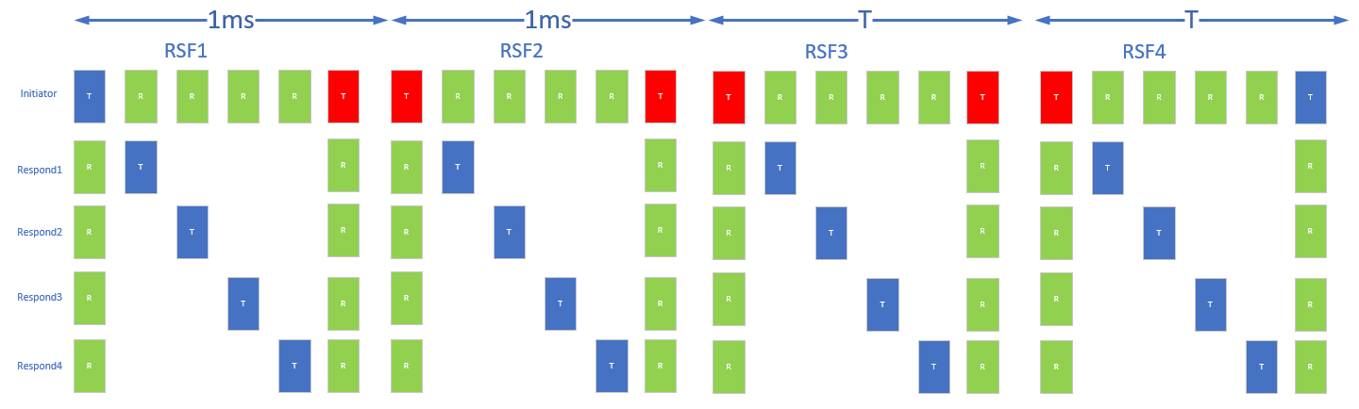
time efficient MMS for one-to-many DS-TWR ranging
        Doc.: IEEE 15-24-0220-00-04ab
Firstly , I study the chapter 10.38.9.3 Time Efficient one-to-many ranging , I lay many RSF in 1ms. But it doesn’t work because the initiator need Tx two time in ranging process, the last Tx RSF in last RSF period will be adjacent to the first Tx RSF in next RSF period. This conflict the principle of Tx one time in 1ms.

Slide 5
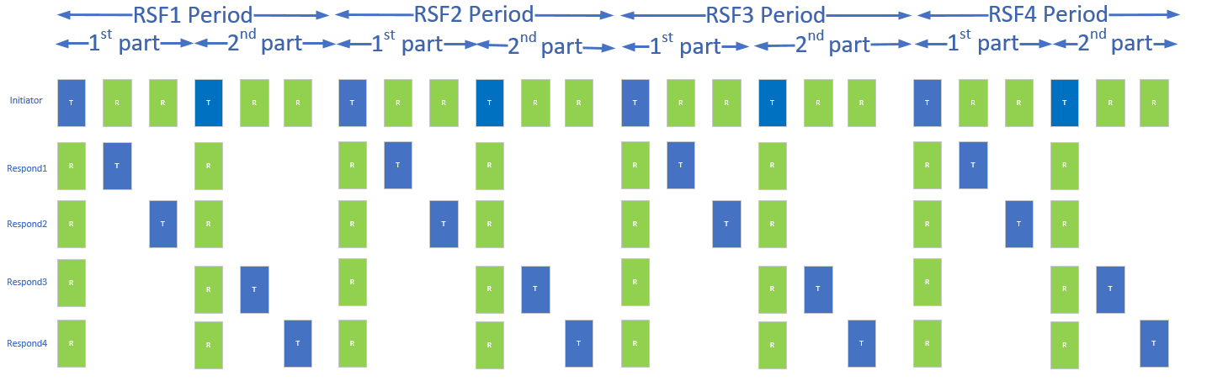
time efficient MMS for one-to-many DS-TWR ranging
        Doc.: IEEE 15-24-0220-00-04ab
the initiator Tx RSFs are distributed in the periods evenly after changed the last Tx RSF into the middle period.
In the below case ,1 initiator is ranging with 4 responders. The responder 1 and 2 are applying DS-TWR with initiator.
But the responder 3 and 4 applying eSS-TWR ranging. For example, initiator ranging with responder3 , initiator do TxTxRx and respdonder3 do RxRxTx.

Slide 6
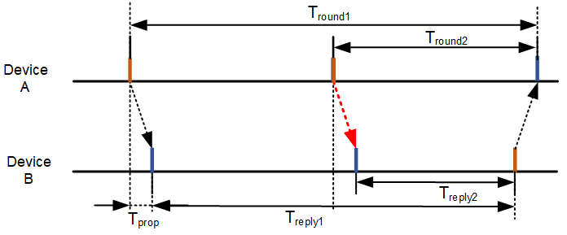
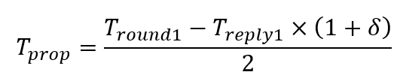

time efficient MMS for one-to-many DS-TWR ranging
        Doc.: IEEE 15-24-0220-00-04ab
The below is a chart describe the eSS-TWR. DeviceA do TxTxRx and DeviceB do RxRxTx.
The ranging error is C*Tf* clock_errorA.
It is like DS-TWR which ranging error is .C*Tf* (clock_errorA+ clock_errorB)/2
Prop time formula
Inside，

Slide 7
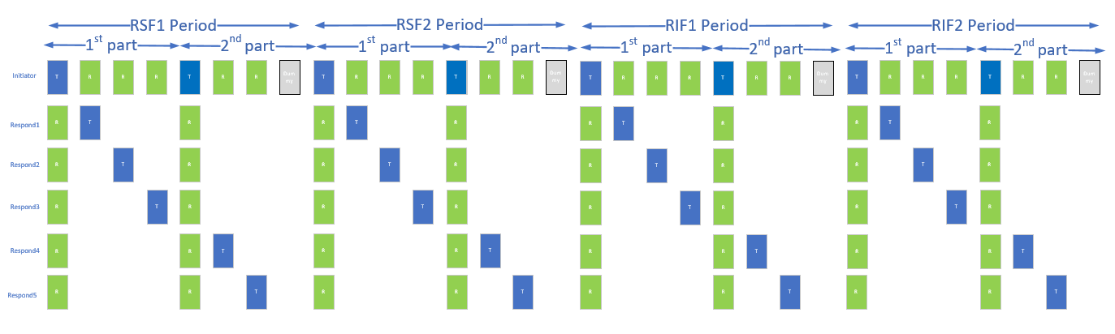
time efficient MMS for one-to-many DS-TWR ranging
        Doc.: IEEE 15-24-0220-00-04ab
If there are odd number responders, we need to fill a dummy RSF time, and then the all RSFs/RIFs will be distributed evenly. In below picture, there are 5 responders, 1/2/3 responders are using DS-TWR ranging ,the 4/5 responders using eSS-TWR ranging.
The first part is configured to 1ms and second part is also configured to 1ms when the ceil(responder number/2) * packet time < 1ms, otherwise they should be configured to 2ms. The “1ms” is equal to 1200RSTU.

Slide 8
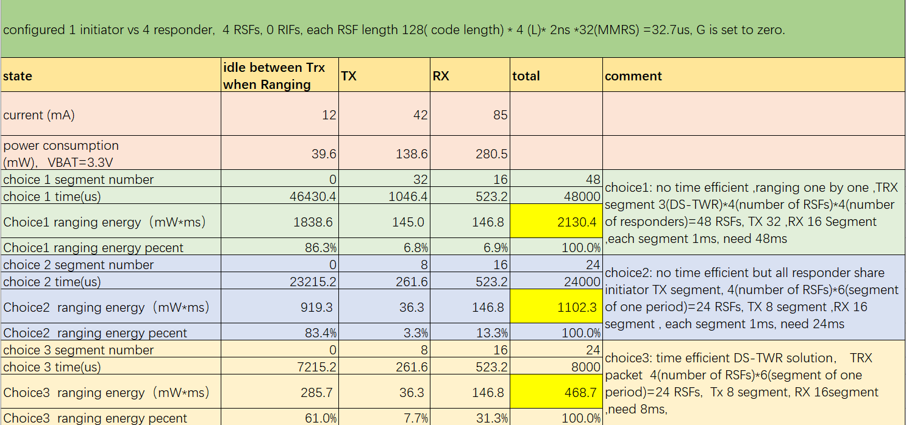
time efficient MMS for one-to-many DS-TWR ranging
        Doc.: IEEE 15-24-0220-00-04ab
Power consumption analysis: Choice3(suggested solution) has great advantages in power consumption, The power consumption of new solution is 1/5 that of the ranging one by one solution.
Time consumption analysis: Choice3(suggested solution) has great advantages in time consumption, The time consumption of new solution is 1/6 that of the ranging one by one solution.

Slide 9
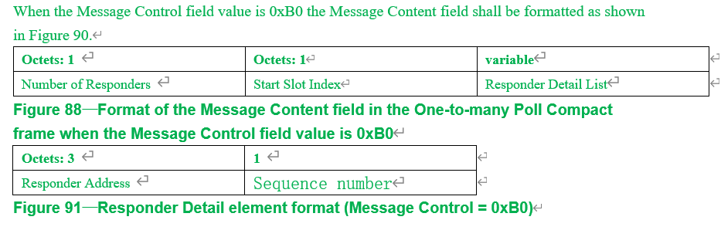
time efficient MMS for one-to-many DS-TWR ranging
        Doc.: IEEE 15-24-0220-00-04ab
Mac protocol modification suggestion:
Modification 1: add a new chapter to descript “Time Efficient one-to-many DS-TWR ranging”
10.38.9.3 Time Efficient one-to-many ranging
10.38.9.3.1 Time Efficient one-to-many SS-TWR ranging
10.38.9.3.2 Time Efficient one-to-many DS-TWR ranging
Modification 2:add words after
“When the Message Control field value is 0xA0 the Message Content is the same as for Message Control
field value is 0x90, except this one-to-many poll Compact frame is signaling that both initiator and
responder devices are to send a measurement report.”

Slide 10
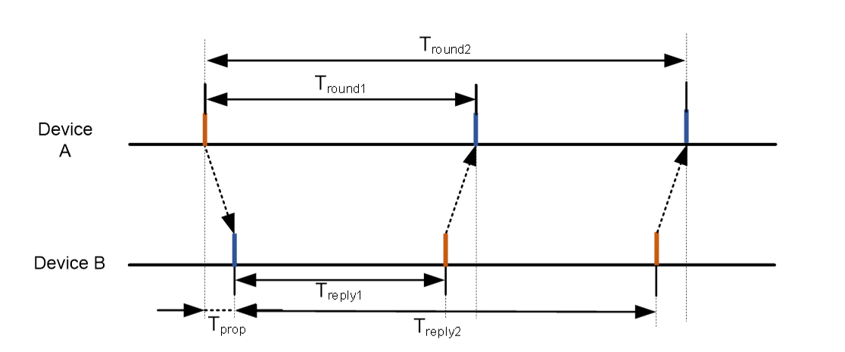
time efficient MMS for one-to-many DS-TWR ranging
        Doc.: IEEE 15-24-0220-00-04ab
Standard ESS-TWR
Suggested new ranging method in this solution is renamed to ESS-TWR type2 or DS-TWR type2

