Slide 1
IG NG-OCC
Submission Title: Towards the design of secure communication for OCC enabled vehicular networks for NG-OCC (May 2024)
Date Submitted: May 16, 2024
Source: Muhammad Adnan, Nguyen Ngoc Huy, Yeong Min Jang, Kookmin University
Address: Room #603 Mirae Building, Kookmin University, 77 Jeongneung-Ro, Seongbuk-Gu, Seoul, 136702, Republic of Korea
Voice: +82-2-910-5068 E-Mail: yjang@kookmin.ac.kr
Re:
Abstract: Present the design of secure communication for OCC enabled vehicular networks for NG-OCC
Purpose: Presentation for contribution on IG NG-OCC
Notice: This document has been prepared to assist the IG NG-OCC. It is offered as a basis for discussion and is not binding on the contributing individual(s) or organization(s). The material in this document is subject to change in form and content after further study. The contributor(s) reserve(s) the right to add, amend or withdraw material contained herein.
Release: The contributor acknowledges and accepts that this contribution becomes the property of IEEE and may be made publicly available by IG NG-OCC.

Slide 2
Towards the design of secure communication for OCC enabled vehicular networks for NG-OCC
May 16, 2024

Slide 3
Contents
Background
    OCC enabled vehicular networks
    Security issues in OCC enabled vehicular networks
Design of secure communication for OCC enabled vehicular networks for NG-OCC
    PKI based digital signature scheme for OCC enabled vehicular networks
Conclusion

Slide 4
Background: OCC Enabled Vehicular Networks
The OCC-based vehicular network presented in [1], combines cloud and vehicular communication for real-time V2V and V2I communication.
It includes four forms: OCC-based V2V and V2I communication, Wi-Fi or cellular-based V2C and I2C communication, and traffic lights.
The system uses vehicle backlight LED lights and a camera to transmit vehicle status and event notifications.

Slide 5
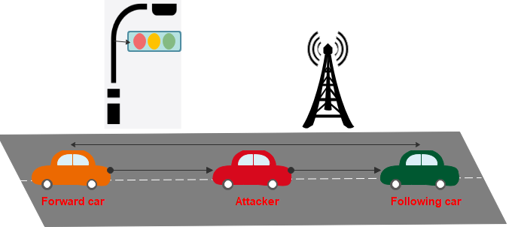
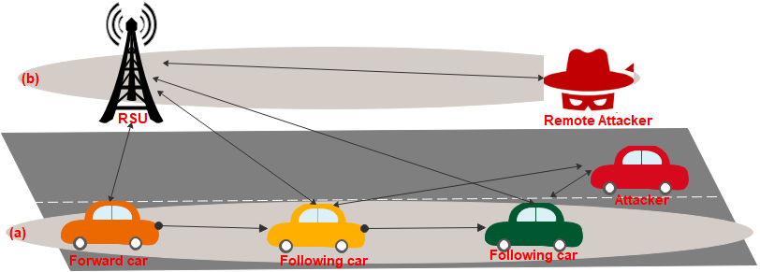
Security Issues in OCC Enabled Vehicular Networks for NG-OCC
Next-generation OCC faces difficulties in securing V2V and V2I communication. Because of early synchronization, man-in-the-middle monitoring, and high-intensity ambient light jamming [2]. Resolving these concerns is essential to OCC's success, as they guarantee privacy, secure deployment, and effective communication.
Man in the middle attack:
A type of cyberattack known as a "man-in-the-middle" occurs when a third party secretly intercepts communication between two parties as shown in Fig.1.
The attacker has the ability to alter communication, listen in on conversations, and possibly even take important information that is shared between the two parties.
Remote attacker:
Remote attackers can intercept optical camera communication, potentially accessing sensitive information and manipulating data [3]. Implementing strong encryption protocols and secure communication channels can help prevent such attacks.
Following afar adversary:
A "following afar adversary" refers to a scenario where a candidate vehicle is following the verifier vehicle at a distance, and the verifier transmits randomly generated checkpoints or following distances to the candidate within a defined time frame as shown in Fig.2.
Fig.1: Man in the middle attack scenario
Fig.2: (a) Following afar adversary (b) Remote adversary

Slide 6
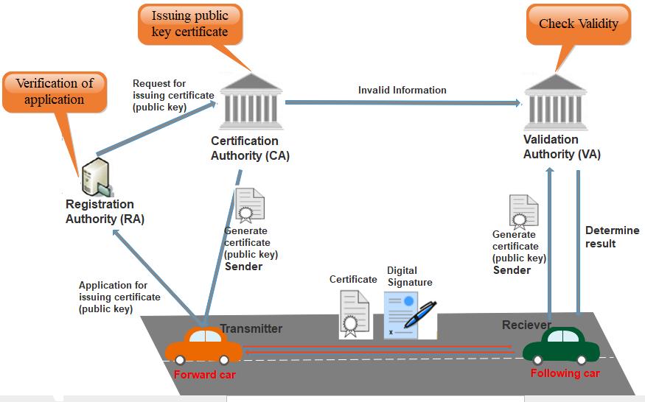
PKI Based Digital Signature for OCC Enabled Vehicular Networks
Fig.3: PKI based digital signature for OCC enabled V2V communication

Slide 7
Conclusion
Security and privacy are the main research dimensions to be considered in the development of OCC-enabled vehicle networks, such as their V2V and V2I communication.
A common attack, like a man-in-the middle attack, a remote attack, and a following-afar adversary, is faced by OCC-enabled vehicle networks.
To protect the network from the above attacks, a PKI-based digital signature is proposed that provides basic security properties like authenticity, integrity, and non-repudiation.
A strong method for protecting OCC-enabled vehicle networks is offered by PKI-based digital signatures. Building trust and improving the security of communications inside these networks are made possible by their assurance of authenticity, integrity, and non-repudiation.
Combining these two improves the efficiency, safety, and dependability of vehicles networks.

Slide 8
Reference
[1] Hasan, M. K., Ali, M. O., Rahman, M. H., Chowdhury, M. Z., & Jang, Y. M. (2021). Optical camera communication in vehicular applications: A review. IEEE transactions on intelligent transportation systems, 23(7), 6260-6281.
[2]Dao, Nhu-Ngoc, et al. "Information Revealed by Vision: A Review on the Next-Generation OCC Standard for AIoV." IT Professional 24.4 (2022): 58-65.
[3] Plattner, Michael, Erik Sonnleitner, and Gerald Ostermayer. "A Security Protocol for Vehicle Platoon Verification Using Optical Camera Communications." IEEE Transactions on Intelligent Transportation Systems (2024).

