Slide 1
IG NG-OCC
Submission Title: Deep Learning-Based Channel Modeling in BPSK SIM FSO/OCC Communication(May 2024)
Date Submitted: May 14, 2024
Source: AL-IMRAN, Nguyen Ngoc Huy, Yeong Min Jang, Kookmin University
Address: Room #603 Mirae Building, Kookmin University, 77 Jeongneung-Ro, Seongbuk-Gu, Seoul, 136702, Republic of Korea
Voice: +82-2-910-5068 E-Mail: yjang@kookmin.ac.kr
Re:
Abstract: Present the use case ResCNN for NG-OCC
Purpose: Presentation for contribution on IG NG-OCC
Notice: This document has been prepared to assist the IG NG-OCC. It is offered as a basis for discussion and is not binding on the contributing individual(s) or organization(s). The material in this document is subject to change in form and content after further study. The contributor(s) reserve(s) the right to add, amend or withdraw material contained herein.
Release: The contributor acknowledges and accepts that this contribution becomes the property of IEEE and may be made publicly available by IG NG-OCC.

Slide 2
Deep Learning-Based Channel Modeling in BPSK SIM FSO/OCC Communication
May 14, 2024

Slide 3
Contents
Introduction
Free Space Optical Communication
Channel Modeling
Result and Discussion

Slide 4
Introduction
Free Space Optical (FSO) communication is a wireless communication technology that uses light to transmit data through free space, typically in the form of laser beams. It operates by sending modulated light signals through the atmosphere, with the receiver detecting and interpreting these signals. FSO offers high bandwidth and security, but its performance can be affected by weather conditions such as fog, rain, or snow.
Channel modeling is a fundamental aspect of wireless communication system design. It refers to the process of creating mathematical or statistical models to simulate the behavior and characteristics of a communication channel.

Slide 5
Channel Estimation
Conventional Channel Estimation
  Least Square Estimation (LS)(1)
  Least Minimum Mean Squared Error (LMMSE)(2)
  Maximum Likelihood Estimation (ML)
Machine Learning Based Channel Estimation
  Deep learning based (3)
  Conventional Neural Network based (4)
  Deep Residual Learning (5)
  FFDNet-based (6)
  ResCBDNet
References
1.Y. S. Hussein, M. Y. Alias, and A. A. Abdulkafi, “On performance analysis of LS and MMSE for channel estimation in VLC systems,” in Proc. IEEE 12th Int. Colloq. Signal Process. Appl. (CSPA), Melaka, Malaysia, 2016, pp. 204–209.
2. X. Shi, S.-H. Leung, and J. Min, “Adaptive least squares channel estimation for visible light communications based on tap detection,” Opt. Commun., vol. 467, Jul. 2020, Art. no. 125712
3. C.-J. Chun, J.-M. Kang, and I.-M. Kim, “Deep learning-based channel estimation for massive MIMO systems,” IEEE Commun. Lett., vol. 8, no. 4, pp. 1228–1231, Aug. 2019.
4. G. Fan, J. Sun, G. Gui, H. Gacanin, B. Adebisi, and T. Ohtsuki, “Fully convolutional neural network-based CSI limited feedback for FDD massive MIMO systems,” IEEE Trans. Cogn. Commun. Netw., vol. 8, no. 2, pp. 672–682, Jun. 2022
5. C. Liu, X. Liu, D. W. K. Ng, and J. Yuan, “Deep residual learning for channel estimation in intelligent reflecting surface-assisted multiuser communications,” IEEE Trans. Wireless Commun., vol. 21, no. 2, pp. 898–912, Feb. 2022.
6. Z. Gao, Y. Wang, X. Liu, F. Zhou, and K.-K. Wong, “FFDNet-based channel estimation for massive MIMO visible light communication systems,” IEEE Wireless Commun. Lett., vol. 9, no. 3, pp. 340–343, Mar. 2020.
.

Slide 6
Channel Modeling
Difference between conventional and machine learning base channel estimation
Using ML for channel estimation can offer advantages in scenarios where traditional methods may struggle to adapt to changing and complex channel conditions like (atmospheric turbulence or mobility of optical sources).
DRL algorithms have the capability to learn and adapt to non-linear and non-stationary channel conditions, which may be difficult for traditional estimation techniques such as Least Squares Estimation, Maximum Likelihood Estimation (MLE) that assume linearity and stationarity.
Traditional estimation methods may assume Gaussian noise(electronic and thermal noise). which may not accurately represent real-world noise characteristics in FSO/OCC systems. ML can learn to handle non-Gaussian noise distributions(Atmospheric turbulence).
Traditional methods often rely on assumptions about the channel, noise, or environmental conditions. ML, being a model-free approach, can learn directly from data without making strong assumptions.

Slide 7
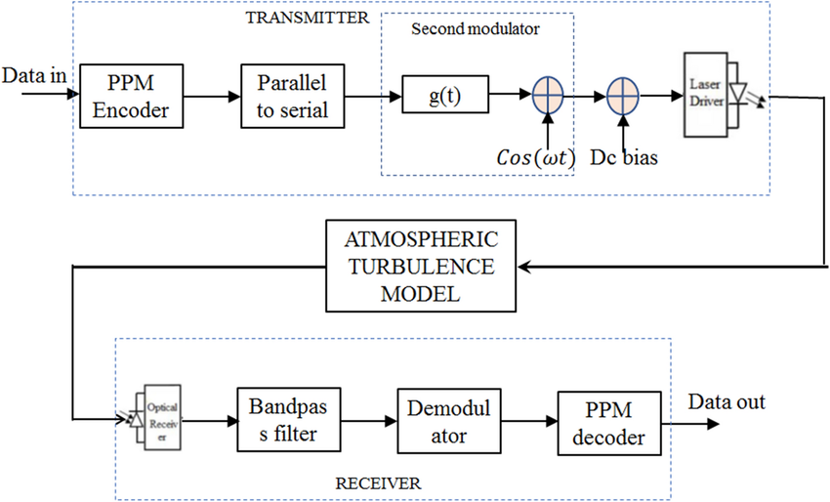
Existing BPSK SIM FSO System

Slide 8


Proposed Model
The source data d(t) modulated with carrier signal. The modulated signal, denoted by x(t), is transmitted by an FSO transmitter across an atmospheric turbulence channel, where it encounters thermal, background and quantum noise at the FSO receiver with zero mean and a variance.
The signal received at the receiver is fed into our model.We train the model using noisy received signal and corresponding transmitted signal with various levels of noise and fading before testing.The training goal is to minimize the difference between the output of the ResCNN and the desired or transmitted signal.
d(t)
x(t)
$$P_{T}$$
B-PSK
∑
Drive Circuit
SIM-Modulation
$$b_{0}$$
DC bias
Weak
Moderate
Strong Turbulent
FSO Link
Photo- Diode
y(t)
d(t)
∑
Residual CNN
De-modulation
n(t)
Noise

Slide 9
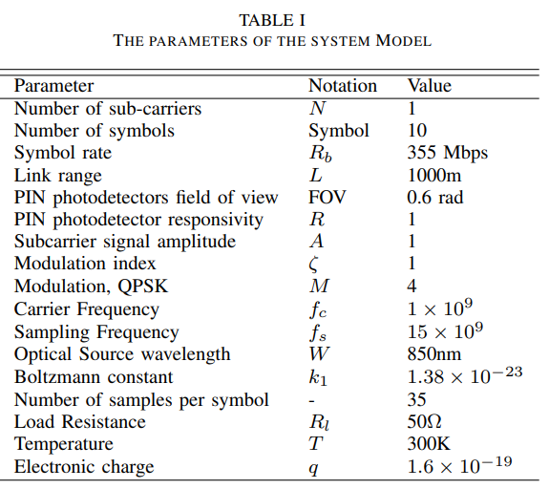
Simulation Parameter

Slide 10
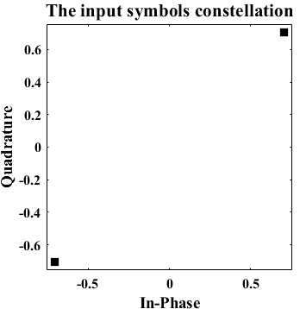
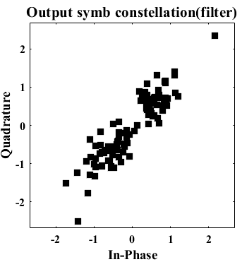
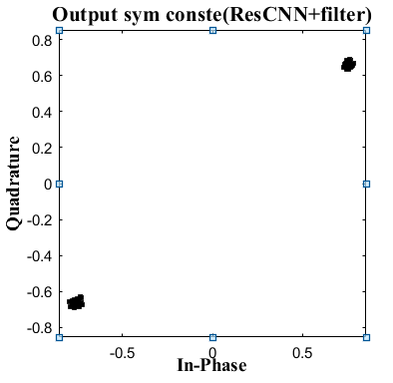
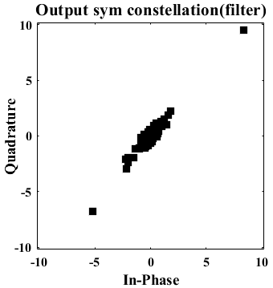
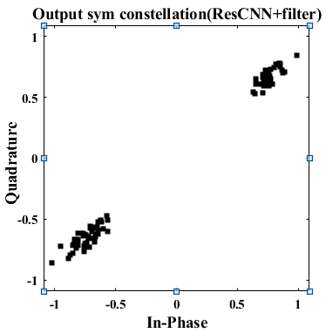
Results and Discussion

Slide 11
Conclusion
In strong fading, the output constellation points become more staggered and move towards the center of the plot when using a normal filter.The constellations are clearly confined within their respective quadrants when we mitigate the turbulence effect by using the ResCNN model.It simplifies the estimation of the absolute phase of QPSK modulation, thereby reducing the error probability during the detection process.

Slide 12
Reference
[1] G. Fan, J. Sun, G. Gui, H. Gacanin, B. Adebisi, and T. Ohtsuki, “Fully convolutional neural network-based CSI limited feedback for FDD massive MIMO systems,” IEEE Trans. Cogn. Commun. Netw., vol. 8, no. 2, pp. 672–682, Jun. 2022.
[2] J. Fan, P. Liang, Z. Jiao, and X. Han, “A compressive sensing and deep learning-based time-varying channel estimation for FDD massive MIMO systems,” IEEE Trans. Veh. Technol., vol. 71, no. 8, pp. 8729–8738, Aug. 2022.
[3] A. Yesilkaya, O. Karatalay, A. S. Ogrenci, and E. Panayirci, “Channel estimation for visible light communications using neural networks,” in Proc. Int Joint Conf. Neural Netw. (IJCNN), 2016, pp. 320–325.

