Slide 1
Project: IEEE P802.15 Working Group for Wireless Personal Area Networks (WPANs)
Submission Title: [Consideration and Proposal on MMS in automotive use case]
Date Submitted: [July 11, 2024]
Source: [Wenzheng Li (Calterah Semiconductor), Zhongxing Yu (Calterah Semiconductor)]
E-Mail: [wenzheng.li@calterah.com, zhongxing.yu@calterah.com]
Re: [Input to the Working Group]
Abstract:
NBA-MMS may take years to come to the market, in order to fully enjoy the MMS gain in automotive use case and consider the compatibility issue to the existing digital car key scenario(e.g. CCC DK3.0)
OOB assisted MMS may be a good choice for the near feature before NBA MMS become widely implemented for both user end and car end.
MMS time efficient one to many ranging is recommended to support 3 responders in a sub-round in order to better adapt to current CCC DS-TWR
Purpose: [Provide the points to be discussed and further to optimize the MMS in 4ab]
Notice: This document has been prepared to assist the IEEE P802.15. It is offered as a basis for discussion and is not binding on the contributing individual(s) or organization(s). The material in this document is subject to change in form and content after further study. The contributor(s) reserve(s) the right to add, amend or withdraw material contained herein.
Release: The contributor acknowledges and accepts that this contribution becomes the property of IEEE and may be made publicly available by P802.15.

Slide 2
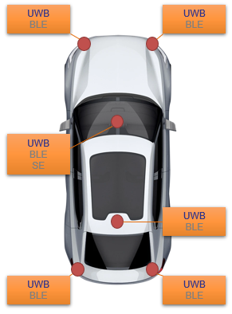


A Common Case for UWB anchor implementation in a Car
Automotive is one of the major market for UWB technology
According to the survey to the main automotive manufactories who already have introduced UWB ranging service in their commercial launched car mode:
  NIO all series
  BMW 7/X1/XM/i4/i7/iX
  BYD (Han EV/Tang/U8/)
  Zeeker all series
The common case is 5 or 6 UWB anchors in a car:
  4 anchors outside the car
  1 or 2 anchors in the cabin
Normally, a UWB anchor is together with the BLE capability as well: UWB+BLE anchor
  UWB and BLE have independent local clock
CCC and ICCE(China) digital key standard is used for the ranging session setup and ranging.
BLE plays a important role in CCC/ICCE digital key use case, which is used for car owner pairing/passive entry/set up UWB ranging session
UWB
BLE
NFC
Car key

Slide 3
CCC Digital Key 3.0 Scenario for BLE with UWB
Vehicle
Car Key
BLE Link Layer Connection Establishment
BLE Connection:
Secure channel establishment between Vehicle and Car key
Mutual authentication between Vehicle and Car key
BLE Pairing and Encryption Setup
URSK Derivation
BLE Connection for UWB session setup:
URSK Derivation and negotiation
UWB Capability exchange
Assist to provide coarse time synchronization information for UWB MAC time grid, assuming independent local clock for UWB and BLE chipset
Setup the UWB ranging session
UWB Capability Exchange
Time Sync
UWB Ranging Session Setup
UWB Ranging

Slide 4
CCC Digital Key 3.0 Scenario for BLE with UWB
Initiator
Responder
UWB Ranging:
One to many DS-TWR is used in CCC
The maximum number of anchors(responders) per ranging round is up to 10 in CCC
Normally, the number or anchors in a car is 5 or 6
Responder 1
…
Responder N
Car key
Vehicle
UWB Ranging packet exchange
CCC is based on the 802.15.4z
SP0 is used for ranging control message(Pre-Poll) and ranging report message(Final_Data)
SP3 is used for RFRAME(Poll/Response/Final)
Three RFRAMES are exchanged for one pair of initiator and responder
SP0 is the bottle neck for the ranging distance
Initiator
Responder
SP0
Pre-Poll
Poll
SP3
Response
Final
SP0
Final_Data

Slide 5
Key Observation of UWB ranging for Automotive today
Normally, 5 or 6 UWB+BLE anchors are implemented in a car
CCC standard is widely used, which applying DS-TWR for one initiator(car key) and multiple(normally 5) responders(car anchor)
BLE is used for UWB ranging session setup and assist coarse time synchronization, BLE and UWB chipset in an anchor usually have independent local clock
SP0 used for control/report message exchange is the bottle neck for ranging distance

Slide 6
What if we introduce MMS in automotive use case
According to the contribution <15-22-0074-00-04ab>, 18 dB link budget improvement with NBA-MMS is expected to be achieved.
18 dB link budget improvement is mainly for the RFRAME with no data, but in CCC scenario, control and report messages using SP0 with data have to be exchanged in a ranging round.

Slide 7
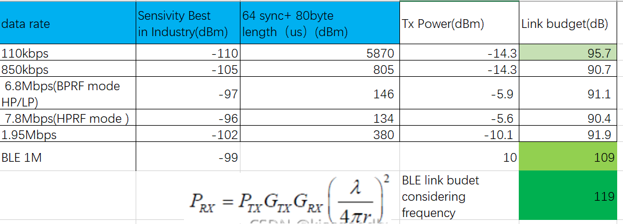
What if we introduce MMS in automotive use case
If the control and report message in control and report phase are using SP0, according to our calculation, only date rate 110kbps can meet 1ms MMS gain! So, the link budget gain for UWB-driven MMS is limited by the control and report phase.
Two ways to fully enjoy the MMS gain:
NBA-MMS
OOB assisted MMS, which means, offload the control and report phase to OOB(BLE)

Slide 8
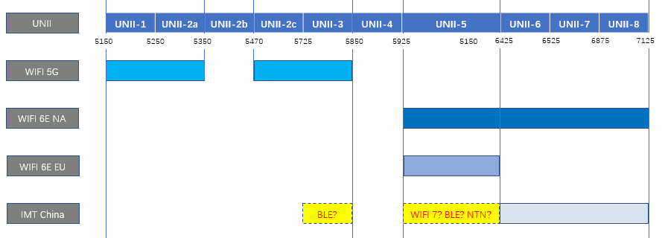
Overview of UNII-3 and UNII-5
NBA-MMS may take years to come to the market due to the unclear spectrum policy in UNII-3 and UNII-5(for example, in China)
NBA-MMS must be supported in both user end(car key or smart phone) and car end
Due to the relatively long technology upgrade procedure for automotive manufactory, the NBA-MMS may take even longer time to become practice, but the BLE is already there

Slide 9
Suggestion for MMS in automotive use case
OOB(BLE) assisted MMS will play a very important role to achieve the MMS link budget gain in ranging distance before NBA-MMS really comes to the market.
MMS needs to fit the most common automotive use case, which apply one to many DS-TWR, and the responders(UWB anchors in a car) is normally 5 or 6 today.

Slide 10
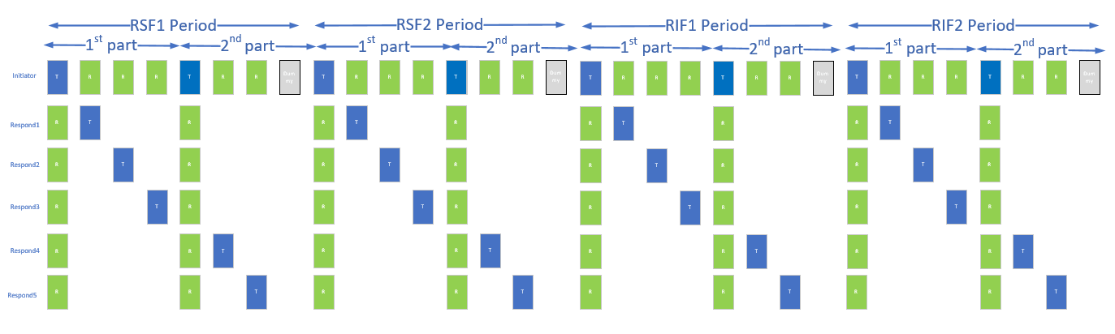
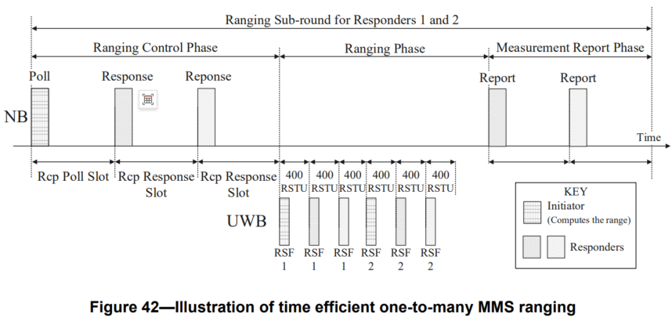
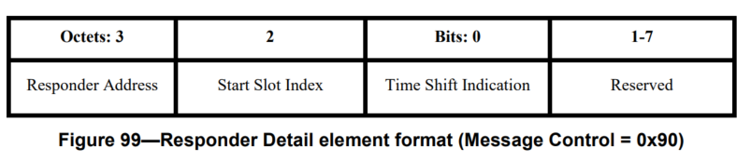
Key Comments for 4ab D1.0
In order to better support MMS in automotive use case, two main comments are raised for current D1.0
Time efficient one to many MMS ranging
The contribution is already proposed in 15-24-0220-00-04ab
Current Time efficient one to many MMS ranging is targeted for SS-TWR with up to 2 responders
DS-TWR is much more common in car key scenario, and the number of responders(anchors) is normally 5 or 6
UWB driven MMS and OOB MMS ranging phase
UWB driven MMS: Initial SYNC+SFD exchange shall be applied for one to one and one to many MMS ranging
OOB MMS: Initial SYNC+SFD exchange is a MUST to get the fine synchronization for one to one and one to many MMS ranging
Control Phase
Ranging Phase
UWB driven MMS
1ms
1ms
2ms
UWB
Packet
SYNC+SFD
RSF1
RSF X
RiF1
Initiator
UWB PHY
0.5ms
1ms
1ms
2ms
UWB
Packet
SYNC+SFD
RSF1
RSF X
RIF1
Responder
DS-TWR for 5 or 6 responders can be completed within two MMS slots
UWB PHY
Initial SYNC+SFD exchange is a MUST for OOB and UWB driven MMS, in order to get the fine synchronization between initiator and responders
400->300RSTU
BLE
Packet
BLE PHY
1ms
1ms
2ms
OOB MMS
Modification on top of 4ab D1.0
For each sub-round, the number of responders shall be increased up to 3
For each sub-round, the time shift indication shall be increased up to 3
SYNC+SFD
RSF1
RSF X
RiF1
Initiator
0.5ms
1ms
1ms
2ms
Bit: 0 1
Different clock for BLE and UWB
SYNC+SFD
RSF1
RSF X
RIF1
Responder
UWB PHY

Slide 11
Suggestion
OOB(BLE) assisted MMS will play a very important role to achieve full MMS link budget gain in ranging distance before NBA-MMS really comes to the market in automotive use case.
In order to better support OOB MMS:
  Suggest that initial SYNC+SFD packets exchange in ranging phase is a MUST to get the fine synchronization for one to one and one to many MMS ranging in both UWB-driven MMS and OOB assisted MMS.
  Suggest the number of responders shall be increased up to 3 in each sub-round of Time efficient one to many MMS ranging

