Slide 1
Project: IEEE P802.15 Working Group for Wireless Personal Area Networks (WPANs)
Submission Title: [Short term parameter negotiation in MMS]
Date Submitted: [July 11, 2024]
Source: [Wenzheng Li (Calterah Semiconductor), Zhongxing Yu (Calterah Semiconductor)]
E-Mail: [wenzheng.li@calterah.com, zhongxing.yu@calterah.com]
Re: [Input to the Working Group]
Abstract:
For the short-term operating parameters indication and negotiation in MMS control and report phase, an setting index related exchange mechanism may be preferred for the reason to reduce the Compact Frame length, which may be more friendly for the usage of unlicensed spectrum for NBA MMS.
Purpose: [Provide the points to be discussed and further to optimize the MMS in 4ab]
Notice: This document has been prepared to assist the IEEE P802.15. It is offered as a basis for discussion and is not binding on the contributing individual(s) or organization(s). The material in this document is subject to change in form and content after further study. The contributor(s) reserve(s) the right to add, amend or withdraw material contained herein.
Release: The contributor acknowledges and accepts that this contribution becomes the property of IEEE and may be made publicly available by P802.15.

Slide 2
Short-term parameters negotiation in MMS
In MMS Control Phase:
An initiator may override the long-term operating parameters of a ranging round by indicating a new set of short-term parameters by sending poll Compact frame
A responder may request short-term operating parameters for the next ranging round during the control phase by sending response Compact frame
In MMS Report Phase
If the responder receives a poll Compact frame from the initiator with a request to suggest short-term operating parameters, then the report Compact frame transmitted by the responder should include the suggested short term operating parameters

Slide 3
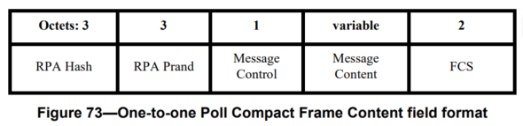
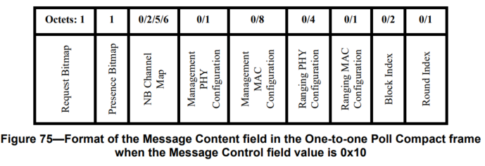
Short-term parameters negotiation is MMS control phase
If we take one-to-one Poll Compact Frame to indicate to short-term parameters in current round as an example:
The maximum content length will be 25 Octets
And the content of the message may be extended in the future release
Similar situation for the response/report Compact frame
Similar situation for the one-to-many MMS ranging control phase
Successful transmission in control phase is important for MMS, otherwise the whole ranging round will fails

Slide 4
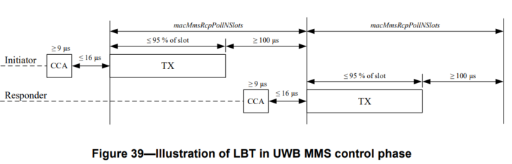
LBT may be required for NBA-MMS
If LBT is required before a transmission, either for regulatory reasons or as a coexistence mechanism, then the device shall perform CCA before each O-QPSK PHY transmission for NBA-MMS control phase and the report phase
UNII-3 and UNII-5 will accommodate WIFI/BLE/Cellular/NTN for satellite…, it will become more and more crowded
The short length of transmission in control and report phase of NBA-MMS is preferred

Slide 5
Proposed setting index based short-term parameters negotiation in MMS
long-term operating parameters
Initialization
Ranging Round
Control Phase
Ranging Phase
Report Phase
short-term operating parameter sets
Initialization:
Initiator configures the long-term operating parameters and short-term operating parameter sets for the upcoming ranging session
The short-term operating parameter sets should include
  A list of short-term parameter sets with specific index for each associated short-term parameter set
  Each short-term parameter set includes the configuration of Management and Ranging MAC/PHY for MMS ranging
Initiator and responder(s) in the same ranging session stores the same short-term operating parameter sets
Control and Report Phase
An initiator may indicate a new set of short-term parameters by sending poll Compact frame containing the specific index, instead of the whole short-term parameter set
A similar mechanism can be used by responder to suggest short-term operating parameters for the next ranging round during the control phase by sending response Compact frame, or by sending report Compact frame in the report phase.

Slide 6
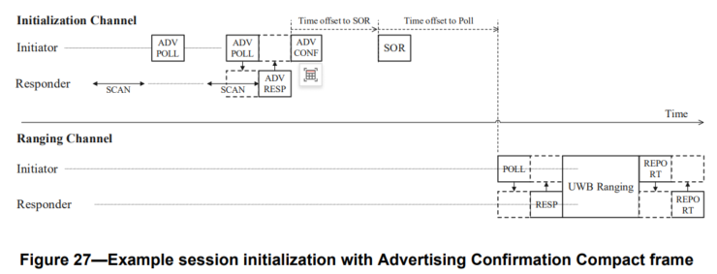
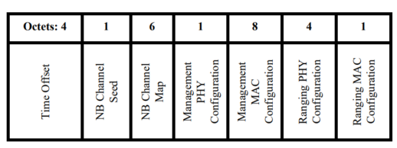
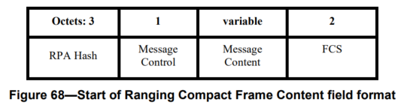
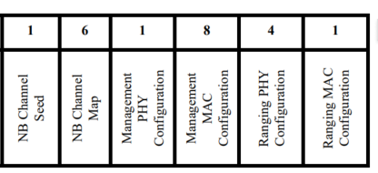
An example for setting index based short-term parameters negotiation in MMS
Initialization and setup phase:
Initiator and responder negotiate the long-term and short-term parameters by exchange ADV Response Compact frame and SOR Compact frame
Initiator indicates a list of short-term parameter sets with specific index for each associated short-term parameter set in SOR
SOR Compact Frame
Index #0
Index #1
Extend to indicate multiple short-term parameter set
Index #2

Slide 7
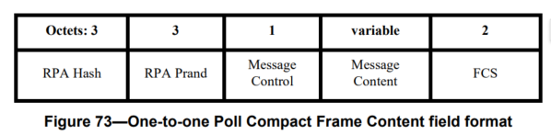
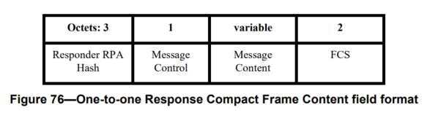
An example for setting index based short-term parameters negotiation in MMS
Control and Report phase:
Initiator indicates the short-term parameter set by including related index instead of the whole the short-term parameters in the Poll Compact frame for current ranging round
Responder suggests the short-term parameter set by including related index instead of the whole the short-term parameters in the Response/Report Compact frame
One-to-one Poll Compact frame
One-to-one Response Compact frame
Index only:2bit
Index only:2bit
Similar extension can be made for the one to many MMS ranging

Slide 8
Suggestion
The short length of transmission in control and report phase of NBA-MMS is preferred in UNII-3 and UNII-5
Successful transmission in control phase is important for MMS, otherwise the whole ranging round will fails
Initiator may configure a list of short-term parameter sets with specific index for each associated short-term parameter set for the upcoming ranging session
In the control and/or report phase of MMS ranging, an index can be exchanged by the Compact frame instead of the whole the short-term parameters

