Slide 1
IEEE 802.15 WNG
ETSI TR 103 970: Feasibility study on the use of UWB in ITS-G5
Date: 11 July 2024
Authors:

Slide 2
ETSI TR 103 970:
Feasibility study on the use of UWB in ITS-G5
11.07.2024
Friedbert Berens, FBConsulting Sarl

Slide 3
Overview
Scope of ETSI TC ITS and ETSI TR 103 970
UWB Use Cases in the Automotive domain
UWB Use Cases in ITS
Further discussions

Slide 4
ETSI TC ITS
TC ITS shall have responsibility:
  Development and maintenance of Standards, Specifications and other deliverables to support the development and implementation of ITS Service provision across the network, for transport networks, vehicles and transport users, including interface aspects and multiple modes of transport and interoperability between systems, but not including ITS application standards, radio matters, and EMC.
  Scope includes communication media, and associated physical layer, transport layer, network layer, security, lawful intercept and the provision of generic web services
  From: https://portal.etsi.org/TB-SiteMap/ITS/its-tor

Slide 5
Scope of TR 103 970
Scope: This technical report will study the feasibility of using UWB (Ultra Wide Band) technology in ITS.
Work part of ETSI TC ITS WG2 (Architecture and Cross Layer)
Work is supported by the following Companies:
      Robert Bosch GmbH
      NXP Semiconductors
      Continental
      FBConsulting Sarl
      Qorvo
      Commsignia
      Ultra Radio
      Yumex Traffic

Slide 6
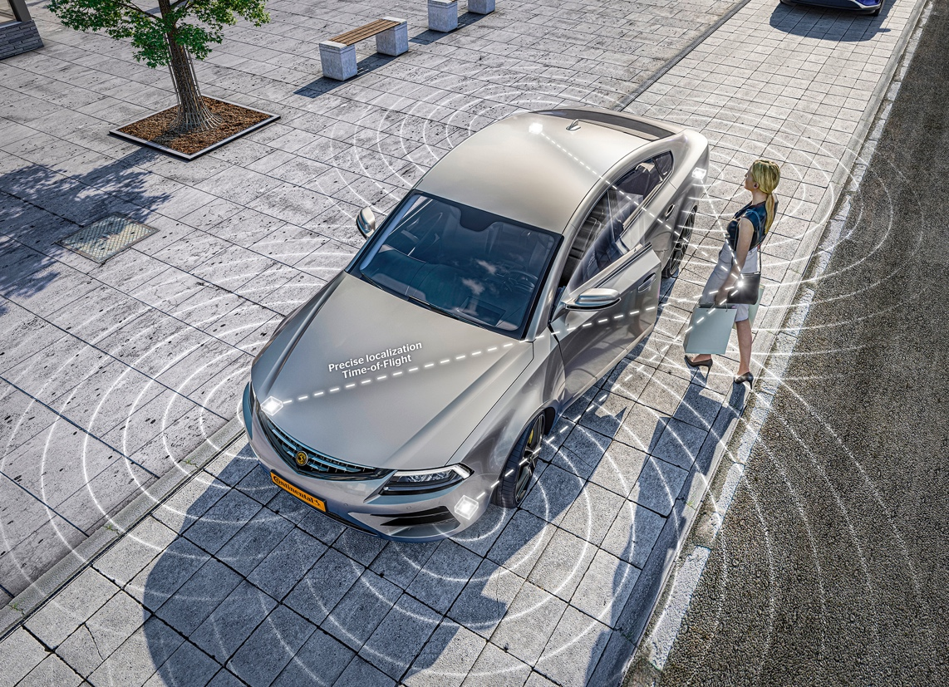
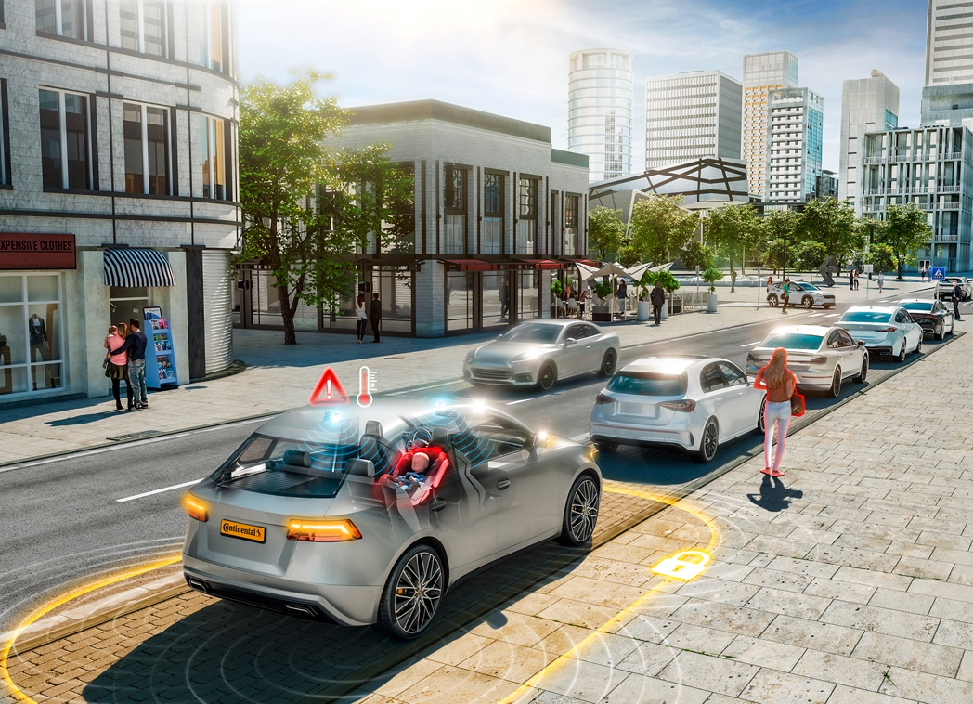
General automotive UWB Use Cases in the draft TR
Keyless entry systems
Child Present detection
copy pictures courtesy of Continental

Slide 7
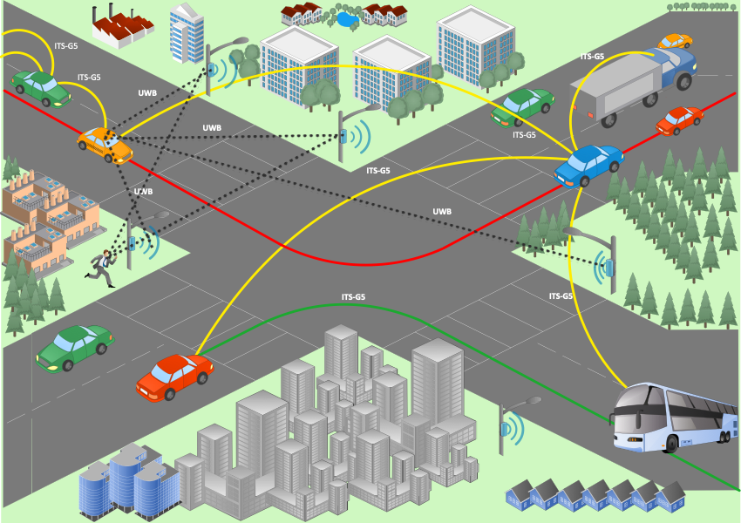
UWB in ITS

Slide 8
Trusted ranging and localization as main factor in ITS
All ITS applications require an accurate, trusted and secure positioning method/methods
GNSS is by fare to coarse for highly automated driving especially in dense urban areas!
Other methods need to be combined to reach required accuracy and reliability
  Radar
  Lidar
  UWB
  and others

Slide 9
Ranging and localization solutions for UWB
Two (three) different ranging methods are available for wireless systems
  Time Difference of arrival (TDoA) using synchronized AP
  Time of Flight between two peers and
  (Passive sensing/finger printing)
All of these methods can be used in ITS
  TDoA would be the method involving either synchronized fixed infrastructure or multiple UWB devices on a car, train, ship or airplane.
  ToF could be the method for relative ranging between traffic participants, e.g. cars, pedestrians, bicycles, e.t.c.
  Passive sensing could be a solution for dense environments involving also non equipped objects.

Slide 10
Some envisaged Use Cases in ITS

Slide 11
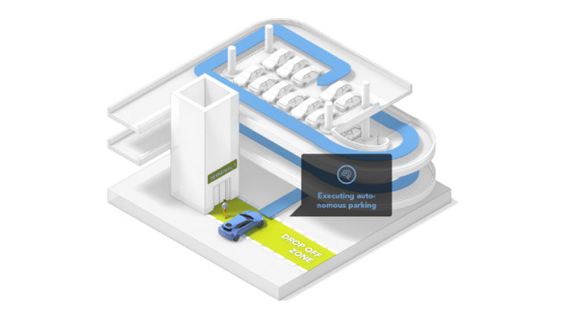
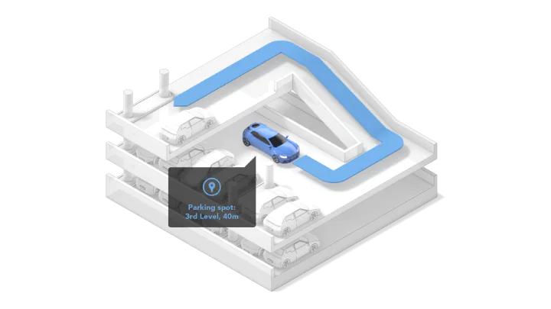
Automated parking and marshalling
Based on UWB infrastructure using TDoA ranging
Accuracy: around 25cm
If indoor: TX power up to
-31.3dBm/MHz in Europe
Can reuse existing UWB on-car devices
pictures courtesy of NXP Semiconductors

Slide 12
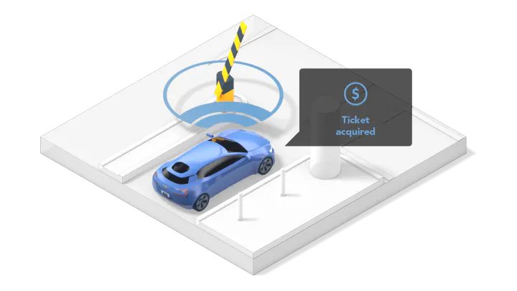
Tolling and charging operations
Based on UWB infrastructure using TDoA ranging or peer-to-peer ToF
Accuracy: around 25 cm – 50 cm
Range: up to 10 m to 20 m
If indoor: TX power up to
-31.3dBm/MHz in Europe
Can reuse existing UWB on-car devices
pictures courtesy of NXP Semiconductors

Slide 13
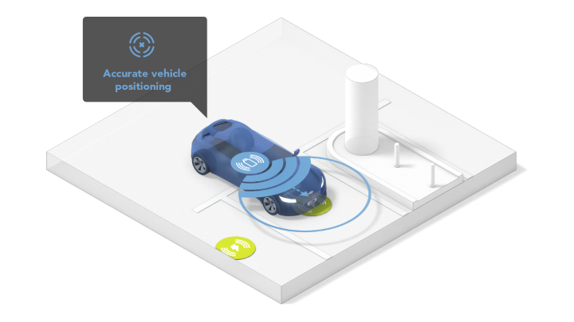
Positioning in general ITS applications
e.g. lane detection,
Based on UWB infrastructure using TDoA ranging or peer-to-peer ToF
Accuracy: around 25 cm – 50 cm
Range: up to 10 m to 20 m
Can reuse existing UWB on-car devices
pictures courtesy of NXP Semiconductors

Slide 14
VRU use case
Based on UWB infrastructure using TDoA ranging
Accuracy: 25 cm
Range: up to 20 m
Can reuse mobile device implementation
Clustering of VRU to reduce communication overhead
ETSI TR 103 300 -1 V2.3.1

Slide 15
VRU use case – Clustering -
Clustering of VRU can be done by peer-to-peer ToF operation
Clustering can also be done by TDoA when infrastructure is available
Clusters can be managed by UWB communication interface using the VRU services of the ETSI ITS protocol
Communication range can be extended be efficient use of geo-networking protocol included in ETSI ITS specifications

Slide 16
Further discussion
Time Difference of arrival (TDoA) using synchronized AP
  Requires synchronized infrastructure
  Low requirements at the terminal side
  Low frequency resource requirements in dense areas
Time of Flight between two peers
  No infrastructure is required
  Higher resource requirements at the terminal side
  High frequency resource requirement in dense areas
For both an integration into the ITS protocol/trust domain is required to reach security and trust

Slide 17
Next steps in ETSI
Further work on draft TR 103 970
Evaluate the impact of integration of UWB into ITS protocol
  Resolution of positioning information
  Fine timing measurements on access layer and interfaces to higher layers
  Security/Trust
  What messages can be reused for UWB communications? VRU Awareness message(VAM) ? CAM? CPM?
  How can geo-networking be used to extend range for VRU clustering by using forwarding?
  Implement secure peer-to-peer capabilities into the ITS protocol
Define preferred channels
  future proofness, 6 GHz → 8 GHz
Spectrum needs and coexistence with RLAN and IMT and other services!
  Optimized intra- and intersystem coexistence.

