Slide 1
Project: IEEE P802.15 Working Group for Wireless Specialty Networks (WSN)
Submission Title: Discussions on CID 965 and 1421
Source: Bin Qian, Panpan Li, Xiaohui Peng, Lei Huang, David Xun Yang (Huawei Technologies)
Address : [Huawei Bantian Base, Longgang District, Shenzhen, 518129 China]
E-Mail: [qianbin14@huawei.com]
Re: Task Group 4ab: UWB Next Generation for 802.15.4
Abstract: [UWB, sensing]
Purpose:
Notice: This document has been prepared to assist the IEEE P802.15. It is offered as a basis for discussion and is not binding on the contributing individual(s) or organization(s). The material in this document is subject to change in form and content after further study. The contributor(s) reserve(s) the right to add, amend or withdraw material contained herein.
Release: The contributor acknowledges and accepts that this contribution becomes the property of IEEE and may be made publicly available by P802.15.
Notes:
Jul 12, 2010
Page 1

Slide 2
CID 965 & 1421
Index # | Commenter | Sub-Clause | Page | Line | Comment | Proposed Change
965 | Riku Pirhonen | 16.4.4 | 209 | 14 | Cross-correlation test and time domain mask are two overlapping requirements. Cross correlation test is superseded by time domain mask test, so it can be removed. | Remove lines 14 - 28, from the text starting with "The transmitted pulse shape…" until "... as |ϕ(τi)| ≤ 0.1 for all τi."
1421 | Bernhard Großwindhager | 16.4.4 | 209 | 14 | It is sufficient to have time domain mask, hence, I propose to remove cross-correlation requirement. | Respective lines should be removed.

Slide 3
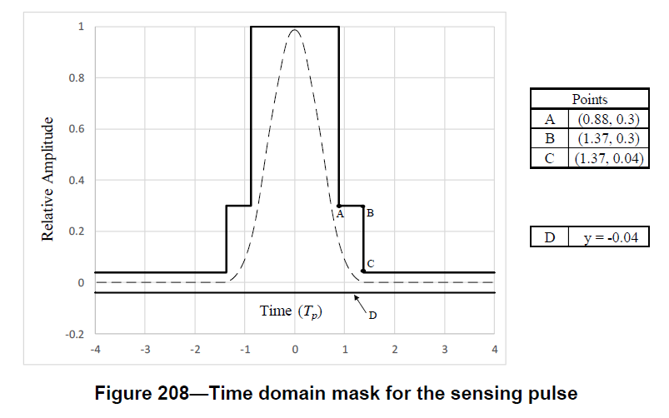
Recap: Time Domain Mask
The time domain mask is used to define the maximum allowable limits for both the precursor and postcursor

Slide 4
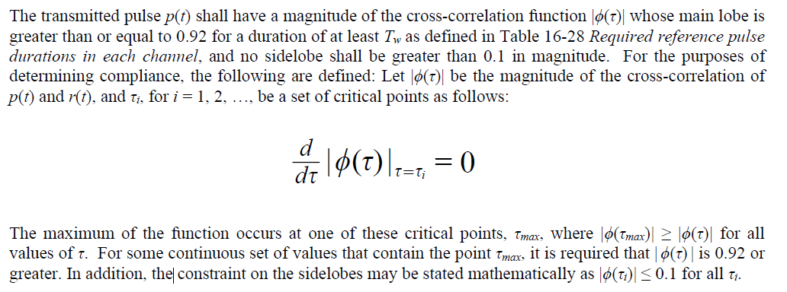
Recap: Cross-correlation Requirement
The cross-correlation requirement is used to limit the deviation of the transmitted pulse from the reference pulse

Slide 5
Discussion
From the recap, it appears that the time domain mask and the cross-correlation requirement do not overlap
This contribution seeks to initiate the discussions on CID 965 and CID 1421. We welcome feedback and input from group members on this topic
To move forward, we are open to adjusting the current thresholds for the main lobe and sidelobe (i.e., 0.92 and 0.1)

Slide 6
Thank You

