Slide 1
Project: IEEE P802.15 Working Group for Wireless Specialty Networks
Submission Title: Overview of 6ma Channel Coding Specification
Date Submitted: 12 September 2024
Source: Kento Takabayashi¹, Takumi Kobayashi², Daisuke Anzai², Marco Hernandez³, Ryuji Kohno^{4,5}
Company: (1) Toyo University (2) Nagoya Institute of Technology (3) University of Oulu (4)Yokohama National University (5) YRP International Alliance Institute
Address: (1) 2100 Kujirai, Kawagoe, Saitama, Japan 350-8585
Voice:[(1) +81-866-94-2104] E-Mail:[takabayashi.kento.xp@gmail.com]
Re: In response to call for technical contributions
Abstract: This presentation summarizes the overview of the Channel Coding Specification for IEEE802.15.6ma.
Purpose: Material for discussion in P802.15.6ma TG corresponding to comments in EC Meeting
Notice: This document has been prepared to assist the IEEE P802.15. It is offered as a basis for discussion and is not binding on the contributing individual(s) or organization(s). The material in this document is subject to change in form and content after further study. The contributor(s) reserve(s) the right to add, amend or withdraw material contained herein.
Release: The contributor acknowledges and accepts that this contribution becomes the property of IEEE and may be made publicly available by P802.15.

Slide 2
Overview of 6ma Channel Coding Specification
September 2024,
Hybrid Session,
Hilton - Waikoloa, HI
Kento Takabayashi ⁽¹⁾, Takumi Kobayashi ⁽²⁾,
Daisuke Anzai⁽²⁾, Marco Hernandez ⁽³⁾, Ryuji Kohno^{(4,5)}
(1) Toyo University (2) Nagoya Institute of Technology (3) University of Oulu (4)Yokohama National University (5) YRP International Alliance Institute

Slide 3
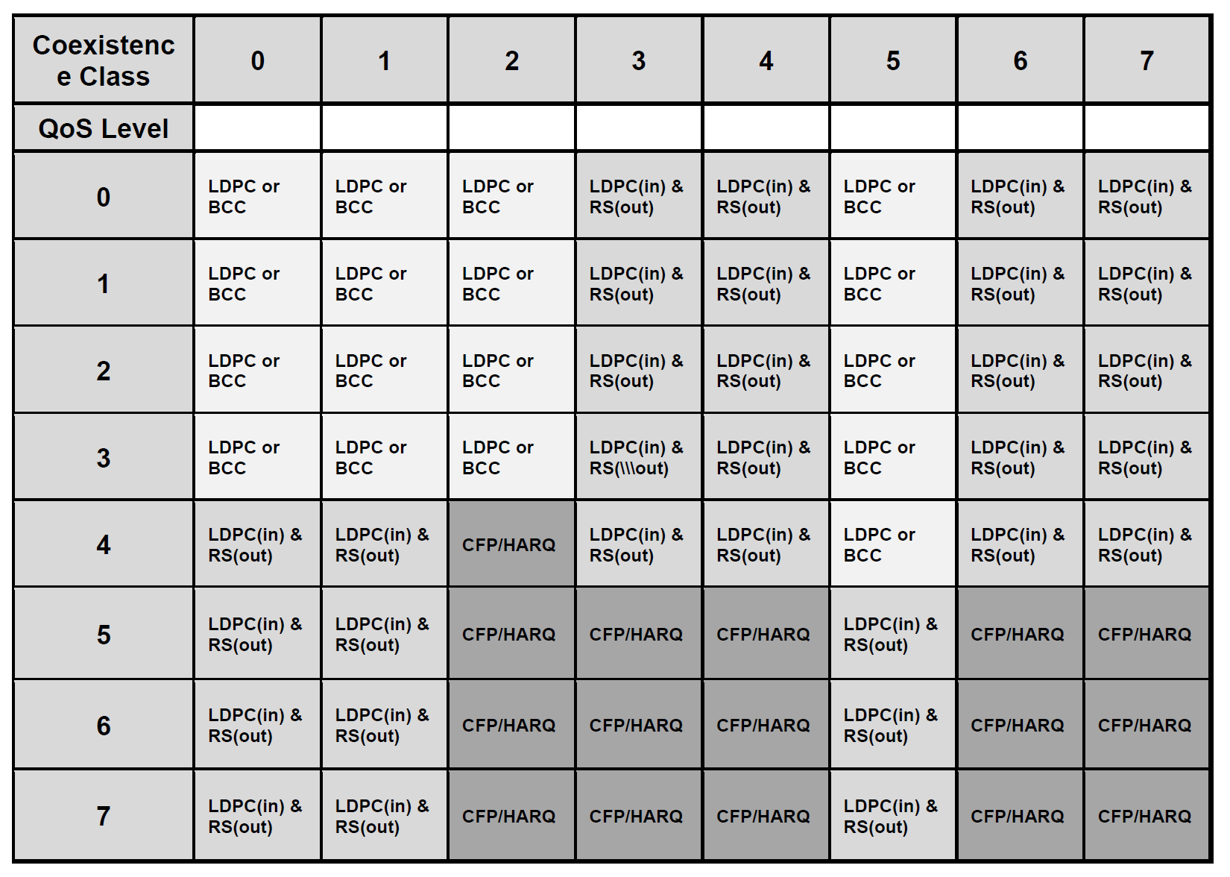
Table of error correcting scheme [1]
Notes:
According to QoS level and coexistence environment class, error correcting schemes are selected

Slide 4
Forward error correcting codes in TG6ma [2]
User priority | Inner code | Outer code | HARQ
0 | 15.4ab LDPC or BCC (R=1/2) |  | -
1 | 15.4ab LDPC or BCC (R=1/2) |  | -
2 | 15.4ab LDPC or BCC (R=1/2) |  | -
3 | 15.4ab LDPC or BCC (R=1/2) |  | -
4 | 15.4ab LDPC (R=1/2) | (54, 46) shortened RS code | -
5 | 15.4ab LDPC (R=1/2) | (54, 38) shortened RS code | -
6 | 15.4ab LDPC (R=1/2) | (54, 28) shortened RS code | -
7 | 15.4ab LDPC (R=1/2) | (54, 14) shortened RS code | -
As an outer code, shortened Reed-Solomon (RS) codes with N=54 (original code length N=63) will be selected to correct burst errors due to interference from other WBANs
The coding rates are changed according to each QoS
As an inner code, 15.4ab LDPC (K=324, 648, 972, R=1/2) or BCC will be selected for the coexistence of 15.6ma and 15.4ab

Slide 5
Coexistence environment level
Coexistence environment class | Environment
0 | 6ma BAN only
1 [1a] | Multiple 6ma BANs 1a
2 [1b] | Multiple 15.6 & 6ma BANs
3 | Multiple 6ma BANs & non-UWB systems (Wi-Fi & Unlicensed 3GPP)
4 [2a] | Multiple 6ma BANs & 802.15 UWB systems
5 [2b] | Multiple 6ma BANs, non-802.15 UWB systems (ETSI UWB systems)
6 [2c] | Multiple 6ma BANs & 802.15 UWB & non-802.15 UWB systems (ETSI UWB)
7 | Multiple 6ma BANs & non-UWB systems (Wi-Fi & Unlicensed 3GPP) & 802.15 UWB & non-802.15 UWB systems (ETSI UWB)
  A hybrid ARQ (HARQ) shall be utilized at the environments which several systems coexist in
  15.6ma considers the half-rate BCC and LDPC as an error correcting code
    A HARQ scheme using those FEC is introduced

Slide 6
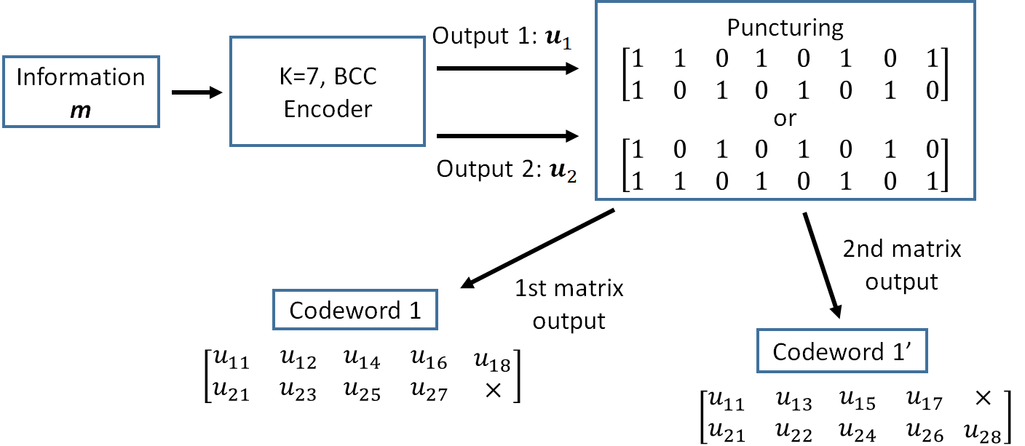
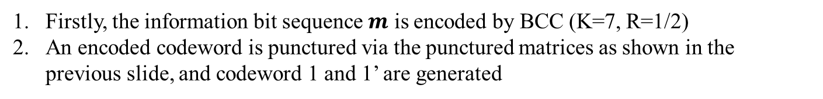
Hybrid ARQ mechanism (BCC case) [3]
Firstly, the information bit sequence $m$ is encoded by BCC (K=7, R=1/2)
An encoded codeword is punctured via the punctured matrices as shown in the previous slide, and codeword 1 and 1’ are generated

Slide 7
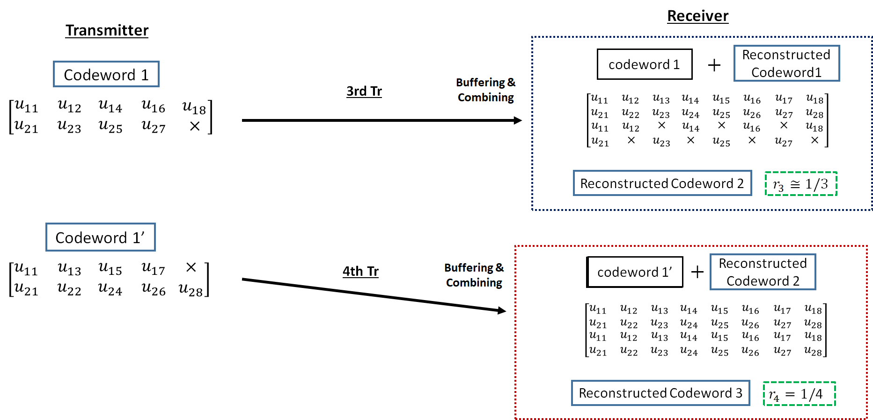
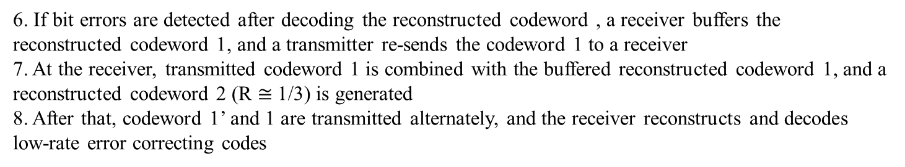
Hybrid ARQ mechanism (BCC case)
6. If bit errors are detected after decoding the reconstructed codeword , a receiver buffers the reconstructed codeword 1, and a transmitter re-sends the codeword 1 to a receiver
7. At the receiver, transmitted codeword 1 is combined with the buffered reconstructed codeword 1, and a reconstructed codeword 2 (R $≅$1/3) is generated
8. After that, codeword 1’ and 1 are transmitted alternately, and the receiver reconstructs and decodes low-rate error correcting codes

Slide 8
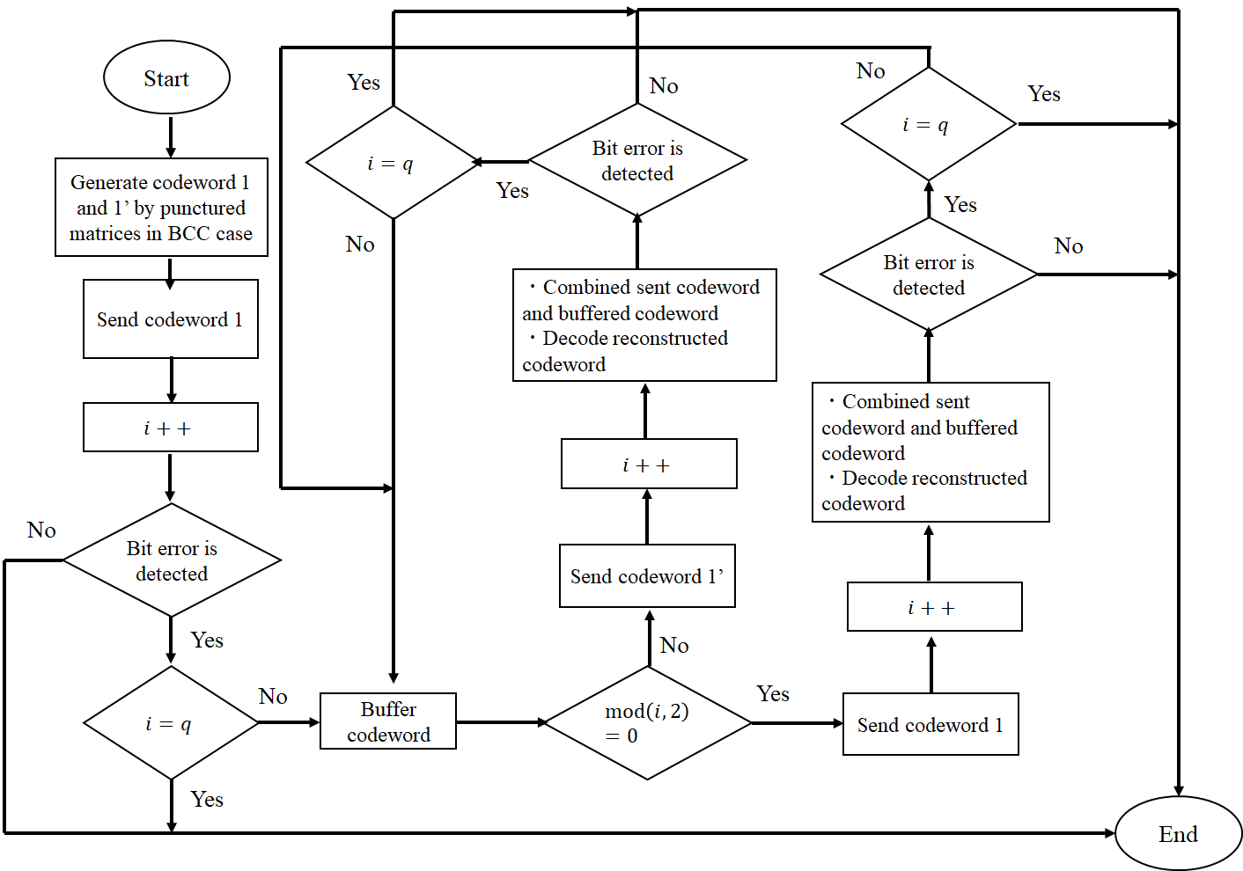
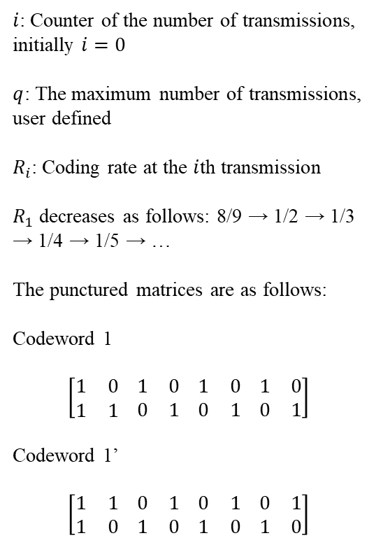
Hybrid ARQ mechanism (BCC case)
$i$: Counter of the number of transmissions, initially $i=0$
$q$: The maximum number of transmissions, user defined
$R_{i}$: Coding rate at the $i$th transmission
$R_{1}$ decreases as follows: 8/9 → 1/2 → 1/3 → 1/4 → 1/5 → …
The punctured matrices are as follows:
Codeword 1
$$\left[\begin{matrix}1 & 0 \\ 1 & 1\end{matrix} \begin{matrix}1 & 0 \\ 0 & 1\end{matrix} \begin{matrix}1 & 0 \\ 0 & 1\end{matrix} \begin{matrix}1 & 0 \\ 0 & 1\end{matrix}\right]$$
Codeword 1’
$$\left[\begin{matrix}1 & 1 \\ 1 & 0\end{matrix} \begin{matrix}0 & 1 \\ 1 & 0\end{matrix} \begin{matrix}0 & 1 \\ 1 & 0\end{matrix} \begin{matrix}0 & 1 \\ 1 & 0\end{matrix}\right]$$

Slide 9
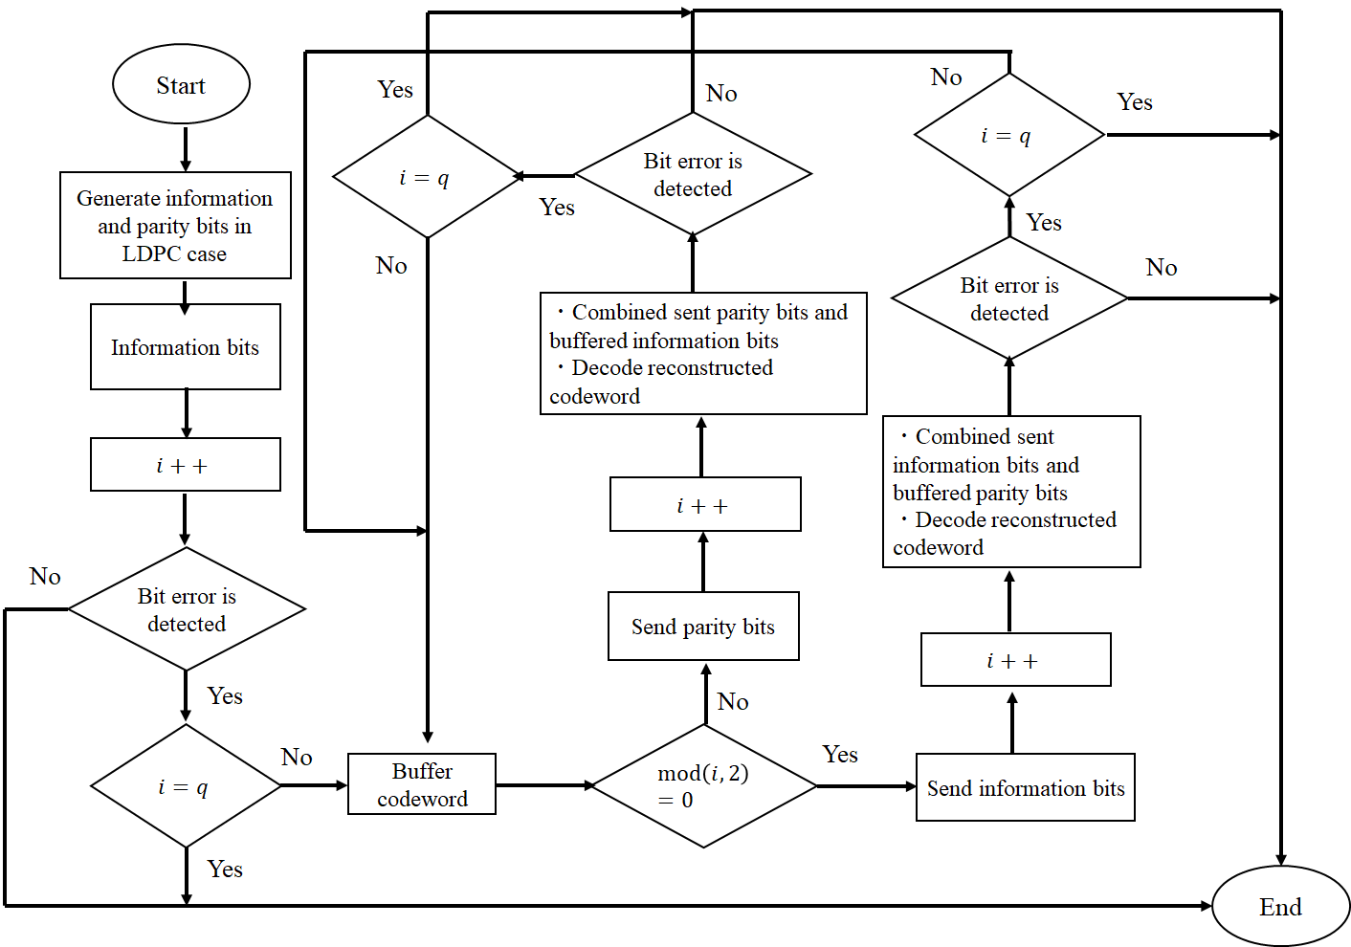
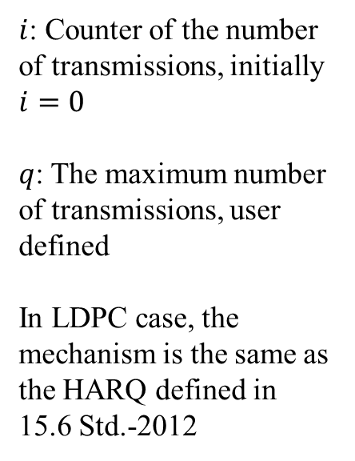
Hybrid ARQ mechanism (LDPC case)
$i$: Counter of the number of transmissions, initially $i=0$
$q$: The maximum number of transmissions, user defined
In LDPC case, the mechanism is the same as the HARQ defined in 15.6 Std.-2012

Slide 10
Results
w/o Interleaving
with Interleaving
Packet error ratio as a function of SNR in the case of bit erasure channel, with and without inter-leaver [2]
Notes:
As coding rates decreases, those PER performances improved.

Slide 11
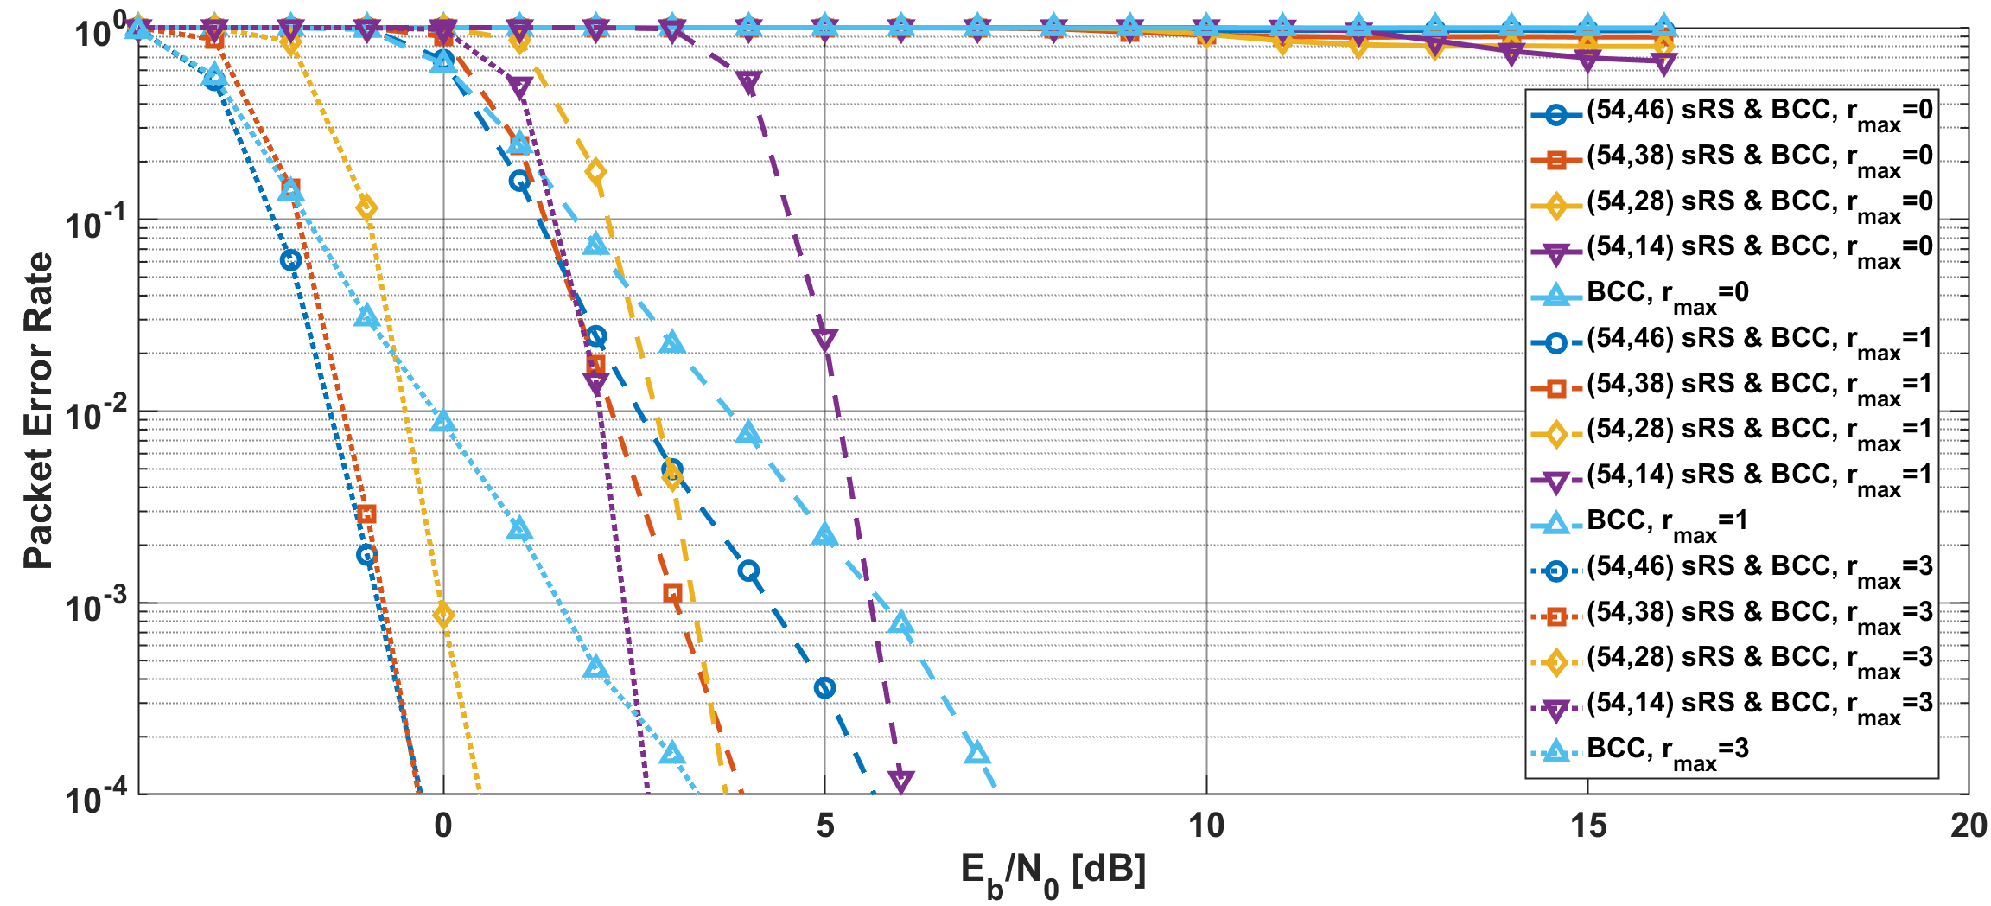
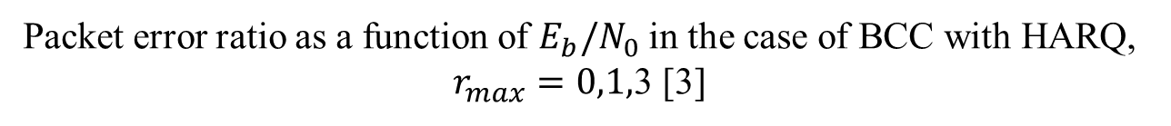
Results
Packet error ratio as a function of $E_{b}/N_{0}$ in the case of BCC with HARQ, $r_{max}=0,1,$3 [3]
Notes:
In case of BCC with HARQ, as $r_{max}$ increased, the PER has greatly improved compared with other schemes

Slide 12
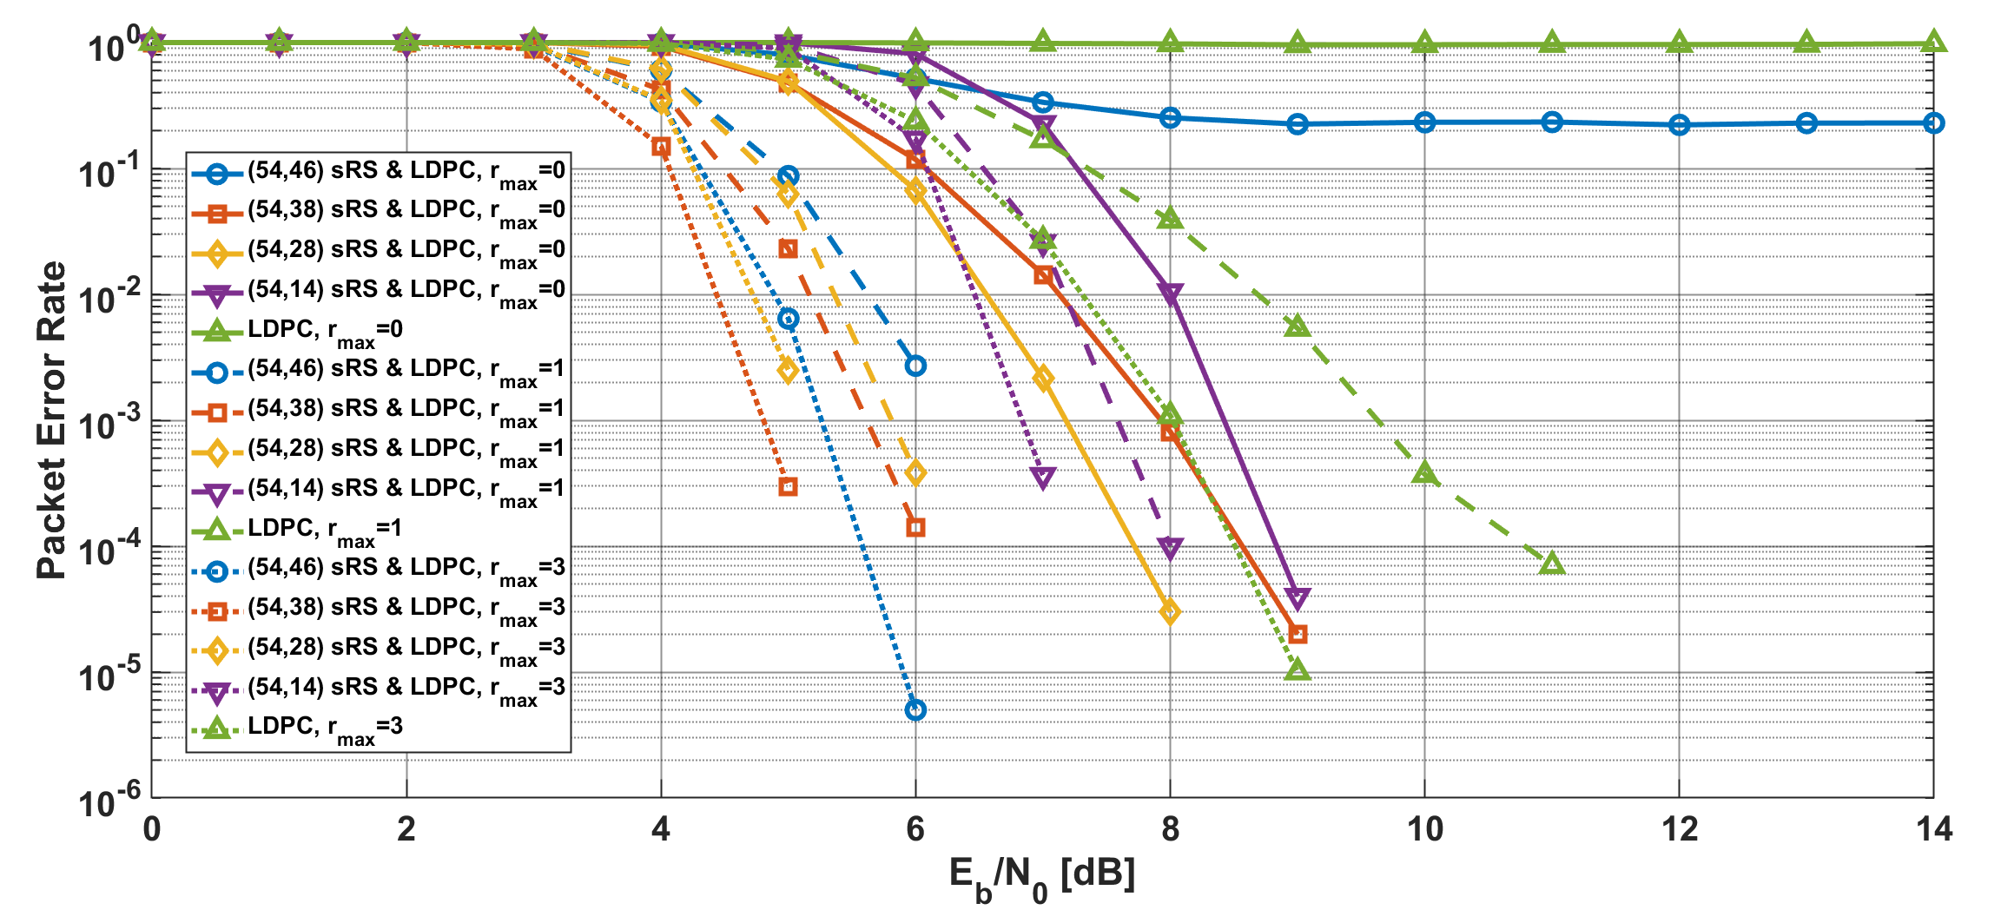
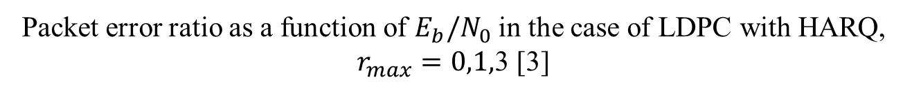
Results
Packet error ratio as a function of $E_{b}/N_{0}$ in the case of LDPC with HARQ, $r_{max}=0,1,$3 [3]
Notes:
As compared with a simple ARQ case, HARQ using LDPC could improved the performance

Slide 13
Conclusion
In low priority QoS cases (0~3), only a single error correcting code are applied
In high priority QoS cases (4~7), an outer and an inner error correcting codes are concatenated
HARQ schemes utilizing BCC and LDPC are utilized at the environments which several systems coexist in (especially class 7)
Previous evaluations confirmed the effectiveness of the above error correcting schemes
As an additional option, application of Super Orthogonal Convolutional Codes (SOCC) is also considered [4]

Slide 14
Reference
[1] Ryuji Kohno, “TG6ma Coexistence Assurance Document,” IEEE P802.15-24-0348-02-06ma
[2] Daisuke Anzai, et al., “Performance Evaluation of Channel Coding with Interleaver Based on TG6ma Channel Model for Some Classes of Coexistence,” IEEE P802.15-24-0247-02-06ma
[3] Kento Takabayashi, et al., “Hybrid ARQ Scheme for High QoS Packets in High Class of Coexistence of IEEE 802.15.6ma,” IEEE P802. 15-23-0576-05-06ma
[4] Kento Takabayashi, et al., “Evaluation of IEEE 802.15.6ma Ultra-wideband Physical Layer Utilizing Super Orthogonal Convolutional Code,” IEEE P802. 15-22-0562-11-06ma

Slide 15
Thank you for your attention ! ! !

Slide 16
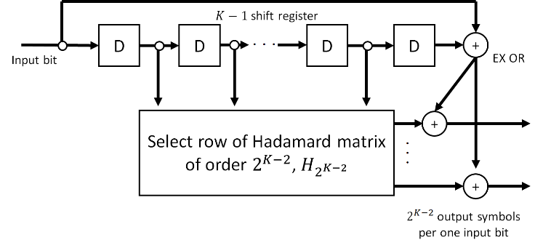
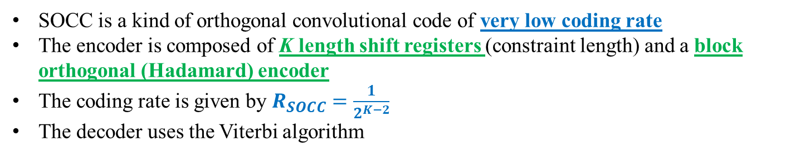
SOCC
Fig. SOCC encoder
SOCC is a kind of orthogonal convolutional code of very low coding rate
The encoder is composed of K length shift registers (constraint length) and a block orthogonal (Hadamard) encoder
The coding rate is given by $R_{SOCC}=\frac{1}{2^{K−2}}$
The decoder uses the Viterbi algorithm
Notes:
The inner (K- 2) bit memories are mapped into one Walsh sequence of length $2^{K−2}$ (two to the power of K-2)
The two outer bits are added to each binary number of the selected Walsh sequence by exclusive OR
One divided by two to the power of K-2
Therefore, SOCCs are considered to be compatible with the UWB, as they use a very wide bandwidth

Slide 17
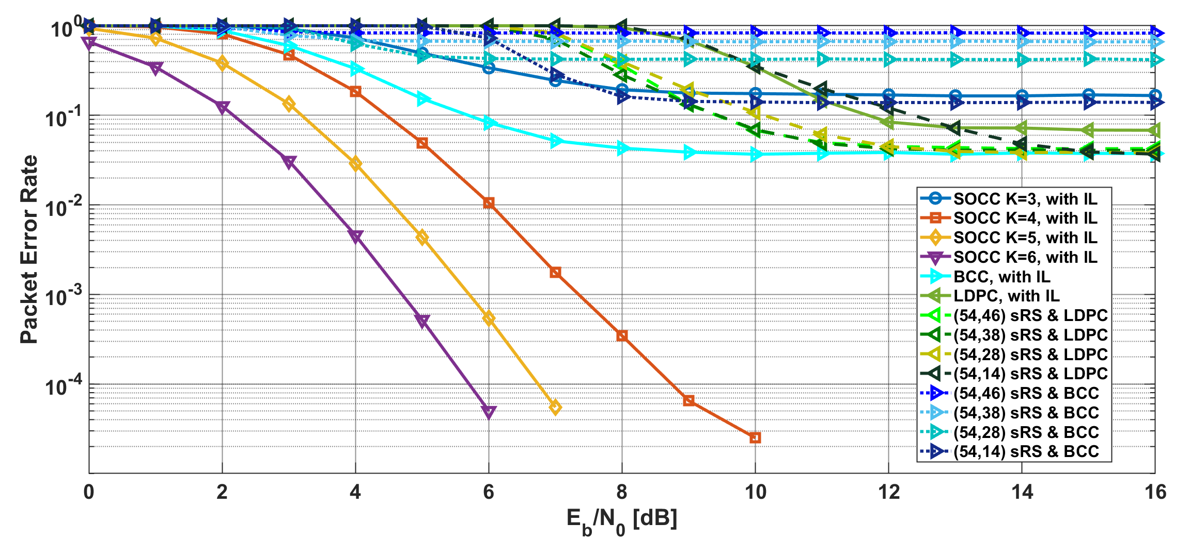
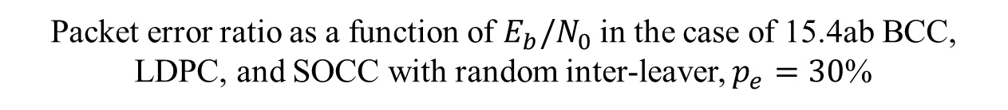
Results
Packet error ratio as a function of $E_{b}/N_{0}$ in the case of 15.4ab BCC, LDPC, and SOCC with random inter-leaver, $p_{e}=30$%
Notes:
SOCC with random inter-leaver had a much better performance than BCC and LDPC.
Low rate SOCC with random inter-leaver could also remove many bit erasures, but BCC and LDPC concatenated with RS could not do them.

