Slide 1
Project: IEEE P802.15 Working Group for Wireless Personal Area Networks (WPANs)
Submission Title: [Further Proposal on MMS in automotive use case]
Date Submitted: [September 11, 2024]
Source: [Wenzheng Li (Calterah Semiconductor), Zhongxing Yu (Calterah Semiconductor)]
E-Mail: [wenzheng.li@calterah.com, zhongxing.yu@calterah.com]
Re: [Input to the Working Group]
Abstract:
According to the survey and the recommendation in <15-24-0362-01-04ab>, NBA-MMS may take years to come to the market, in order to fully enjoy the MMS gain in automotive use case and consider the compatibility issue to the existing digital car key scenario(e.g. CCC DK3.0)
OOB assisted MMS may be a good choice for the near feature before NBA MMS become widely implemented
One to many ranging scenario is more common in automotive UWB ranging case.
According to the proposal in <15-24-0403-01-04ab>, in order to support time synchronization in UWB time domain in UWB-driven MMS and OOB assisted MMS for both one to one MMS ranging and one to many MMS ranging
For one to one MMS ranging, initial SYNC+SFD should be exchanged in the ranging phase for UWB driven MMS and OOB assisted MMS.
For time efficient one to many MMS ranging, initial SYNC+SFD should be exchanged in the ranging phase of each sub-round as the first fragment for UWB driven MMS and OOB assisted MMS.
This submission is to provide the updates to the concerns raised in the discussion
Whether only one SYNC+SFD fragment exchange is enough for UWB time synchronization in OOB assisted MMS?
If first ranging fragment is instead with SYNC+SFD in time efficient one to many ranging, whether the MMS gain for link budget can be achieved?
Purpose: [Provide the points to be discussed and further to optimize the MMS in 4ab]
Notice: This document has been prepared to assist the IEEE P802.15. It is offered as a basis for discussion and is not binding on the contributing individual(s) or organization(s). The material in this document is subject to change in form and content after further study. The contributor(s) reserve(s) the right to add, amend or withdraw material contained herein.
Release: The contributor acknowledges and accepts that this contribution becomes the property of IEEE and may be made publicly available by P802.15.

Slide 2
SYNC+SFD fragment exchange for UWB time synchronization
The bottle neck for MMS ranging phase relies on the SYNC+SFD for synchronization for both UWB-driven MMS and OOB assisted MMS
*Datasheet of one popular UWB chipset
**According to the contribution <15-22-0074-00-04ab>,
Scenario(UWB Synchronization) | Pulse peak Tx power | Packet Tx Power | Sensitivity | Link budget
Current CCC 6.8M* | -1dBm | -7dBm | -97dBm | 90dB
4ms MMS in theory** | -1.8dBm | -7.8dBm | -114dBm | 106dB
UWB Coase Sync + Tx Pwr in Law（256sync +TSX）1ms | 0dBm | -7dBm | -106dBm*** | 99dB
UWB Coase Sync + Tx Pwr in Law（64sync +TSX）1ms | 7dBm | -1dBm | -102dBm*** | 101dB
9~11dB gain for one SYNC+SFD exchange
*** simulation result
1 RX ANT, TSX for 20ppm, 99% ranging packet successful receiving rate
According to our calculation:
Without initial exchange of SYNC+SFD fragment, no MMS gain can be achieved, this is true for both UWB driven MMS and OOB assisted MMS
With Once exchange of SYNC+SFD in MMS, 9~11dB link budget gain is expected to be achieved compared with current 4z commercial launched UWB chipset in CCC ranging scenario

Slide 3
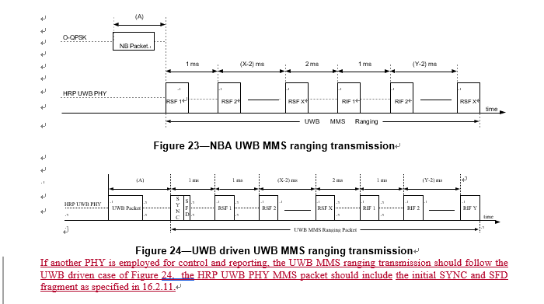
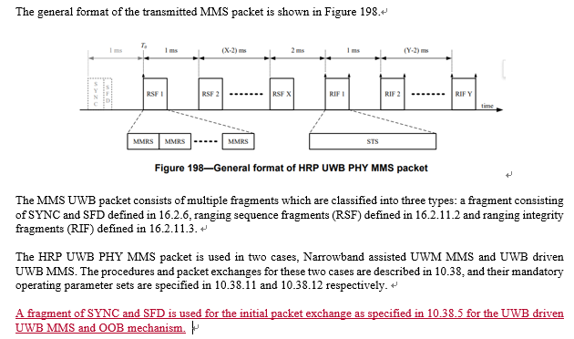
Proposed amendment #1 for D1.0
Due to the importance of the exchange of the SYNC+SFD in MMS ranging for both UWB-driven MMS and OOB assisted MMS, it is proposed to include the following change, according to the contribution of <15-24-0403 -01-04ab>
An instruction for initial SYNC+SFD fragment exchange is proposed to be added for OOB assisted MMS in clause 10.38.1 and 16.2.11.1

Slide 4
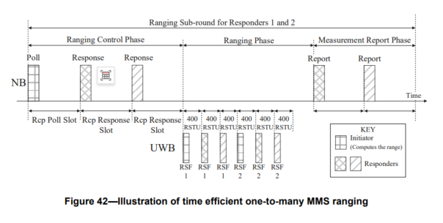
Time efficient one-to-many ranging for UWB driven MMS and OOB assisted MMS
What we have now: time efficient one-to-many ranging is only for NBA-MMS
No exchange of SYNC+SFD in the ranging phase
Two ways to go forward:
Clarify that only NBA-MMS can utilize the time efficient one-to-many ranging
  According to the contribution of <15-24-0362-01-04ab>, the spectrum policy for NB UWB is not clear in some regions, which may impede the NBA-MMS to come to the market
  LBT is still controversial in IEEE
Include support of UWB-driven MMS and OOB assisted MMS in time efficient one-to-many ranging
(Recommend)
One-to-many ranging is a more common case in automotive scenario, excluding the support of UWB-driven MMS and OOB assisted MMS may lose one of the important target use cases for one-to-many time efficient MMS ranging

Slide 5
Time efficient one-to-many ranging for UWB driven MMS and OOB assisted MMS
If the supported number of UWB MMS fragments per ranging round is still limited to two, then for UWB-driven and OOB assisted time efficient one to many ranging
Initial fragment is SYNC+SFD
Secondary fragment is RSF of RIF
MMS gain can still be achieved in time efficient way for both UWB-driven MMS and OOB assisted MMS
Current 4z SP3 for ranging measurement
Timestamp #1
SYNC
SFD
STS
Only one timestamps can be measured current sp3 packet
1 SYNC+SFD with 1 RSF/RIF for UWB-driven/OOB assisted MMS
Timestamp #1
Timestamp #2
SYNC
SFD
RSF
At lease two timestamps can be measured with 1 SYNC+SFD and 1 RSF fragments in time efficient one-to-many ranging.
3dB MMS gain is expected compared with 4z SP3 packet(by combination of two timestamps).
RIF
Ranging integrity

Slide 6
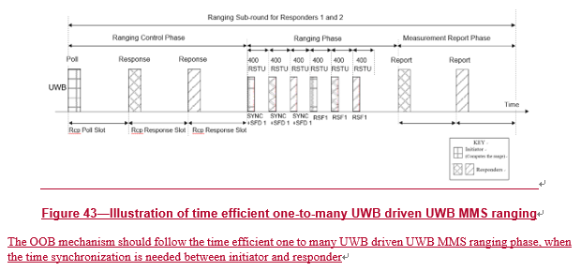
Proposed amendment #2 for D1.0
In order to support time efficient one to many ranging for both UWB-driven MMS and OOB-assisted MMS, according to the contribution of <15-24-0403 -01-04ab>
The description for UWB-driven and OOB assisted MMS is proposed to be added in time efficient one to many ranging in clause 10.38.8.3

Slide 7
Suggestion
Proposed amendment #1: An instruction for initial SYNC+SFD fragment exchange is proposed to be added for OOB assisted MMS in clause 10.38.1 and 16.2.11.1
Proposed amendment #2:The description for UWB-driven and OOB assisted MMS is proposed to be added in time efficient one to many ranging in clause 10.38.8.3

