Slide 1
Range test of OFDM Long Range Mode in the Dallas, Texas area
Hybrid Meeting
September, 2024

Slide 2
Agenda
System setup
OFDM-LR TX analysis
Range test results
Range test site survey data

Slide 3
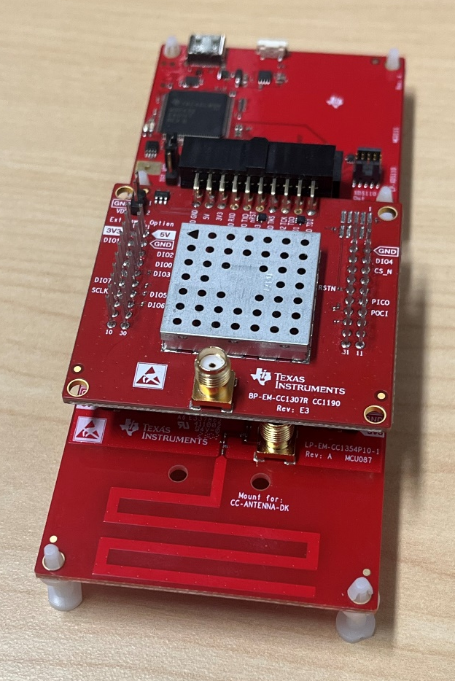
System Setup
XDS110 Debugger
CC1307 + CC1190 Booster Pack
Modem configuration
  OFDM-LR
    OFDM option 2 (500kHz bandwidth)
    DSSS 6
    Effective data rate: 1.4kbps
Output power: 26dBm
Payload configuration
  60 blinks/min
  120 packets/min
  20 byte payload with a 4 byte header
  48 bytes/sec
CC1354P10 Launchpad
Notes:
Used packet TX/packet RX code examples from the CC1307 SDK
Modified the SDK to enable OFDM-LR and LoRa

Slide 4
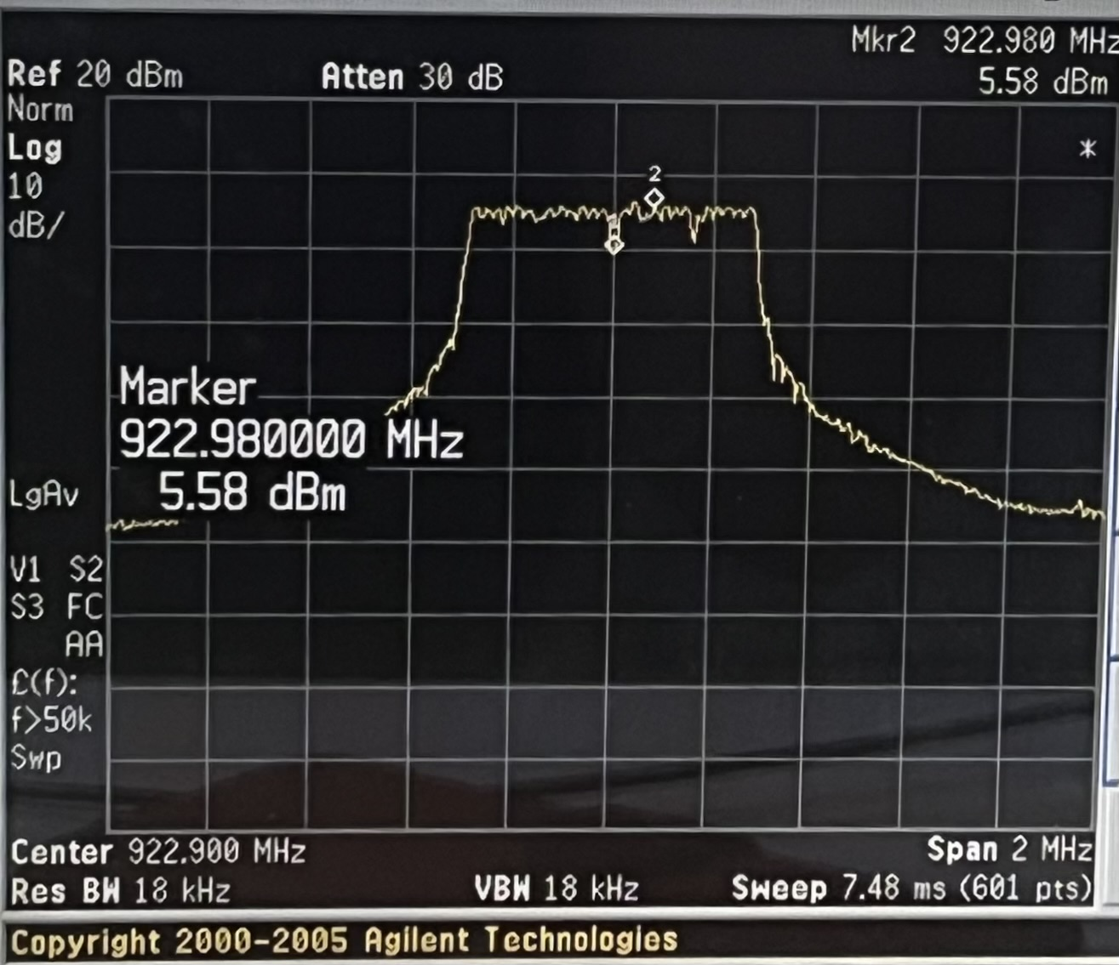
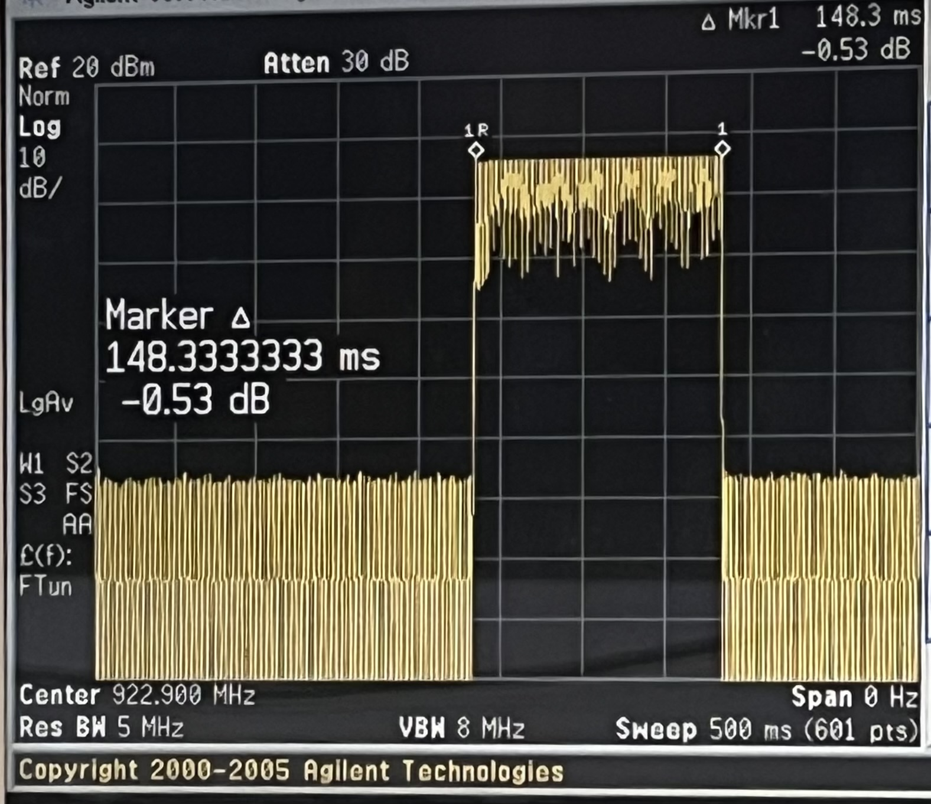
OFDM-LR | Transmit analysis
OFDM-LR peak hold spectral plot. Showing 500kHz occupied bandwidth. External attenuation of 20dB + 1dB cable loss needs to be taken into account. Total of 26.58 dBm of output power.
Total on air time of 148.3ms measured for an OFDM-LR signal, with 20 byte payload and 4 byte header.
Notes:
Total dBm is 5.58 to 21 written in text

Slide 5
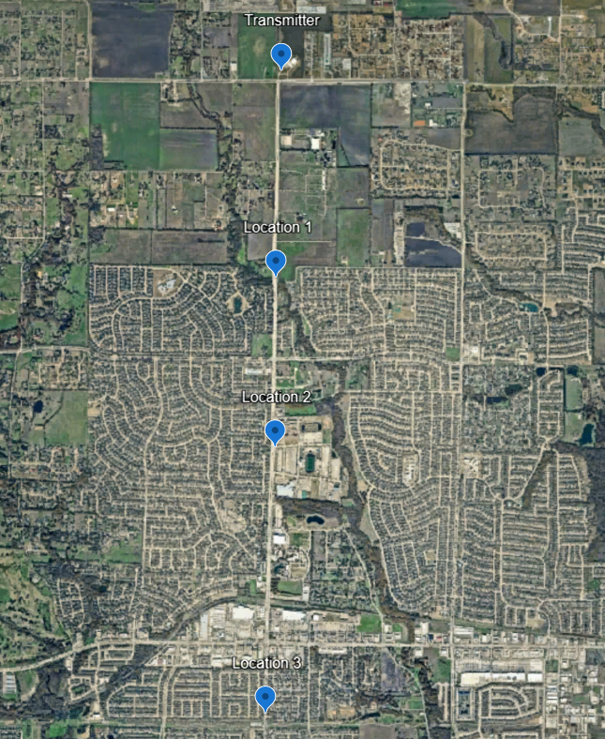

Map
Field test in Murphy, Texas
Transmitter to Location 1
  1.1 miles / 1.77 km
Transmitter to Location 2
  2.1 miles / 3.38 km
Transmitter to Location 3
  3.6 miles / 5.79 km

Slide 6
Data
OFDM-LR Average
Location | Distance (miles) | Distance (km) | Blinks | Packets | PER%
1 | 1.1 | 1.77 | 60 | 120 | 0.0%
2 | 2.1 | 3.38 | 58.7 | 117.3 | 2.2%
3 | 3.6 | 5.79 | 39 | 78 | 35.0%
Notes:
Counted the blinks manually while timing a 1 minute interval.
Notes:
SF means spreading factor

Slide 7
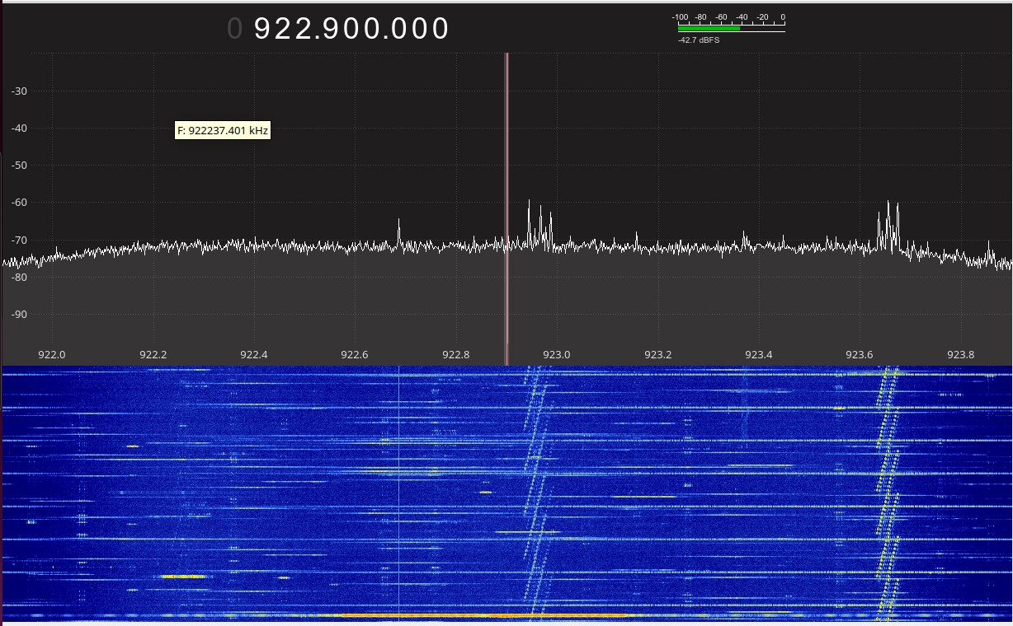
Noise | Transmitter
Not a calibrated setup, relative assessments only
Intense short narrowband signals
Fast frequency hopping medium bandwidth signal
Intense Wideband signal
Unknown non-FCC signal

Slide 8
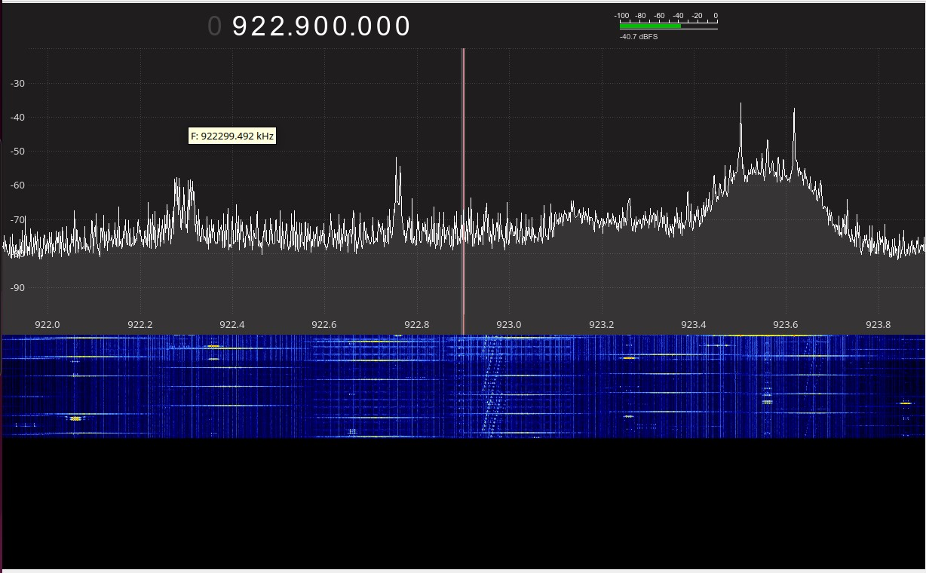
Noise | Location 1
Not a calibrated setup, relative assessments only
Intense short narrowband signals
Unknown non-FCC signal
Fast frequency hopping medium bandwidth signals

Slide 9
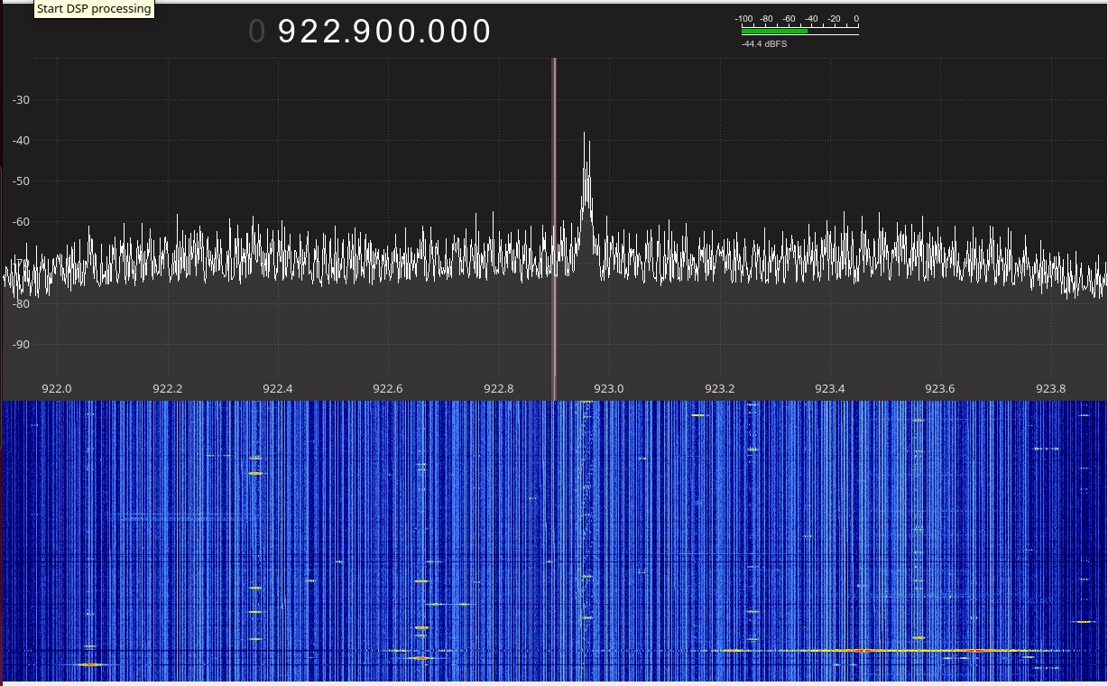
Noise | Location 2
Not a calibrated setup, relative assessments only
Intense short narrowband signals
Unknown non-FCC signal
Intense Wideband signal

Slide 10
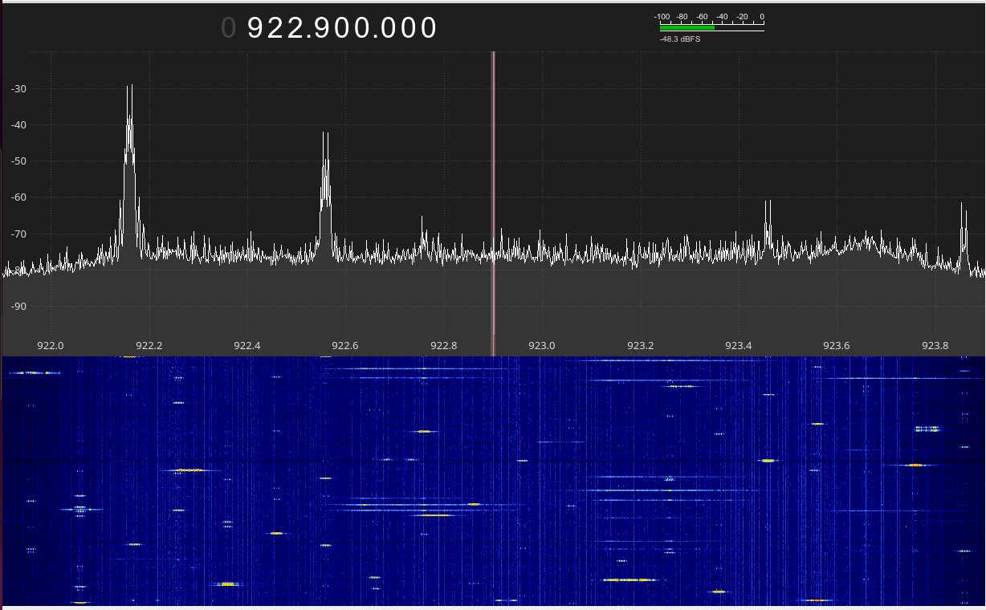
Noise | Location 3
Not a calibrated setup, relative assessments only
Intense short narrowband signals
Fast Frequency hopping medium bandwidth signals

