Slide 1
Project: IEEE P802.15 Working Group for Wireless Personal Area Networks (WPANs)
Submission Title: [Evaluation Methods for Transmission Characteristics of IEEE 802.15.4ad under Interference Noise]
Date Submitted: 11 September 2024
Source: Hiroshi Harada (Kyoto University)
Address Yoshidahonmachi. Sakyo, Kyoto, 606-8501, Japan
Voice: +81-75-753-5317 , E-Mail: hiroshi.harada@i.kyoto-u.ac.jp
Re: [Wireless Next Generation, Long Range extension enhancements to 802.15.4-2020]
Abstract: Evaluation Methods for Transmission Characteristics of IEEE 802.15.4ad. A part of this contribution was supported from the commissioned research (No.05101) by National Institute of Information and Communications Technology (NICT) , Japan.
Purpose: Propose channel models to evaluate proposed systems for IEEE 802.15.4ad.
Notice: This document has been prepared to assist the IEEE P802.15. It is offered as a basis for discussion and is not binding on the contributing individual(s) or organization(s). The material in this document is subject to change in form and content after further study. The contributor(s) reserve(s) the right to add, amend or withdraw material contained herein.
Release: The contributor acknowledges and accepts that this contribution becomes the property of IEEE and may be made publicly available by P802.15.

Slide 2
Evaluation Methods for Transmission Characteristics of IEEE 802.15.4ad under Interference Noise
September 2024
Sept. 11, 2024
Hiroshi Harada

Slide 3
Background
September 2024
Doc#378 provided a proposal for a method to evaluate interference.
In Doc#378, the interference is defined by parameters such as Mean Arrival Rate, Bandwidth, and Frame length to generate interference.
Then, let the proposed method generate without changing the center frequency and calculate the PER
In order to simplify the simulation for PER evaluation, the parameters for the generation of interference need to be determined simply.
This document proposes parameters for interference generation for simple simulation.

Slide 4
Interference generation
Category
Mean Arrival Rate
Interference
Generator
Bandwidth
Interference
(Frequency, Time domain)
Frame length
C/I
(or Pathloss)
Interference is generated as band-limited white noise; center frequency is randomly generated within the observation bandwidth

Slide 5
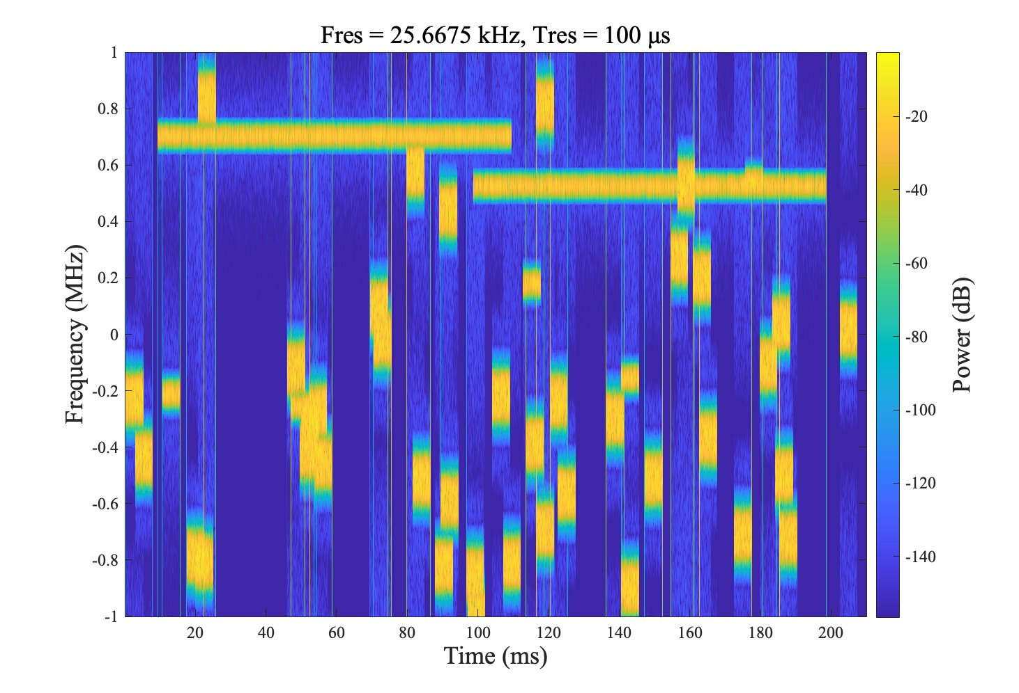
Interference generation example
Category | Mean Arrival Rate [1/s/km²/ MHz] | Bandwidth [kHz] | Frame length [ms]
1 | 0.8 | 100 | 5
2 | 0.15 | 20 | 5
3 | 0.04 | 10 | 100
4 | 0.01 | 1000 | 30
Assumed C/I is 0dB

Slide 6
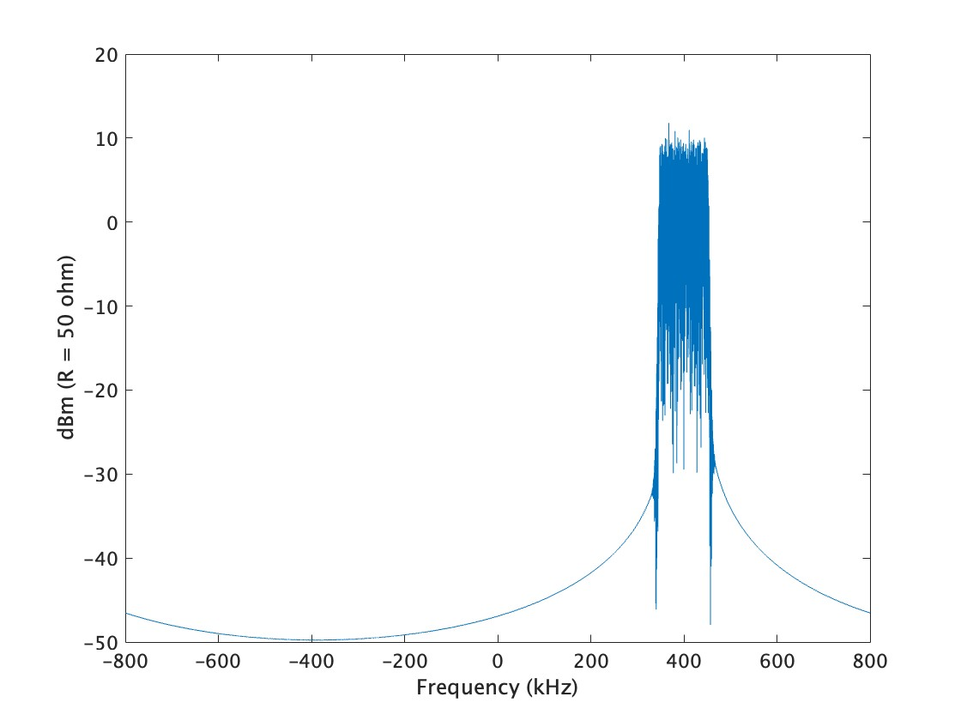
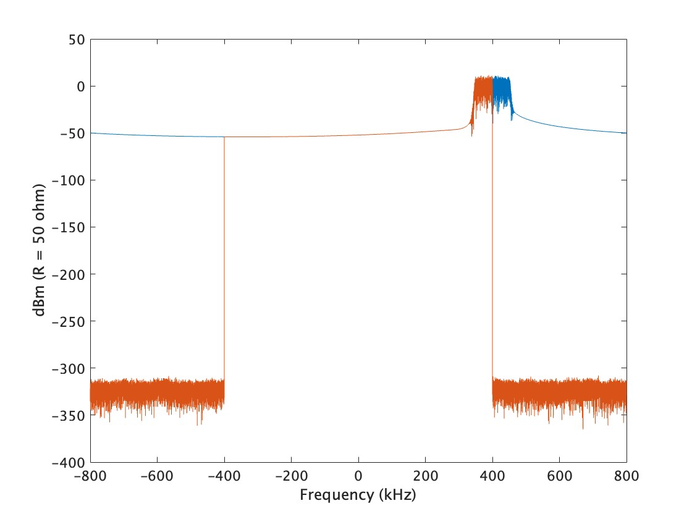
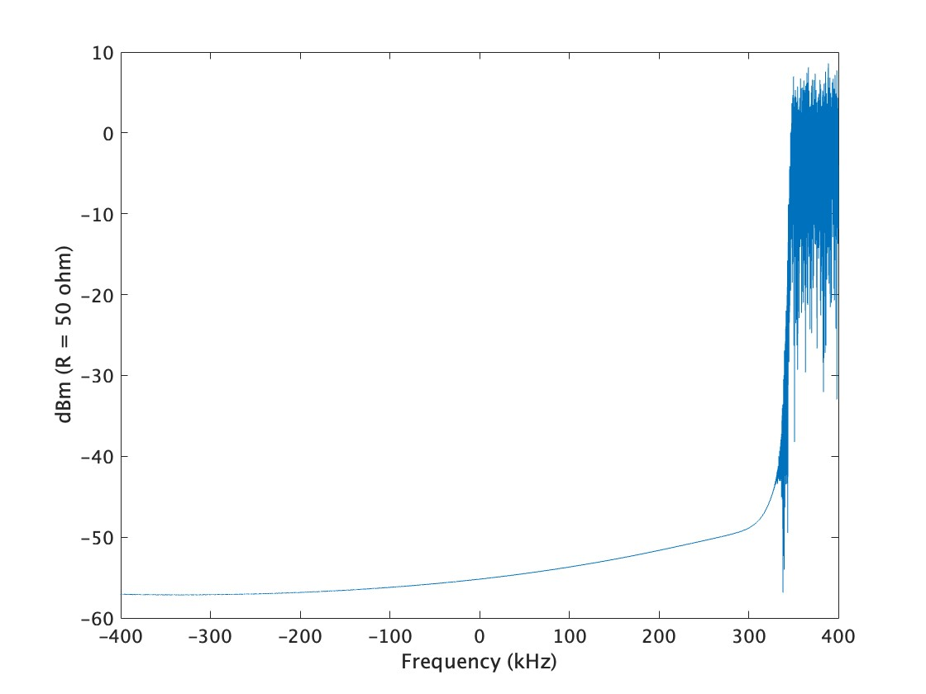
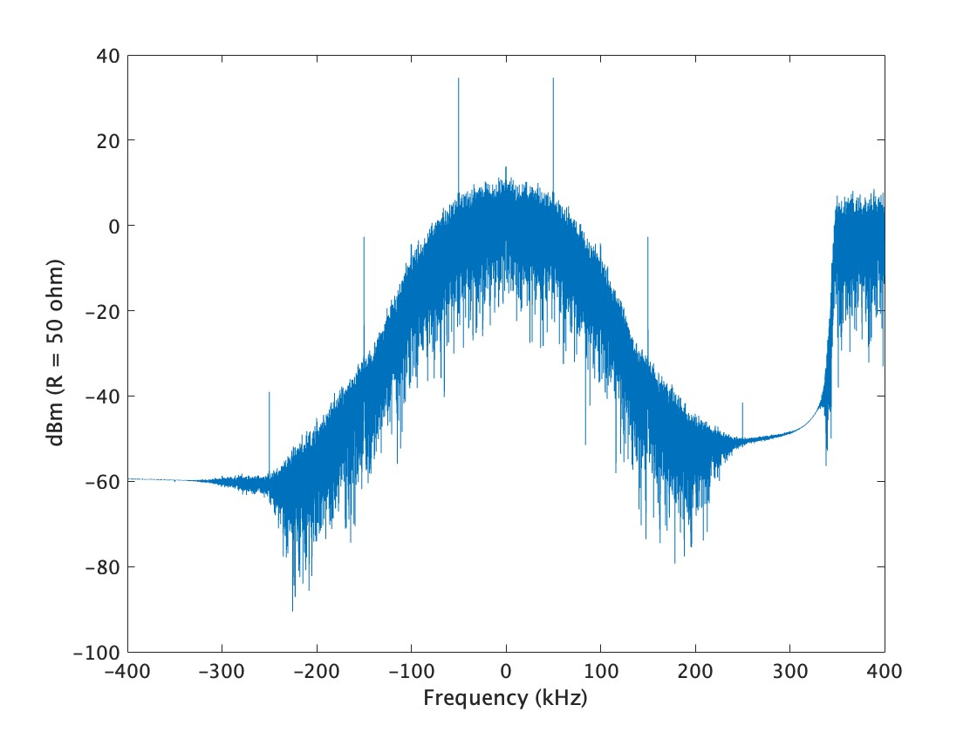
Incorporation of the generated interference signals into a transmission evaluation simulator
(Example of SUN FSK signal with 400 kHz bandwidth)
Interference
generator
BPF
Down-
sampling
SUN FSK signal
SUN FSK
Receiver
800 kHz

Slide 7
Case1: w/o frequency hopping
*Not to scale

Slide 8
Challenges
The interference is defined by parameters such as Mean Arrival Rate, Bandwidth, and Frame length to generate interference.
In order to simplify the simulation for PER (Packet Error Rate) evaluation, the parameters for the generation of interference need to be determined simply.
This document proposes parameters for interference generation for simple simulation.
Category | Mean Arrival Rate [1/s/km²/ MHz] | Bandwidth [kHz] | Frame length [ms]
1 | 0.8 | 100 | 5
2 | 0.15 | 20 | 5
3 | 0.04 | 10 | 100
4 | 0.01 | 1000 | 30

Slide 9
Proposal
The proposer indicates the Channel bandwidth to be used. The value assumes BW.
Interference noise is generated based on White Gaussian Noise. Let nBW be the bandwidth of the noise
The time length of the noise signal should be the same as the length of the proposed packet
The bandwidths of the noise shall be 2 MHz, 200 kHz, 125 kHz, and 10 kHz. (Based on Doc. 498)
If the bandwidth of that noise exceeds BW, then the bandwidth of the largest noise is BW
If the noise bandwidth is smaller than the BW, its center frequency changes randomly within the BW range

Slide 10
Examples
Packet
Noise
BW < nBW or BW=nBW
BW
Time
BW > nBW
nBW
BW
Time

Slide 11
Examples (modified)
Packet
Noise
BW < nBW or BW=nBW
BW
Time
BW > nBW
nBW
BW
Time

Slide 12
Graphs shown to the TG
CINR-PER (4 cases)
  nBW must be 2 MHz, 200 kHz, 125 kHz, and 10 kHz.
If the bandwidth of that noise exceeds BW, then the bandwidth of the largest noise is BW
If the noise bandwidth is smaller than the BW, its center frequency changes randomly within the BW range

