Slide 1
Project: IEEE P802.15 Working Group for Wireless Specialty Networks (WSN)
Submission Title: Frequency Stitching Channel Usage Method
Source: Panpan Li, Bin Qian, Lei Huang, David Xun Yang (Huawei Technologies)
Address : [Huawei Bantian Base, Longgang District, Shenzhen, 518129 China]
E-Mail: [lipanpan25@huawei.com]
Re: Task Group 4ab: UWB Next Generation for 802.15.4
Abstract: [NB, UWB]
Purpose:
Notice: This document has been prepared to assist the IEEE P802.15. It is offered as a basis for discussion and is not binding on the contributing individual(s) or organization(s). The material in this document is subject to change in form and content after further study. The contributor(s) reserve(s) the right to add, amend or withdraw material contained herein.
Release: The contributor acknowledges and accepts that this contribution becomes the property of IEEE and may be made publicly available by P802.15.
Notes:
Jul 12, 2010
Page 1

Slide 2
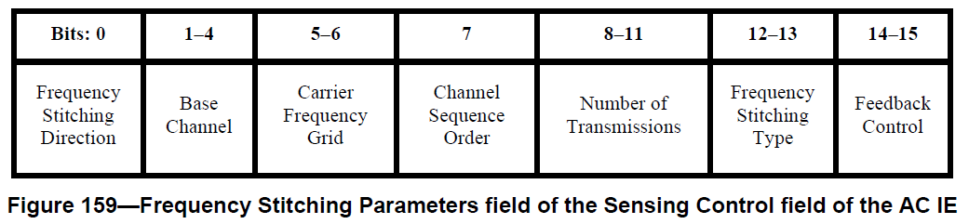
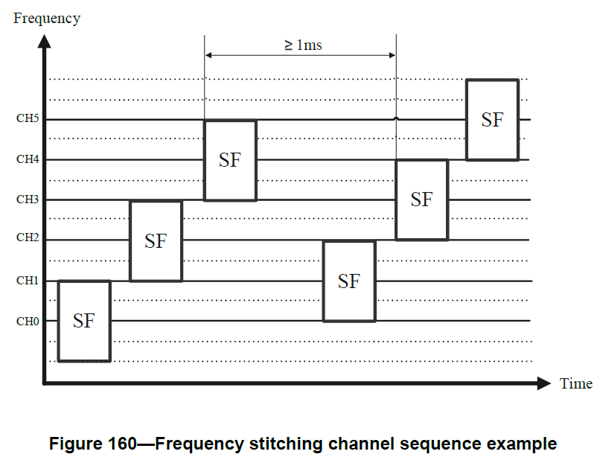
Recap of Frequency Stitching
The Carrier Frequency Grid field
  0: no overlap of adjacent frequency stitching channels
  1: 25% overlap of adjacent frequency stitching channels
  2: 50% overlap of adjacent frequency stitching channels
  3: 75% overlap of adjacent frequency stitching channels
The Channel Sequence Order field
  0: if the Frequency Stitching Direction field is one, the channels used are selected in sequence starting at the channel defined by the Base Channel field value and increasing in frequency using the step size defined by the Carrier Frequency Grid field value. On the other hand, if the Frequency Stitching Direction field is zero, the channels used are selected in sequence starting at the channel defined by the Base Channel field value and decreasing in frequency using the step size defined by the Carrier Frequency Grid field value.
  1: the channel used for the p-th transmission is selected according to the formula:
  CH( ((p × (OF+1)) MOD (N)) + ((p × (OF +1)) DIV (N)) ),
The Frequency Stitching Type field
  0: Intra-packet frequency stitching
  1: Inter-packet frequency stitching
  2: Combination of intra-packet frequency stitching and inter-packet frequency stitching
  3: Reserved

Slide 3
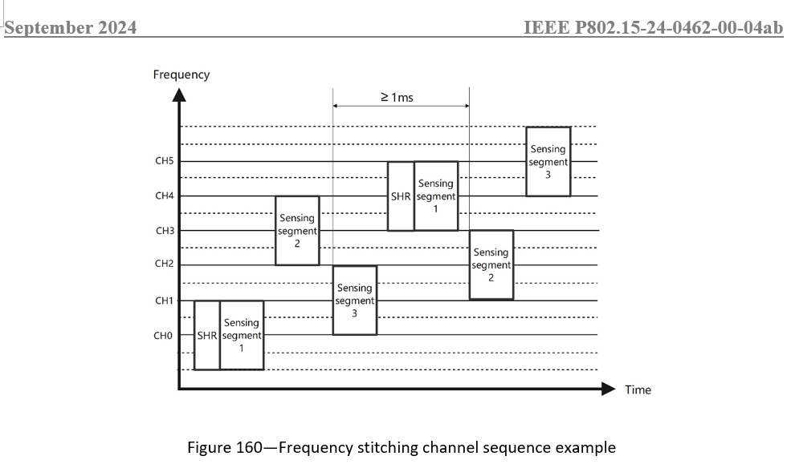
Problems raised in CID 901, 1253, 264
Problem 1 (CID 901, 1253):
  missing the transmission of SHR in each sensing packet
Problem 2 (CID 264):
  formula not match figure example
Proposed solution in DCN 0462r0 (presented in Sep F2F): SHR will be transmitted with first sensing segment
Group feedback: length of SHR+segment is longer than length of segment, resulting power backoff
Target: transmit SHR separately
Index # | Commenter | Sub-Clause | Page | Line | Comment | Proposed Change
901 | Carl Murray | 10.39.6.1 | 150 | 11 | "Figure 160 and the associated text is incomplete as it does not address the SHR of the sensing packet. What happens if the SHR overlaps an SF (of its owns SFs or another packets). | Update the figure to include the SHR and describe the spacing when the SHR overlaps an SF.
1253 | Billy Verso | 10.39.6.1 | 150 | 11 | Figure 160 is misleading since it is not showing the sensing packet completely with SHR, and the 4 sensing segments. | Update figure to show full sensing packet(s) with SHR
264 | Li-Hsiang Sun | 10.39.6.1 | 150 | 4 | The example does not match formula on p149 for OF=2, N=6 | fix the formula, the (OF+1) in formula for OF=1,2 should be replace by a value of (1+1), i.e. there is 1 overlapping channel in the grid to a base channel for the case of OF=1 and 2 so for these 2 cases the order should be the same

Slide 4
Proposed Solution
In the following, we try to solve the above problems from two aspects
  Simple modifications on Intra-packet frequency stitching
  Combination of intra-packet frequency stitching and inter-packet frequency stitching
    We assume every sensing packet have four sensing segments.

Slide 5
Aspect 1: Intra-packet frequency stitching
SHR is transmitted first, the last sensing segment is transmitted at same logic channel with SHR
N channels: N+1 transmissions (1 SHR and N sensing segments)
The Channel Sequence Order field
  0: In-sequence channel order, the channel used for the p-th transmission is selected according to the formula:
  CH( p MOD (N) ), p=0:N
  1: Out-of-sequence channel order, the channel used for the p-th transmission is selected according to the formula:
  CH( (((p MOD(N)) × (OF+1)) MOD (N)) + (((p MOD(N)) × (OF+1)) DIV (N)) ), p=0:N
Frequency
Frequency
Frequency
CH3
Sensing segment 3
Sensing segment 2
CH2
CH3
Sensing segment 3
Sensing segment 1
Sensing segment 1
Sensing segment 2
CH3
Sensing segment 3
CH1
CH2
CH2
CH1
Sensing segment 1
Sensing segment 2
SHR
Sensing segment 4
SHR
Sensing segment 4
CH1
SHR
Sensing segment 4
CH0
CH0
CH0
Time
Time
Time
OF=0, The Channel Sequence Order field=0
OF=2, The Channel Sequence Order field=0
OF=2, The Channel Sequence Order field=1

Slide 6
Analysis
After presenting r0, we received feedback from group:
  No need to let SHR and last sensing segment transmitted at same channel, can just let all transmissions at different channels
Argument:
  The wider of the channel bandwidth used, the more accurate of the sensing accuracy. Note that SHR is not used to obtain CIRs, transmitting SHR at another channel will waste bandwidth. So we would like to allocate all available channels with sensing segments, while SHR will reuse a channel with some sensing segment. This problem is especially severe in China.
Notes:
By transmitting SHR separately, may avoid power backoff for some cases (when sensing segment length being 512 symbols)

Slide 7
Aspect 2: Combination of intra-packet and inter-packet
Simply extending aspect 1 to multiple packets may still require long transmission time between the last sensing segment and the SHR of next sensing packet.
Proposed to further reduce the transmission time.
>=1 ms
Frequency
>=1 ms
Frequency
CH7
SEG
3
SHR
SEG
4
SEG
3
CH7
SEG
3
CH6
SEG
2
CH6
CH5
SEG
1
SEG
2
CH5
SEG
2
CH4
SEG
1
CH4
CH3
CH3
SEG
2
CH2
SEG
1
SEG
1
SHR
SEG
4
CH2
SEG
3
CH1
SHR
SEG
4
CH1
CH0
SHR
SEG
4
CH0
Time
Proposed scheme
Time
If simply extend aspect 1

Slide 8
Aspect 2: Combination of intra-packet and inter-packet
Propose to reverse the order of channel usage when switching the sensing packet when the Channel Sequence Order field is 1.
N channels: 1.25*N transmissions (1 SHR and 4 sensing segments in every sensing packet)
The Channel Sequence Order field
  0: In-sequence channel order, the channel used for the p-th transmission is selected according to the formula:
  CH( q MOD (N) ),
  q= 4*(p DIV(5))+((p MOD(5)) MOD(4)),
  p=0:1.25*N-1
  1: Out-of-sequence channel order, the channel used for the p-th transmission is selected according to the formula:
  CH( ((q × OF) MOD (N)) + ((q × OF) DIV (N)) ),
  q= 4*(p DIV(5))+((p MOD(5)) MOD(4)), if (p DIV(5)) is odd,
  q= 4*(p DIV(5))+ 3-((p MOD(5)) MOD(4)), if (p DIV(5)) is even,
  p=0:1.25*N-1
Time

Slide 9
Aspect 2: Examples
N=8
p | 0 | 1 | 2 | 3 | 4 | 5 | 6 | 7 | 8 | 9
q | 0 | 1 | 2 | 3 | 0 | 4 | 5 | 6 | 7 | 4
N=8
p | 0 | 1 | 2 | 3 | 4 | 5 | 6 | 7 | 8 | 9
q | 0 | 1 | 2 | 3 | 0 | 7 | 6 | 5 | 4 | 7
Frequency
>=1 ms
CH7
SEG
3
>=1 ms
CH6
SEG
2
Frequency
CH5
SEG
1
CH7
SHR
SEG
4
CH6
SEG
3
CH4
SHR
SEG
4
SEG
1
CH5
SEG
2
CH3
SEG
3
CH4
CH3
SEG
2
CH2
SEG
2
SEG
1
SEG
1
CH2
SEG
3
CH1
CH1
SHR
SEG
4
SHR
SEG
4
CH0
CH0
OF=1, The Channel Sequence Order field=0
Time
Time
OF=2, The Channel Sequence Order field=1

Slide 10
Summary
We revised the existing frequency stitching channel usage method considering the existence of SHR.

