Slide 1
Project: IEEE P802.15 Working Group for Wireless Specialty Networks (WSN)
Submission Title: Proposed enhancements to secure Compact frames
Date Submitted: 5 November, 2023
Source: Rojan Chitrakar, Lei Huang, Bin Qian, David Xun Yang (Huawei Technologies)
Email: rojan.chitrakar@huawei.com
Abstract: Proposed enhancement to secure Compact frames
Purpose: Proposed enhancement to secure Compact frames
Notice: This document has been prepared to assist the IEEE P802.15. It is offered as a basis for discussion and is not binding on the contributing individual(s) or organization(s). The material in this document is subject to change in form and content after further study. The contributor(s) reserve(s) the right to add, amend or withdraw material contained herein.
Release: The contributor acknowledges and accepts that this contribution becomes the property of IEEE and may be made publicly available by P802.15.
Notes:
Jul 12, 2010
Page 1

Slide 2
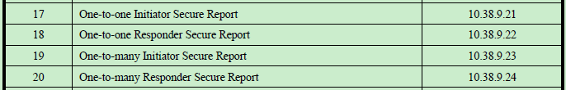
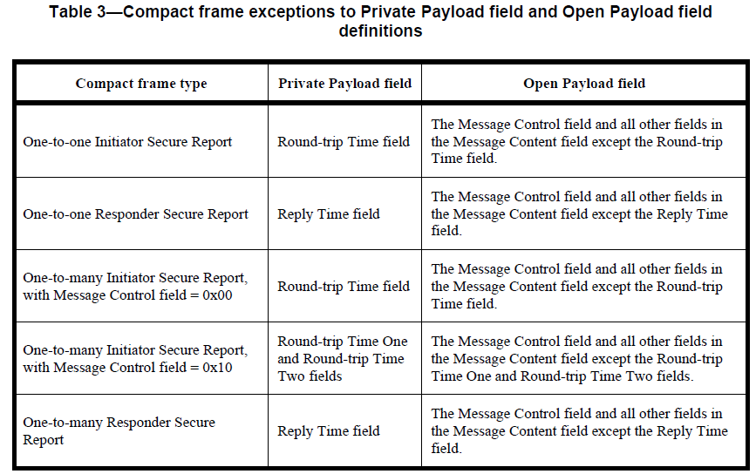
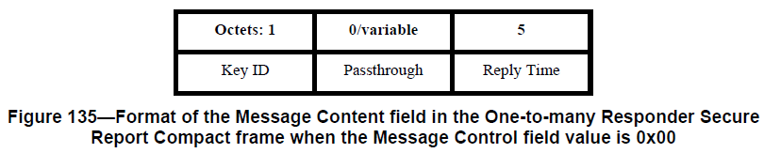
Secure Report Compact frames (1)
In 4ab D1.0, only Report Compact frames can be secured. 4 types of Secure Report Compact frames:
Only the fields carrying the timing measurements (Reply Time or Round-trip Time) can be encrypted.

Slide 3
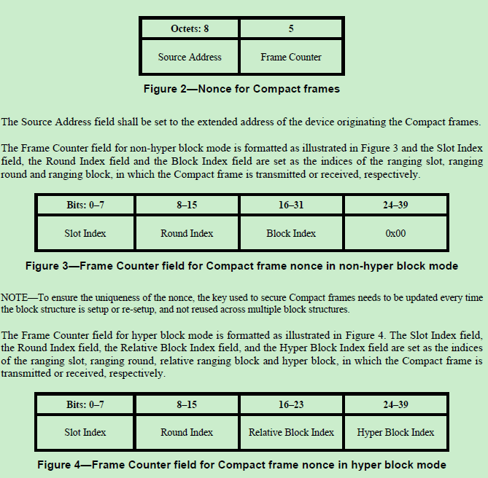
Secure Report Compact frames (2)
9.3.2.4 AEAD Nonce for Compact frames
Compact frames do not carry Frame Counter.
The Nonce used in the AEAD security operation for Compact frame is implicitly constructed using the indices of slot, round, block (and hyper block).
=> Only Compact frames that are used within a ranging block structure (i.e., during ranging rounds) can be secured. Compact frames used outside a ranging block structure (during Initialization and Setup, Acquisition) cannot be secured.

Slide 4
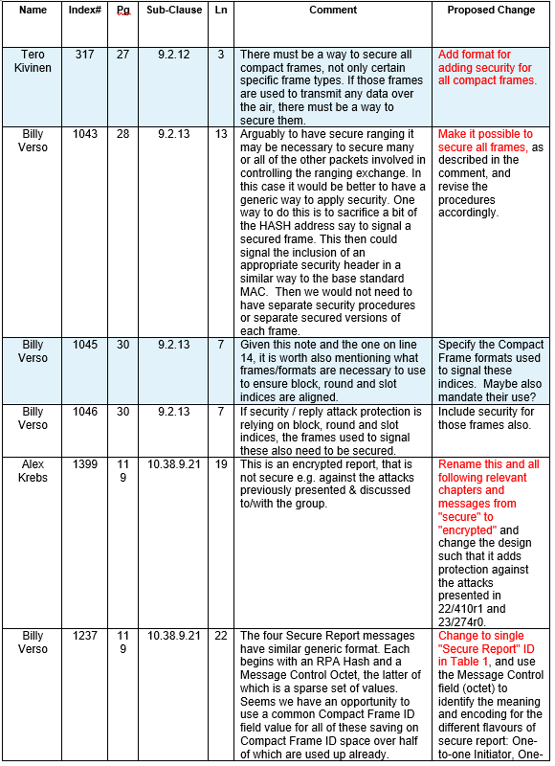
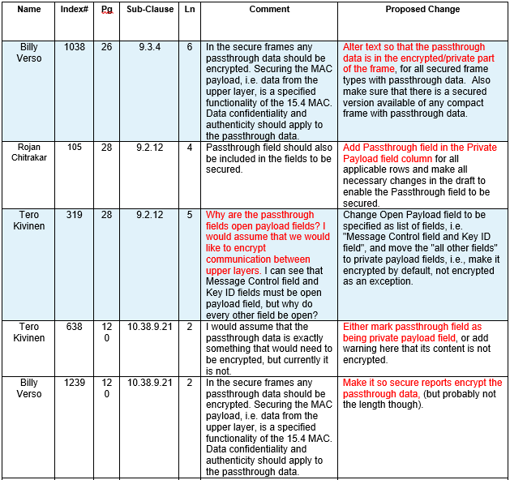
Some of the related LB207 Comments
Several comments asking to secure all Compact frames:
Several comments asking to secure Passthrough field:

Slide 5
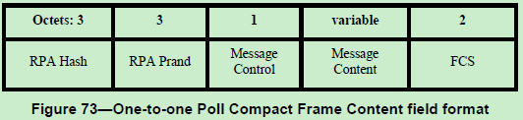
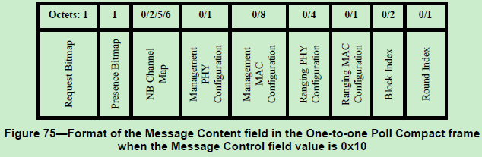
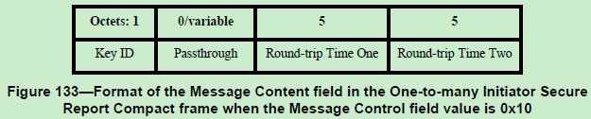
Key points of the proposed enhancements
1) Compact frames that are used within a ranging block structure are eligible for security and these frames are:
One-to-one Poll
One-to-one Response
One-to-one Initiator Report
One-to-one Responder Report
One-to-many Poll
One-to-many Response
One-to-many Responder Report
One-to-many Initiator Report
Compact frames that are used outside a ranging block structure are not eligible for security and these frames are:
Advertising Poll
Advertising Response
Start of Ranging
Advertising Confirmation
Public Advertising Poll
Public Advertising Response
Public Start of Ranging
Acquisition
2) Entire Message Content field is secured.
Fields related to security is moved out of the Message Content field to a new field (Security Control).

Slide 6
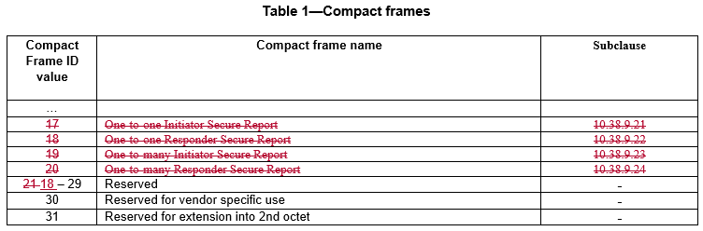
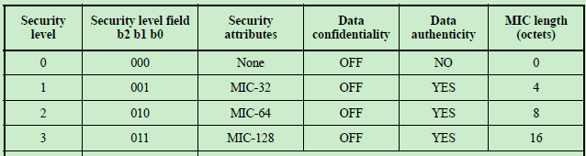
Key technical changes (1)
1) All Secure Report frames are removed.
2) The MSB of the Message Control field (b7) is used to indicate whether security is enabled => Message Control field is reduced to 7 bits.
In Compact frames that cannot be secured, this bit is reserved.
Octets: 3 | 0 or 3 | Bits: 0 - 6 | 7 | variable | 2
RPA Hash | RPA Prand | Message Control | Reserved | Message Content | FCS
In Compact frames that can be secured, the bit is used to indicate whether security is enabled. If the bit = 1, Security Control field is present and MIC field replaces the FCS field.
Octets: 3 | 0 or 3 | Bits: 0 – 6 | 7 | Octets: 0 or 1 | variable | 2/4/8/16
RPA Hash | RPA Prand | Message Control | Security Enabled | Security Control | Message Content | FCS or MIC
Figure xx3—Security Control field format
Bits: 0 - 2 | 3 - 5 | 6 - 7
Security Level | Key ID | Reserved

Slide 7
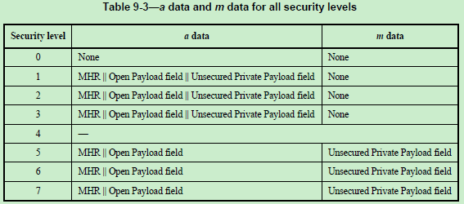
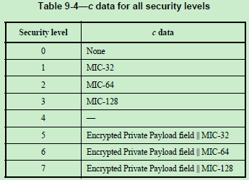
Key technical changes (2)
3) the MHR as used in Table 9-3, is defined as the right-concatenation of the Frame Type field, the Compact Frame ID field, the RPA Hash field and, if present, the RPA Prand field, the Message Control field, the Security Enabled field and if present, the Security Control field. The Private Payload field shall be set to the Message Content field, and Open Payload field shall be empty.
Bits: 0-2 | 3-7 | Octets: 3 | 0 or 3 | Bits: 0 – 6 | 7 | Octets: 0 or 1 | variable | 2/4/8/16
Frame Type | Compact Frame ID | RPA Hash | RPA Prand | Message Control | Security Enabled | Security Control | Message Content | FCS or MIC
MHR
Private Payload field

