Slide 1
        doc.: 15-24-0620-00-04ab
Project: IEEE P802.15 Working Group for Wireless Personal Area Networks (WPANs)
Submission Title: Dynamic PHR Sync Length Negotiation
Date Submitted: November, 2024
Source: Vinod Kristem, Xiliang Luo, Moche Cohen (Apple)
Address: One Apple Park Way, Cupertino, CA 95104, USA
E-Mails: vkristem@apple.com
Abstract: Proposal to address the gaps in the sync length negotiation
Purpose: To bring awareness on the potential gaps in sync negotiation and address them
Notice: This document has been prepared to assist the IEEE P802.15. It is offered as a basis for discussion and is not binding on the contributing individual(s) or organization(s). The material in this document is subject to change in form and content after further study. The contributor(s) reserve(s) the right to add, amend or withdraw material contained herein.
Release: The contributor acknowledges and accepts that this contribution becomes the property of IEEE and may be made publicly available by P802.15.

Slide 2
        doc.: 15-24-0620-00-04ab
PAR Objective | Proposed Solution (how addressed)
Safeguards so that the high throughput data use cases will not cause significant disruption to low duty-cycle ranging use cases
Interference mitigation techniques to support higher density and higher traffic use cases
Other coexistence improvement
Backward compatibility with enhanced ranging capable devices (ERDEVs)
Improved link budget and/or reduced air-time
Additional channels and operating frequencies
Improvements to accuracy / precision / reliability and interoperability for high-integrity ranging
Reduced complexity and power consumption
Hybrid operation with narrowband signaling to assist UWB
Enhanced native discovery and connection setup mechanisms
Sensing capabilities to support presence detection and environment mapping
Low-power low-latency streaming | Address the gaps in Dynamic PHR Sync length negotiation
Higher data-rate streaming allowing at least 50 Mbit/s of throughput | Address the gaps in Dynamic PHR Sync length negotiation
Support for peer-to-peer, peer-to-multi-peer, and station-to-infrastructure protocols
Infrastructure synchronization mechanisms

Slide 3
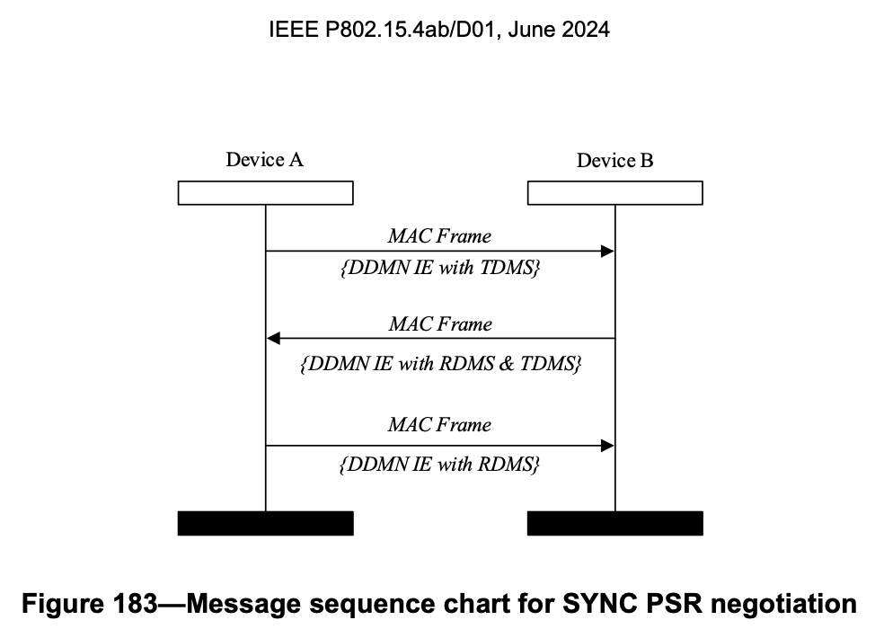
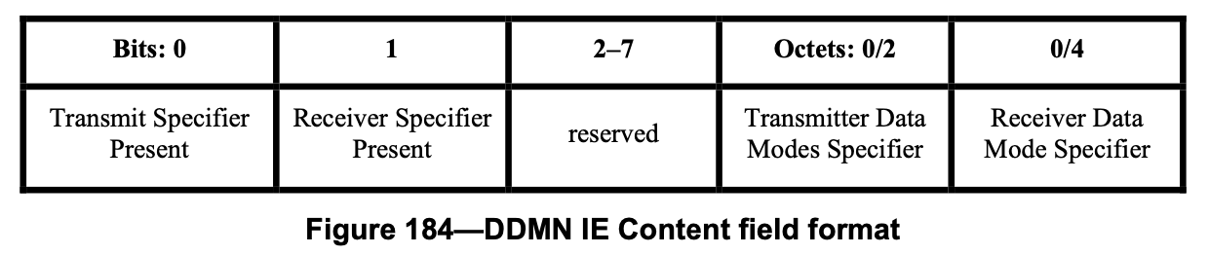


Introduction
        doc.: 15-24-0620-00-04ab
Dynamic data mode introduced in IEEE 802.15.4ab
  Enables in-band dynamic switching of data rates/coding packet to packet
3-way handshake using Dynamic Data Mode Negotiation (DDMN) IE
  Negotiates Sync PSR, SFD length, data rates supported

Slide 4
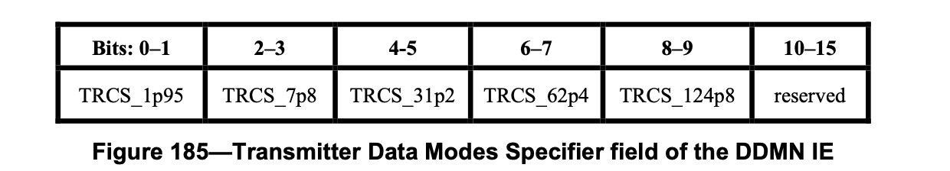
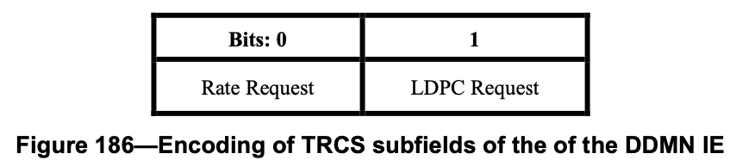
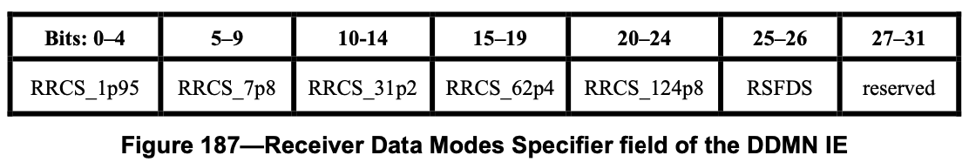
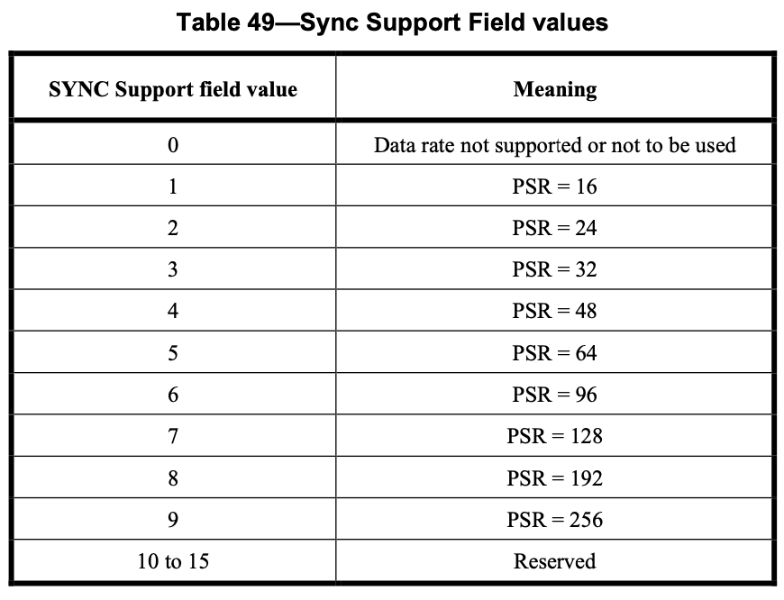
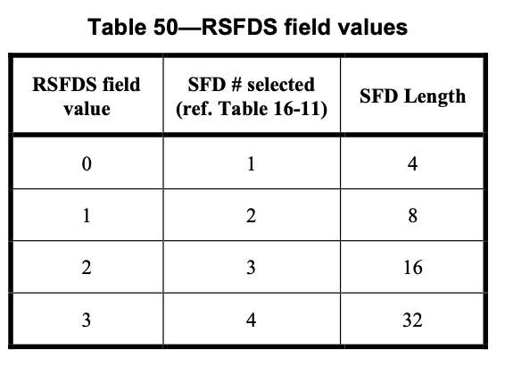
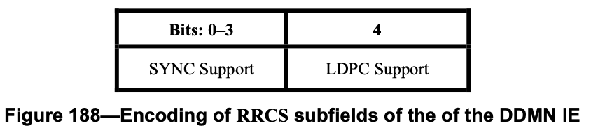
Sync, SFD, data rate Negotiation
        doc.: 15-24-0620-00-04ab
Transmitter sends DDMN IE with TDMS
  Specifies data rate and coding it supports and wishes to use
Receiver sends DDMN IE with RDMS
  Specifies the supported data rates, required Sync PSR per data rate, common SFD length

Slide 5
Gaps in negotiation
        doc.: 15-24-0620-00-04ab
Transmitter determines the list of feasible data rates it can use
  Transmitter shall use the data rates that both can support
  Transmitter shall use SFD length specified by receiver, for all data rates
  Transmitter shall use Sync PSR no smaller than the value specified by receiver
Receiver cannot determine outcome of negotiation
  Receiver not aware of transmitter support on Sync PSR and SFD length
  Transmitter decisions on feasible data rates not signaled to the receiver
Receiver would not be aware of an unsuccessful negotiation (no agreement)
Tx/Rx behavior not defined incase of an unsuccessful negotiation
  Potential interop issues
  E.x. Transmitter might fall back to 4z PHR, receiver would be anticipating dynamic PHR

Slide 6
Successful negotiation scenario
        doc.: 15-24-0620-00-04ab
A
B
A B
Wish list: {1.95, 7.8}
TDMS
1.95
7.8
31.2
62.4
124.8
RDMS
1.95
7.8
31.2
62.4
124.8
Sync PSR:
64
64
64
64
(SFD 8)
If Tx supports Sync PSR 64 and SFD length 8 negotiation successful
Both Tx and Rx perceives it as successful negotiation

Slide 7
Unsuccessful negotiation: Unsupported SFD length
        doc.: 15-24-0620-00-04ab
A
B
A B
Wish list: {1.95, 7.8}
TDMS
1.95
7.8
31.2
62.4
124.8
RDMS
1.95
7.8
31.2
62.4
124.8
(SFD 32)
If Tx cannot support SFD length 32 (optional) negotiation unsuccessful
  No feasible data rates
Rx perceives it as successful negotiation, unaware of Tx SFD support

Slide 8
Unsuccessful negotiation: Unsupported Sync PSR
        doc.: 15-24-0620-00-04ab
A
B
A B
Wish list: {1.95, 7.8}
TDMS
1.95
7.8
31.2
62.4
124.8
RDMS
1.95
7.8
31.2
62.4
124.8
Sync PSR:
192
192
64
32
(SFD 8)
If Tx cannot support Sync PSR 192 or 256 (optional) negotiation unsuccessful
  No feasible data rates
Rx perceives it as successful negotiation, unaware of Tx Sync PSR support

Slide 9
Unsuccessful negotiation: Only one common rate
        doc.: 15-24-0620-00-04ab
A
B
A B
Wish list: {62.4, 124.8}
TDMS
1.95
7.8
31.2
62.4
124.8
RDMS
1.95
7.8
31.2
62.4
124.8
Tx might choose not to go ahead with dynamic PHR
  Not feasible to switch data rates
Rx perceives it as successful negotiation, unaware of Tx decision

Slide 10
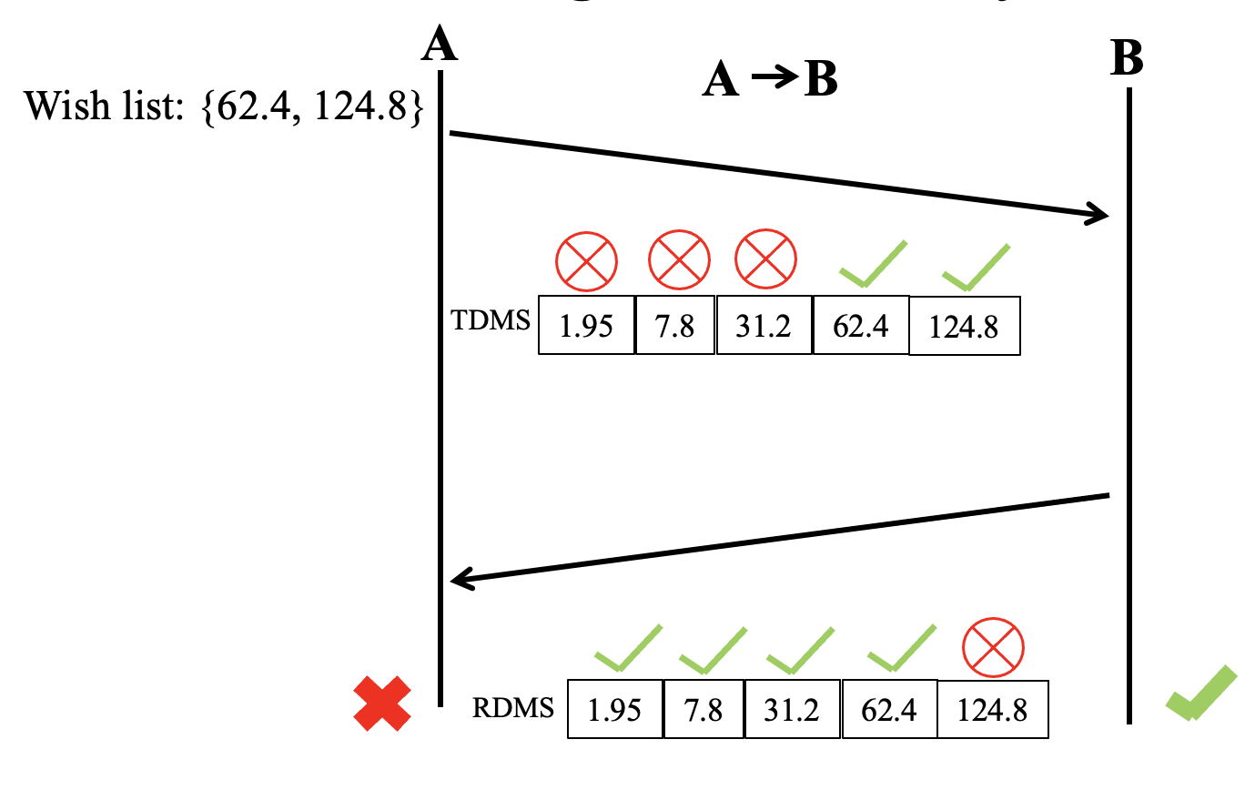
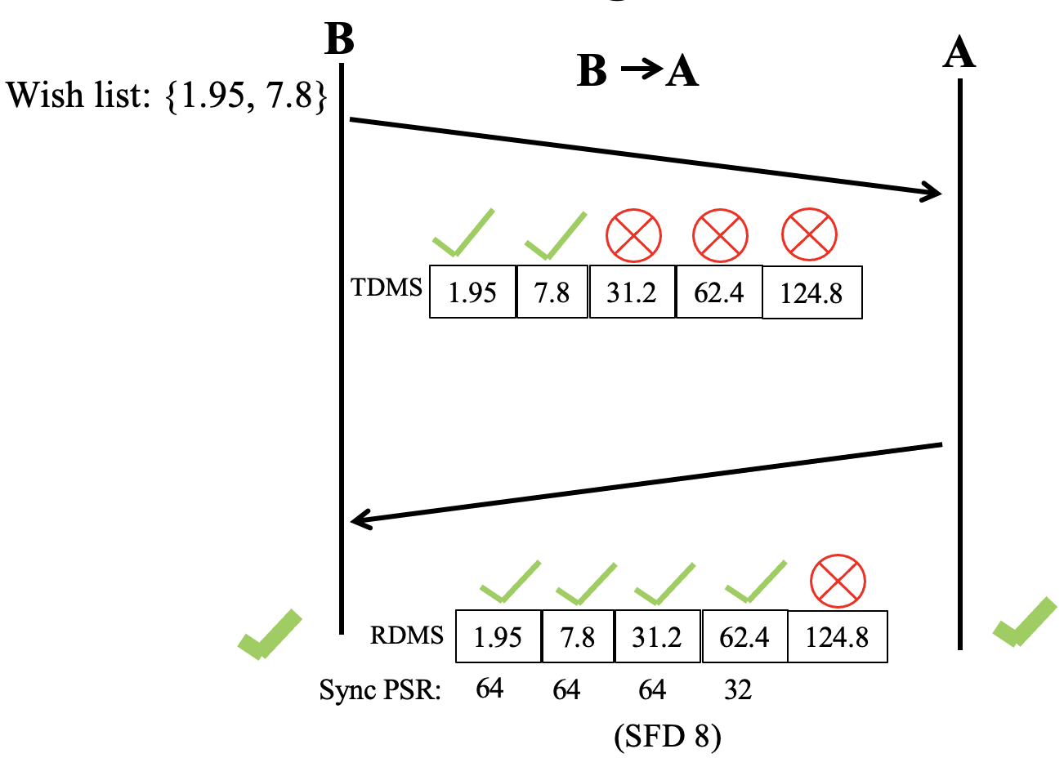
Unsuccessful negotiation only in one direction
        doc.: 15-24-0620-00-04ab
Negotiation can be successful only in one direction
  Asymmetric traffic/requirements in uplink and downlink
  Asymmetric capabilities as transmitter and receiver for a device
B A: Dynamic PHR, A B: fall back to 4z PHR
  Could make things more challenging if receiver doesn’t know the result of negotiation

Slide 11
Filling the gaps
        doc.: 15-24-0620-00-04ab
Gap in negotiation: Receiver might not know outcome of the negotiation, or the list of feasible data rates
  Receiver unaware of Tx support on Sync and SFD length
  Negotiation decision not signaled by transmitter
Receiver could benefit knowing outcome of negotiation
  Avoids potential interop issues
  Receiver can be better prepared for the agreed data rates
HRP UWB PHY PIB Attribute (phyHrpUwbPhrDataRate) used to communicate OOB on the PHR/PSDU rate
  Does not provide complete information on outcome of negotiation
  Better to add in-band signaling as part of the negotiation
We provide few options to address these gaps

Slide 12
Option 1: Expand TDMS to include Sync and SFD support
        doc.: 15-24-0620-00-04ab
Signal the transmitter support of Sync PSR and SFD length using TDMS
  Need large bit mask to completely specify the transmitter support
Enables receiver to determine the outcome of negotiation and which data rates are feasible
Bits: 0 | 1 | 2-41
Rate Request | LDPC Request | Bit mask with Sync and SFD support

Slide 13
Option 2: Signaling negotiation status
        doc.: 15-24-0620-00-04ab
Reconfigure reserved bits in DDMN to indicate the negotiation status to receiver
  Enables receiver to be aware of outcome of negotiation and which data rates are feasible
Bits: 0 | 1 | 2 | 3-7 | Octets:0/2 | 0/4
Transmit Specifier Present | Receiver Specifier Present | Negotiation Specifier valid | Negotiation Specifier (NS) | TDMS | RDMS
Bits: 3 | 4 | 5 | 6 | 7
Negotiation status for 1.95 Mb/s | Negotiation status for 7.8 Mb/s | Negotiation status for 31.2 Mb/s | Negotiation status for 62.4 Mb/s | Negotiation status for 124.8 Mb/s

Slide 14
Option 2: Handshake for bidirectional exchange
        doc.: 15-24-0620-00-04ab
Bits: 0 | 1 | 2 | 3-7 | Octets:0/2 | 0/4
Transmit Specifier Present | Receiver Specifier Present | Negotiation Specifier valid | Negotiation Specifier (NS) | TDMS | RDMS
A
B
MAC Frame
{DDMN IE with TDMS}
MAC Frame
{DDMN IE with RDMS and TDMS}
MAC Frame
{DDMN IE with valid NS and RDMS}
MAC Frame
{DDMN IE with valid NS}
Would need a 4-way handshake for bidirectional communication of NS

Slide 15
Option 3: TDMS to indicate feasible data rates
        doc.: 15-24-0620-00-04ab
A B
Transmitter gets receiver requirements using RDMS
Transmitter determines which data rates are feasible based on RDMS, and its own wish list
Transmitter indicates feasible data rates using TDMS
No changes to TDMS, RDMS or DDMN IE definitions
A
B
MAC Frame
{DDMN IE with RDMS}
MAC Frame
{DDMN IE with TDMS}

Slide 16
Unsuccessful negotiation: Unsupported SFD length (Revisit using Option 3)
        doc.: 15-24-0620-00-04ab
Current handshake
Handshake with option 3
Wish list: {1.95, 7.8}
Wish list: {1.95, 7.8}
A
B
A
B
A B
A B
TDMS
1.95
7.8
31.2
62.4
124.8
RDMS
1.95
7.8
31.2
62.4
124.8
(SFD 32)
RDMS
1.95
7.8
31.2
62.4
124.8
TDMS
1.95
7.8
31.2
62.4
124.8
(SFD 32)
Rx unaware of unsuccessful negotiation
Both Tx and Rx aware of unsuccessful negotiation

Slide 17
Unsuccessful negotiation: Unsupported Sync PSR (Revisit using Option 3)
        doc.: 15-24-0620-00-04ab
Current handshake
Handshake with option 3
Wish list: {1.95, 7.8}
Wish list: {1.95, 7.8}
A
B
A
B
A B
A B
TDMS
1.95
7.8
31.2
62.4
124.8
RDMS
1.95
7.8
31.2
62.4
124.8
Sync PSR:
192
192
64
32
(SFD 8)
RDMS
1.95
7.8
31.2
62.4
124.8
Sync PSR:
192
192
64
32
TDMS
1.95
7.8
31.2
62.4
124.8
(SFD 8)
Rx unaware of unsuccessful negotiation
Both Tx and Rx aware of unsuccessful negotiation

Slide 18
Unsuccessful negotiation: Only one common rate (Revisit using Option 3)
        doc.: 15-24-0620-00-04ab
Current handshake
Handshake with option 3
Wish list: {62.4, 124.8}
Wish list: {62.4, 124.8}
A
A
B
A B
B
A B
RDMS
1.95
7.8
31.2
62.4
124.8
TDMS
1.95
7.8
31.2
62.4
124.8
TDMS
1.95
7.8
31.2
62.4
124.8
RDMS
1.95
7.8
31.2
62.4
124.8
Rx unaware of unsuccessful negotiation
Both Tx and Rx aware of unsuccessful negotiation

Slide 19
Option 3: Handshake for bidirectional exchange
        doc.: 15-24-0620-00-04ab
3-way handshake would be sufficient
No need of explicit bits for signaling negotiation status
  Implicitly captured by TDMS
A
B
MAC Frame
{DDMN IE with RDMS}
MAC Frame
{DDMN IE with TDMS and RDMS}
MAC Frame
{DDMN IE with TDMS}

Slide 20
Summary
        doc.: 15-24-0620-00-04ab
DDMN IE facilitates dynamic PHR sync negotiation in 4ab
  3-way handshake to negotiate data rates, Sync PSR, and SFD length
Identified some gaps in current negotiation/handshake
  Scenarios in which receiver unaware of unsuccessful negotiation, leading to potentially different behavior on transmitter and receiver
  Could lead to potential interop issues
Provided few options to address the gaps
  Option 3 resolves the issues with minimal changes to 4ab spec. D1.0

Slide 21
APPENDIX
        doc.: 15-24-0620-00-04ab

Slide 22
Option 2: Optimized handshake
        doc.: 15-24-0620-00-04ab
3-way handshake would be sufficient
Bits: 0 | 1 | 2 | 3-7 | Octets:0/2 | 0/4
Transmit Specifier Present | Receiver Specifier Present | Negotiation Specifier valid | Negotiation Specifier (NS) | TDMS | RDMS
A
B
MAC Frame
{DDMN IE with TDMS and RDMS}
MAC Frame
{DDMN IE with TDMS* and RDMS}
TDMS*: TDMS, determined after taking RX requirements (RDMS) into account
(indicates support of feasible data rates)
MAC Frame
{DDMN IE with valid NS}

Slide 23
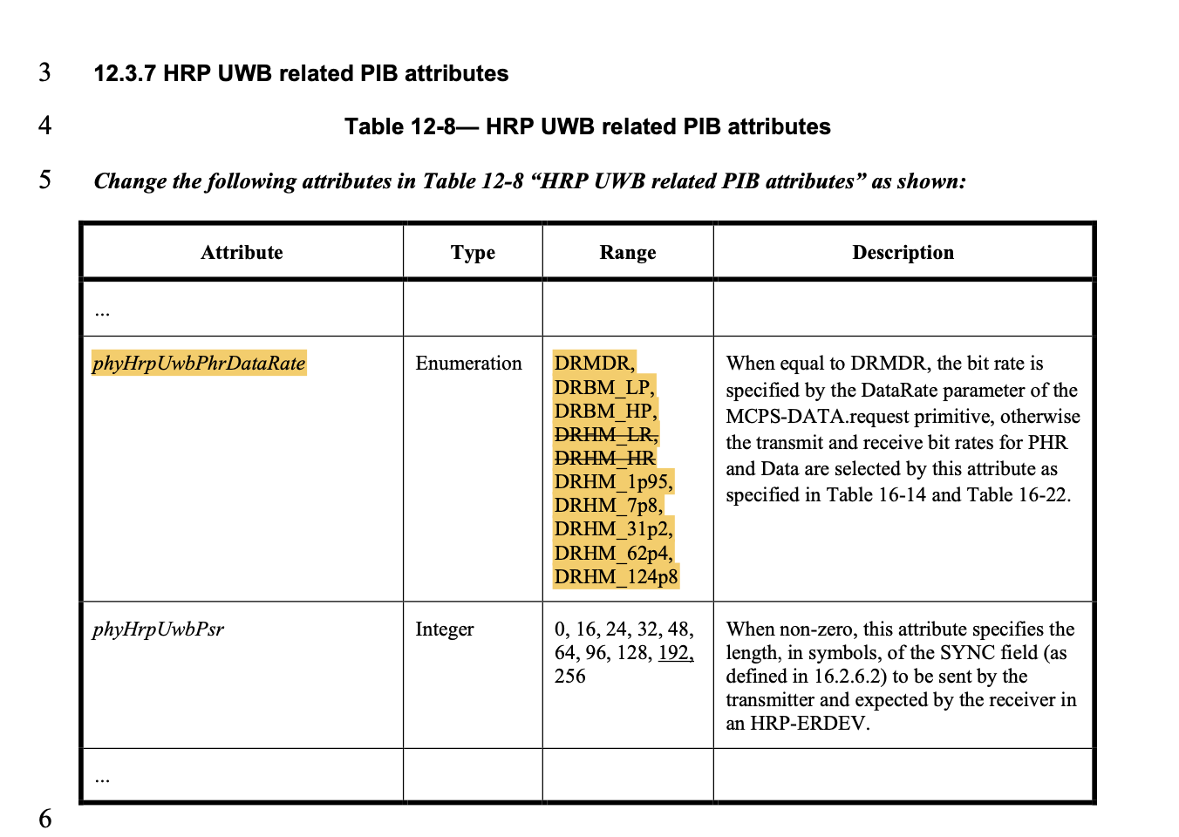
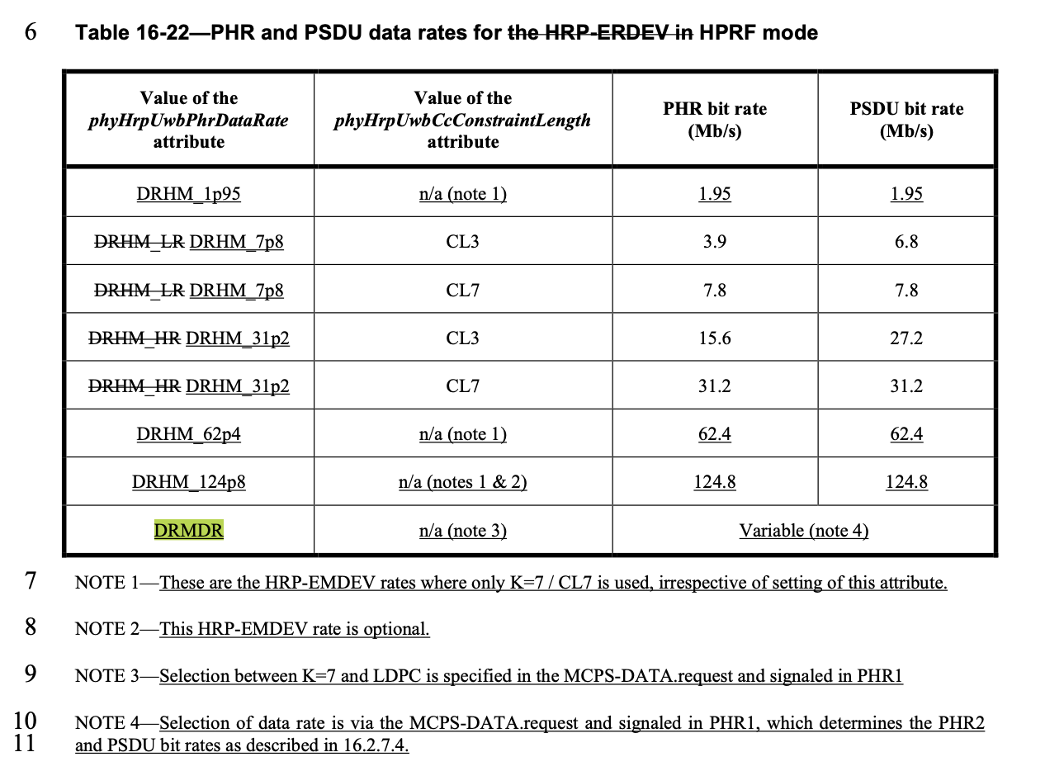
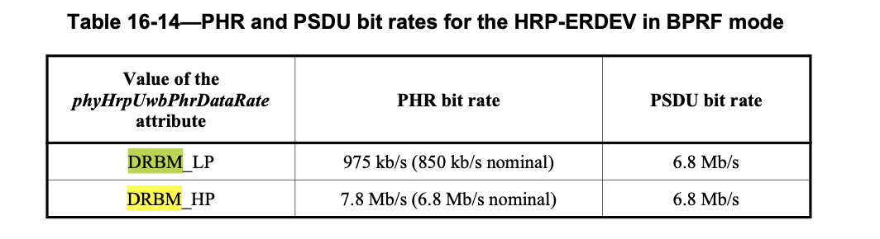
        doc.: 15-24-0620-00-04ab
DRMDR: Dynamic data rate mode

Slide 24
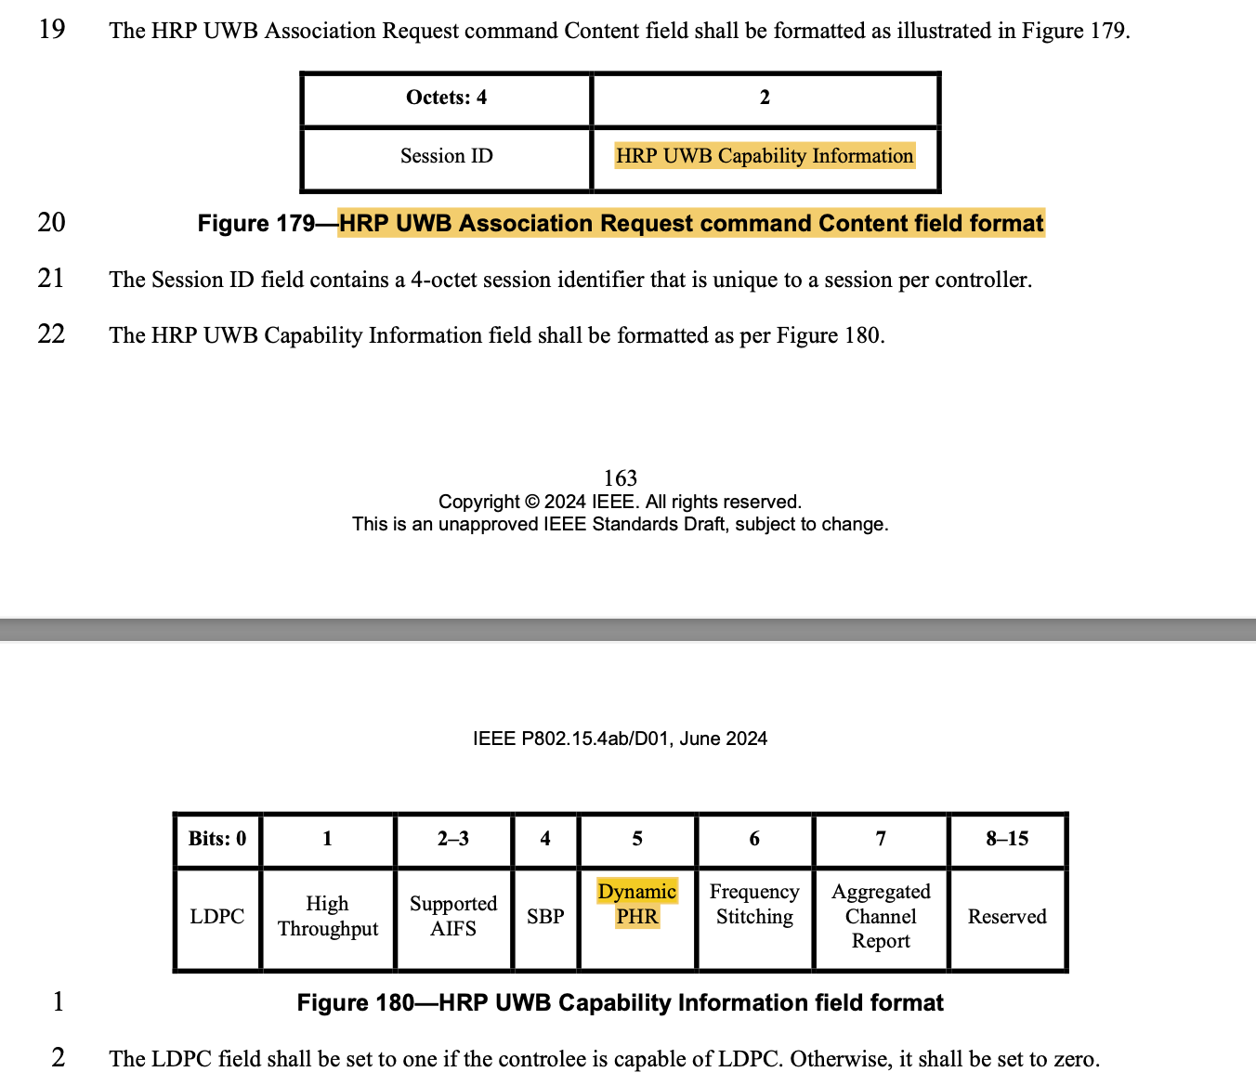
        doc.: 15-24-0620-00-04ab
Capability/Association typically done OOB

