Slide 1
Project: IEEE P802.15 Working Group for Wireless Specialty Networks (WSNs)
Submission Title: Advancing FSO Networks for Next-Generation Drone Communication Systems
Date Submitted: Nov. 12, 2024
Source: Muhammad Ayaz, Nguyen Ngoc Huy, Yeong Min Jang (Kookmin University)
Address: Room #603 Mirae Building, Kookmin University, 77 Jeongneung-Ro, Seongbuk-Gu, Seoul, 136702, Republic of Korea
Voice: +82-2-910-5068 E-Mail: yjang@kookmin.ac.kr
Re:
Abstract: Advancing FSO Networks for Next-Generation Drone Communication Systems
Purpose: Presentation for contribution on IG NG-OWC
Notice: This document has been prepared to assist the IG NG-OWC. It is offered as a basis for discussion and is not binding on the contributing individual(s) or organization(s). The material in this document is subject to change in form and content after further study. The contributor(s) reserve(s) the right to add, amend or withdraw material contained herein.
Release: The contributor acknowledges and accepts that this contribution becomes the property of IEEE and may be made publicly available by IG NG-OWC.

Slide 2
Advancing FSO Networks for Next-Generation Drone Communication Systems
Nov. 12, 2024

Slide 3
Contents
Backgroud
UAV-FSO communication deployment
FSO-based drone-assisted mobile network architecture
Proposed System Model
Conclusion
References

Slide 4
Background
Free Space Optics (FSO), a wireless optical communication technology, presents a promising solution for high-speed, secure, and flexible communication networks.
When integrated with Unmanned Aerial Vehicles (UAVs), or drones, FSO can revolutionize various applications, from emergency response and disaster relief to precision agriculture and remote sensing.
Named Data Networking (NDN) is a revolutionary network architecture that leverages a content-centric approach, significantly enhancing network performance and efficiency
NDN's in-network caching mechanism enables data to be cached at various network nodes. This reduces network congestion and latency, especially in scenarios where multiple drones require the same data.

Slide 5
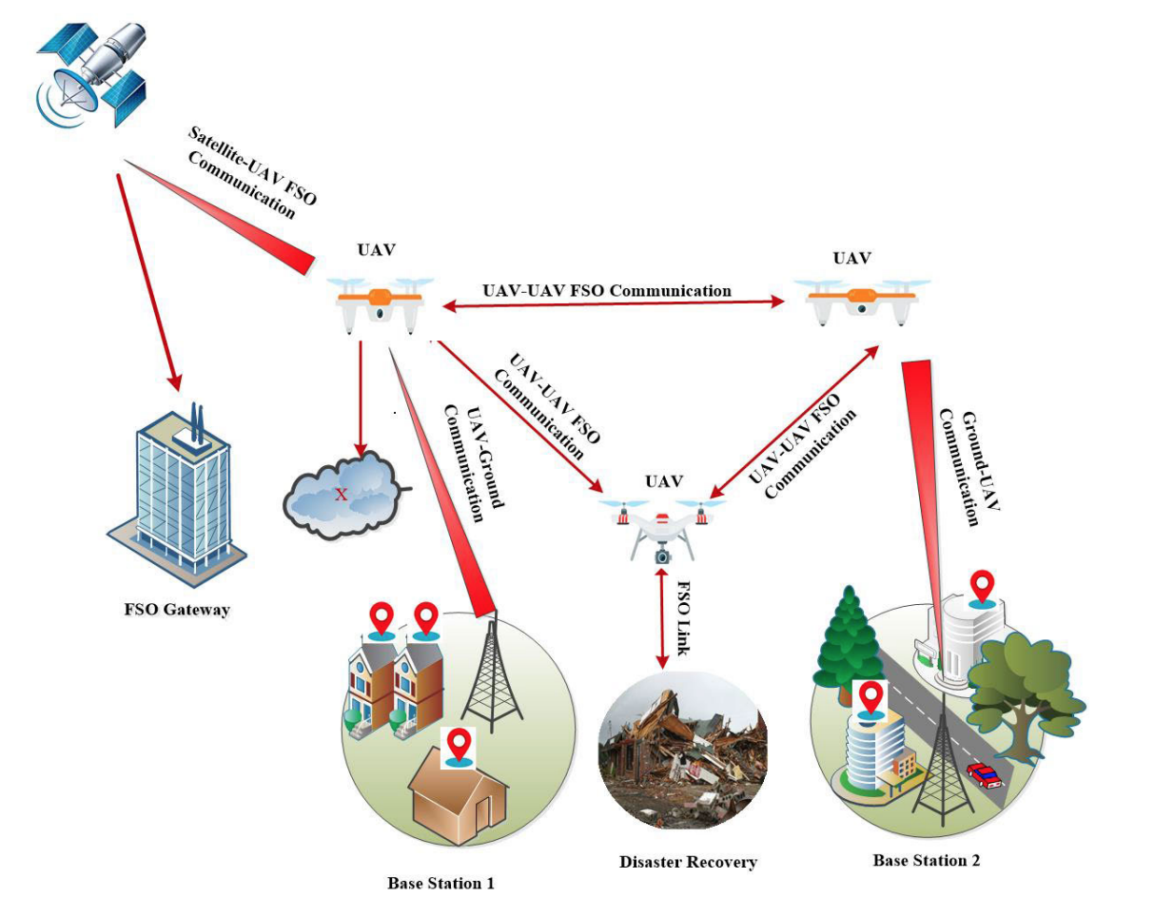
A typical UAV-FSO communication deployment scenario.
A combination of UAV-FSO can provide seamless connectivity with high-speed data and secured transmission
A typical UAV-FSO deployment scenario with a wide range of applications i.e., inter UAV-FSO communication between UAVs for range enhancement, disaster management, last-mile access, satellite-to-ground communication,
The integration of UAV-based FSO communication with cutting-edge advances in 5G and future 6G technology promises revolutionary potential.[1]
Fig.1: UAV-FSO Communication

Slide 6
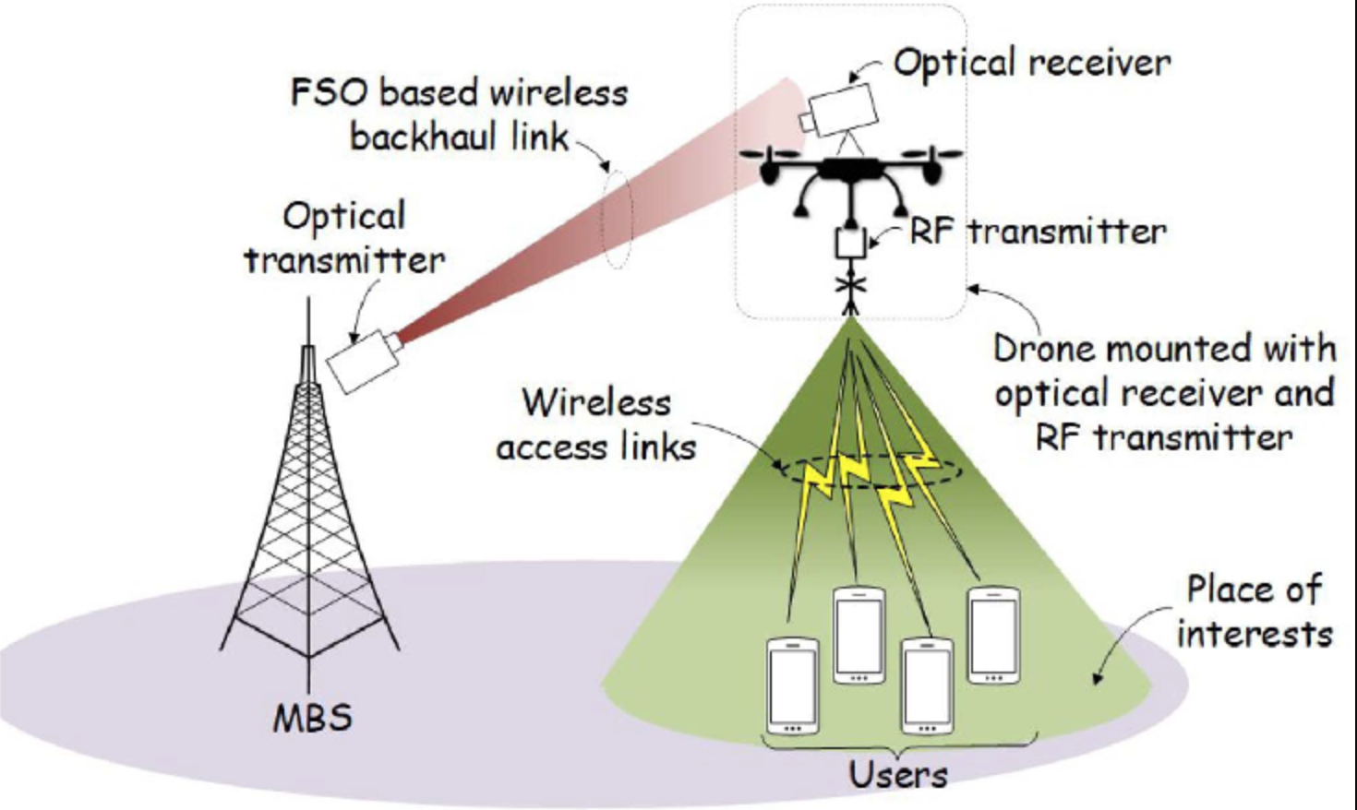
FSO-based drone-assisted mobile network architecture.
Fig.2: FSO-based drone-assisted mobile network architecture.[3]

Slide 7
System Model
Drone-based networking services may require frequent handovers due to their shorter coverage radius compared to traditional infrastructure like cellular networks. As a result, it handles frequent handovers by pre-caching data to the target network provider before handover via a content store.
The operation process occurs when a drone receives an Interest packet.
First, when it receives an interest of data, it determines if data exists in its CS. If data exists, it decides if it should be pre-cached.
Generates an Interest Packet (Request for Data)
Send Interest Packet (Request for Data)
Data Packet Response
Returning the Data Packet

Slide 8
Advantages
  Reduced Latency
  Once the alert data is cached in the network, other drones can receive the same information quickly, without waiting for it to be generated or fetched from the original source again.
  Efficient Resource Usage
  Caching reduces the need for repeated requests to the same source, which is especially useful in a highly mobile and dynamic environment like vehicular networks, where vehicles are constantly moving and changing locations.
  Built-in Security
  The Data packets are signed by the data producer (Vehicle A). This ensures that the alert message came from a legitimate source and hasn’t been tampered with, which is crucial for safety-critical applications in vehicular networks
  Scalability
  As more vehicles on the road request data, the network can scale effectively. The data is distributed across the network through caching and interest forwarding, allowing the system to handle a large number of vehicles without overwhelming central servers

Slide 9
Conclusion
The integration of Named Data Networking (NDN) and Free Space Optics (FSO) presents a promising avenue for the development of advanced drone networks
NDN content-centric approach and in-network caching capabilities offer significant advantages in terms of scalability, flexibility, and resilience, particularly in dynamic and unpredictable drone environments
FSO provides high-speed communication links with minimal electromagnetic interference, making it ideal for drone-to-drone or drone-to-ground communication in environments where traditional RF-based communication might suffer from congestion or interference
By leveraging FSO's high-speed, secure, and license-free communication, we can further enhance the performance and reliability of drone networks.

Slide 10
References
[1] Nzekwu, N. J., Fernandes, M. A., Fernandes, G. M., Monteiro, P. P., & Guiomar, F. P. (2024). A comprehensive review of UAV-Assisted FSO relay systems. Photonics, 11(3), 274. https://doi.org/10.3390/photonics11030274
[2] Choi, S., Joe, I., & Kim, W. (2019). Data Pre-Caching Mechanism in NDN-based Drone Networks. Journal of IKEEE, 23(4), 1116–1121. https://doi.org/10.7471/ikeee.2019.23.4.1116
[3] Yu, L., Sun, X., Shao, S., Chen, Y., & Albelaihi, R. (2023). Backhaul-Aware Drone Base Station Placement and Resource Management for FSO-Based Drone-Assisted Mobile Networks. IEEE Transactions on Network Science and Engineering, 10(3), 1659–1668. https://doi.org/10.1109/tnse.2022.3233004
[4] Gu, Z., Jiang, J., Dong, T., Liu, Z., & Ji, Y. (2024). Cross-Layer Topology Control Mechanism for FSO-Based UAV Relay Networks. MDPI, 1274–1279. https://doi.org/10.1109/iccworkshops59551.2024.10615902

