Slide 1
Project: IEEE P802.15 Working Group for Wireless Specialty Networks (WSNs)
Submission Title: Lightweight AI for NG-OWC in Constrained Environment
Date Submitted: Nov 12, 2024
Source: Muhammad Rangga Aziz Nasution, Ida Bagus Krishna Yoga Utama, Nguyen Ngoc Huy, Yeong Min Jang (Kookmin University)
Address: Room #603 Mirae Building, Kookmin University, 77 Jeongneung-Ro, Seongbuk-Gu, Seoul, 136702, Republic of Korea
Voice: +82-2-910-5068 E-Mail: yjang@kookmin.ac.kr
Re:
Abstract: Present the Lightweight AI for NG-OWC in Constrained Environment
Purpose: Presentation for contribution on IG NG-OWC
Notice: This document has been prepared to assist the IG NG-OWC. It is offered as a basis for discussion and is not binding on the contributing individual(s) or organization(s). The material in this document is subject to change in form and content after further study. The contributor(s) reserve(s) the right to add, amend or withdraw material contained herein.
Release: The contributor acknowledges and accepts that this contribution becomes the property of IEEE and may be made publicly available by IG NG-OWC.

Slide 2
Lightweight AI for NG-OWC in Constrained Environment
Nov. 12, 2024

Slide 3
Contents
Background
Techniques for making deep learning models lightweight
Advantages of Lightweight AI for NG-OWC
Conclusion

Slide 4
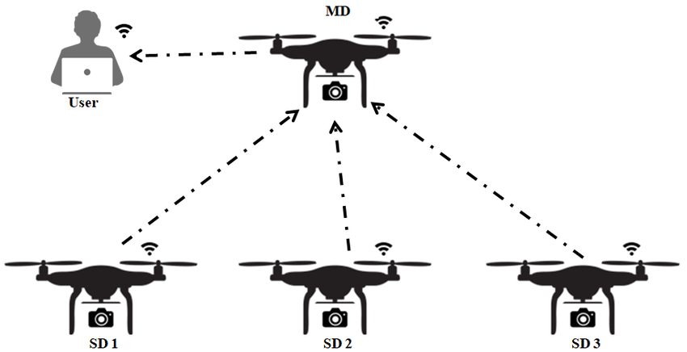
Background
Deep learning models have become increasingly mature, demonstrating remarkable capabilities across a wide range of applications. As the deep learning grows, its integration to constrained systems is gaining attention.
As a result, current research is focused on making these models more lightweight without sacrificing performance, driven by the growing demand for AI on edge devices where efficient operation in constrained environments is essential.
Similarly, advancements in Optical Wireless Communication (OWC) require lightweight models that can process data efficiently and operate in real time, even on devices with limited processing power and memory.

Slide 5
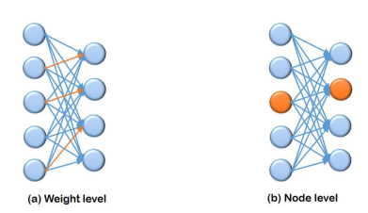
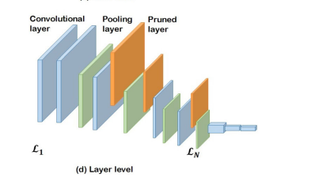
Techniques for making deep learning models lightweight
Pruning
Model pruning entails reducing the parameter count by eliminating less significant weights, neurons, channels, or entire layers. This process can be unstructured (removing individual weights) or structured (removing groups), substantially enhancing model efficiency with minimal impact on performance.

Slide 6
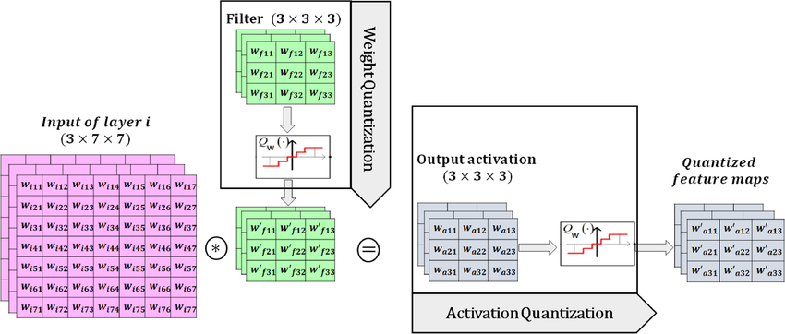
Techniques for making deep learning models lightweight
Quantization
Quantization involves lowering the numerical precision of model weights and activations, often from 32-bit floating-point to 8-bit integer formats, to reduce memory and computational demands. Post-training quantization is frequently employed, enabling models to retain acceptable accuracy while operating efficiently on low-power devices.

Slide 7
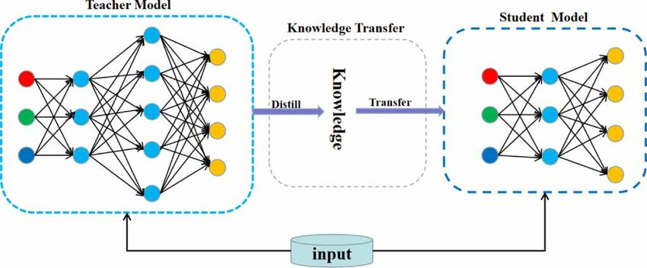
Techniques for making deep learning models lightweight
Knowledge Distillation
Knowledge distillation transfers knowledge from a larger, more complex “teacher” model to a smaller “student” model by using the teacher’s outputs or intermediate layers to guide the student’s training. This technique is effective for model compression, allowing the student model to approach the teacher’s performance with significantly less parameters.

Slide 8
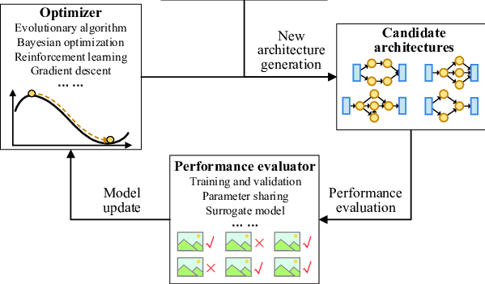
Techniques for making deep learning models lightweight
Neural Architecture Search
Neural Architecture Search (NAS) automates the design of model architectures by exploring configurations that balance accuracy and computational cost. Employing methods like reinforcement learning or evolutionary algorithms, NAS discovers efficient architectures suited to specific hardware constraints.

Slide 9
Advantages of Lightweight AI for NG-OWC
Faster transmitter detection
Optical wireless communication (OWC) employs line-of-sight (LoS) based communication to transfer data. Lightweight models are designed for minimal computational overhead, enabling faster detection of transmitter signals in real time LoS system.
Lower power consumption and resource efficiency
These models consume less power, enabling battery-powered devices to operate longer without recharging. They are optimized for resource-constrained hardware, making them ideal for edge devices in optical wireless communication.

Slide 10
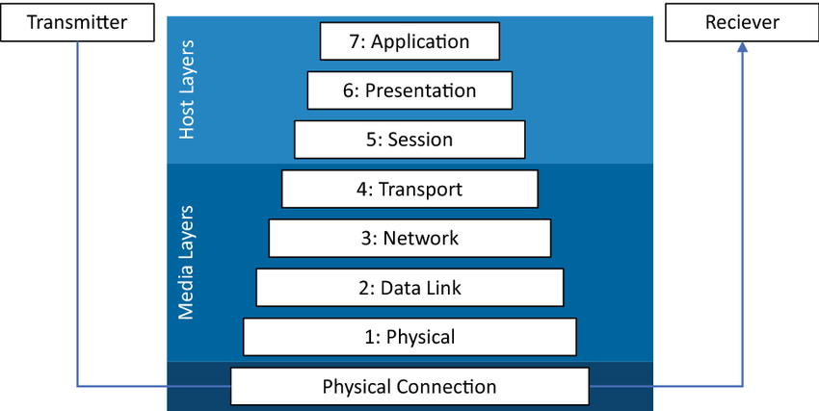
Advantages of Lightweight AI for NG-OWC
Reduce latency in every communication layer
Lightweight AI models process signals faster due to fewer parameters and lower computational complexity, which is crucial for low-latency applications like augmented reality and autonomous vehicles. Their ability to quickly adapt to changing conditions enhances communication speed without introducing delays.

Slide 11
Conclusion
Lightweight AI models have recently gained significant attention, driven by the need for efficient, scalable AI solutions across various fields. Applying lightweight AI model for OWC is crucial to enhance communication quality.
Key techniques for creating these models include pruning, quantization, knowledge distillation, and neural architecture search, each focusing on reducing computational demands while maintaining performance.
Applying Lightweight AI models in optical wireless communication (OWC) technology can reduce latency, allowing for faster transmitter detection and reduce latency of the communication itself.
Lightweight models also offer the advantage of lower power consumption and optimized resource efficiency, making them ideal for battery-powered and edge devices.

Slide 12
References
S. A. Celtek, A. Durdu, and E. Kurnaz, “Design and simulation of the hierarchical tree topology based wireless drone networks,” in 2018 International Conference on Artificial Intelligence and Data Processing (IDAP), 2018, pp. 1–5.
C.-H. Wang, K.-Y. Huang, Y. Yao, J.-C. Chen, H.-H. Shuai, and W.-H. Cheng, “Lightweight AI: An overview,” IEEE Consum. Electron. Mag., vol. 13, no. 4, pp. 51–64, 2024.
H.-I. Liu et al., “Lightweight AI for resource-constrained environments: A survey,” ACM Comput. Surv., vol. 56, no. 10, pp. 1–42, 2024.
J. Tmamna et al., “Pruning deep neural networks for green energy-efficient models: A survey,” Cognit. Comput., vol. 16, no. 6, pp. 2931–2952, 2024.
J. Tmamna, E. B. Ayed, R. Fourati, A. Hussain, and M. B. Ayed, “Bare‐Bones particle Swarm optimization‐based quantization for fast and energy efficient convolutional neural networks,” Expert Syst., vol. 41, no. 4, 2024.
F. He, C. Liu, M. Wang, E. Yang, and X. Liu, “Network lightweight method based on knowledge distillation is applied to RV reducer fault diagnosis,” Meas. Sci. Technol., vol. 34, no. 9, p. 095110, 2023.
Y. Tian, S. Peng, S. Yang, X. Zhang, K. C. Tan, and Y. Jin, “Action command encoding for surrogate-assisted neural architecture search,” IEEE Trans. Cogn. Dev. Syst., vol. 14, no. 3, pp. 1129–1142, 2022.
A. S. Elgamal, O. Z. Aletri, B. A. Yosuf, A. Adnan Qidan, T. El-Gorashi, and J. M. H. Elmirghani, “AI-driven resource allocation in optical wireless communication systems,” in 2023 23rd International Conference on Transparent Optical Networks (ICTON), 2023, pp. 1–5.
J. Vrana, “The core of the fourth revolutions: Industrial internet of things, digital twin, and cyber-physical loops,” J. Nondestruct. Eval., vol. 40, no. 2, 2021.

