Slide 1
Project: IEEE P802.15 Working Group for Wireless Specialty Networks
Submission Title: Deep-learning based Invisible Light Object Detection for OWC Network in Drone Systems
Date Submitted: November 12, 2024
Source: Muhammad Alfi Aldolio, Ida Bagus Krishna Yoga Utama, Yeong Min Jang (Kookmin University)
Address [Address: Room #603 Mirae Building, Kookmin University, 77 Jeongneung-Ro, Seongbuk-Gu, Seoul, 136702, Republic of Korea]
Voice: [+82-2-910-5068] E-Mail: [yjang@kookmin.ac.kr]
Re:
Abstract: Visible light-based OWC in drones often faces limitations in low-light or high-glare environments, but with deep-learning approach for object detection using invisible light, specifically infrared (IR) and near-infrared (NIR) spectrums able to enhance OWC performance and reliability in various lighting conditions
Purpose: Presentation for contribution on IG NG-OWC
Notice: This document has been prepared to assist the IEEE P802.15. It is offered as a basis for discussion and is not binding on the contributing individual(s) or organization(s). The material in this document is subject to change in form and content after further study. The contributor(s) reserve(s) the right to add, amend or withdraw material contained herein.
Release: The contributor acknowledges and accepts that this contribution becomes the property of IEEE and may be made publicly available by P802.15.

Slide 2
Deep-learning based Invisible Light Object Detection for OWC Network in Drone Systems
Muhammad Alfi A., Ida Bagus Krishna Y. U, Yeong Min Jang
Kookmin University

Slide 3
Introduction
Drones are used more in tasks like monitoring, delivery, and surveillance, they need strong and secure communication networks to operate effectively.
Traditional systems that use visible light struggle with accuracy in poor visibility, which can disrupt communication and data transfer.
In contrast invisible light, such as infrared (IR) and near-infrared (NIR), works better in low-light or challenging environments.
By using deep-learning models, such convolutional neural networks (CNNs), detecting and tracking objects quickly and accurately.
By applying these models to IR and NIR data, drones can detect communication signals more reliably in complex environments.

Slide 4
Existing Solutions
Visible Light Communication (VLC) Systems
VLC is a form of optical wireless communication that uses light-emitting diodes (LEDs) to transmit data by rapidly switching the LEDs on and off at speeds imperceptible to the human eye. VLC operates within the visible light spectrum (400 ~ 700 nm) and is an emerging technology for high-speed, short-range communication.
Advantages | Disadvantages
The rapid on/off switching of LEDs supports fast data transmission. | Requires direct LoS between the transmitter and receiver, limiting mobility and flexibility.
Systems can operate in close proximity without significant interference. | Bright light sources, like sunlight, can disrupt VLC signals
 | Depends on LEDs, might be not practical

Slide 5
Existing Solutions
2. Camera-Based OWC (OCC)
Camera-based OWC leverages cameras as receivers to detect modulated light signals transmitted by LEDs or other light sources. It well-suited for dynamic environments where devices are mobile or need to capture signals from multiple angles.
Advantages | Disadvantages
Can interpret modulated light patterns, enabling more detailed data encoding. | Cameras have slower frame rates, limiting data transmission speed.
Devices like smartphones and drones, already have cameras that can be repurposed for OWC. | Can be affected by ambient lighting, leading to potential interference.
Can handle non-line-of-sight communication | Wide-angle camera capture can unknown signals beyond the intended area

Slide 6
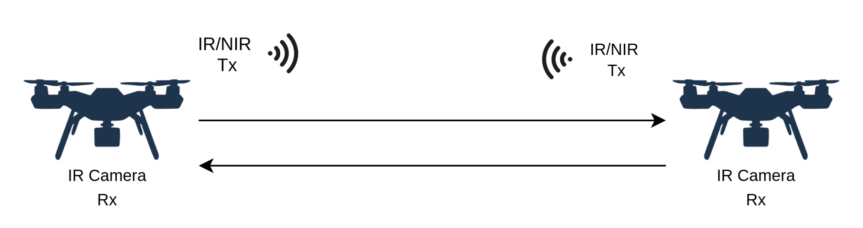
Proposed Solutions
Using IR/NIR wavelengths, the system can avoid interference from ambient visible light and maintain communication under diverse lighting conditions (day, night, indoors, outdoors).
IR/NIR signals can extend the range of communication by reducing signal loss from visible light interferences.
Fig. 1: Drone Systems using IR/NIR Wireless Communication

Slide 7
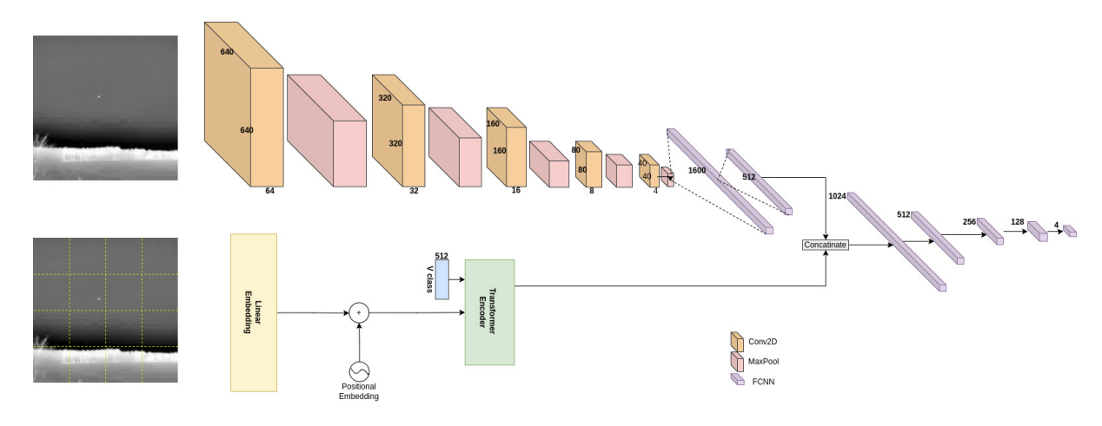
Proposed Solutions
Deep Learning Models like Convolutional Neural Networks (CNNs) or Transformer-based models can analyze and decode modulated invisible light patterns from IR/NIR cameras, enabling reliable, real-time data transmission.
Using invisible IR/NIR wavelengths as transceiver provides a layer of physical security as these signals are less detectable than visible light.
Fig. 2: Network for Distorted Image Feature [3]

Slide 8
Conclusion
VLC and Camera-based OWC(OCC), offer promising solutions for high-speed, secure, and interference-free communication. However, both approaches face limitations—VLC struggles with line-of-sight dependency and visible light interference, while Camera-based OWC suffers from lower data rates and high power consumption.
AI-Driven Invisible Light OWC System that leverages the IR/NIR spectrum combined with AI-enhanced processing able to reduced interference, enchanted mobility, and increased data density

Slide 9
References
W. Ali, R. Chen, M. Crisp and R. V. Penty, "8.2 Gbps Optical Wireless Link Using SiPM at NIR Wavelength," in Journal of Lightwave Technology, vol. 42, no. 5, pp. 1375-1380, 1 March1, 2024, doi: 10.1109/JLT.2023.3320030.
A. Bentamou, A. Zein-Eddine, O. Messai and Y. Gavet, "Real-Time Drone Detection and Tracking in Distorted Infrared Images," 2023 IEEE International Conference on Image Processing Challenges and Workshops (ICIPCW), Kuala Lumpur, Malaysia, 2023, pp. 3594-3598, doi: 10.1109/ICIPC59416.2023.10328374.
W. Ali, R. Chen, M. Crisp and R. V. Penty, "8.2 Gbps Optical Wireless Link Using SiPM at NIR Wavelength," in Journal of Lightwave Technology, vol. 42, no. 5, pp. 1375-1380, 1 March1, 2024, doi: 10.1109/JLT.2023.3320030.

