Slide 1
        DCN 15-24-0634-00-04ab
Project: IEEE P802.15 Working Group for Wireless Personal Area Networks (WPANs)
Submission Title: Non-interleaved NBA MMS
Date Submitted: November 12, 2024
Source: Riku Pirhonen (NXP)
Abstract: Current UWB Multi-millisecond (MMS) operation supports interleaved transmission of initiator and responder ranging packets. This proposals introduces minimal changes to allow also non-interleaved operation to support traditional SS-TWR and DS-TWR.
Purpose: Propose non-interleaved option for MMS by introducing ExtendedRpDuration.
Notice: This document has been prepared to assist the IEEE P802.15. It is offered as a basis for discussion and is not binding on the contributing individual(s) or organization(s). The material in this document is subject to change in form and content after further study. The contributor(s) reserve(s) the right to add, amend or withdraw material contained herein.
Release: The contributor acknowledges and accepts that this contribution becomes the property of IEEE and may be made publicly available by P802.15.

Slide 2
Non-Interleaved SS- and DS-TWR for NBA-MMS
3 x RpDuration
Report phase
2 x RpDuration
RpDuration
macMms
RcpPoll
NSlots
macMms
RcpPoll
NSlots
Initiator
macMms
RcpResp
NSlots
1 ms slot
Responder
NB packet
Initiator NB slots length is defined by macMmsRcpPollNSlots
Responder NB slot length is defined be macMmsRcpRespNSlots
ExtendedRpDuration defines the number of UWB MMS packets
UWB RSF/RIF

Slide 3
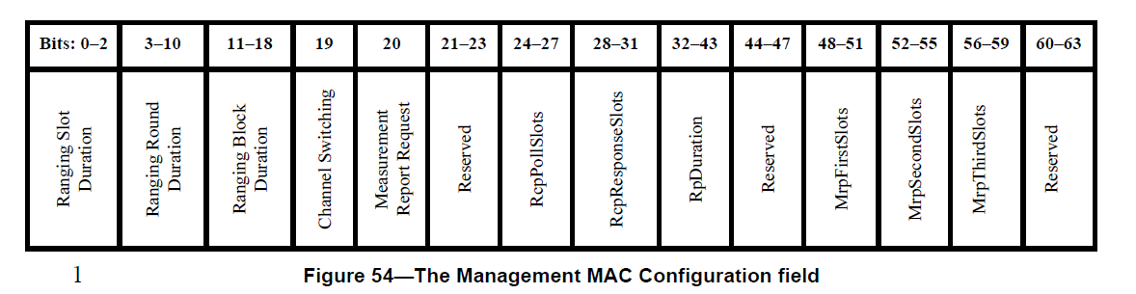
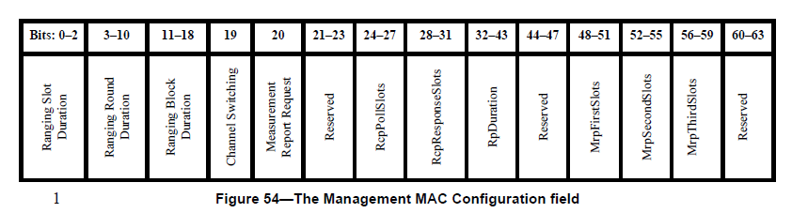
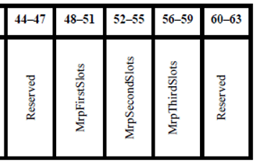
10.38.9.3.12 The Management MAC Configuration field
Add ExtendedRpDuration bits
44-45
46-47
ExtendedRpDuration

Slide 4
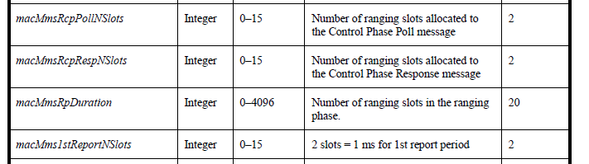
10.38.10.1 MMS specific MAC PIB attributes
macMmsExtendedRpDuration | Integer | 0 – 3 | 0 = Interleaved ranging phase 1 = Non-interleaved ranging phase of double RpDuration 2 = Non-interleaved ranging phase of triple RpDuration 3 = reserved | 0
0 = Single RpDuration, Interleaved mode
1 = Single RpDuration, Single UWB MMS Packet
2 = Double RpDuration, Non-interleaved mode
3 = Triple RpDuration, Non-interleaved mode

