Slide 1

IEEE 802 Wireless Interim
802.15 WNG Tech Focus Info Package
Jan 15, 2025
Held in Kobe & Hybrid via Webex

Slide 2
General Administrative
The following WG15 Leadership will be heavily involved in running the event onsite Tues./Wed.:
  Phil Beecher (802.15 WG 1st Vice Chair) pbeecher@ieee.org
  Ann Krieger (802.15 WG 2nd Vice Chair) annkrieger.dod@gmail.com
  Thomas Kuerner (Chair WG15 SC on Terahertz Comms.) t.kuerner@tu-braunschweig.de
  Iwao Hosako (WG15 SC Terahertz Vice Chair and local industry contact) hosako@nict.go.jp
  Ben Rolfe (WNG Chair) ben@blindcreek.com
  Clint Powell (802.15 WG Chair - remote) cpowell@ieee.org
and will be coordinating closely with:
  Jon Rosdahl (802 WCSC Treasurer and Events Planning) ben@blindcreek.com
  Sara Archer (Mtg. Events) sara@mtgevents.com.au
  Daniel Branik (Mtg. Events) daniel@mtgevents.com.au

Slide 3
Guest Fee Waivers & Demo Associated Costs
Guest Registration Fees for Wed. 1/15
Costs for AM & PM Breaks, Lunch, and Wed. Eve Social
(Dinner Cruise) were waived by the 802 WCSC on it’s 12/18 call.
Demo Associated Costs for Wed. 1/15
Cost for space and electricity for demo/display booths were waived by the 802 WCSC on it’s 12/18 call.

Slide 4
Tues./Wed. Timeline w.r.t. WNG & Demos
Tues.
Afternoon Demo packages arrive and are stored in provided area
Wed.
All presenter and demo assistant guests are invited to participate in the following:
8:30-9am Guests Meet & Greet w/802 Leadership
All presenter/demo assistants meet and greet with WG15 and Terahertz SC leadership, available WCSC leadership and 802 Chair James Gilb
9-10am WG15 Midweek plenary
9am-12pm Demo Set Up
10-10:30am Normal AM break
10:30am-12:30pm
WG15 WNG Tech Focus Presentations
~12-4pm Demos
Tech Demos on 4th floor immediately starting a conclusion of WNG
12-1:30pm Lunch
Regular lunch (with reserved tables for the invited guests and WG15 leadership if possible)
3:30-4pm Normal PM break
4-5pm Demo Tear Down and Pack
~6-9:30pm 802 Evening Social (Dinner Cruise)

Slide 5
Invited Guests
802.15 WNG THz Presentations
THz Presentation 1 – “Current Status of 3e Device”
  Mr. Keitarou Kondou (NICT)
THz Presentation 2 – “Progress of 3d; Results of the ThoR Project”
  Dr. Tetsuya Kawanishi (Waseda Univ.)
THz Presentation 3 – “Progress of 3d; New Use Case”
  Dr. Yozo Shoji (NICT)

Slide 6
Invited Guests
802.15 WNG THz Demo Assistants
THz Demo 1 – “THz wave (3d) + MMW (3e) Hybrid Wireless Communication System”
  Dr. Shinsuke Hara (NICT)
  Dr. Keizo Inagaki (NICT)
THz Demo 2 – “New Use Case (3e/3d)”
  Dr. Nguyen Duc Phuc (NICT)
  Mr. Aire Suzuki (NICT)
THz Demo 3 – “Uncompressed 4K Video Transmission at 300GHz”
  Dr. Isao Morohashi (NICT)
  Dr. Tadashi Kishimoto (NICT)

Slide 7
IEEE Non-endorsement
Disclaimer/Logo Policy
Presenters/demo assistants must conceal/prevent as much as possible any trademarks or brand names and have the non-endorsement disclaimer in their presentation and on display in their demo.
Presentations are due to the WG15 Leadership listed on Slide 2 by COB on Fri. 1/3, to allow ample time to review for any adjustments needed w.r.t. the above policy.

Slide 8
Non-endorsement Disclaimer Statement Instructions
(see next slide for Disclaimer statement)
To be inserted after introduction slide(s) -
&
- To be included on the demo display board -

Slide 9
DISCLAIMER
The use of any particular/specific brands of components, equipment, or instruments as a part of the demonstration and presentation does not constitute an endorsement of those brands by IEEE, IEEE SA, or the IEEE LMSC.

Slide 10
Demo Storage Requirements
The three THz demos together would take up about 5 square meters if boxes are layed out flat, less if they are stacked.
  THz Demo 1
  - THz wave (3d) + MMW (3e) Hybrid Wireless Communication System
  Cardboard: 4 boxes
  Box size W320 x D435 x H320 (size 120)
  Total: 4 boxes
  Storage space - 1 square meter
  THz Demo 2
  - New Use Case (3e/3d)
  Container (box): 1 (OD mm: 530 x 366 x 336)
  Robot car (in hard case) (Outer diameter: about the same as above)
  Approx. 40' display: (Approx. 1200 x 800 x 200 when packed)
  Total: 3 pieces
  Storage space - 2 square meters
  THz Demo 3
  - Uncompressed 4K Video Transmission at 300GHz
  Pelican case 1: W80cm x D60cm x H44cm, 37kg
  Pelican case 2: W80cm x D58cm x H49cm, 45kg
  Pelican case 3: W121cm x D43cm x H24cm, 30kg
  Cardboard 1: W63cm x D55cm x H28cm, 18kg
  Cardboard 1: W80cm x D29cm x H54cm, 8kg
  Total: 5 pieces
  Storage space - 2 square meters

Slide 11
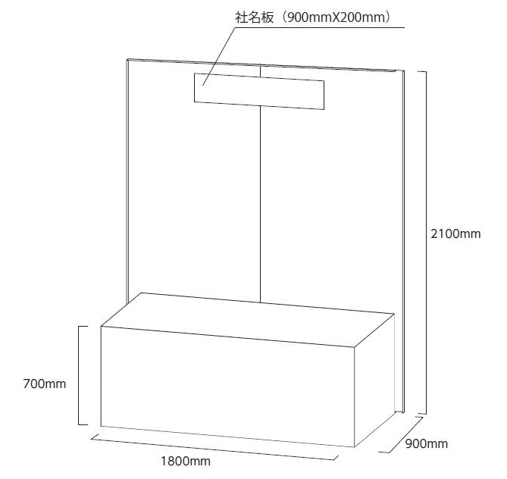
Demo Display Booth

Slide 12
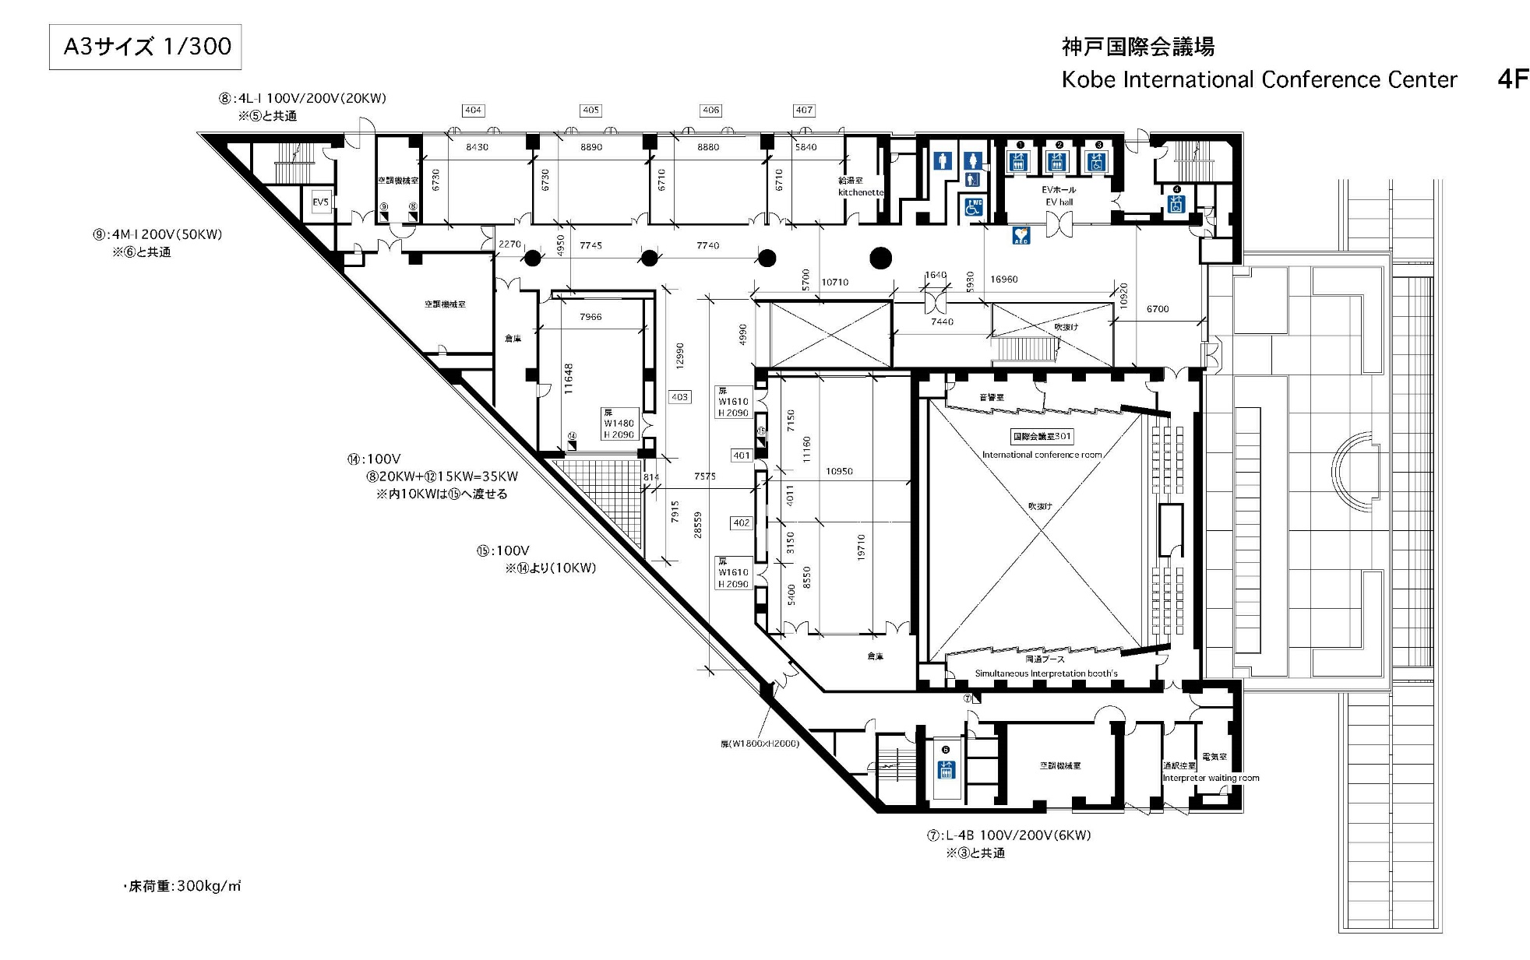
Floor Plan of Demos - on 4th Floor
Demo/Display Booths

Slide 13
802.15 WNG Tech Focus Agenda
WNG Open Ben Rolfe (BlindCreek Associates) 1min
802 Chair Welcome James Gilb (GA-ASI) 1min
WG15 Overview and Agenda Phil Beecher (Wi-SUN Alliance) 4min
THz Intro Thomas Kuerner (TUB) / Iwao Hosako (NICT) 10min
  Current status of 3e device, Q&A
  Mr. Keitarou Kondou (NICT) 20min
  Progress of 3d: Results of the ThoR Project, Q&A
  Prof./Dr. Tetsuya Kawanishi (Waseda Univ.) 20min
  Progress of 3d: New Use Case, Q&A
  Dr. Yozo Shoji (NICT) 20min
  THz Summary Thomas Kuerner (TUB) / Iwao Hosako (NICT) 5min
15.4 Intro Phil Beecher (Wi-SUN Alliance) 1min
  Latest R&D Progress in Wireless Smart Utility Networks, Q&A
  Dr. Hiroshi Harada (Kyoto Univ.), Q&A 20min
  15.4 Summary Phil Beecher (Wi-SUN Alliance) 5min
WNG Close Ben Rolfe (BlindCreek Associates) 1min
Demos immediately following WNG, until 4pm in common/break area on 4th floor

