Slide 1

IEEE 802 Wireless Interim
Introduction to the THz Presentations and Demonstrations
802.15 WNG Tech Focus
Jan 15, 2025
Held in Kobe & Hybrid via Webex

Slide 2
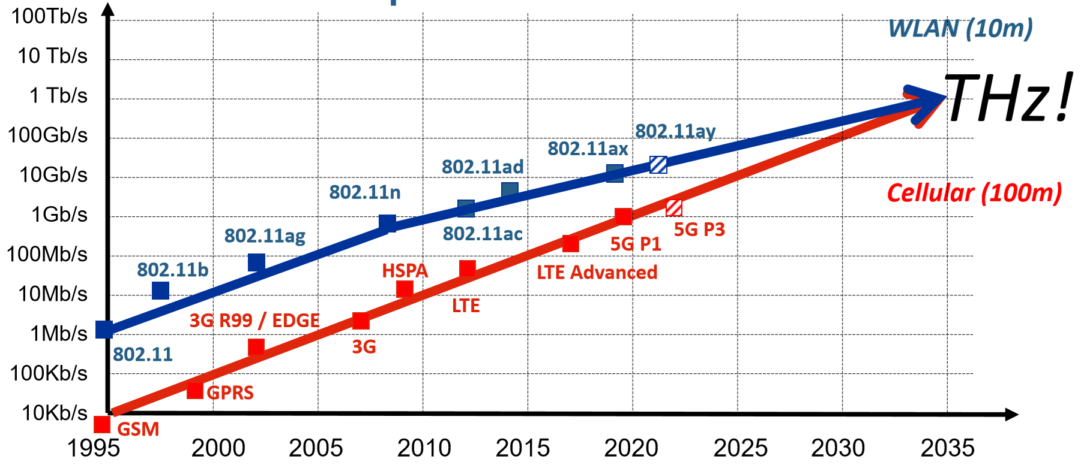
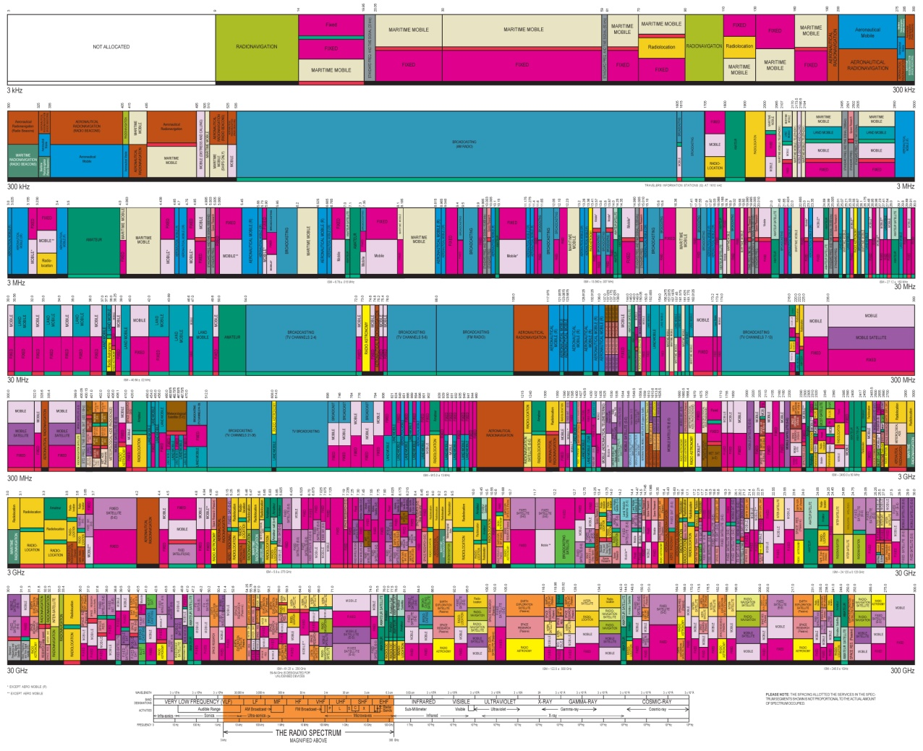

Why should we work on THz Communications?
3 kHz
300 kHz
300 kHz
3 MHz
3 MHz
30 MHz
30 MHz
300 MHz
300 MHz
3 GHz
3 GHz
30 GHz
30 GHz
300 GHz
Source: G. Fettweis, 1St TERAFLAG Workshop Cassis 2018
“ 6G research should look at the problem of transmitting up to 1 Tbps per user. This is possible through the efficient utilization of the spectrum in the THz regime. Extended spectrum towards THz will enable merging communications and new applications such as 3D imaging and sensing.
Source: http://jultika.oulu.fi/Record/isbn978-952-622354-4

Slide 3
A Short History on THz Communications in Standards and Demonstrations
2008 IEEE 802.15 Interest Group THz has been established
2014-2017 Development of IEEE Std 802.15.3d-2017
  Amendment for fixed point-to-point links
  Applications:
    Wireless Backhauling/Fronthauling
    Wireless Linkls in Data Centers
    Intra-device communications
    Kiosk Downloading
Parallel development of IEEE Std 802.15.3e-2017
60 GHz High-Rate Close Proximity communications
2019 WRC 19 identifies 137 GHz of spectrum between 275 and 450 GHz for FIXED and MOBILE service
2022 EU Japan project ThoR demonstrates the first bidirectional 300 GHz Backhaul Link with real data transmission based on IEEE Std 802.15.3
2022-2023 Revision towards IEEE Std 802.15.3-2023

Slide 4
Difference between IEEE Std 802.15.3e,
IEEE Std 802.15.3d and IEEE Std 802.15.3-2023
IEEE Std 802.15.3d provides a new 300 GHz PHY for Std. IEEE 802.15.3-2016
  MAC and PHY are mainly based on IEEE 802.15.3e-2017, a 60 GHz PHY, which introduced the concept of Pairnet
    Point-to-point nature with highly-directive antennas reduces the problem of interference and „fighting for access“
    Positions of Tx and Rx antennas are known
  8 different channel bandwidths (as multiples of 2.16 GHz) at 252-321 GHz
IEEE Std 802.15.3-2023 introduced:
  16-APSK and 32-APSK
  Extension of spectrum up to 450 GHz
  Extension of RIFS to allow larger transmission ranges
THz SC PHY
THz OOK PHY
BPSK
QPSK
8-PSK
Modulation
8-APSK
16-QAM
64-QAM
Modulation
OOK
FEC
LDPC (1440,1344)
LDPC (1440,1026)
FEC
RS (240,224)
V. Petrov, T. Kürner and I. Hosako, "IEEE 802.15.3d: First Standardization Efforts for Sub-Terahertz Band Communications toward 6G," in IEEE Communications Magazine, vol. 58, no. 11, pp. 28-33, November 2020

Slide 5
Invited Guests
802.15 WNG THz Presentations
THz Presentation 1 – “Current Status of 3e Device”
  Mr. Keitarou Kondou (NICT)
THz Presentation 2 – “Progress of 3d; Results of the ThoR Project”
  Dr. Tetsuya Kawanishi (Waseda Univ.)
THz Presentation 3 – “Progress of 3d; New Use Case”
  Dr. Yozo Shoji (NICT)

Slide 6
IEEE 802 Wireless Interim
THz Presentations
Conclusions and Demonstrations
802.15 WNG Tech Focus
Jan 15, 2025
Held in Kobe & Hybrid via Webex

Slide 7
What is missing to make THz Communications Reality?
Demonstrations show IEEE Std 802.15.2023 is working at 300 GHz
  Using 60 GHz-HRCP chipsets implementing IEEE Std 802.15.3-2023 combined with up/down-mixing to 300 GHz RF
  Solid basis to create integrated chipsets at 300 GHz
Mobile Applications require
  Research of device discovery and beam tracking algorithms
    A couple of ongoing research projects are adressing this issue
  Amnendments to IEEE Std 802.15.3-2023 or even new standards need to address this

Slide 8
802.15 WNG THz Demo Overview
THz Demo 1 – “THz wave (3d) + MMW (3e) Hybrid Wireless Communication System”
  Dr. Shinsuke Hara (NICT)
  Dr. Keizo Inagaki (NICT)
THz Demo 2 – “New Use Case (3e/3d)”
  Dr. Nguyen Duc Phuc (NICT)
  Mr. Aire Suzuki (NICT)
THz Demo 3 – “Uncompressed 4K Video Transmission at 300GHz”
  Dr. Isao Morohashi (NICT)
  Dr. Tadashi Kishimoto (NICT)

Slide 9
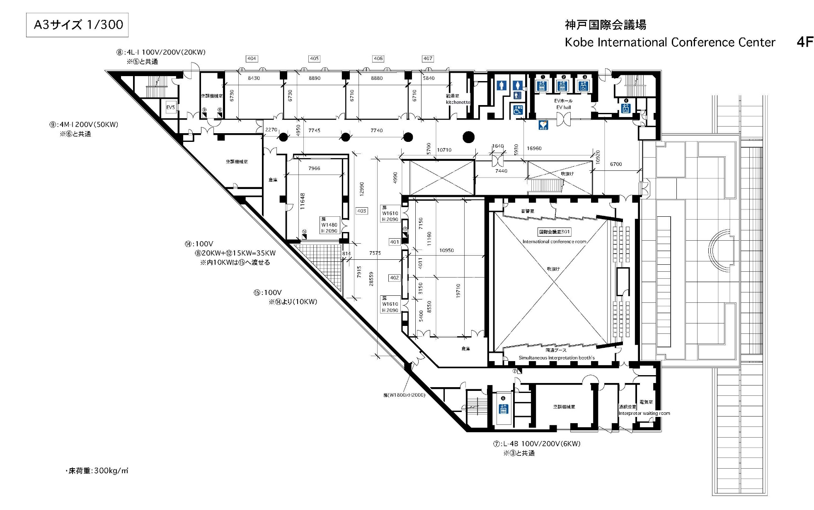
Floor Plan of Demos - on 4th Floor
Demo/Display Booths

