Slide 1
Results of the ThoR Project
Tetsuya Kawanishi
Waseda Univ.

Slide 2
DISCLAIMER
The use of any particular/specific brands of components, equipment, or instruments as a part of the demonstration and presentation does not constitute an endorsement of those brands by IEEE, IEEE SA, or the IEEE LMSC.

Slide 3
Overviews of ThoR Project
ThoR:TeraHertz end-to-end wireless systems supporting ultra high data Rate applications
A joint EU-Japan project to provide technical solutions for the data networks beyond 5G based on 300 GHz RF wireless links.
EC Coordinator: Prof. Thomas Kürner, TUBS
Japan Coordinator: Prof. Tetsuya Kawanishi, Waseda University
Start date: 01-Jul-2018
End date: 30-Jun-2022
Project cost: 1,498,879 EUR + 185,915,477 JPY

Slide 4
ThoR Consortium
EU partners funded by the EC in Horizon 2020
TU Braunschweig (EC Coordinator), Germany
Deutsche Telekom, Germany
Fraunhofer IAF, Germany
Siklu Communications, Israel
University of Lille, France
University of Stuttgart, Germany
Vivid Components, UK
Japanese partners funded by NICT, Japan
Waseda University (Japanese Coordinator)
Chiba Institute of Technology
Gifu University
NEC Corporation
HRCP R&D Partnership

Slide 5
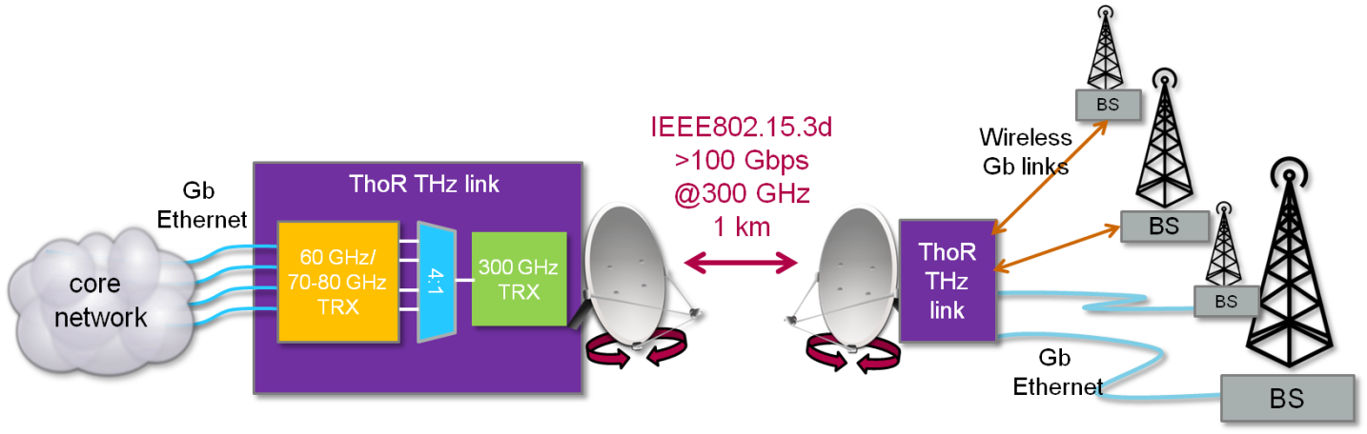
ThoR approach: Demonstrating the Capability of 300 GHz Backhaul/ Fronthaul links
Photonic LO

Slide 6
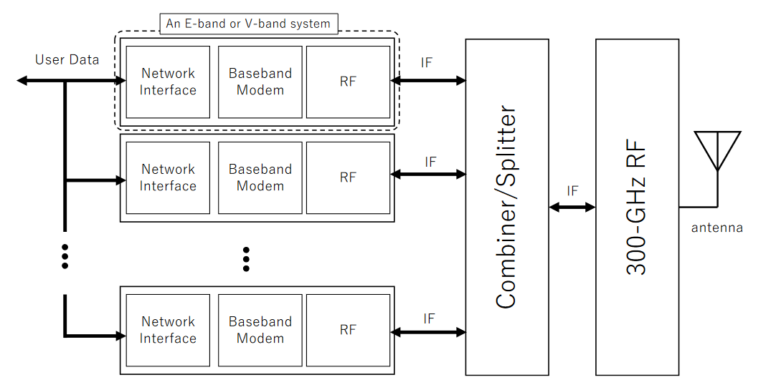
Networking Interface and Baseband Modem
The ThoR demonstrator uses a super-heterodyne concept where the RF signal of modems oeprating at 60 GHz and 70/80 GHz, respectively are used as the IF signal for the subsequent 300 GHz RF Front-end
In the ThoR hardware demonstrator two types of modems have been used:
  FDD modems
    oeprating at 70/80 GHz
    Up to for 4 2x2 GHz channels are aggregated
  TDD modems
    operating at 60 GHz and at a bandwidth of 2.16 GHz
    used to demonstrate, that IEEE Std 802.15.3e with an extension of the IFS value is working for backhaul applications
Source: ThoR Deliverable D3.5 available at https://thorproject.eu/results/deliverables/.Testing "Report of 60 GHz TRX Module"

Slide 7
Concept of demonstration system using V-band modem
Up converter
LO
240.84GHz
300GHz Out
30dB VAT
2
：
1
combine
Almost common between 15.3d/e
r
V Band
V Band
V-band Modem
Input
Input
LLC sublayer
Port1
Port2
TRX Signal Path 1
TDD TRX1
Data link
MAC sublayer
802.15.3e 60GHz Wireless
CH2
User data
Module
PLCP sublayer
10GbE
(60GHz RF, BB, MAC & IF)
PHY
802.15.3e 60GHz Wireless
CH3
PMD sublayer
Module
TRX Signal Path 2
(60GHz RF, BB, MAC & IF)
OSI Reference model
TDD TRX2
V Band
V Band
Output
Output
Port1
Port2
Source: K. Kondou: “Development of the ThoR 60 GHz transceiver module” ThoR Final Workshop https://thorproject.eu/events/thor-final-workshop-and-demo/
1:2 splitter
LO
240.84GHz
300GHz Input
Down converter
Example of THz transceiver with V-band modems

Slide 8
Examples of ThoR outcomes
Near-field measurements and antenna characterisation by Gifu University
300 GHz front end development by Fraunhofer IAF and Univ. Stuttgart
Development of a high power TWTA by NEC
Development of E-band modems by Siklu
Development of V-band modems by HRCP
Analysis of requirements for wireless transport links by Deutsche Telekom
Measurement of 300 GHz band high-gain antennas by CIT
E-band photonic LO development by University of Lille
Automatic planning algorithms for THz comms by TU Braunschweig
300 GHz link design and interference study by Waseda University

Slide 9
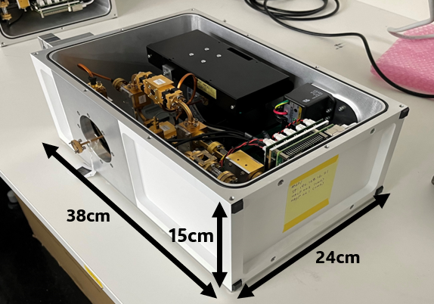
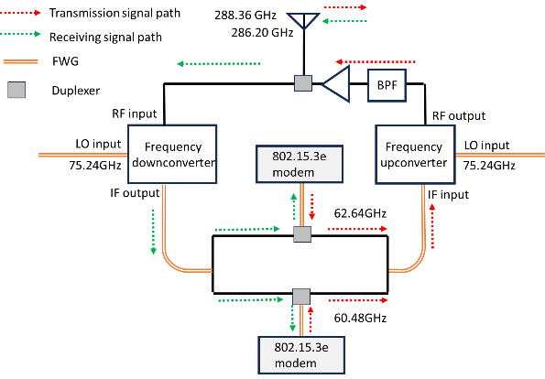
Post ThoR Project
Japan Coordinator: Prof. Shintaro Hisatake, Gifu University
Project cost: 125M JPY
Project period: 2021-2023 (JPN fiscal year)
TDD-based transceiver

Slide 10
RF output: 286.2GHz and 288.36GHz
Flexible waveguides (FWS)
TDD signals are converted into transmission and receiving signals through duplexers.

Slide 11
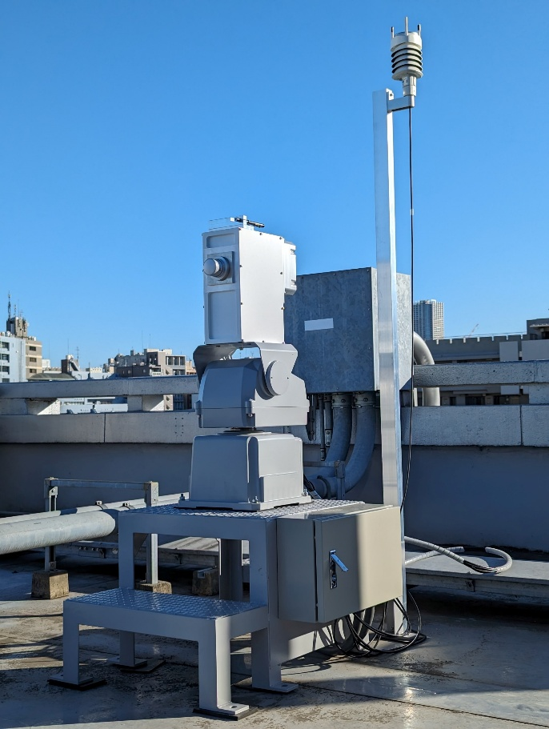

300GHz outdoor units (ODUs)
ODU2
ODU1

Slide 12
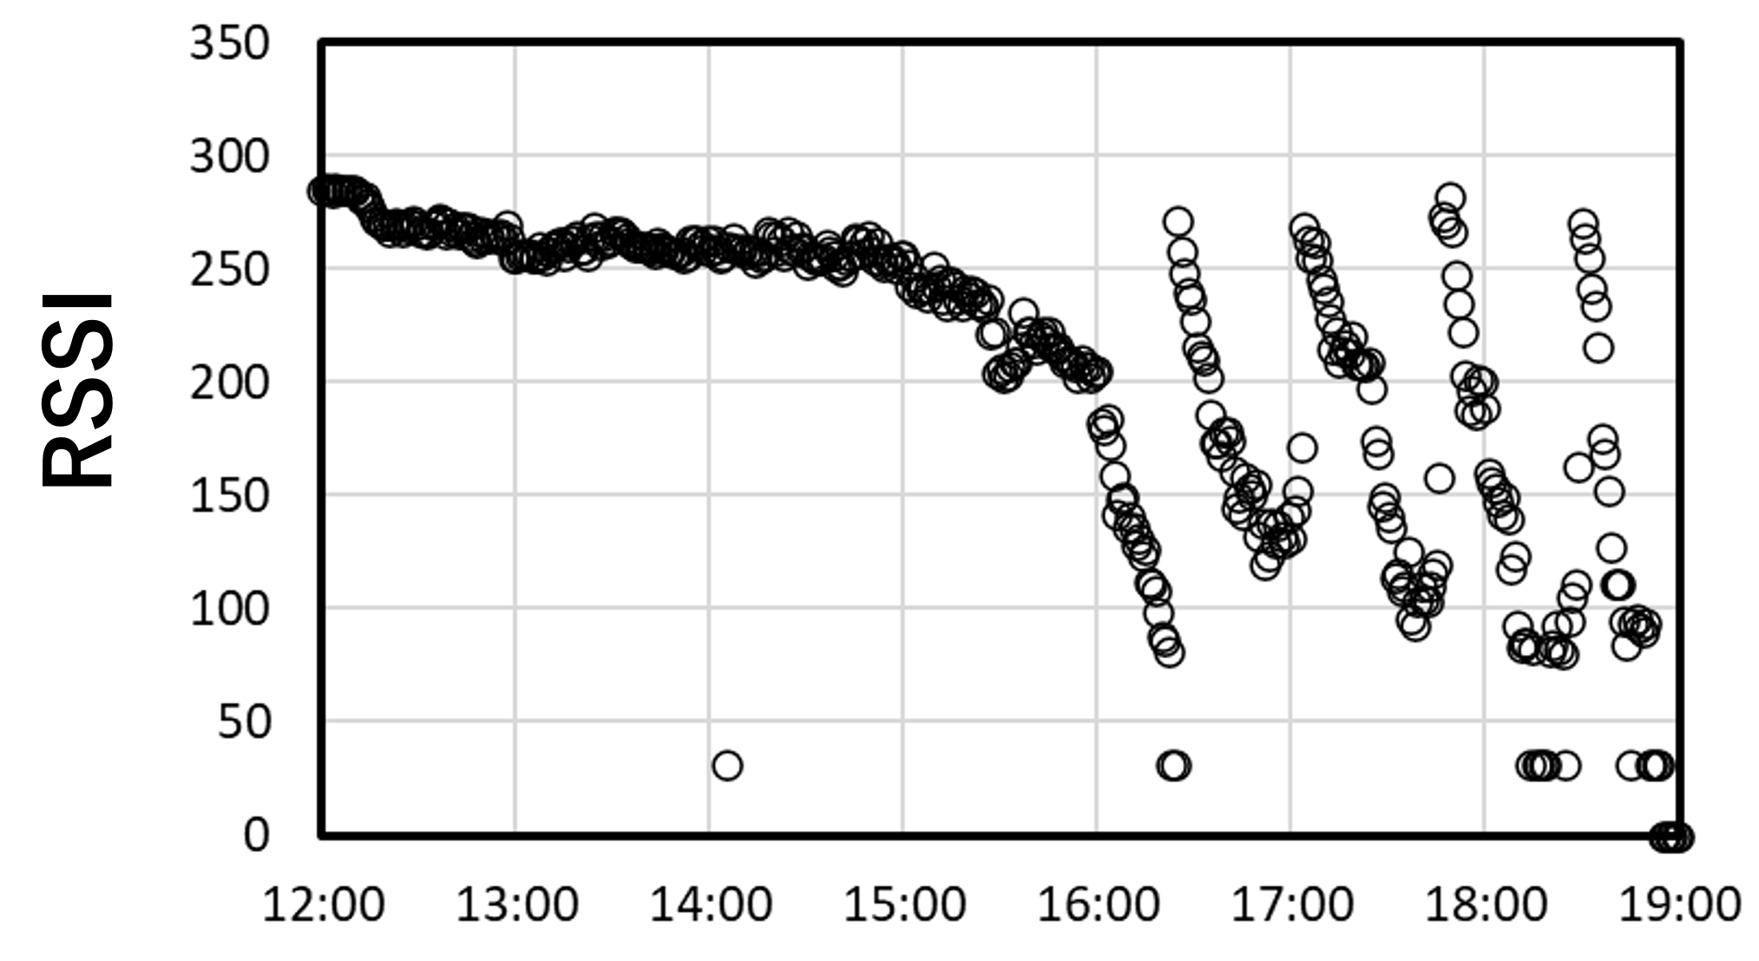
RSSI under snow condition
February 5th, 2024

Slide 13








Link degradation due to weather condition
Gas attenuation
Rain drop attenuation
Antenna tilt due to wind

Slide 14
Antenna tilt due to wind
99.99%: 15m/s
With some margin
0.4deg (20m/s)
APT/AWG/REP-81

Slide 15
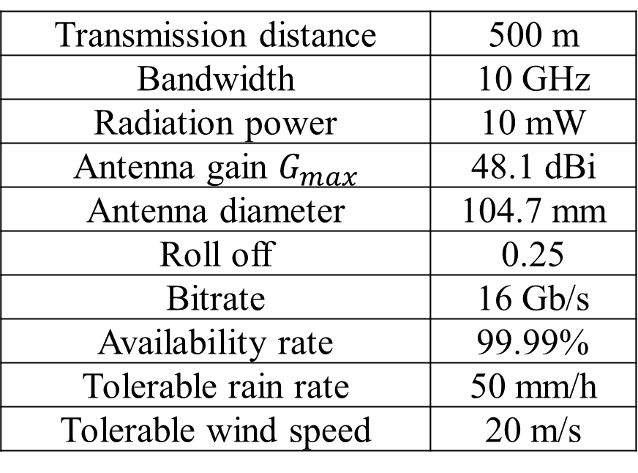
Example of 300GHz fixed wireless system
Transmission distance | 500 m
Bandwidth | 10 GHz
Radiation power | 10 mW
Antenna gain $G_{max}$ | 48.1 dBi
Antenna diameter | 104.7 mm
Roll off | 0.25
Bitrate | 16 Gb/s
Availability rate | 99.99%
Tolerable rain rate | 50 mm/h
Tolerable wind speed | 20 m/s

Slide 16
Conclusion
300 GHz outdoor transceivers have been developed for high-speed point-to-point fixed wireless links.
IEEE802.15.3e compliant 60 GHz transceivers are used as baseband and IF units.
Long-term transmission experiments under various weather conditions are underway.

