Slide 1
Project: IEEE P802.15 Working Group for Wireless Personal Area Networks (WPANs)
Submission Title: [Probability of LBT Narrowband Devices Failing FCC VLP CBP Certification (KDB 987594)]
Date Submitted: [February 20, 2025]
Source: [Alex Krebs, Stuart Thomas, Xiaowen Wang, Alon Paycher, Yann Ly-Gagnon (Apple)]
Email: krebs (at) apple.com
Re: [Input to the Working Group]
Abstract: [Evaluation of the Probability of LBT Narrowband Devices Failing FCC VLP CBP Certification (KDB 987594).]
Purpose: []
Notice: This document has been prepared to assist the IEEE P802.15. It is offered as a basis for discussion and is not binding on the contributing individual(s) or organization(s). The material in this document is subject to change in form and content after further study. The contributor(s) reserve(s) the right to add, amend or withdraw material contained herein.
Release: The contributor acknowledges and accepts that this contribution becomes the property of IEEE and may be made publicly available by P802.15.

Slide 2
PAR Objective | Proposed Solution (how addressed)
Safeguards so that the high throughput data use cases will not cause significant disruption to low duty-cycle ranging use cases
Interference mitigation techniques to support higher density and higher traffic use cases
Other coexistence improvement | Proof of NB LBT FCC non-compliance
Backward compatibility with enhanced ranging capable devices (ERDEVs)
Improved link budget and/or reduced air-time
Additional channels and operating frequencies
Improvements to accuracy / precision / reliability and interoperability for high-integrity ranging
Reduced complexity and power consumption
Hybrid operation with narrowband signaling to assist UWB
Enhanced native discovery and connection setup mechanisms
Sensing capabilities to support presence detection and environment mapping
Low-power low-latency streaming
Higher data-rate streaming allowing at least 50 Mbit/s of throughput
Support for peer-to-peer, peer-to-multi-peer, and station-to-infrastructure protocols
Infrastructure synchronization mechanisms

Slide 3
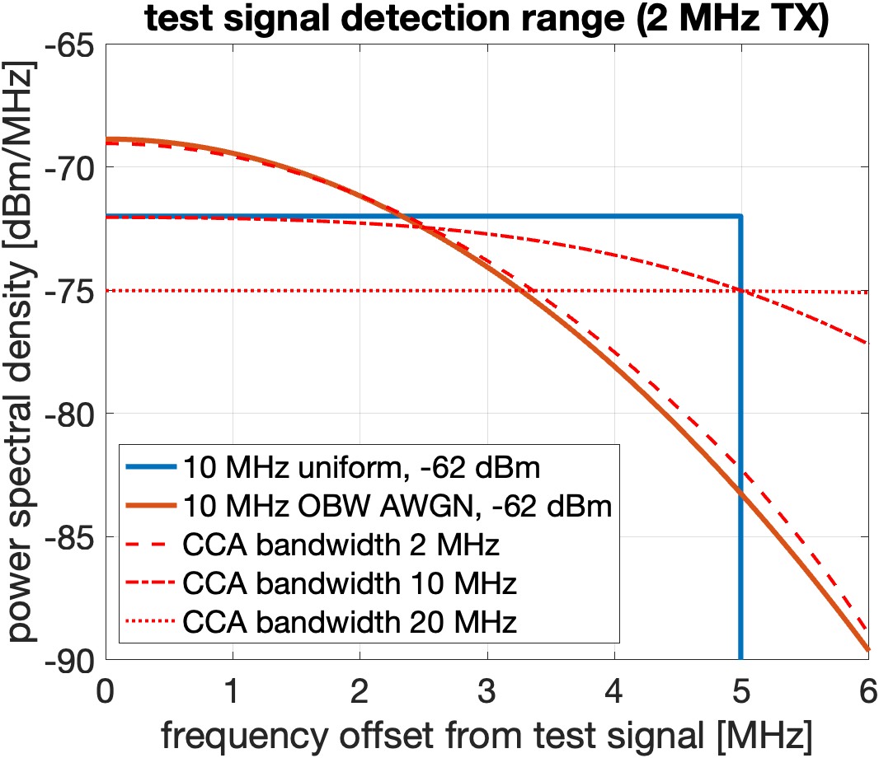
KDB 987594 (VLP CBP) Narrowband Test Signal Sampling
CCA bandwidth | 2 MHz | 10 MHz | 20 MHz
Probability of failure at EDT = –76 dBm/MHz (1dB margin) | 40% | 8% | 0%
EDT sensitivity required for FCC compliance (non-coherent) [dBm/MHz] | –89 | –77 | –75

Slide 4
Conclusion
A consideration has been made that LBT narrowband devices will fail FCC CBP VLP certification
  KDB 987594 requires 90% detection of a –72 dBm/MHz AWGN random carrier test signal
  PSD in 2 MHz CCA/EDT –75 dBm/MHz upper bounds detection probability at 55%
  CCA/EDT sensitivity theoretically required to pass test is 24 dB below 20 MHz 802.11 WLAN EDT
    difficult to achieve even in conducted test lab environment, practically impossible to deploy for radiated operation
    even if there were no noise floor, a 24 dB EDT offset to 20 MHz wideband VLP devices would effectively eliminate spectrum access for NB devices in the presence of 802.11 WLAN
Without regulatory changes, narrowband LBT device operation in 6-8GHz UNII bands is non-permissible in FCC regulatory domain

