Slide 1
Project: IEEE P802.15 Working Group for Wireless Specialty Networks (WSNs)
Submission Title: Discussion on Free Space Optics for Drone Network
Date Submitted: March 11, 2025
Source: Huy Nguyen, Muhammad Ayaz, Yeong Min Jang (Kookmin University)
Address: Room #603 Mirae Building, Kookmin University, 77 Jeongneung-Ro, Seongbuk-Gu, Seoul, 136702, Republic of Korea
Voice: +82-2-910-5068 E-Mail: yjang@kookmin.ac.kr
Re:
Abstract: Discussion on Free Space Optics for Drone Network.
Purpose: Presentation for contribution on IG NG-OWC
Notice: This document has been prepared to assist the IG NG-OWC. It is offered as a basis for discussion and is not binding on the contributing individual(s) or organization(s). The material in this document is subject to change in form and content after further study. The contributor(s) reserve(s) the right to add, amend or withdraw material contained herein.
Release: The contributor acknowledges and accepts that this contribution becomes the property of IEEE and may be made publicly available by IG NG-OWC.

Slide 2
Discussion on Free Space Optics for Drone Network
March 11, 2025

Slide 3
Contents
Overview of FSO
Advantages of FSO
FSO limitations
UAV-FSO communication deployment scenario
FSO-based drone-assisted mobile network architecture
Conclusion
References

Slide 4
Overview of FSO
Free Space Optics (FSO), a wireless optical communication technology, presents a promising solution for high-speed, secure, and flexible communication networks.
Free Space Optics (FSO) presents a promising approach for enhancing drone network capabilities, particularly in scenarios demanding high bandwidth and secure communication.
Integrated with Unmanned Aerial Vehicles (UAVs), or drones, FSO can revolutionize various applications, from emergency response and disaster relief to precision agriculture and remote sensing.
FSO and UAVs provide transformative possibilities for secure, high-speed, and mobile communication networks, paving the way for next-gen aerospace and telecommunication systems

Slide 5
Overview of FSO
Advantages of FSO
High rates
No frequency license required
Fast and easy installation
Distance up to kms
Compatible with other access technologies
Cost effective, movable asset
Near-zero latency over all distances
Transparent to networks or protocols.
Internal and external mounting

Slide 6
Overview of FSO
FSO limitations
Spreading loss is higher and there is atmospheric loss due to water and carbon dioxide molecules.
Power consumption is higher.
It is easy to intercept due to its propagation medium and hence it is less secure than OFC.
Transmitter and receiver should be in LOS (Line of Sight) to each other for its operation.
The FSO transmitted signal gets blocked due to trees, animals, buildings and other atmospheric conditions. Birds and scintillation cause beam interruptions. Hence availability of FSO link depends on weather.

Slide 7
UAV-FSO communication deployment scenario.
Disaster Response and Emergency Communications
UAV-FSO networks are deployed rapidly in disaster zones (e.g., earthquakes, floods) where terrestrial infrastructure is damaged.
Drones establish temporary FSO links to relay critical data (e.g., HD video, sensor data) between rescue teams and command centers.
Military and Surveillance Applications
UAV-FSO systems provide secure, high-bandwidth links for military surveillance,
Inter-Satellite and Airborne Networks
UAV swarms or high-altitude platforms (HAPs) use FSO to establish links with satellites or other airborne nodes, enabling space-air-ground integrated networks (SAGIN).
Environmental Monitoring and Precision Agriculture
UAV-FSO networks collect and transmit environmental data (e.g., air quality, crop health) from remote areas.

Slide 8
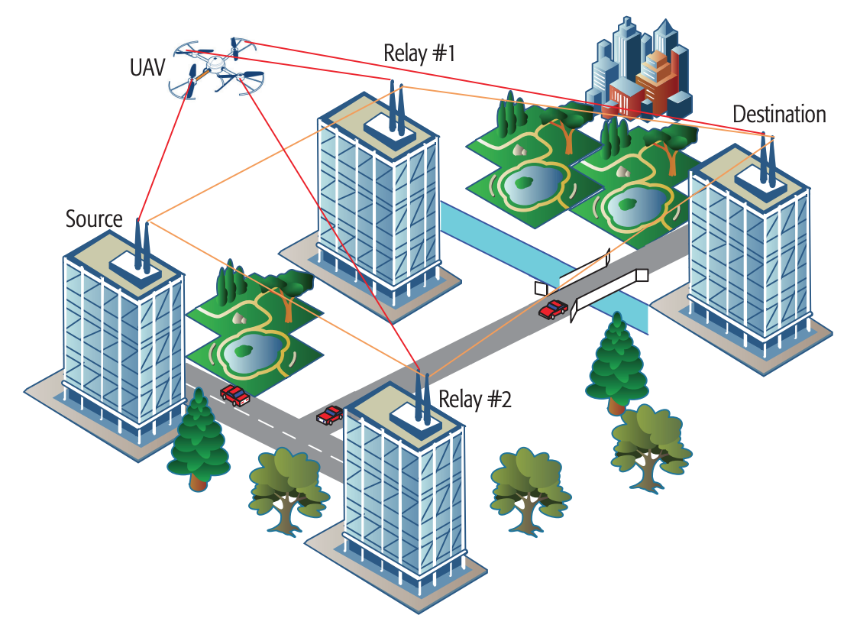
UAV-FSO communication deployment scenario.
Figure.1.Relay-Assisted FSO Systems [2]

Slide 9
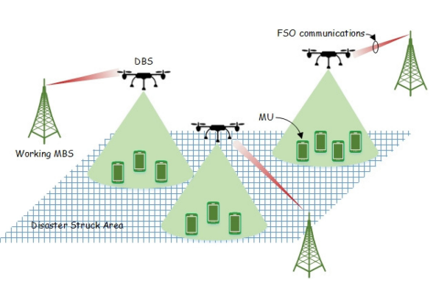
FSO-based drone-assisted mobile network architecture.
In order to quickly recover communications in disaster struck areas and achieve low communications delay between MUs and working MBSs
Free space optics (FSO) based drone assisted mobile access network architecture
Figure.2. FSO-based drone-assisted mobile network architecture [4]

Slide 10
Conclusion
Free Space Optics (FSO) and Unmanned Aerial Vehicles (UAVs) represents a cutting-edge synergy between high-speed optical communication and aerial platforms.
FSO uses laser beams to transmit data through free space, offering ultra-fast speeds.
Advances in AI, adaptive optics, and hybrid systems will reinforce reliability, while innovations like quantum key distribution (QKD) could further enhance security.
Challenges like atmospheric effects and alignment persist, advances in hybrid systems, adaptive optics, and AI-driven control are paving the way for scalable deployments.

Slide 11
References
[1] Nallagonda, V. R., & Krishnan, P. (2021). Performance analysis of FSO based inter-UAV communication systems. Optical and Quantum Electronics, 53(4). https://doi.org/10.1007/s11082-021-02843-w
[2] Fawaz, W., Abou-Rjeily, C., & Assi, C. (2018). UAV-Aided cooperation for FSO communication systems. IEEE Communications Magazine, 56(1), 70–75. https://doi.org/10.1109/mcom.2017.1700320
[3] Nzekwu, N. J., Fernandes, M. A., Fernandes, G. M., Monteiro, P. P., & Guiomar, F. P. (2024). A comprehensive review of UAV-Assisted FSO relay systems. Photonics, 11(3), 274. https://doi.org/10.3390/photonics11030274
[4] Wu, D., Sun, X., & Ansari, N. (2019). An FSO-Based drone assisted mobile access network for emergency communications. IEEE Transactions on Network Science and Engineering, 7(3), 1597–1606. https://doi.org/10.1109/tnse.2019.2942266
[5] Yu, L., Sun, X., Shao, S., Chen, Y., & Albelaihi, R. (2023). Backhaul-Aware Drone Base Station Placement and Resource Management for FSO-Based Drone-Assisted Mobile Networks. IEEE Transactions on Network Science and Engineering, 10(3), 1659–1668. https://doi.org/10.1109/tnse.2022.3233004

