Slide 1
March 11,2025
Project: IEEE P802.15 Working Group for Wireless Specialty Networks (WSNs)
Submission Title: Future Directions of NG FSO Technologies for Drone Application.
Date Submitted: March 11, 2025
Source: Rafat Bin Mofidul, Yeong Min Jang (Kookmin University)
Address: Room #603 Mirae Building, Kookmin University, 77 Jeongneung-Ro, Seongbuk-Gu, Seoul, 136702, Republic of Korea
Voice: +82-2-910-5068 E-Mail: yjang@kookmin.ac.kr
Re:
Abstract: Present the future directions for advancing FSO technologies for drone application.
Purpose: Presentation for contribution on IG NG-OWC.
Notice: This document has been prepared to assist the IG NG-OWC. It is offered as a basis for discussion and is not binding on the contributing individual(s) or organization(s). The material in this document is subject to change in form and content after further study. The contributor(s) reserve(s) the right to add, amend or withdraw material contained herein.
Release: The contributor acknowledges and accepts that this contribution becomes the property of IEEE and may be made publicly available by IG NG-OWC.

Slide 2
March 11,2025
Future Directions of NG FSO Technologies for Drone Application.
March 11, 2025

Slide 3
Contents
March 11,2025
Introduction & Motivation
Current Challenges in FSO
Emerging Solutions (Currently)
Future Direction 1 – AI/ML Integration
Future Direction 2 – Hybrid Networks
Future Direction 3 – Advanced Modulation & Coding
Future Direction 4 – Hardware Innovations
Conclusion

Slide 4
Introduction
March 11,2025
The primary objective is to enable high-bandwidth, low-latency drone communication systems tailored for emerging 6G networks, surveillance operations, and disaster response scenarios.
This focus addresses the growing demand for reliable, high-speed connectivity in dynamic environments, where traditional infrastructure may be unavailable or insufficient.
Such advancements are critical to support data-intensive applications like real-time video streaming, autonomous coordination, and emergency communications in remote or disaster-stricken regions.
FSO provides fiber-like speeds without spectrum licensing, supports resilient UAV mesh networks in remote areas, and aligns with net-zero goals through energy efficiency.

Slide 5
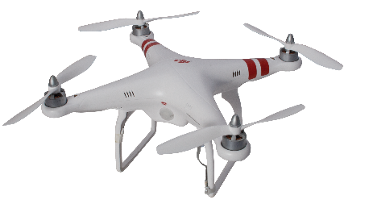

March 11,2025
Current Challenges in FSO
Atmospheric Turbulence :
  Causes random fluctuations in beam intensity (scintillation).
  Modeled by log-normal, Gamma-Gamma, or Málaga distributions.
Weather Effects :
  Fog, rain, haze, and dust introduce high attenuation/scattering.
  Visibility drastically limits link range and data rates.
Pointing Errors :
  Mechanical vibrations, UAV motion, and beam misalignment
fog
Figure 1: Drone FSO communication affected by fog, experiencing beam turbulence and pointing errors.

Slide 6
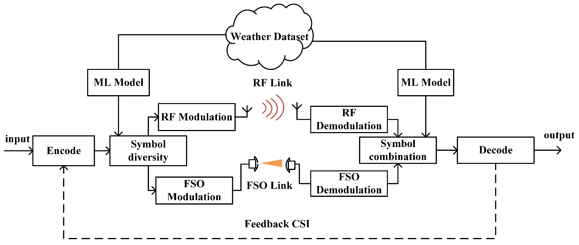
March 11,2025
Emerging Solutions (Currently)
Hybrid RF/FSO Systems
RF link provides backup in adverse weather or non-line-of-sight (NLOS).[1]
Increases link availability and reliability.
Adaptive Optics :
Wavefront correction via deformable mirrors, tip/tilt mirrors.
Compensates atmospheric distortions in real-time.
MIMO & Diversity :
Multiple transmit/receive apertures reduce fading.
Spatial or aperture averaging to mitigate turbulence and pointing errors.
Figure 2. ML-based soft-switching model for Hybrid FSO/RF links.[2]

Slide 7
Future Direction 1 – AI/ML Integration
Predictive Beam Alignment:
Machine learning to anticipate drone position, pointing error corrections
Real-time feedback loops for dynamic beam steering.
Turbulence Prediction :
ML Algorithms forecast atmospheric conditions, improving link efficiency.
Autonomous Networks :
AI-driven FSO for self-healing networks in 6G.

Slide 8
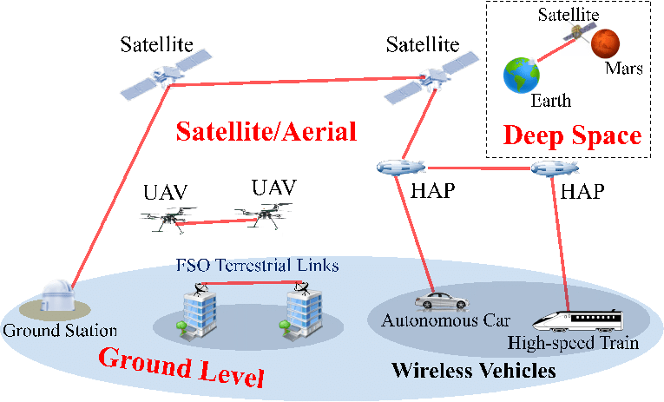
Future Direction 2 – Hybrid Networks
6G Backhaul :
UAV-FSO as part of ultra-dense, low-latency 6G architectures.[3]
Terabit-class wireless front/backhaul with integrated optical solutions
Space-Based FSO :
LEO/GEO satellite constellations offering inter-satellite laser links
UAV-FSO bridging satellite downlinks for remote connectivity [4]
UAV Mesh Networks :
Multi-hop FSO links among drone swarms. Seamless coverage for disaster relief, military, or wide-area sensor networks
Figure 3: An example of FSO communication networks [5].

Slide 9
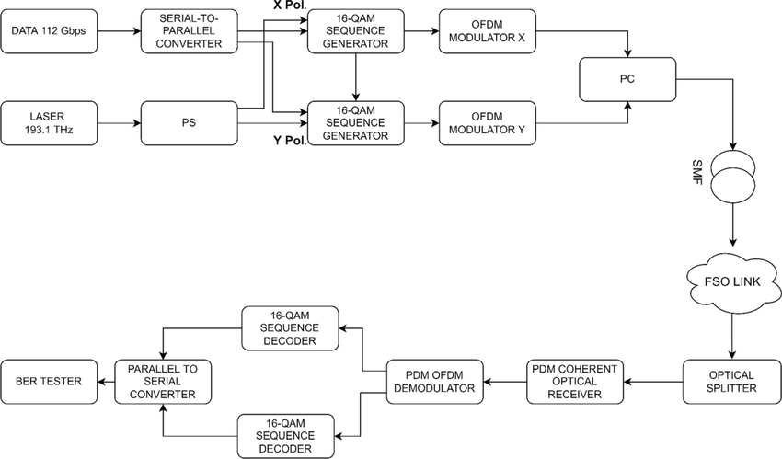
Future Direction 3 – Advanced Modulation & Coding
High-Order Modulation :
16-QAM, 64-QAM, OFDM variants for higher spectral efficiency. Mitigation of scintillation with adaptive bit-loading
Coded Modulation :
LDPC Codes reduce BER up to 10⁻¹² in strong turbulence.
Figure 4: Simulation diagram of PDM-OFDM-16-QAM-based fiber-FSO-PON convergent system [6]

Slide 10
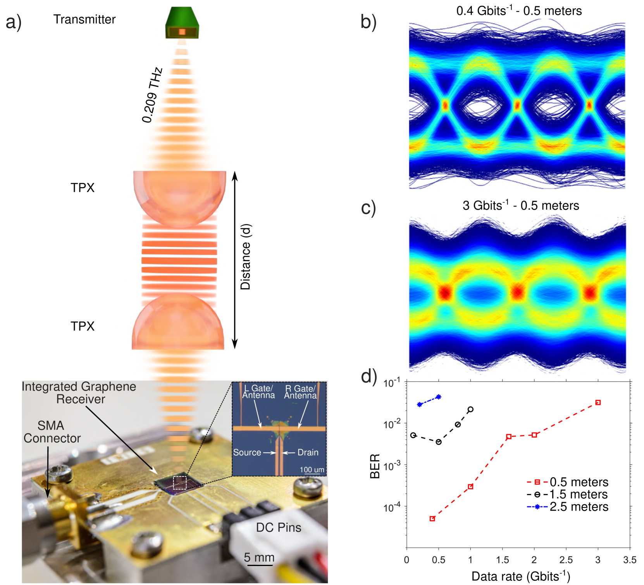
Future Direction 4 – Hardware Innovations
Mid-Infrared (MIR) FSO :
Potentially lower scattering loss and improved eye-safety
Suitable for new atmospheric windows
Nano-Antennas :
Compact, low-power optical transmitters/receivers .
Graphene-based photodetectors enable THz-band FSO at 1 pJ/bit [7]
Compact Transceivers :
On-chip photonic integration for size/weight/power (SWaP) constraints
Mass-produced, low-cost solutions for wide-scale UAV deployment
Figure: Evaluation kit and digital data-stream detection as a function of the sub-THz wireless link distance. a) Schematic of the configuration containing lenses with a variable distance between the transmitter and the graphene receiver. On the bottom part, the optical image of the side view of the fabricated PCB-integrated receiver on a metal support. The inset shows the optical image of the graphene receiver. b) Collected eye diagrams at data rates of 0.4 and c) 3 Gbits-1 with a distance of 0.5 m between the lenses and 0.64 m between the transmitter and receiver. The carrier frequency is 0.209 THz. d) BER in log scale as a function of data rate detection for different distances of the sub-THz wireless link. [7]

Slide 11
Conclusion
Next-generation FSO (NG-FSO) technologies for drone applications promise major advancements in speed, security, and reliability.
AI/ML algorithms will enable predictive beam alignment and turbulence modeling, improving link availability under varying conditions.
Novel hardware, such as mid-infrared (MIR) FSO devices and nano-antennas, will optimize energy efficiency and reduce UAV payload.
Hybrid architectures that combine RF and satellite connectivity alongside FSO will ensure robust communication in adverse weather.
Advanced modulation and coding schemes can further mitigate scintillation and pointing errors, allowing for higher throughput and lower latency.
Collectively, these developments will empower autonomous, high-bandwidth UAV networks for secure remote operations and beyond.

Slide 12
Reference
[1] Kumar, S., & Sharma, N. (2022). “Emerging Military Applications of Free Space Optical Communication Technology: A Detailed Review.” J. Phys.: Conf. Ser. 2161, 012011.
[2]J. Shao, Y. Liu, X. Du, and T. Xie, “Adaptive Modulation Scheme for Soft-Switching Hybrid FSO/RF Links Based on Machine Learning,” Photonics, vol. 11, no. 5, p. 404, Apr. 2024, doi: https://doi.org/10.3390/photonics11050404.
[3] Tumma, Y., & Kappala, V.K. (2024). “A Review on Deployment of UAV-FSO System for High-Speed Communication.” IEEE Access.
[4] Sharma, D., Tripathi, A., & Kumari, M. (2024). “FSO systems for next generation networks: a review, techniques and challenges.” Journal of Optical Communications.
[5]H. D. Le and A. T. Pham, “Link-Layer Retransmission-Based Error-Control Protocols in FSO Communications: A Survey,” IEEE Communications Surveys and Tutorials, vol. 24, no. 3, pp. 1602–1633, Jan. 2022, doi: https://doi.org/10.1109/comst.2022.3175509.
[6]F. Koppens et al., “High-Speed Graphene-based Sub-Terahertz Receivers enabling Wireless Communications for 6G and Beyond,” Research Square (Research Square), Dec. 2024, doi: https://doi.org/10.21203/rs.3.rs-5387794/v1.
[7]Ammar Armghan et al., “A 112 Gbps flexible fiber-free space optics convergent passive optical network system for broadcasting high-speed data traffic under different weather conditions,” Optical and Quantum Electronics, vol. 55, no. 1, Dec. 2022, doi: https://doi.org/10.1007/s11082-022-04392-2.

